Slide 2
Power Trip
Events leading up to World War 2

Slide 3
Essential Questions
What caused World War 2?
What conditions allow leaders to take too much power?

Slide 4
Lesson Objectives
Explain the rise of dictators prior to World War II, and how their leadership made conditions favorable for war.
Compare and contrast modern and historic leaders

Slide 5

Stand Up, Sit Down
Respond to the following: “What do people look for in a leader when times are tough?”
Write down 3 words or short phrases
Notes:
K20 Center. (n.d.). Stand up, Sit Down. Strategy. https://learn.k20center.ou.edu/strategy/1771

Slide 6
Stand Up, Sit Down
Everyone stand up
As we go around the room, share a response
As others mention your answers, cross them out on your paper
Once all three of your responses have been said, sit down
  Only those still standing will respond
Notes:
K20 Center. (n.d.). Stand up, Sit Down. Strategy. https://learn.k20center.ou.edu/strategy/1771

Slide 7

I Notice, I Wonder
As you watch the following video, respond with:
  What are two events you notice leading up to World War 2?
  What do you still wonder?
Notes:
K20 Center. (n.d.). I notice, I wonder. Strategy. https://learn.k20center.ou.edu/strategy/180

Slide 8
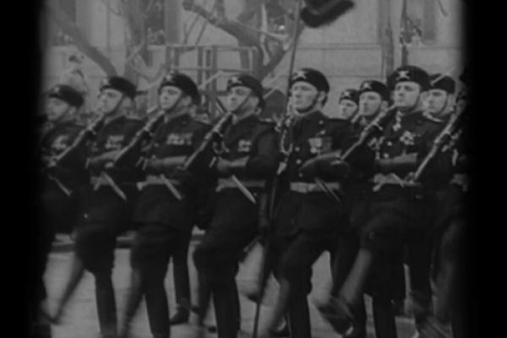
The Gathering Storm
Notes:
https://www.ww2classroom.org/?q=node/216
From the collection to the classroom: Teaching history with the National WWII Museum. The Gathering Storm | From the Collection to the Classroom. (n.d.). Retrieved January 24, 2023, from https://www.ww2classroom.org/?q=node%2F216

Slide 9

Jigsaw
As a group, research Stalin, Mussolini, Hitler, and Tojo.
In your graphic organizer, answer:
  Conditions in which they came to power
  How they used the military & territory acquisition
  Methods of keeping control
  Causes of World War II
Notes:
K20 Center. (n.d.). Jigsaw. Strategy. https://learn.k20center.ou.edu/strategy/179

Slide 10
Jigsaw - Share Out
Each group will share out on one of the four dictators:
  Conditions in which they came to power
  How they used the military & territory acquisition
  Methods of keeping control
  Causes of World War II
Notes:
K20 Center. (n.d.). Jigsaw. Strategy. https://learn.k20center.ou.edu/strategy/179

Slide 11
Essential Questions
What caused World War 2?
What conditions allow leaders to take too much power?

Slide 12
Lesson Objectives
Explain the rise of dictators prior to World War II, and how their leadership made conditions favorable for war.

Slide 13

What Is A Democracy?
Three volunteers will define democracy
Your order will be decided by the number on your index card
Choose one of the definitions to write on your graphic organizer, or write your own
Notes:
K20 Center. (n.d.). Airplane Landing. Strategy. https://learn.k20center.ou.edu/strategy/78

Slide 14
What Is A Dictatorship?
Three volunteers will define dictatorship
Your order will be decided by the number on your index card
Choose one of the definitions to write on your graphic organizer, or write your own
Notes:
K20 Center. (n.d.). Airplane Landing. Strategy. https://learn.k20center.ou.edu/strategy/78

Slide 15
Dictator or Not?
For each of the following modern leaders, you will decide if you think they are in a dictatorship or democracy.

Slide 16
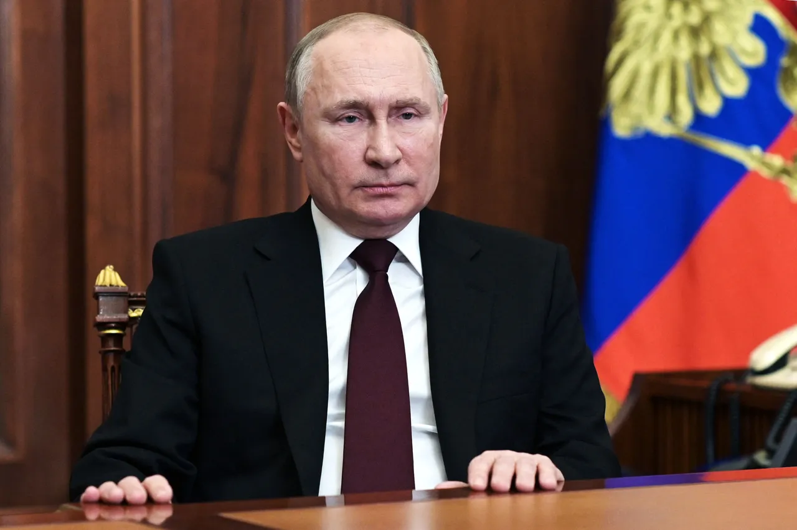
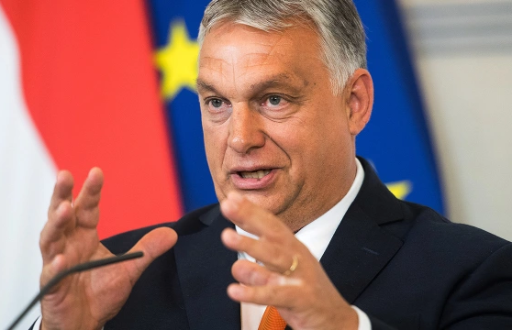
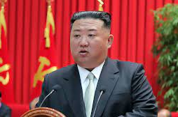
Dictator or Not?
1.
2.
3.
Was elected president
Has engaged in multiple land acquisition attempts
In 2021, changed constitution to seek two more terms
Was elected Prime Minister
Got rid of his country’s parliament temporarily during COVID
His party controls approximately 80% of media
Title is Supreme Leader
In 2014 elected without a single vote against
Routinely testing nuclear missiles
Comes from
bloodline required
to lead

Slide 17
Dictator or Not?
1.
2.
3.
Vladimir Putin
President of Russia
Widely considered an autocratic leader, but government is a constitutional republic
Viktor Orban
Prime Minister of Hungary
Widely considered an autocratic leader, but government is a representative democracy
Kim Jong-un
Supreme Leader of
North Korea
North Korea is a totalitarian
dictatorship

Slide 18

T-Chart
Choose one dictator from World War II:
  Stalin, Mussolini, Hitler, and Tojo
And one of the modern leaders we analyzed:
  Putin, Orban, and Kim
Compare using your T-Chart handout
Use information from the video, articles, and a brief web inquiry
Notes:
K20 Center. (n.d.). T-chart. Strategies. https://learn.k20center.ou.edu/strategy/86

Slide 19
A-CLAP - Evaluate Your Sources
Authority - Is there an author with qualification or credentials provided?
Currency - Is there a publication or last-updated date provided? (not always necessary)
Leaning - Is the source objective with minimal bias or intention to persuade?
Accuracy - Based on what you know, is it accurate?
Purpose - What is the source’s audience, does it meet
your needs?

Slide 20
Reflection
At the bottom of your T-Chart answer the following question:
What conditions allow leaders to take too much power?
Use evidence from the video, articles, and your web inquiry to answer

