Slide 2
Reign of Terror:
The Osage Murders

Slide 3
Essential Questions
How have native people been exploited throughout America’s history?
How does the discovery of natural resources impact people?

Slide 4
Lesson Objectives
Recognize the key players and key events of the Reign of Terror.
Discover how and why so many Osage were exploited in the early 1920s.
Evaluate the how, why, and when of government intervention in tribal affairs.

Slide 5
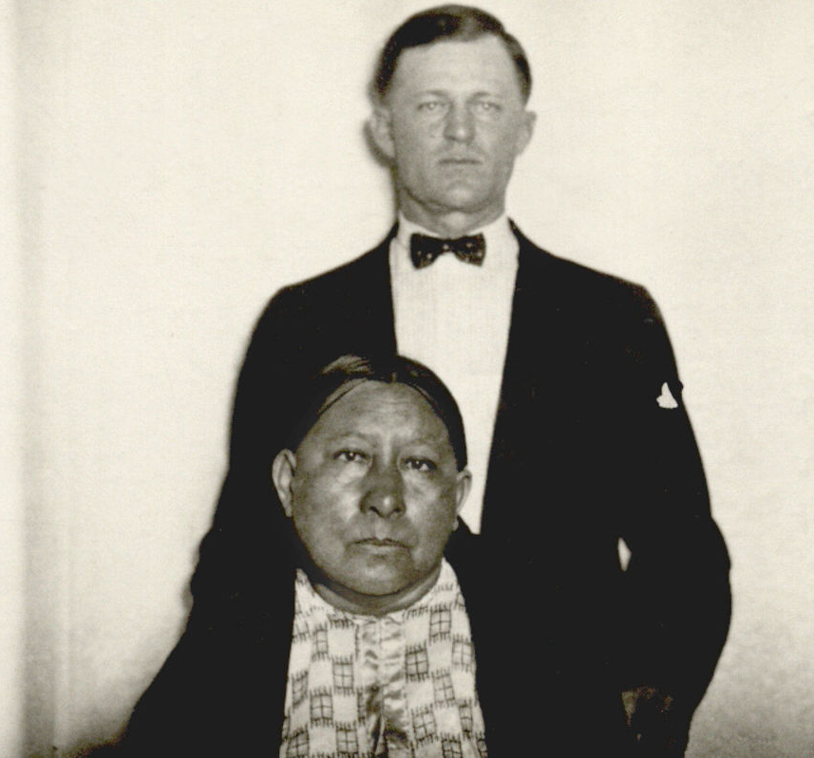
What do you think?
Do the man and woman in this photo seem like a married couple? Why or why not?
Notes:
Source: https://www.famous-trials.com/images/ftrials/osage/mollieburkhart.jpg
Yes; but his brother would eventually admit to killing members of her family and was slowly poisoning her
https://www.famous-trials.com/osage-home/2378-the-osage-reign-of-terror-murder-trials-an-account
https://history.howstuffworks.com/american-history/osage-tribe-murders.htm
K20 Center. (n.d.). Elbow partners. Strategies. https://learn.k20center.ou.edu/strategy/116

Slide 6
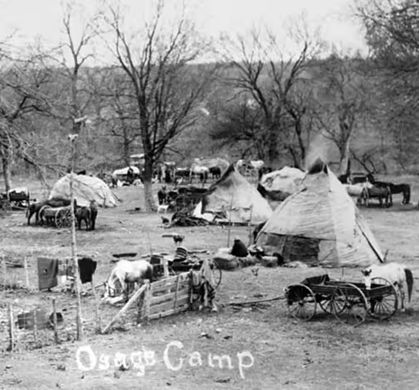
What do you think?
Did the Osage buy their land in Oklahoma? Why do you think that?
Notes:
Image Source: https://history.howstuffworks.com/american-history/osage-tribe-murders.htm
Information Source: https://www.youtube.com/watch?v=Vlwud1C0Tf4
True: First leaving their land between the Arkansas and Missouri rivers to move to Kansas, the Osage then sold their land in Kansas and settled in OK because they thought the land was infertile and the whites would finally leave them alone

Slide 7
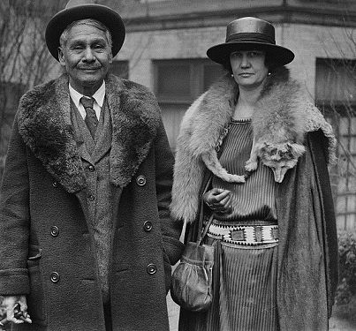
What do you think?
Can you believe this native man’s income was about $14,000 to $15,000 per month when this picture was taken? Why or why not?
Notes:
Source: http://nativeamericannetroots.net/diary/370
True: But in spite of the fact that his royalty income was $14k-$15k, he was only given a few hundred a year.

Slide 8
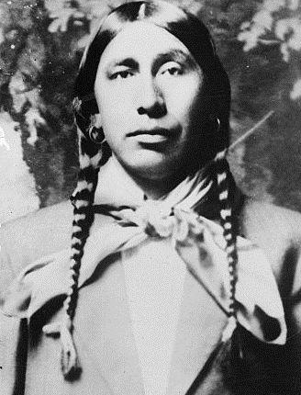
What do you think?
How many people do you think would have to be murdered before the FBI would investigate?
Notes:
Image Source: https://www.famous-trials.com/images/ftrials/osage/roan1.jpg
Information Source: https://www.youtube.com/watch?v=Vlwud1C0Tf4
False: Over TWO dozen were murdered

Slide 9
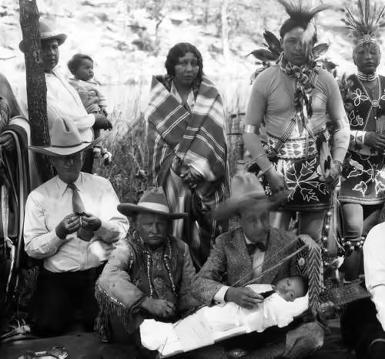
What do you think?
What are reasons the government might take away a person’s right to handle their own money?
Notes:
Image and Information source: https://history.howstuffworks.com/american-history/osage-tribe-murders.htm
Note: maybe ask them about Britney Spears conservatorship?

Slide 10
Honeycomb Harvest
Think about how the information in one card might be related to information on another card.
Organize the cards so the sides of related hexagons are touching.
Try to connect the honeycomb cards in a way that makes sense to you.
Notes:
K20 Center. (n.d.). Honeycomb harvest. Strategies. https://learn.k20center.ou.edu/strategy/61

Slide 11
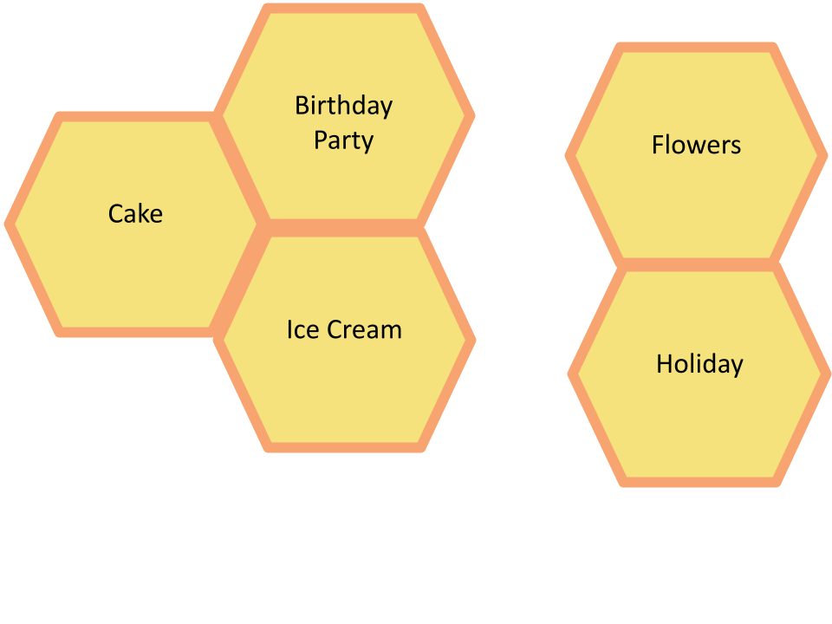
Honeycomb Harvest Example
Notes:
K20 Center. (n.d.). Honeycomb harvest. Strategies. https://learn.k20center.ou.edu/strategy/61

Slide 12
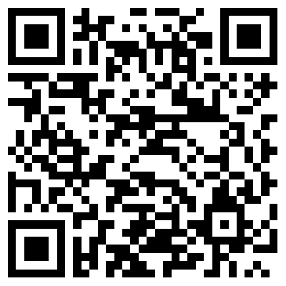
Reign of Terror: The Osage Murders
Scan the QR code or use the short URL to access the Reign of Terror: The Osage Murders reading.
k20.ou.edu/osage-terror

Slide 13
Reign of Terror: The Osage Murders
As you read
Select text highlighted in orange; then select the close button to return to the reading.
Select the Next button at the bottom of the screen to move forward.
k20.ou.edu/osage-terror

Slide 14
Return to Honeycomb Harvest
Think about how the information in one card might be related to information on another card.
Organize the cards so that the sides of related hexagons are touching.
Try to connect the honeycomb cards in a way that makes sense to you.
Notes:
K20 Center. (n.d.). Honeycomb harvest. Strategies. https://learn.k20center.ou.edu/strategy/61

Slide 15
Three Sticky Notes
On your first sticky note, write one word that summarizes the reading.
On your second sticky note, write a phrase that summarizes the reading.
On a third sticky note, write a sentence that summarizes the reading.
Notes:
K20 Center. (n.d.). Three sticky notes. Strategies. https://learn.k20center.ou.edu/strategy/153

Slide 16
Legislative Acts
Read through the Legislative Acts handout.
As you read, think about why the act was created.
What were the circumstances that may have led to this act?
Who benefited from this act?
How does this act relate to the others?
Take notes. This handout will help in the next activity.
Notes:
K20 Center. (n.d.). Google Jamboard. Tech Tools. https://learn.k20center.ou.edu/tech-tool/2336
K20 Center. (n.d.). True for who? Strategies. https://learn.k20center.ou.edu/strategy/1586

Slide 17
True For Who
Discuss the claim.
What were the circumstances that shaped the claim?
Who made it or would make it?
What were the intentions or goals in the situation?
What was at stake?
View the claim from each perspective.
The Osage
Non-native Oklahomans
U.S. Government
For each claim, decide on whether or not the claim is true or false.
Would they think the claim is true? False?
Maybe both?
Why?
Notes:
K20 Center. (n.d.). True for who? Strategies. https://learn.k20center.ou.edu/strategy/1586

Slide 18
Choice Board
In the Choice Board,
Choose one square from each column.
Watch the video or explore the site.
While you do so, ask yourself the following:
What does the video tell me about the Osage Nation?
How might the videos be a response to the Reign of Terror?
Notes:
K20 Center. (n.d.). Choice boards. Strategies. https://learn.k20center.ou.edu/strategy/73

Slide 19
How I Know It
On a sheet of paper, draw a large circle. Outside that circle, draw a large rectangle.
Now that you have watched three videos, write everything you have learned from them in the circle.
In the rectangle, write how you have learned the information inside the circle.
Draw a line between each idea you have learned about and the way in which you learned it.
Notes:
K20 Center. (n.d.). How I know it. Strategies. https://learn.k20center.ou.edu/strategy/144

