Slide 2
Windows To The Soul
A Creative Writing Project

Slide 3
Essential Question
What does a piece of art communicate to us?
How can art inform our writing?

Slide 4
Lesson Objectives
Create a visual art product based on a list of adjectives.
Write a narrative short story using descriptive adjectives.

Slide 5
Commit and Toss
Choose a person you admire.
It should be a public figure from past or present.
Select three sticky notes.
On each sticky note:
Write your name
Write one adjective or characteristic that describes this person, one on each sticky note
Crumple up each sticky note.
Add it to the basket.
Notes:
K20 Center (n.d.). Commit and Toss. Strategies. https://learn.k20center.ou.edu/strategy/119

Slide 6
Stand Up, Sit Down
Stand up at your desk.
When it is your turn, read one adjective from one of your sticky notes and crumple it back up.
If someone else names an adjective that is on one of your sticky notes, crumple it back up.
Once all your sticky notes are crumpled up, sit down.
Notes:
K20 Center (n.d.). Stand Up, Sit Down. Strategies. https://learn.k20center.ou.edu/strategy/1771

Slide 7
Who do you admire?
Share the name of the person you chose.
What adjectives on the list apply to the person you admire?

Slide 8
Art Project
Think of your three characteristics.
Draw a pair of eyes that best represents the adjectives or characteristics you chose and the person you admire.

Slide 9
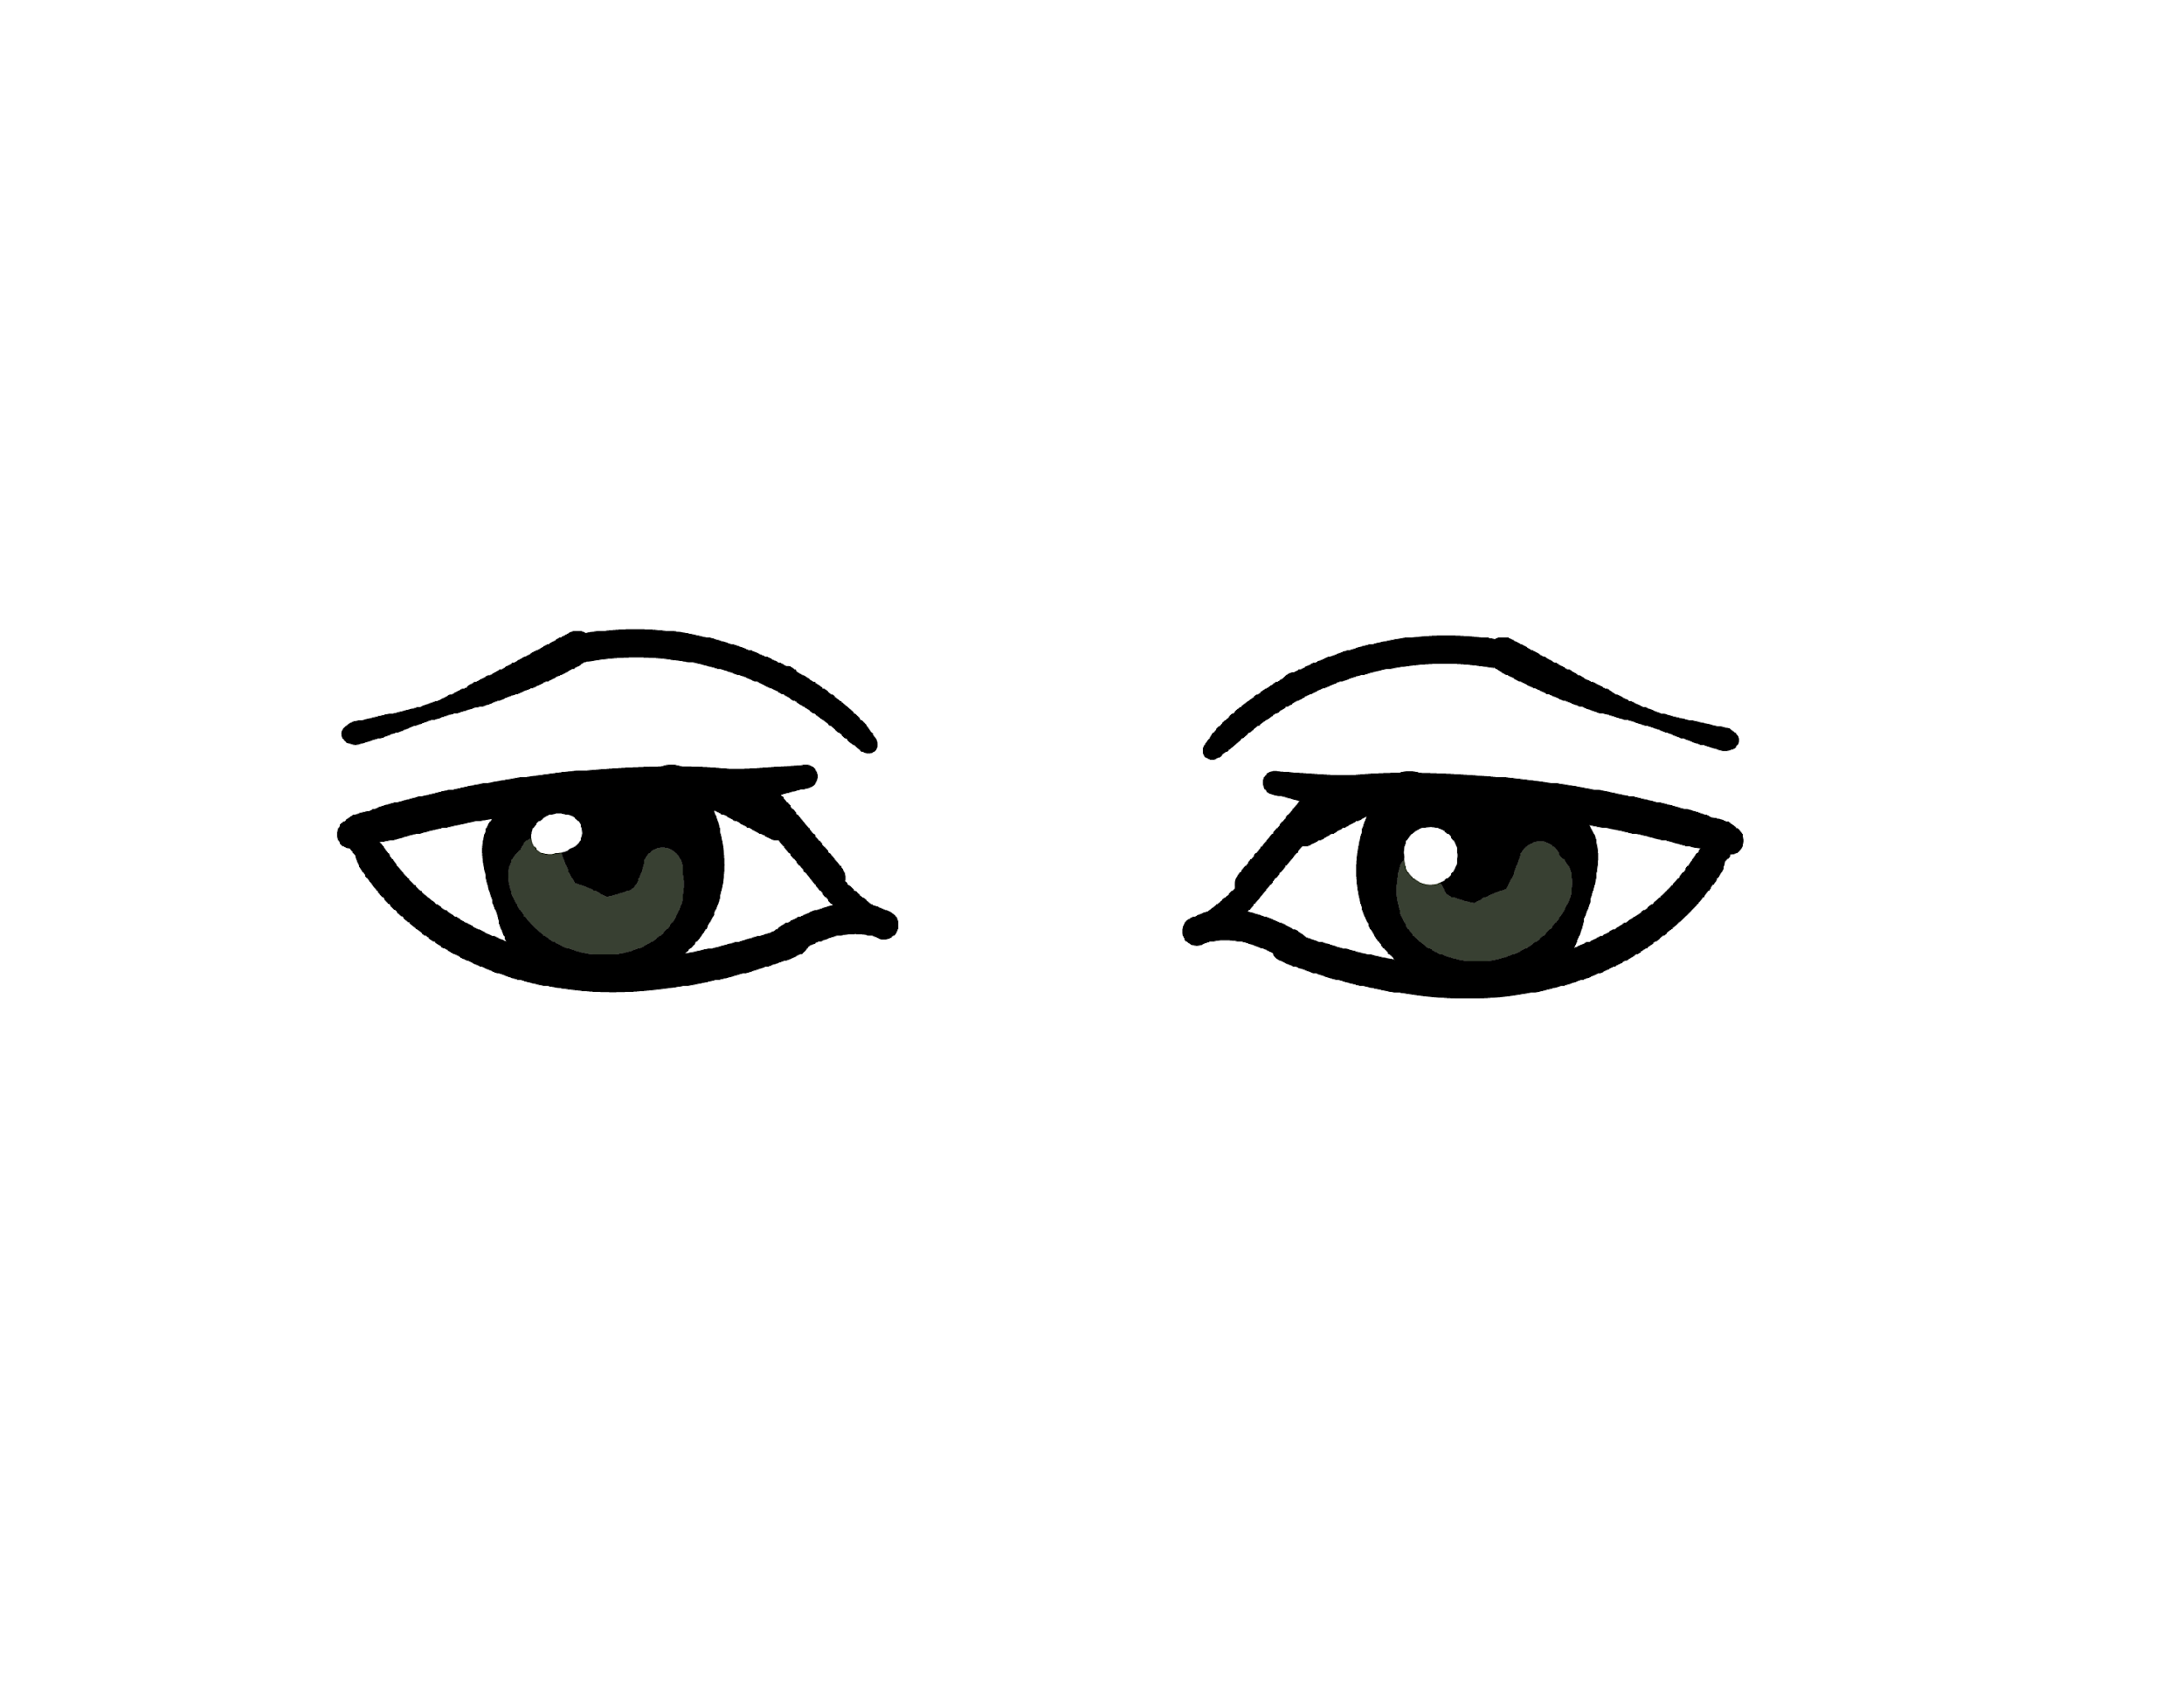
You can judge a person by simply looking
into their eyes.

Slide 10
Think about the people you admire and the eyes you have drawn to represent them. What experiences do you think the eyes have seen?

Slide 11
The Eyes Have a Story to Tell
Write a narrative form the perspective of the eyes you created.
You can start with a story or build a character to begin.
Include the adjectives/characteristics you chose from the Commit and Toss activity.

Slide 12
Star and a Wish
On your groups assigned wall, choose two writings to provide feedback for.
Using your Gallery Walk Checklist mark all the elements the writing shows.
On your sticky note provide the following feedback:
Write a star showing something the writer did well from the checklist.
✔ Write a check noting something the writer might want to check again or revise before writing a final copy.
Notes:
K20 Center (n.d.). Two Stars and a Wish. Strategies. https://learn.k20center.ou.edu/strategy/83
K20 Center (n.d.). Gallery Walk/Carousel. Strategies. https://learn.k20center.ou.edu/strategy/118

