Slide 2
Active or Passive? “The Monkey’s Paw”
7th Grade or 8th Grade
English/Language Arts

Slide 3
Essential Questions
How do we recognize active and passive voice?
What is the importance of recognizing active and passive voice?

Slide 4
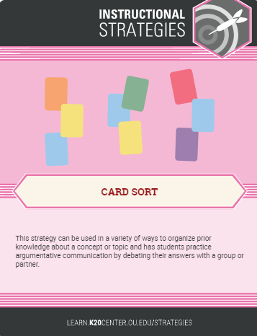
Card Sort Activity
With your partner, read the sentences on all the cards together.
Some of the sentences are similar in the way they are written.
Sort the cards into two groups of sentences whose structures seem the same.

Slide 5
Card Sort Activity
Discuss with your partners how you sorted the sentence cards into two groups.
What was your reasoning?
Be prepared to discuss your reasoning with the class.
Notes:
The teacher should ask each group to choose a spokesperson. The spokesperson is to share the reasoning for why the group identified certain sentences as similar. The teacher may wish to write the group reasons on the board.

Slide 6
What is the difference between active and passive voice sentences?
Active Voice
Passive Voice
The subject of the sentence does the action.
Examples:
Sarah danced the polka.
The building tumbled down.
The boy must have eaten all the candy.
It’s unclear who is doing the action.
The subject is being acted upon by the verb. Usually has some form of the “be” verb (am, is, are, was, etc.).
Examples:
The polka was danced by Sarah.
The building is being torn down by the work crew.
The candy must have been eaten.

Slide 7
Card Sort Answers
Active Voice
His three listeners leaned forward eagerly.
The solider shook his head.
Mrs. White looked up sharply.
Mr. White took the paw from his pocket reluctantly.
She came stumbling across the room toward him.
Passive Voice
The blinds were drawn.
In the business of supper, the talisman was forgotten.
The dirty little paw was pitched on the sideboard.
The son was killed in an accident at the factory.
A shock was given me all the same.

Slide 8
Topic Choices
Why our school is the best.
The dangers of social media.
How not to be a bully nor a victim of bullying.
How to make good grades.
Best tips for getting along with friends.
Group choice.*
*with teacher approval

Slide 9
Create a summary
Create a summary of “The Monkey’s Paw” by W. W. Jacobs.
The summary should contain seven to ten statements.
Include at least one or two sentences in active voice and at least one sentence in passive voice.

