Slide 2
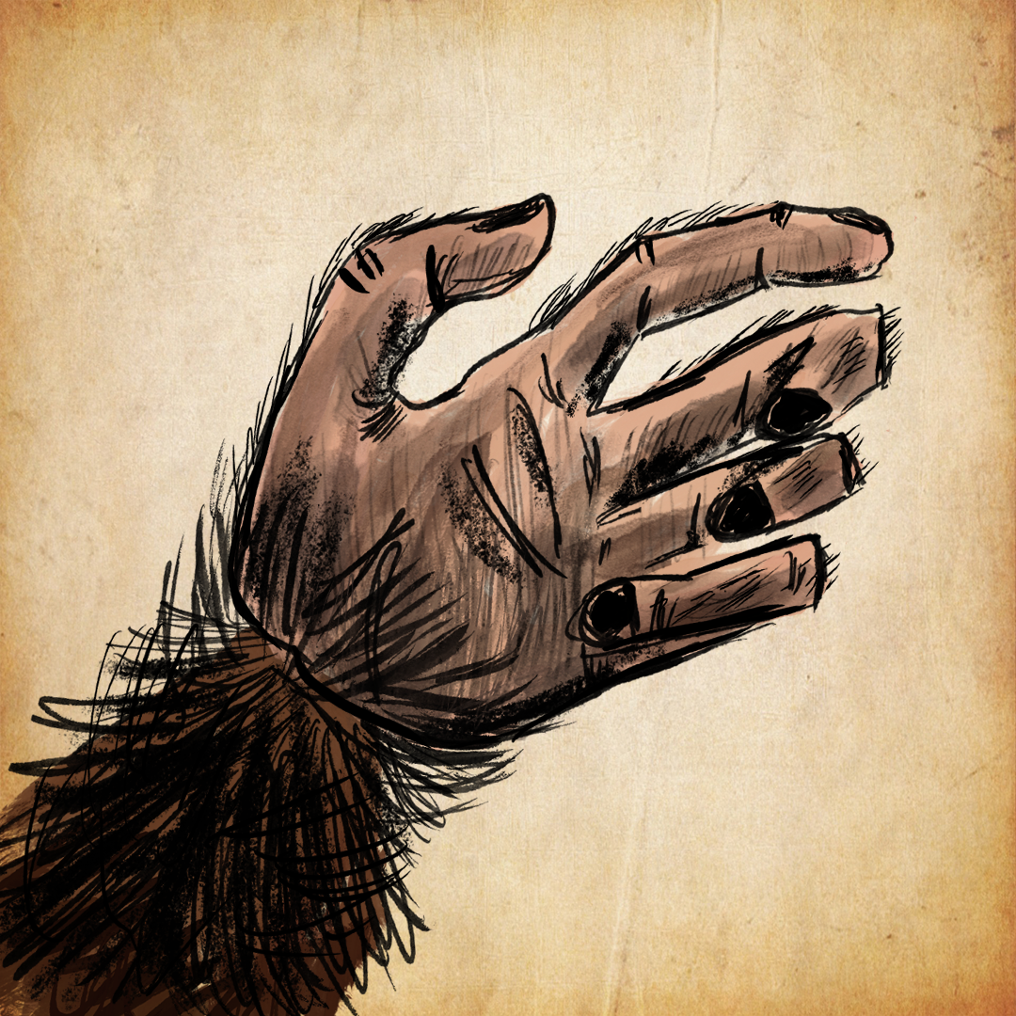
Active or Passive? “The Monkey’s Paw”
Grammar/Language Usage

Slide 3
Essential Questions
How do we recognize active and passive voice?
What is the importance of recognizing active and passive voice?

Slide 4
Learning Objectives
Identify whether a sentence is written in active or passive voice and explain how the voice is used.
Summarize and paraphrase ideas from one or more texts while keeping the original meaning and putting the ideas in a logical order.

Slide 5


Card Sort
With your partner, read the sentences on all the cards together.
Some of the sentences are similar in the way they are written.
Sort the cards into two groups of sentences whose structures seem the same.
K20 10 Minute Timer
Notes:
K20 Center. (n.d.). Card sort. Strategies. https://learn.k20center.ou.edu/strategy/147
K20 Center. (2021). 10-Minute timer. YouTube. https://youtu.be/9gy-1Z2Sa-c?si=mZT8we776f2Oew46

Slide 6
Card Sort
Discuss with your partners how you sorted the sentence cards into two groups.
What was your reasoning?
Be prepared to discuss your reasoning with the class.
Notes:
K20 Center. (n.d.). Card sort. Strategies. https://learn.k20center.ou.edu/strategy/147

Slide 7
What is the difference between active and passive voice sentences?
Active Voice
Passive Voice
The subject of the sentence performs the action of the sentence.
It’s unclear who is doing the action.
The actor may be deliberately disguised.
The subject is being acted upon by the verb. The verb phrase includes some form of the “be” verb (am, is, are, was, etc.).
Notes:
Active and passive voice--usage and differences. (n.d.) Grammar. Writing Guide. A researchguide.com. https://www.aresearchguide.com/active-and-passive-voice.html

Slide 8
What is the difference between active and passive voice sentences?
Active Voice
Passive Voice
Examples:
Sarah danced the polka.
The building tumbled down.
The boy ate all the candy.
Examples:
The polka was danced by Sarah.
The building is being torn down by the work crew.
The candy must have been eaten.
Notes:
Active and passive voice--usage and differences. (n.d.) Grammar. Writing Guide. A researchguide.com. https://www.aresearchguide.com/active-and-passive-voice.html

Slide 9
Card Sort Answers
Active Voice | Passive Voice
His three listeners leaned forward eagerly. The soldier shook his head. Mrs. White looked up sharply. Mr. White took the paw from his pocket reluctantly. She came stumbling across the room toward him. | The blinds were drawn. In the business of supper, the talisman was partly forgotten. The dirty little paw was pitched on the sideboard. The son was killed in an accident at the factory. A shock was given to me all the same.

Slide 10

Active or Passive?
Remember…
Active: The subject of the sentence does the action.
Passive: It’s unclear who is doing the action. Or the writer intentionally disguises the actor. The subject is being acted upon by the verb.
With your Elbow Partner…
Create an active voice sentence about what just happened.
Next, make the sentence passive.
Notes:
K20 Center. (n.d.). Elbow partners. Strategies. https://learn.k20center.ou.edu/strategy/116
Active and passive voice--usage and differences. (n.d.) Grammar. Writing Guide. A researchguide.com. https://www.aresearchguide.com/active-and-passive-voice.html

Slide 11
Choose a Topic
Why is our school the best?
What are the dangers of social media?
How can you not to be either a bully or a victim of bullying?
How can you make good grades?
What are some of the best tips for getting along with friends?
Group choice.*
*with teacher approval

Slide 12

T-Chart
Using your topic…
Write 10 active voice sentences on one side of your chart.
Write 10 passive sentences on the other side.
When your group finishes switch with another group and peer review each other’s work.
Make corrections as needed.
Notes:
K20 Center. (n.d.). T-chart. Strategies. https://learn.k20center.ou.edu/strategy/86

Slide 13
T-Chart
Now, make a poster version of your T-chart.
Share your charts with the class.
Notes:
K20 Center. (n.d.). T-chart. Strategies. https://learn.k20center.ou.edu/strategy/86

Slide 14

“The Monkey’s Paw” W.W. Jacobs
Notes:
Lewis, R. (2012). The Monkey's paw. (video file). Youtube.com. https://www.youtube.com/watch?v=ugjegclLNhM

Slide 15
Create a Summary
Read “The Monkey’s Paw” by W. W. Jacobs.
Create a summary.
  The summary should contain 7-10 statements.
  Include at least 1 or 2 sentences in active voice and at least one sentence in passive voice.

Slide 16
The best way to tell the difference between active and passive voice is to…

