Slide 2
American Imperialism
“The White Man’s Burden” by Rudyard Kipling

Slide 3
Essential Questions
What is American imperialism?
What motivated the United States to acquire countries and islands beyond its continental borders?

Slide 4
Lesson Objective
Analyze American imperialism, including the concept of “The White Man’s Burden.”

Slide 5
What do you think imperialism means?

Slide 6
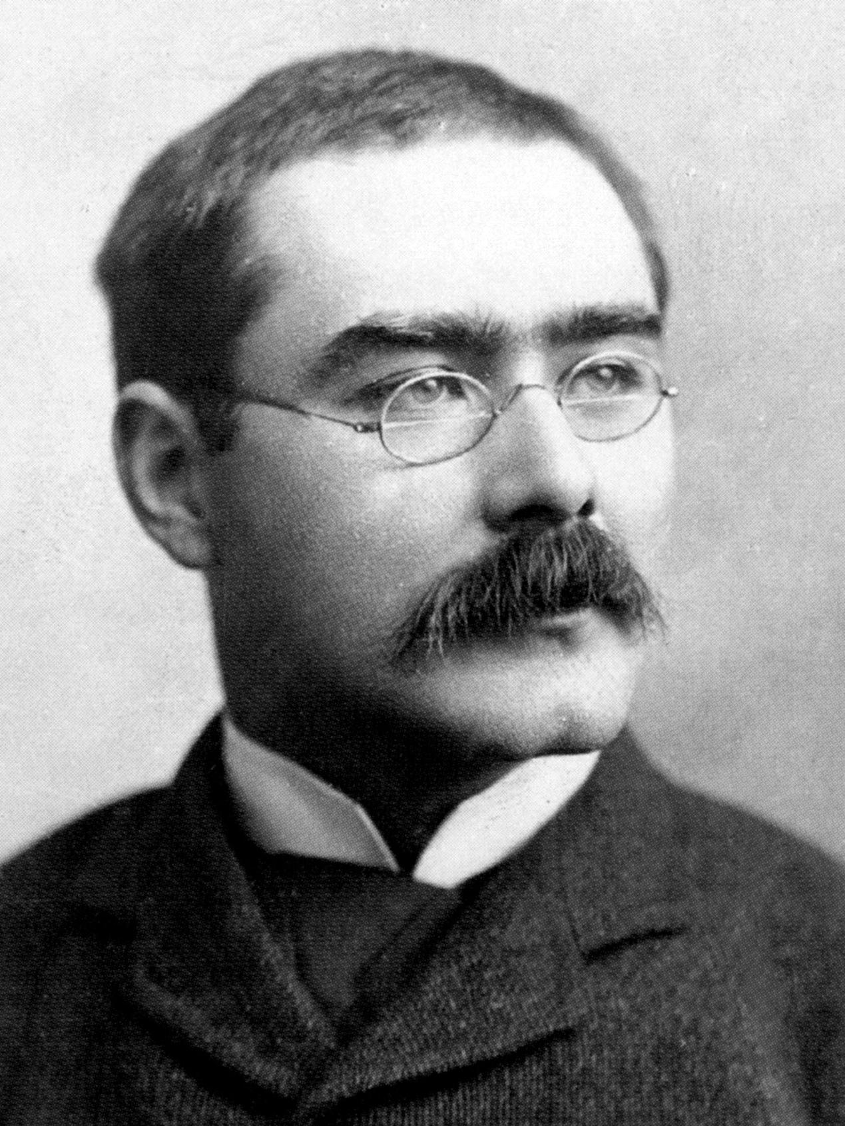
“The White Man’s Burden” by Rudyard Kipling
Author Rudyard Kipling
December 30, 1865 – January 18, 1936
English journalist
Born in British India
Awards and Prizes
1907 Nobel Prize in Literature; first English-language writer to receive the prize and the youngest recipient to date
British Poet Laureateship (declined)
Knighthood (declined)
Notable work of fiction:
The Jungle Book (1991)
Notes:
Birkenhead, L. (1978). Rudyard Kipling. Random House Inc.
Eliott & Fry (1907). Kipling in 1895 [Photograph]. Wikimedia Commons.
https://commons.wikimedia.org/wiki/File:Rudyard_Kipling_(portrait).jpg
Stewart, J. I. M. (2022). Rudyard Kipling. Britannica. Retrieved April 29, 2022, from https://www.britannica.com/biography/Rudyard-Kipling
Kipling, R. (1991). The Jungle Book. New York: Arcade Pub.

Slide 7
“The White Man’s Burden”
As you are reading “The White Man’s Burden” by Rudyard Kipling, circle or underline any answer you find to the following questions:
According to the poem, what “burden” does Kipling want white men to take up?
In the poem, how does Kipling describe the people that white men will “save”?
What reason does Kipling give for white men to take up this “burden”?

Slide 8
What do you think imperialism means?

Slide 9
Alfred T. Mahan, naval admiral and historian wrote:
The Influence of Sea Power Upon History (1949) book
“Having no foreign establishments (for the US), either colonial or military, the ships of war of the United States will be like land birds, unable to fly far from their own shores.
"To provide resting places for them (the ships), where they can coal and repair, would be one of the first duties of a government proposing itself the development of the power of a nation at sea.”
Notes:
Mahan, A. T. (1949). The influence of sea power upon history, 1660-1783. Boston: Little, Brown.

Slide 10
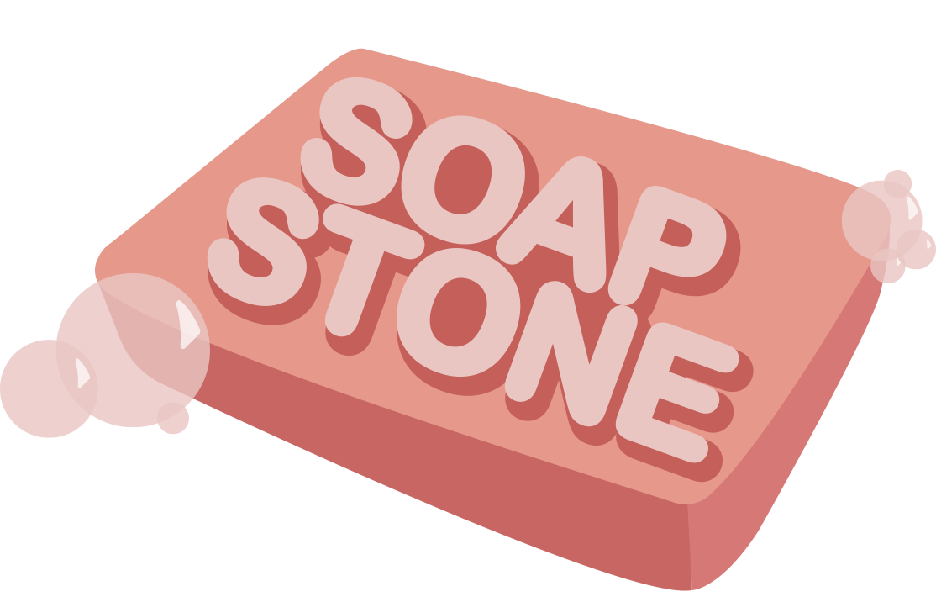
SOAPSTone
While reading the quote, identify:
S: Who is the SPEAKER?
O: What is the OCCASION?
A: Who is the AUDIENCE?
P: What is the PURPOSE?
S: What is the SUBJECT matter?
T: What is the TONE? (pro- or anti-imperialist)

Slide 11
Jigsaw
Work in groups of three.
Each group will receive three primary source documents.
Have each member read one document.
Write your name at the top of your document.

Slide 12
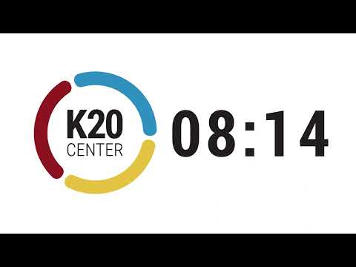
Stop and Jot
As you read your assigned document, Stop and Jot main ideas and key details in the margins.
Write down at least three main ideas.
Notes:
K20 Center. (2022, April 6). K20 Center 20 minute timer [Video]. Youtube. https://www.youtube.com/watch?v=bjcwzinQlEE&ab_channel=K20Center

Slide 13
Jigsaw
Group up with others who read the same document as yours.
Share your main ideas and key details.
Share new ideas as you listen to what others have learned about your document.

Slide 14
SOAPSTone
Referring to your assigned document, work with your group to answer:
S: Who is the SPEAKER?
O: What is the OCCASION?
A: Who is the AUDIENCE?
P: What is the PURPOSE?
S: What is the SUBJECT matter?
T: What is the TONE? (pro- or anti-imperialism)
Notes:
K20 Center. (2022, April 6). K20 Center 20 minute timer [Video]. Youtube. https://www.youtube.com/watch?v=bjcwzinQlEE&ab_channel=K20Center

Slide 15
Jigsaw
Go back to your original group and share what you learned about your assigned document.
As you discuss with your group, make sure you answer the SOAPStone questions for all the documents on your organizer.

Slide 16
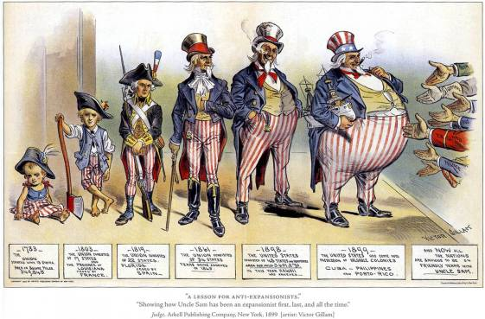
Notes:
Gillam, V. (1899). Lesson for Anti-Expansionists [Image] UHM Library Digital Image Collections, Retrieved April 11, 2022, from https://digital.library.manoa.hawaii.edu/items/show/31967.

Slide 17
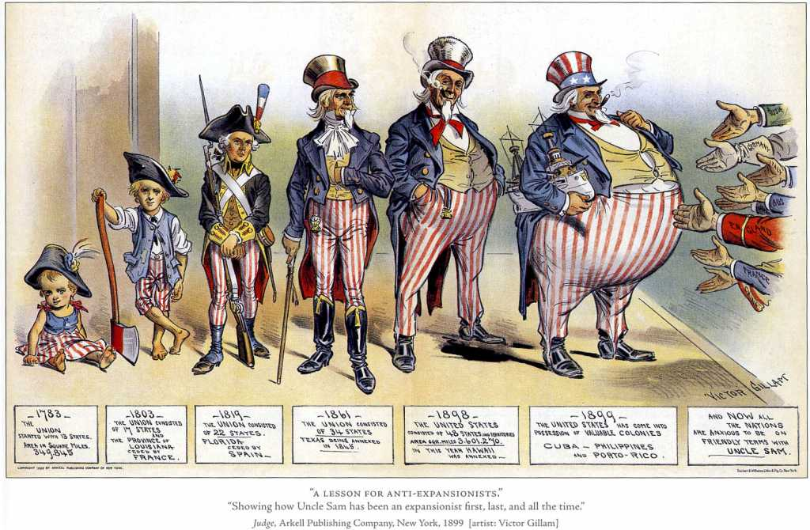
Discussion Questions
From a pro-imperialist perspective, what type of mindset "justifies" expansion to other territories or countries?
What do you think is the cost of Uncle Sam’s expansionist ways?
Do you think other countries are still “anxious to be on friendly terms” with the United States?
Notes:
Gillam, V., “Lesson for Anti-Expansionists,” UHM Library Digital Image Collections, Retrieved April 11, 2022, from https://digital.library.manoa.hawaii.edu/items/show/31967.

Slide 18
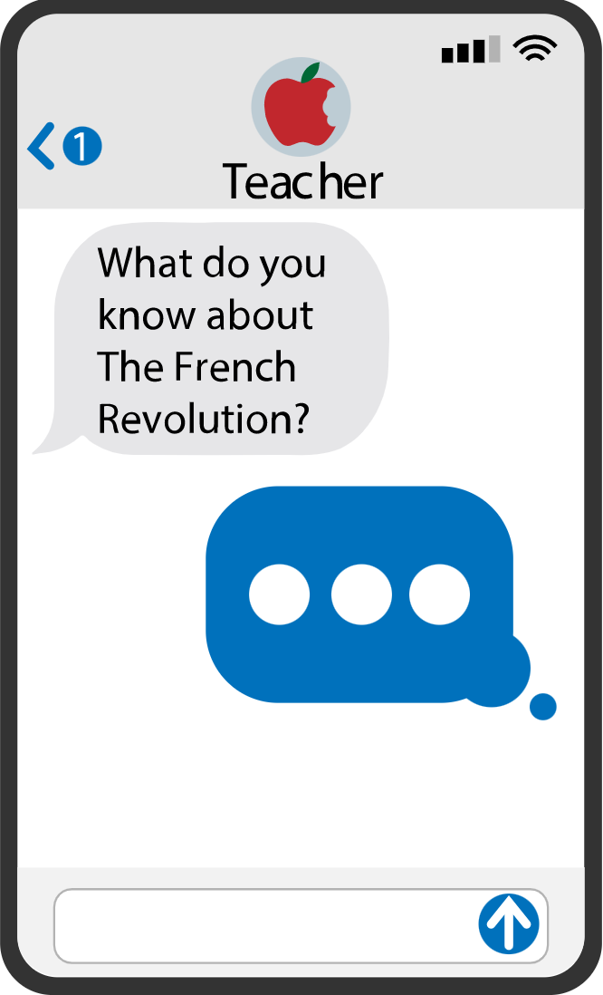
Quick Write
Using evidence from the primary source documents, answer:
Why would nations be “anxious to be on friendly terms with Uncle Sam?”

