Slide 2
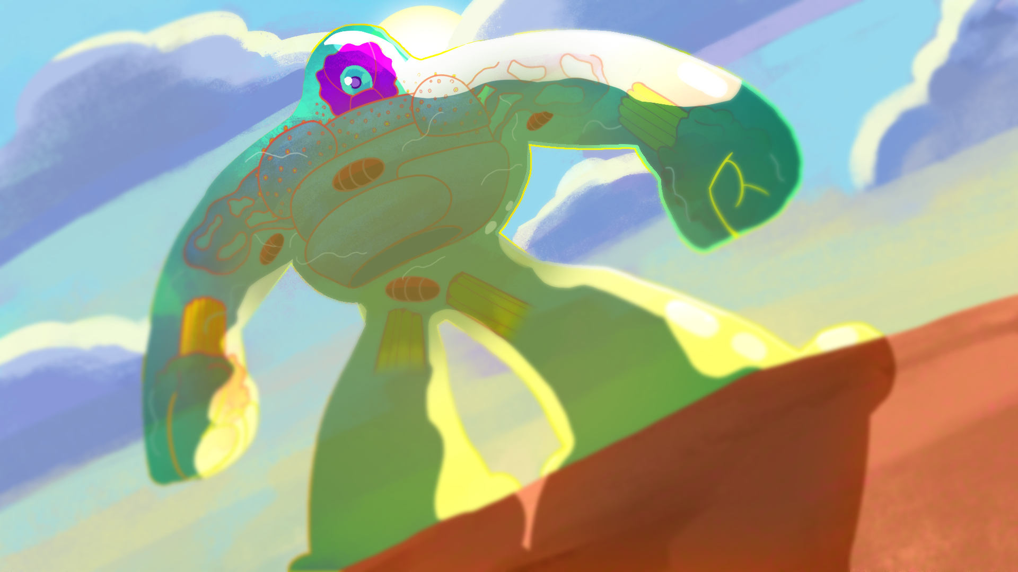
What’s My Purpose in This Life?
Intro to Cell Theory: Organelles

Slide 3
Essential Questions
Why are organelles important to cells?
Why are cells called “the building blocks of life”?

Slide 4
Lesson Objectives
Identify the structure and function of various cell organelles.
Differentiate between plant and animal cells.
List the 3 principles of the Cell Theory.

Slide 5
https://www.youtube.com/watch?v=gFuEo2ccTPA
Notes:
Frank Gregorio. (2012, January 31). Introduction to cells [Video]. YouTube. https://www.youtube.com/watch?v=gFuEo2ccTPA

Slide 6
https://www.youtube.com/watch?v=EW6UCWDQfj0
Notes:
Moe Sal. (2011, November 14). How it’s made frozen, pizzas. [Video]. YouTube. https://www.youtube.com/watch?v=EW6UCWDQfj0

Slide 7
Say What?!
What did you notice as the ingredients went from pizza dough to the finished pizza?
Can you think of examples of everyday things that also have ordered steps?
Challenge: Why do you think I showed both a video about cells and making pizzas?

Slide 8
https://www.youtube.com/watch?v=gFuEo2ccTPA
Notes:
Frank Gregorio. (2012, January 31). Introduction to cells [Video]. YouTube. https://www.youtube.com/watch?v=gFuEo2ccTPA

Slide 9
Cell Theory
All living organisms are made up of cells.
A cell is the basic unit of life.
Every cell comes from a pre-existing cell.

Slide 10
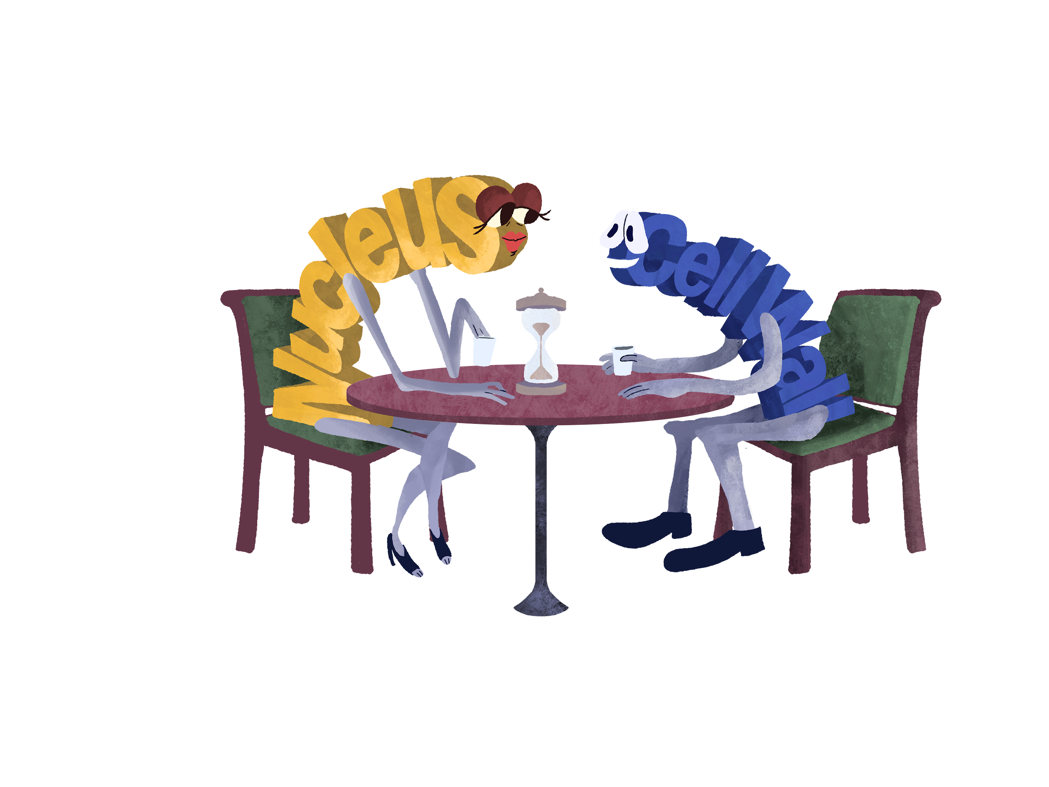
Pick a Cell Organelle
In your group divide out the 12 cell organelles, one to each group member.
Research your assigned cell organelle and fill out the Cell Organelles Speed Dating Profile.
Be sure to include if it is in a plant, animal, or both cells.
Notes:
K20 Center. (n.d.). Concept Speed Dating. Strategies.https://learn.k20center.ou.edu/strategy/3330

Slide 11
Concept Speed Dating
With your partner you will have 30 seconds each to share about your Cell Organelle.
Use your Cell Organelle Speeding Date Profile when it is your turn to share.
Fill in your Cell Organelle Note Catcher when your partner is sharing.
When the bell rings you will switch partners and start again.
Notes:
K20 Center. (n.d.). Concept Speed Dating.Strategies.https://learn.k20center.ou.edu/strategy/3330

Slide 12
Concept Speed Dating
Notes:
K20 Center. (2021, September 21). K20 Center 30 second timer [Video]. YouTube. https://www.youtube.com/watch?v=o9ViOMe_Wnk

Slide 13
https://www.youtube.com/watch?v=8IlzKri08kk
Notes:
Amoeba Sisters. (2016, November 2). Introduction to Cells: The Grand Cell Tour [Video]. YouTube. https://www.youtube.com/watch?v=8IlzKri08kk

Slide 14
Cellular Systems Analogy
What other places, objects, etc. work as a system like a cell?
With your group illustrate your system and label each structure.
Fill out the structure and function on your handout.

Slide 15
Cell Organelle | Person/Structure | Description
Nucleus | Principal | Like a principal manages a school, the nucleus controls and manages the day-to-day operations and makes decisions.
Cell Membrane | School Outer wall | Like the schools surrounding walls provide protection and control entrance and exits, the cell membrane regulates what can enter or leave the cells.
Mitochondria | Cafeteria | Like the school cafeteria provide food for energy to students, the mitochondria is where energy is produced from breaking down food molecules.
Lysosomes | Custodian | Like the custodian removes trash and unwanted materials from the school, the lysosomes aim to remove any waste from the cell that is no longer in use or malfunctions.

Slide 16
Histotechnologist Teresa LaRose
https://www.youtube.com/watch?v=elYoLs8XM6U
Notes:
K20 Center. (2020, July 14). Histotechnologist - Terese LaRose - Zoom into your career [Video]. YouTube. https://www.youtube.com/watch?v=elYoLs8XM6U
Click on the image to play video

Slide 17
Ovarian Teratoma
https://www.youtube.com/watch?v=pMua1d5BE4g
Notes:
The following option pertains to sensitive content and the URL might be restricted for certain school districts. Please advise students with a squeamish stomach to turn away before the 10 second mark.
Click on the image to play video
Tranquility. (2017, January 6). Ovarian teratoma [Video]. YouTube. https://www.youtube.com/watch?v=pMua1d5BE4g

Slide 18
What’s my purpose in this life?
Goal: Find out which organelle you are.
Mix and mingle: Ask one question only and then move on to another person to ask another question.
Repeat.
Good question example: Am I found in a plant cell?
Bad question example: Am I a ribosome?
Notes:
K20 Center. (n.d.). Kick me. Strategies. https://learn.k20center.ou.edu/strategy/121
YouTube. (2021, September 21). K20 Center 5 minute timer. YouTube. https://www.youtube.com/watch?v=EVS_yYQoLJg

