Slide 2
Melting Pot or Salad Bowl?
Cultural Diversity

Slide 3
Essential Questions
How does culture shape our identity?
In what ways can cultural diversity enhance or complicate our lives?

Slide 4
Lesson Objectives
Identify the ways in which culture shapes our lifestyles.
Examine how cultural characteristics, such as language, ethnicity, and religion impact local communities.

Slide 5
Japanese Culture
As you watch the video, think about the following:
What do you notice about Japanese culture?
What information does this video tell you about the culture?
Are there any images that might seem offensive or not representative of Japanese culture?

Slide 6
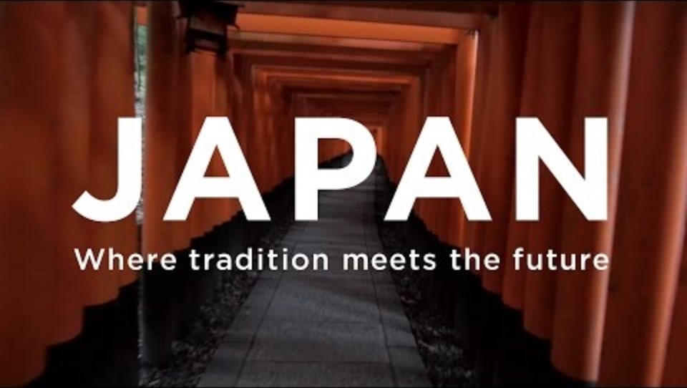
Japanese Culture
Where Tradition Meets the Future
Notes:
JNTO. [visitjapan]. (2016, November 6). Japan - Where tradition meets the future. [Video]. YouTube. https://youtu.be/WLIv7HnZ_fE?si=NNtW8HZj0yxV6M6o

Slide 7
Japanese Culture
What do you notice about Japanese culture?
What information does this video tell you about the culture?
Are there any images that might seem offensive or not representative of Japanese culture?

Slide 8
Mexican Culture
As you watch the next video, think about the following:
What do you notice about Mexican culture?
What information does this video tell you about the culture?
Are there any images that might seem offensive or not representative of Mexican culture?

Slide 9
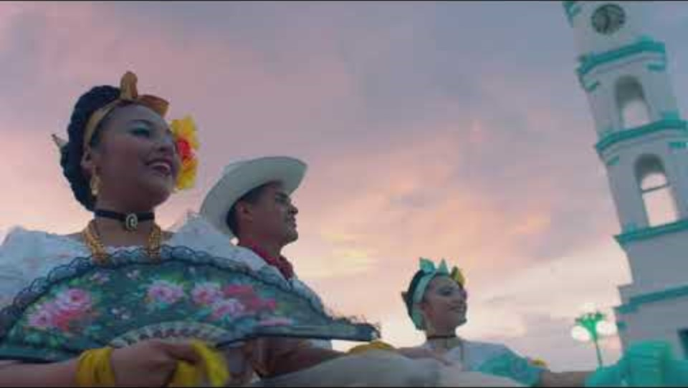
Mexican Culture
Mexico, A World of Its Own
Notes:
VisitMexico. (2018, February 7). Mexico, a world of its own. [Video]. YouTube. https://youtu.be/P6Oz626qERs?si=zAXBrk9KVKLDRPvy

Slide 10
Mexican Culture
What do you notice about Mexican culture?
What information does this video tell you about the culture?
Are there any images that might seem offensive or not representative of Mexican culture?

Slide 11
Black Culture
As you watch the next video, think about the following:
What do you notice about Black culture?
What information does this video tell you about the culture?
Are there any images that might seem offensive or not representative of Black culture?

Slide 12
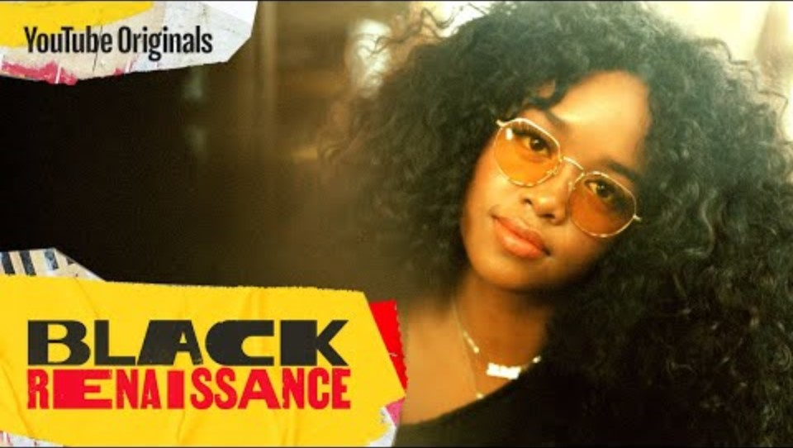
Black Culture
Black Renaissance: What is Black Culture?
Notes:
YouTube Originals. (2021, March 1). Black renaissance: What is black culture? [Video]. YouTube. https://youtu.be/weCGpwm4_UU?si=k4ffDHJzr1cdjcX-

Slide 13
Black Culture
What do you notice about Black culture?
What information does this video tell you about the culture?
Are there any images that might seem offensive or not representative of Black culture?

Slide 14


Think-Pair-Share
Culture is the artistic (and other manifestations) of race, religion, ethnicity, language, and gender. Other elements might include music, traditions, clothing, food, etc.
What evidence of different cultures do you see within your school or community?
Notes:
K20 Center. (n.d.). Think-Pair-Share. Strategies. https://learn.k20center.ou.edu/strategy/139
Johnson, G. [GDJ]. (2020). Hands. [Illustration]. Pixabay. https://pixabay.com/vectors/hands-vortex-cooperation-caring-5371512/

Slide 15
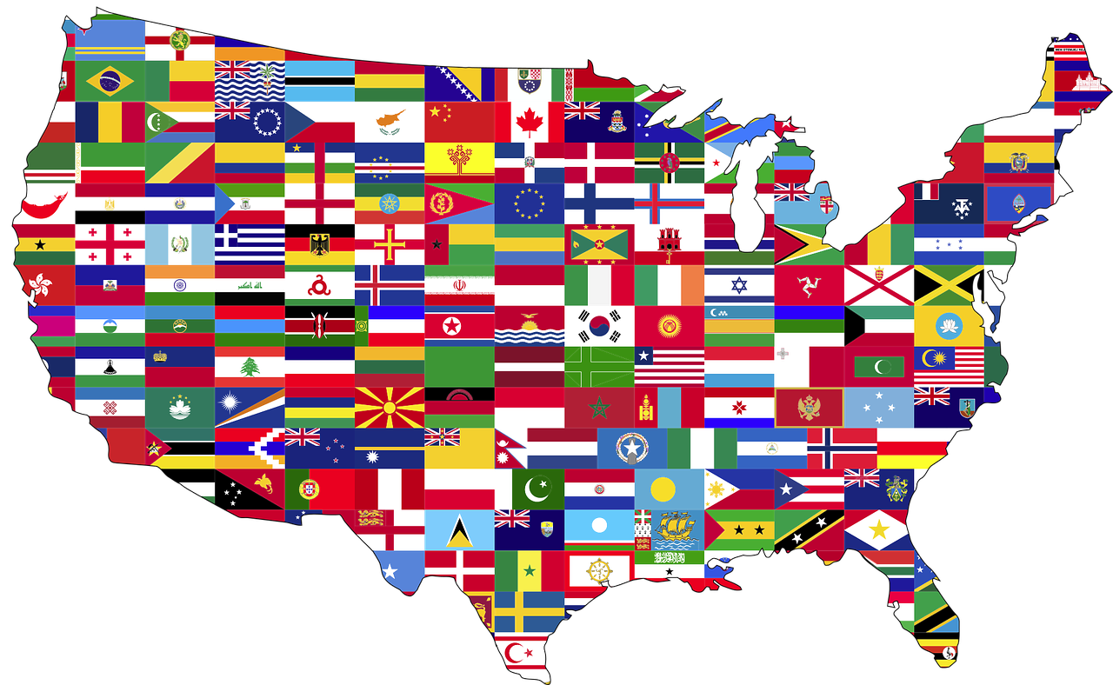
Think-Pair-Share
The United States is a country of many cultures.
The U.S. is an example of a nation with cultural diversity.
Do our cultural differences (diversity) enrich or complicate our lives?
Why do you think that?
Notes:
K20 Center. (n.d.). Think-Pair-Share. Strategies. https://learn.k20center.ou.edu/strategy/139
Johnson, G. [GDJ]. (2017). United [Illustration]. Pixabay. https://pixabay.com/vectors/united-unity-togetherness-2723203/

Slide 16
Cultural Identity: Gender
Culture is defined by indicators such as religion, race, language, gender, and ethnicity.
How might gender impact your culture?
  Are roles dependent on gender? If so, who typically serves in which roles?
Notes:
K20 Center. (n.d.). Think-Pair-Share. Strategies. https://learn.k20center.ou.edu/strategy/139

Slide 17
Cultural Identity: Ethnicity
How would you describe your ethnicity?
  African American
  Asian American
  Native American
  Caucasian
  Latino/a American
  Other
How might ethnicity impact your culture?
Notes:
K20 Center. (n.d.). Think-Pair-Share. Strategies. https://learn.k20center.ou.edu/strategy/139

Slide 18
Cultural Identity: Language
What language is spoken most often in your family?
What other language(s) are spoken?
How might language impact your culture?
Notes:
K20 Center. (n.d.). Think-Pair-Share. Strategies. https://learn.k20center.ou.edu/strategy/139

Slide 19
Cultural Identity: Religion
How might religion impact your culture?
  Are there certain traditions you have that are based on your religion?
Notes:
K20 Center. (n.d.). Think-Pair-Share. Strategies. https://learn.k20center.ou.edu/strategy/139

Slide 20
Cultural Identity
Does your culture influence the food/dishes you eat?
  If so, how?
Does your culture influence how you dress or what music you listen to?
  If so, how?
Notes:
K20 Center. (n.d.). Think-Pair-Share. Strategies. https://learn.k20center.ou.edu/strategy/139

Slide 21
Cultural Identity
Have you ever experienced prejudice because of your culture?
  If so, in what form?
Since our modern society is comprised of many different cultures, in your opinion, what is one actionable step we can take against racism and prejudice?
Notes:
K20 Center. (n.d.). Think-Pair-Share. Strategies. https://learn.k20center.ou.edu/strategy/139

Slide 22
Defining American Culture
How would you define American culture?
Think about the following concepts:
Traditions / Rituals
Religion
Race
Gender
Clothing
Music
Food
Language

Slide 23
Cultural Insights
Cultural Identity: a sense of belonging or feeling that you belong to a particular culture
Cultural Diversity: the existence of a variety of cultural or ethnic groups within a society
Cultural Diffusion: the spread of cultural traits from one culture to another

Slide 24
Cultural Insights
Assimilation: the process where a group or individual adopts the cultural traits of the dominant or popular culture, often losing their own
Acculturation: the process of a group or individual adapting to or borrowing traits from another culture

Slide 25
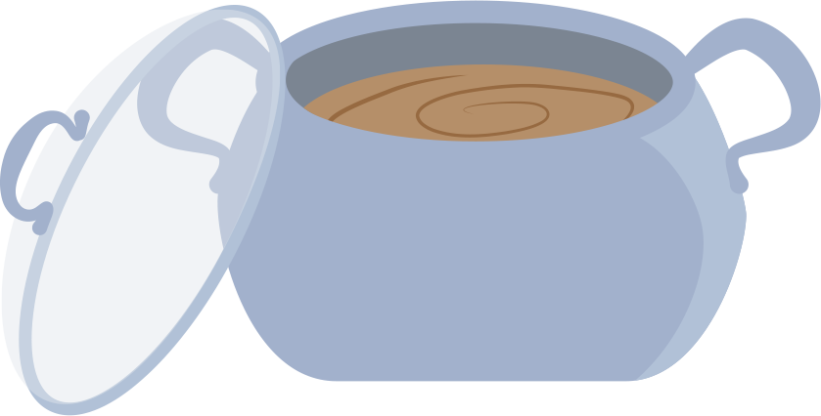
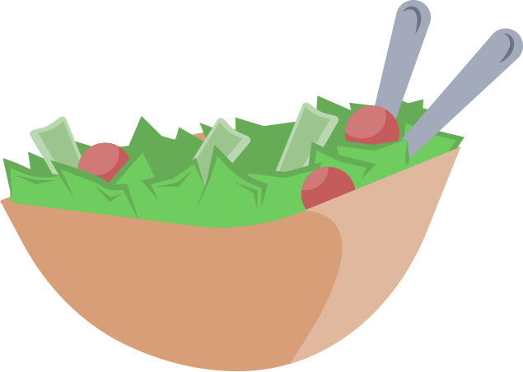
Melting Pot or Salad Bowl?
Is the United States a melting pot or salad bowl?
“Melting Pot” – The idea that immigrants who come to the United States assimilate into a dominant culture and adopt the customs, language, and beliefs of current Americans.
“Salad Bowl” – The idea that various cultures live side by side—like salad ingredients—but do not merge into a single, uniform culture. Each culture keeps its own distinct qualities beside one another within a larger community.

Slide 26
Melting Pot or Salad Bowl?
Is the United States a melting pot or salad bowl?
Are we a country that has assimilated immigrants into a melting pot?
Are all Americans expected to act in a certain way?
Are we more of a culturally diverse country where cultures have specific identities within the community?
To what extent are we (the United States) a mixture of both a melting pot and a salad bowl?

Slide 27
Mixed Salad
What if we’re somewhere in the middle?
A “melting pot” is like a soup.
  It has 1 texture and 1 flavor.
A “mixed salad” is like a stew.
  It has multiple textures and 1 flavor.

Slide 28
Melting Pot, Mixed Salad, or Salad Bowl?
Paragraph 1: Is the United States more of a melting pot, mixed salad, or salad bowl? Explain your thinking.
Paragraph 2: In what ways can cultural diversity enhance or complicate our lives?

Slide 29
Community Quilt
Create 2 squares for the quilt. Draw, color, and label each square.
The first square should be something that celebrates cultural diversity.
The second square should be something that celebrates cultural diffusion.

Slide 30
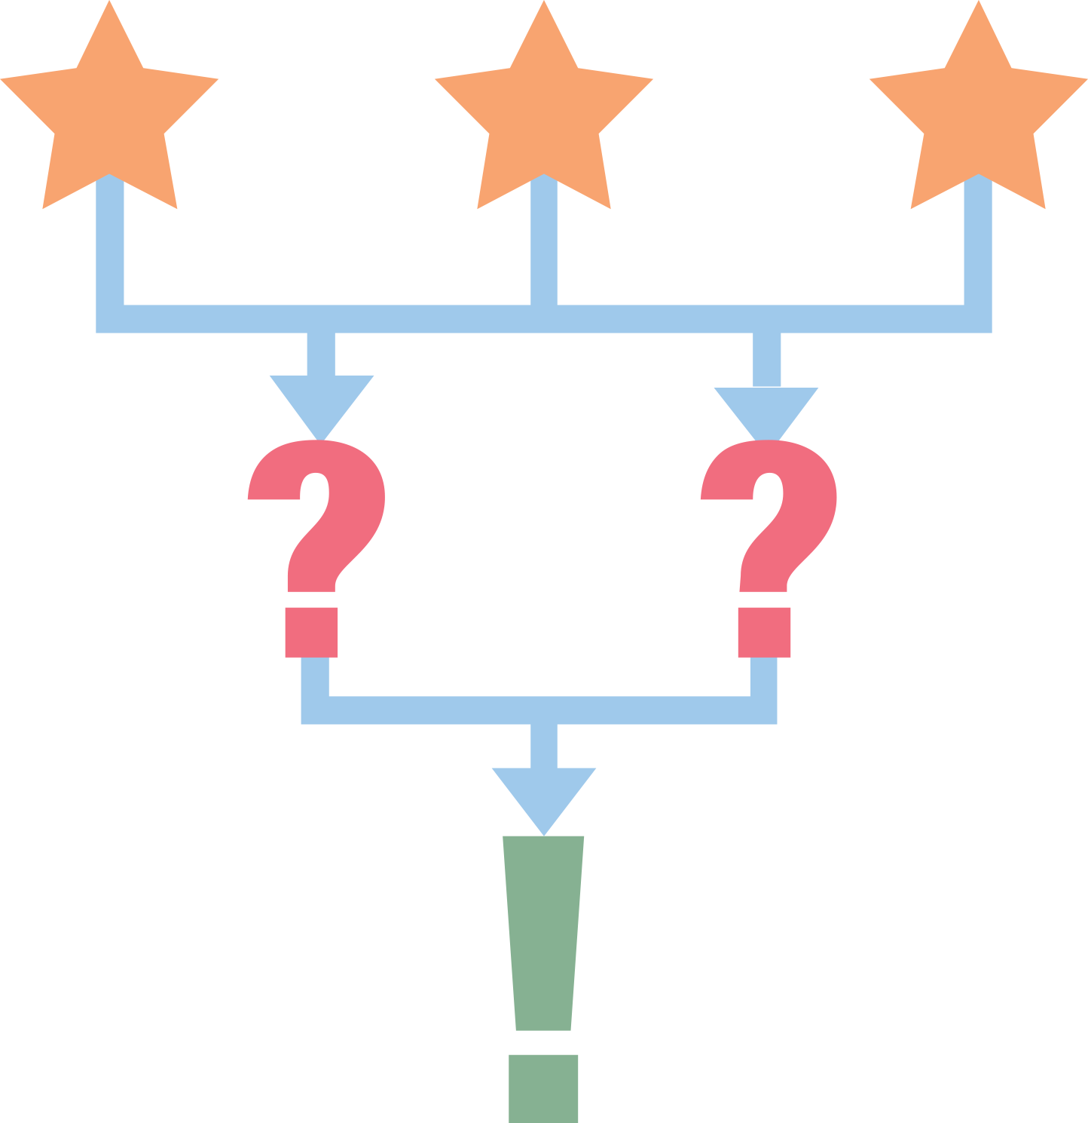
3-2-1
3: What are 3 ways that culture shapes our identity?
2: Give 2 examples of how cultural diversity can enhance or complicate life.
1: What is 1 question you still have about culture?
Notes:
K20 Center. (n.d.). 3-2-1. Strategies. https://learn.k20center.ou.edu/strategy/117

