Slide 2
Traditional Transformations, Part 1
Translations: Seminole Patchwork

Slide 3
Essential Question
How are transformations and symbolism used through First American cultures?

Slide 4
Lesson Objectives
Represent coordinate-plane transformations graphically, algebraically, and verbally.
Apply transformations to solve problems.

Slide 5
Seminole Patchwork
<insert video>
Hyperlink Video Title

Slide 6
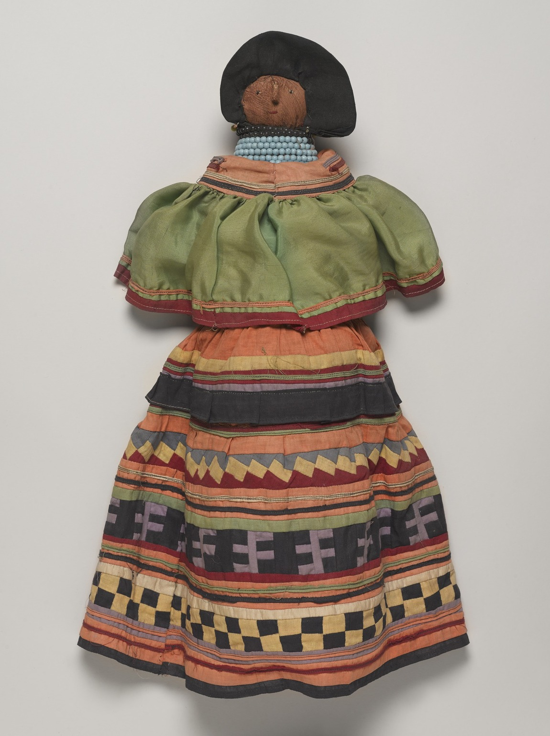
Detailed Designs
Seminole patchwork patterns are repeated by duplicating the image and then sliding it. Work with a partner to complete each table.
After completing each table, think about the results:
What do you notice?
What do you wonder?
Doll Wearing Seminole Woman’s Outfit from the Brooklyn Museum
Notes:
Seminole. Doll Wearing Seminole Woman's Outfit, ca. 1940. Cotton, palmetto fiber, silk, beads, paper, 20 1/2 × 11 × 5 3/16 in. (52.1 × 27.9 × 13.2 cm). Brooklyn Museum, A. Augustus Healy Fund, 41.222. Creative Commons-BY (Photo: , 41.222_PS9.jpg) https://www.brooklynmuseum.org/opencollection/objects/51463

Slide 7
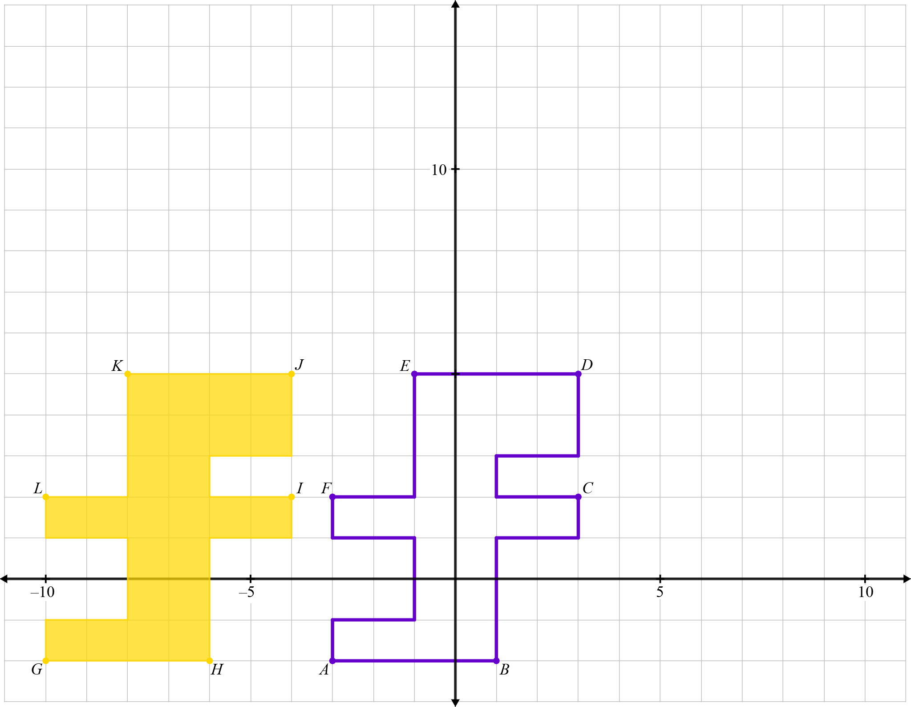
Detailed Designs: Question 1
Initial Image | Final Image

Slide 8
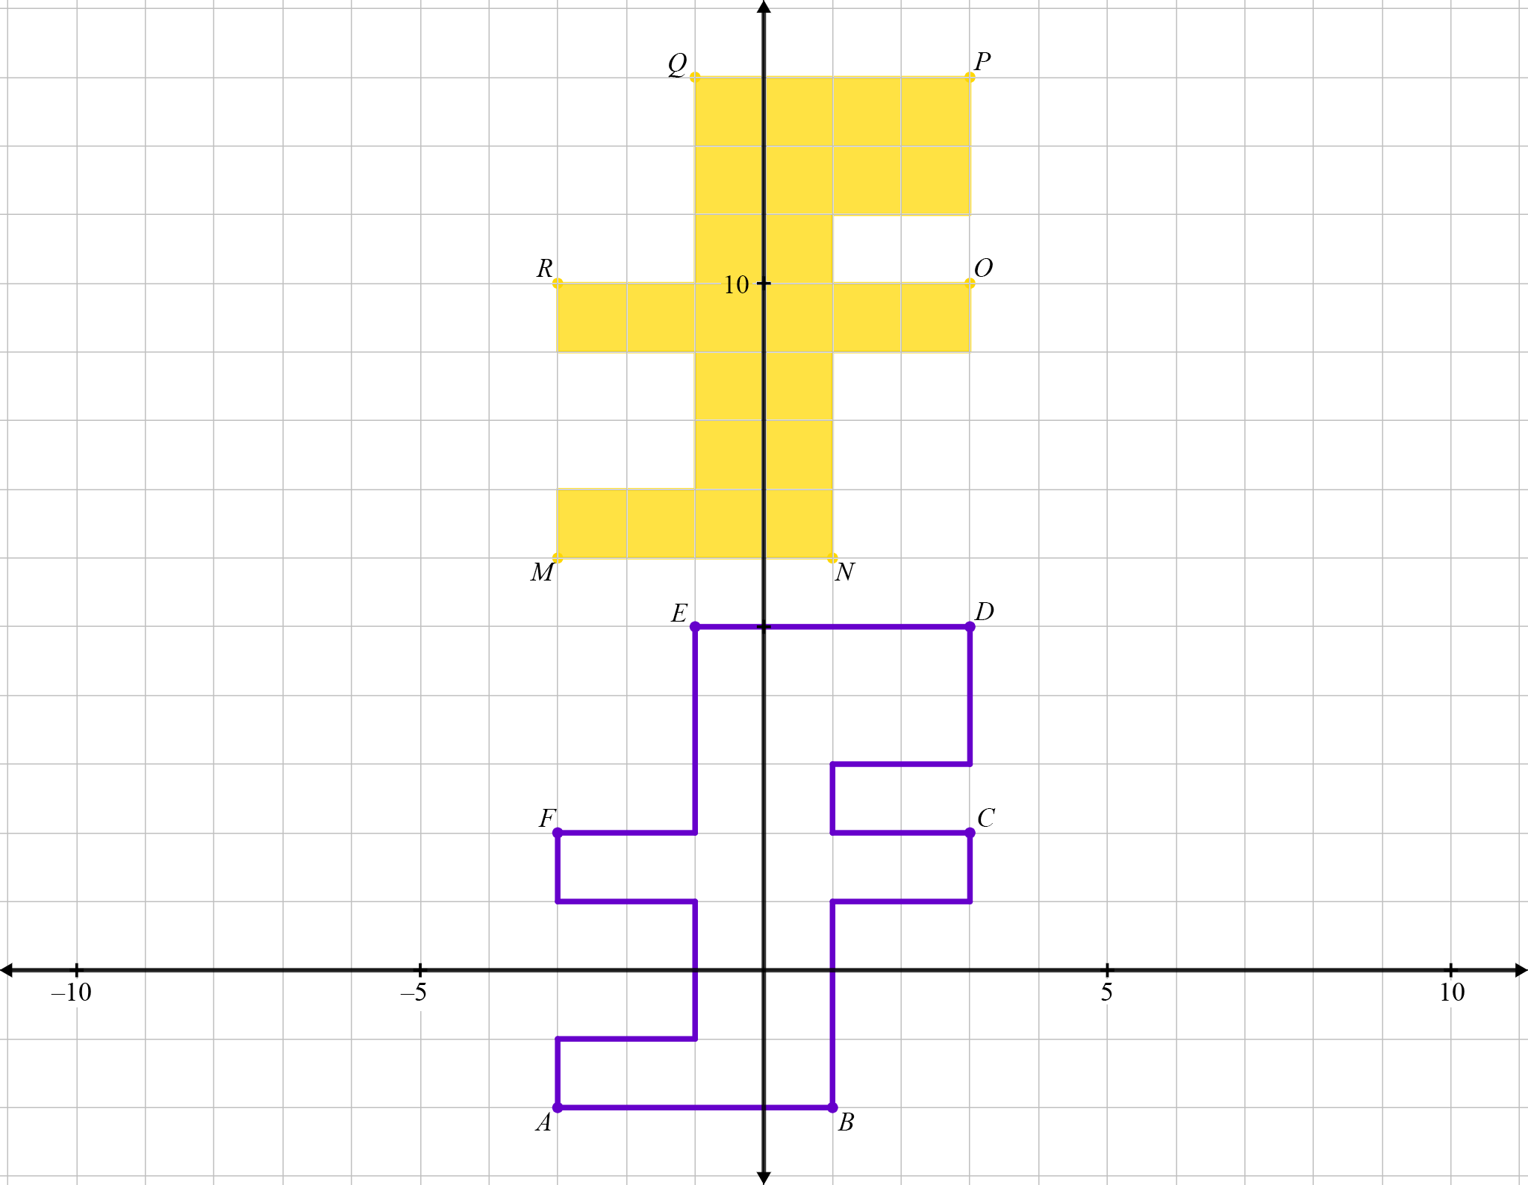
Detailed Designs: Question 2
Initial Image | Final Image

Slide 9
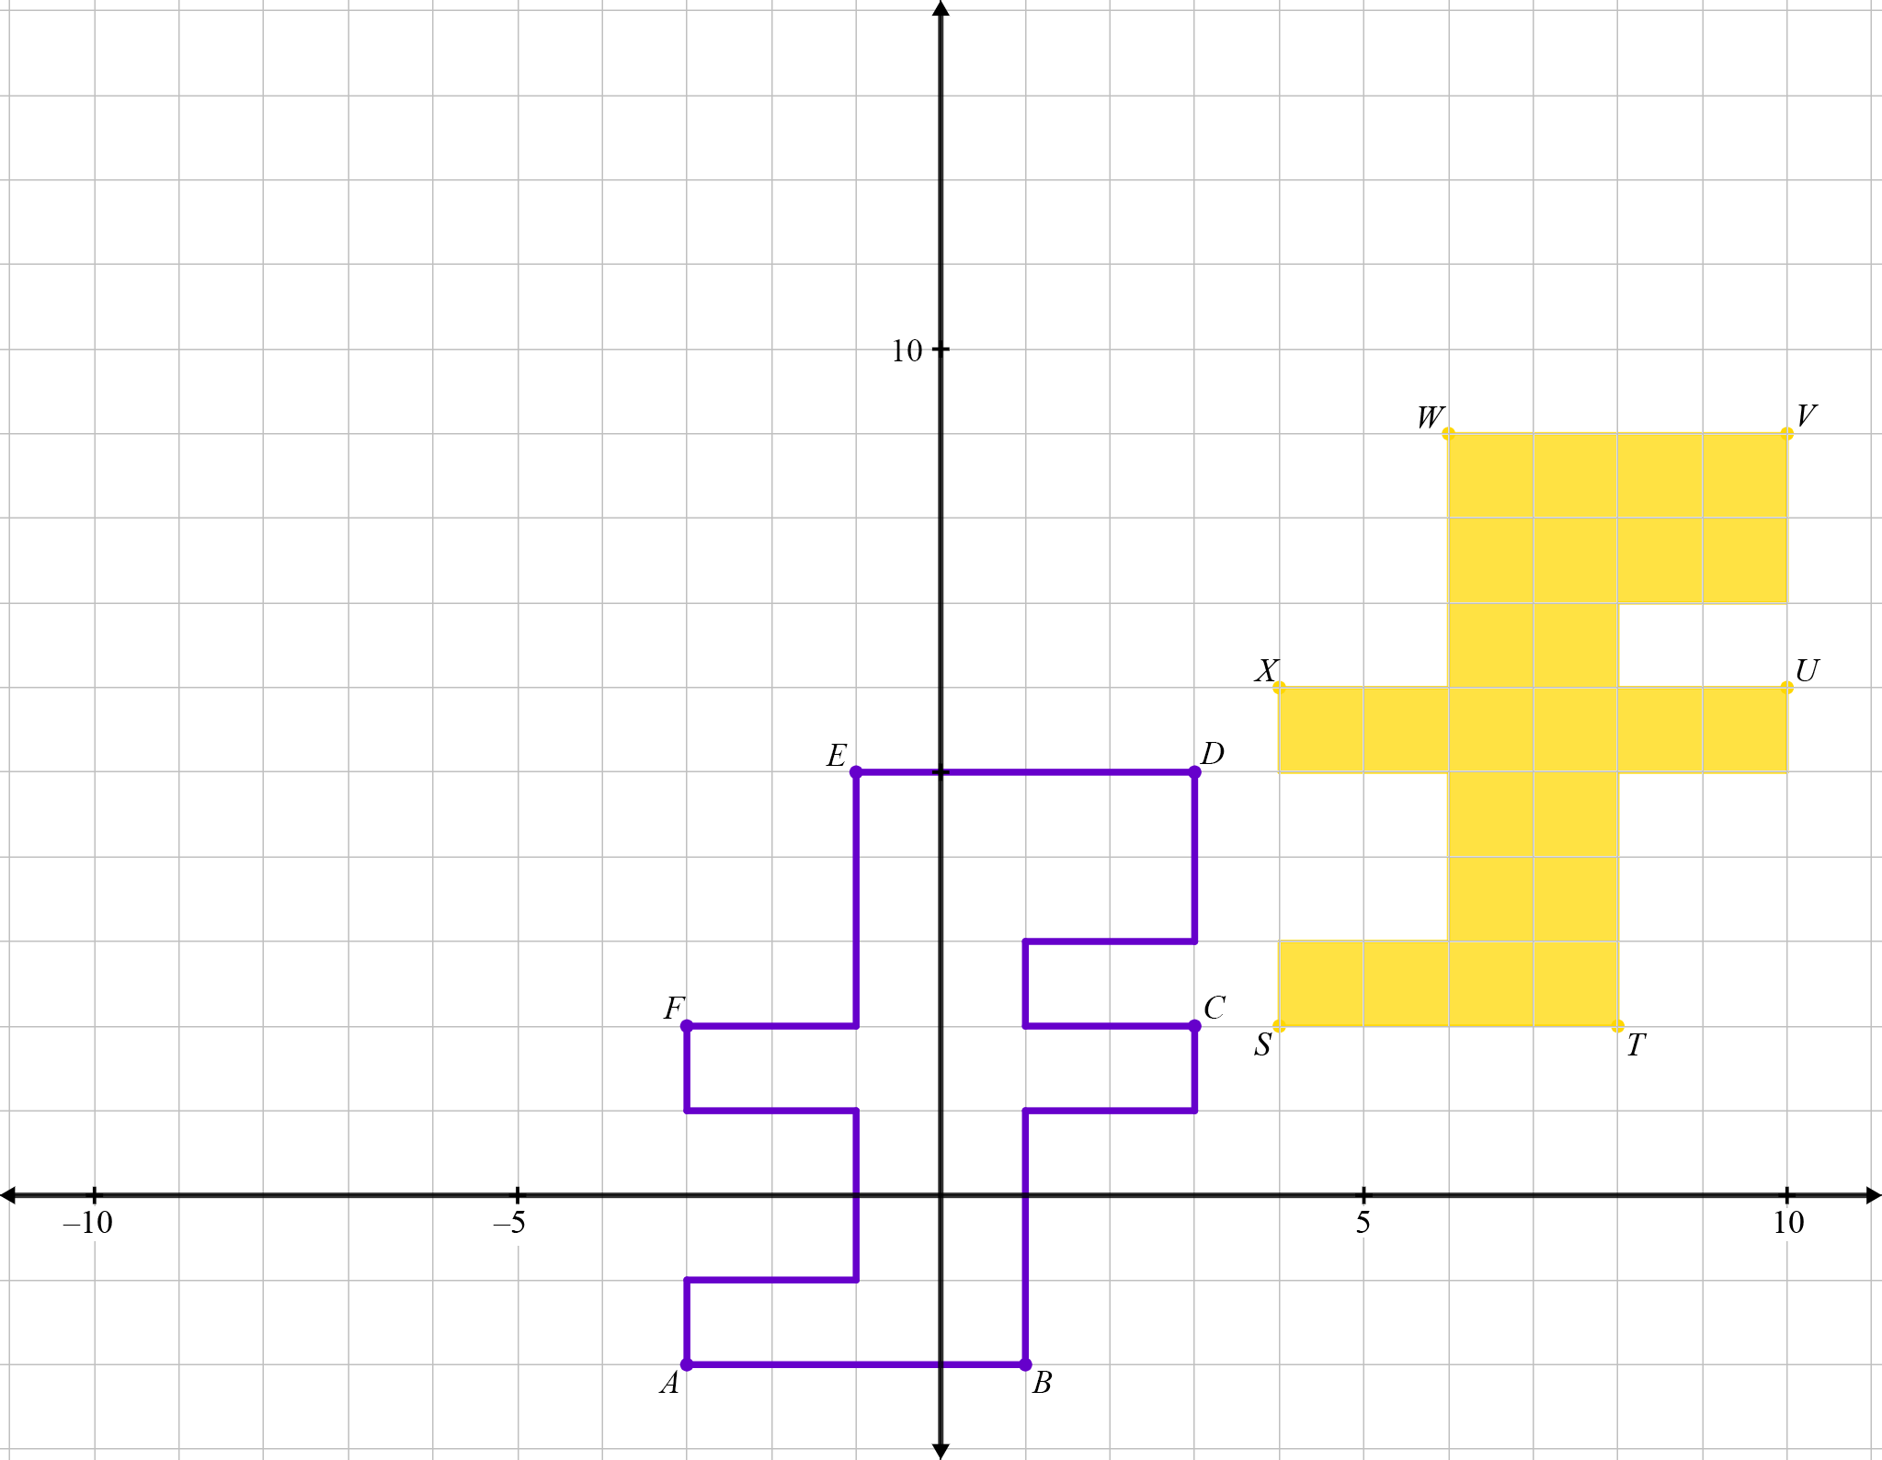
Detailed Designs: Question 3
Initial Image | Final Image

Slide 10
Detailed Designs: I Notice, I Wonder
Comparing all 3 graphs and all 3 tables, is there anything else you noticed?
What do you wonder?
Notes:
K20 Center. (n.d.). I Notice, I Wonder. Strategies. https://learn.k20center.ou.edu/strategy/180

Slide 11
Guided Notes
Let’s complete the Guided Notes together.

Slide 12
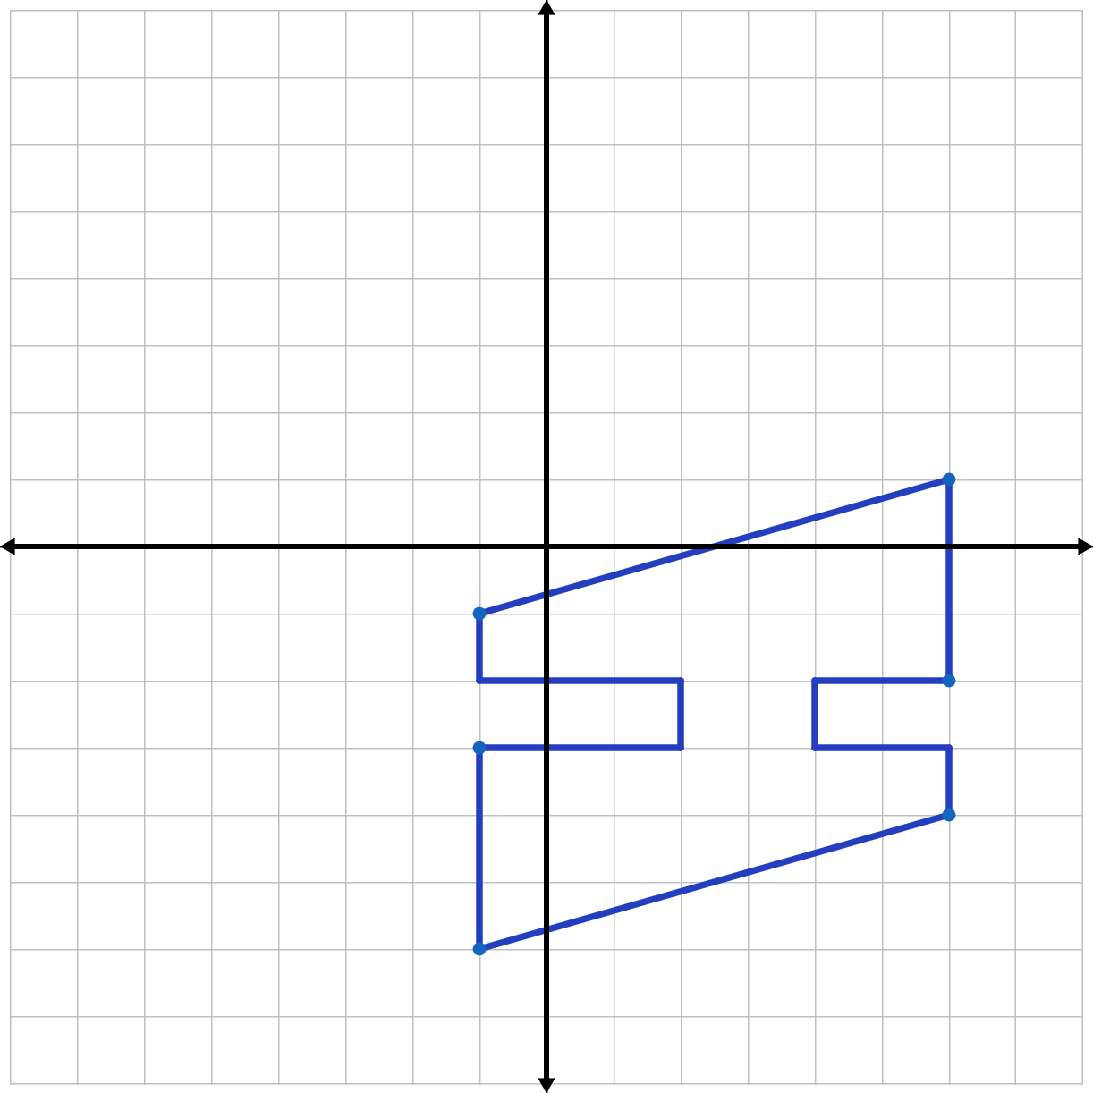
Trying Translations
Work with a partner to draw each translation.
Then choose and label 6 points on the preimage and label the corresponding 6 points on the image.

Slide 13
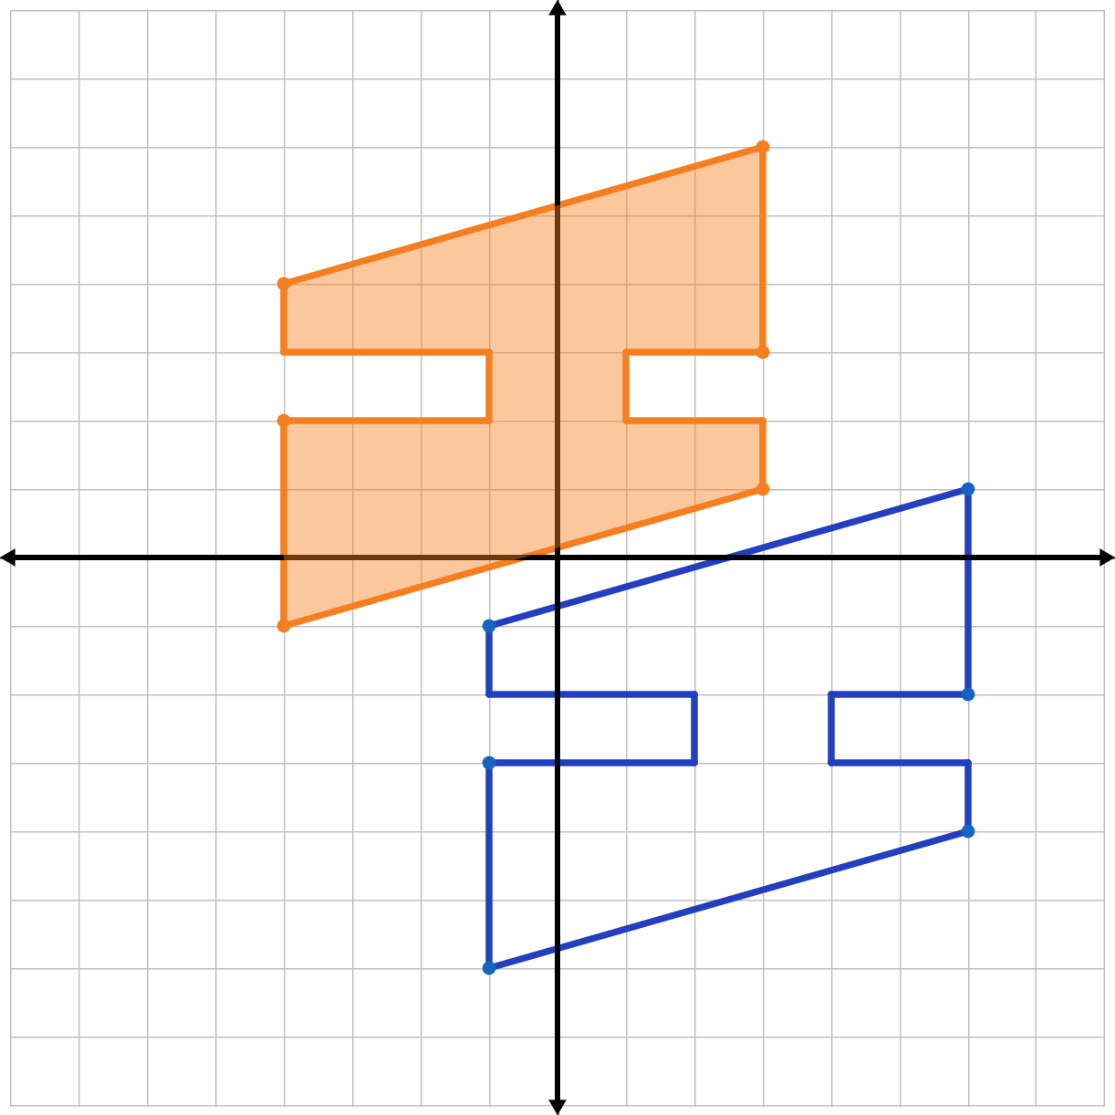
Trying Translations: Question 1
The preimage is translated 3 units left and up 5 units.
Which points did you label?
How did you label the corresponding points?

Slide 14
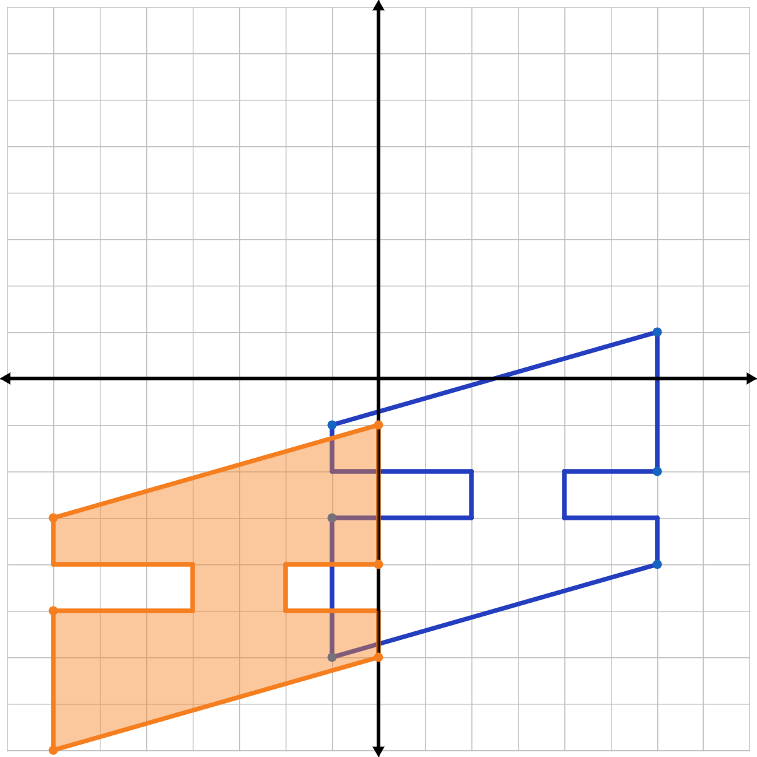
Trying Translations: Question 2
The preimage is translated 3 units left and up 5 units.
Which points did you label?
How did you label the corresponding points?

Slide 15
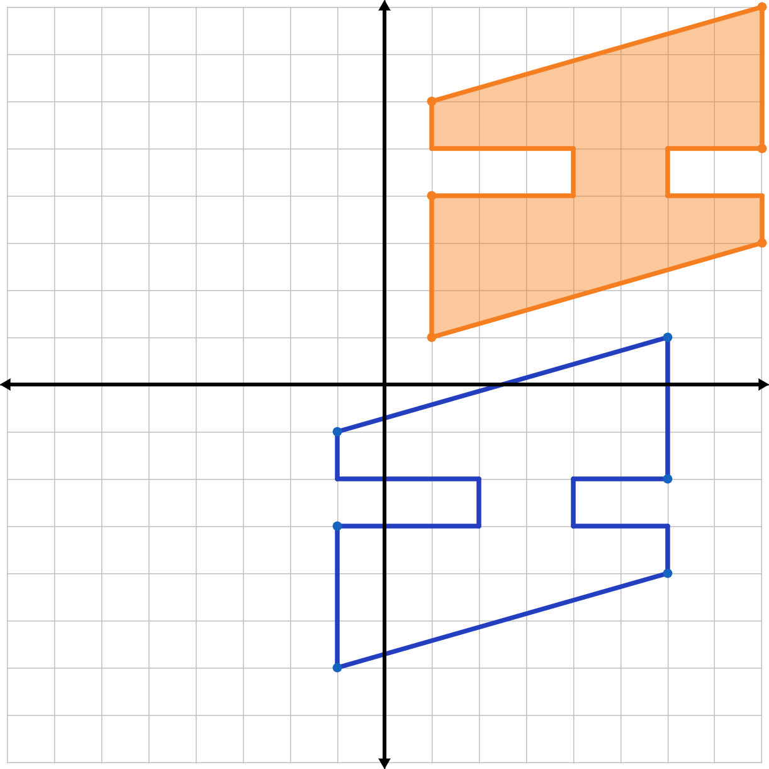
Trying Translations: Question 3
The preimage is translated 3 units left and up 5 units.
Which points did you label?
How did you label the corresponding points?

Slide 16
Inverted Pyramid: Step 1
Individually write the steps for your procedure.
Group 1: How do I describe a translation that I see on a graph as an algebraic rule?
Group 2: How do I describe a translation that I see on a graph as a vector?
Group 3: How do I draw a translation on graph paper when given an algebraic rule?
Group 4: How do I draw a translation on graph paper when given a vector?
Notes:
K20 Center. (n.d.). Inverted Pyramid. Strategies. https://learn.k20center.ou.edu/strategy/173

Slide 17
Inverted Pyramid: Step 2
Find a partner within your group and compare your steps.
What is the same? What is different?
Refine your steps: create the most efficient, yet general steps.
Should it take 5 steps? Could it get done in 3 steps?
Do these steps work for all problems like this?
Group 1: graph → algebraic rule
Group 2: graph → vector
Group 3: algebraic rule → graph
Group 4: vector → graph
Notes:
K20 Center. (n.d.). Inverted Pyramid. Strategies. https://learn.k20center.ou.edu/strategy/173

Slide 18
Inverted Pyramid: Step 3
Get together with everyone from your group and compare your steps.
What is the same? What is different?
Refine your steps: create the most efficient, yet general steps.
Should it take 5 steps? Could it get done in 3 steps?
Do these steps work for all problems like this?
Group 1: graph → algebraic rule
Group 2: graph → vector
Group 3: algebraic rule → graph
Group 4: vector → graph
Notes:
K20 Center. (n.d.). Inverted Pyramid. Strategies. https://learn.k20center.ou.edu/strategy/173

Slide 19
Inverted Pyramid: Step 4
Pick a spokesperson from your group to share the finalized steps with the whole class.
How do we go from one representation to another?
Group 1: graph → algebraic rule
Group 2: graph → vector
Group 3: algebraic rule → graph
Group 4: vector → graph
Notes:
K20 Center. (n.d.). Inverted Pyramid. Strategies. https://learn.k20center.ou.edu/strategy/173

Slide 20
Translating Me
The patterns from Seminole patchwork often represent the creator. Think about how to symbolize something important in your school life, home life, or about your personal interests.
Add this preimage to the jacket, leaving room to translate it twice.
Draw both translations.
Label each figure as preimage, image 1, and image 2.
Notes:
K20 Center. (n.d.). Caption This. Strategies. https://learn.k20center.ou.edu/strategy/82

Slide 21
Translating Me
Trade papers.
Use your partner’s design to describe the two translations.
Describe image 1 with an algebraic rule.
Describe image 2 with a vector.
Notes:
K20 Center. (n.d.). Caption This. Strategies. https://learn.k20center.ou.edu/strategy/82

Slide 22
Translating Me
Check your work with your partner.
Does your translation describe your partner’s work?
Discuss your preimage designs.
How does it represent you?
Write a 1-3 sentence caption for your partner’s jacket design.
Include how it is meaningful to your partner.
Include the math involved.
Notes:
K20 Center. (n.d.). Caption This. Strategies. https://learn.k20center.ou.edu/strategy/82

