Slide 2
Traditional Transformations, Part 2
Reflections: Osage Ribbon Work

Slide 3
Essential Question
How are transformations and symbolism used through indigenous cultures?

Slide 4
Lesson Objectives
Represent coordinate-plane transformations graphically, algebraically, and verbally.
Apply transformations to solve problems.

Slide 5
Osage Ribbonwork and Reflections
You are about to watch a video of Dana Daylight sharing her knowledge of her tribe and the craft of making Osage ribbonwork.
Keep in mind the following questions as you watch the video:
  What is one new thing you learned from this video?
  What is one thing that you already knew?

Slide 6
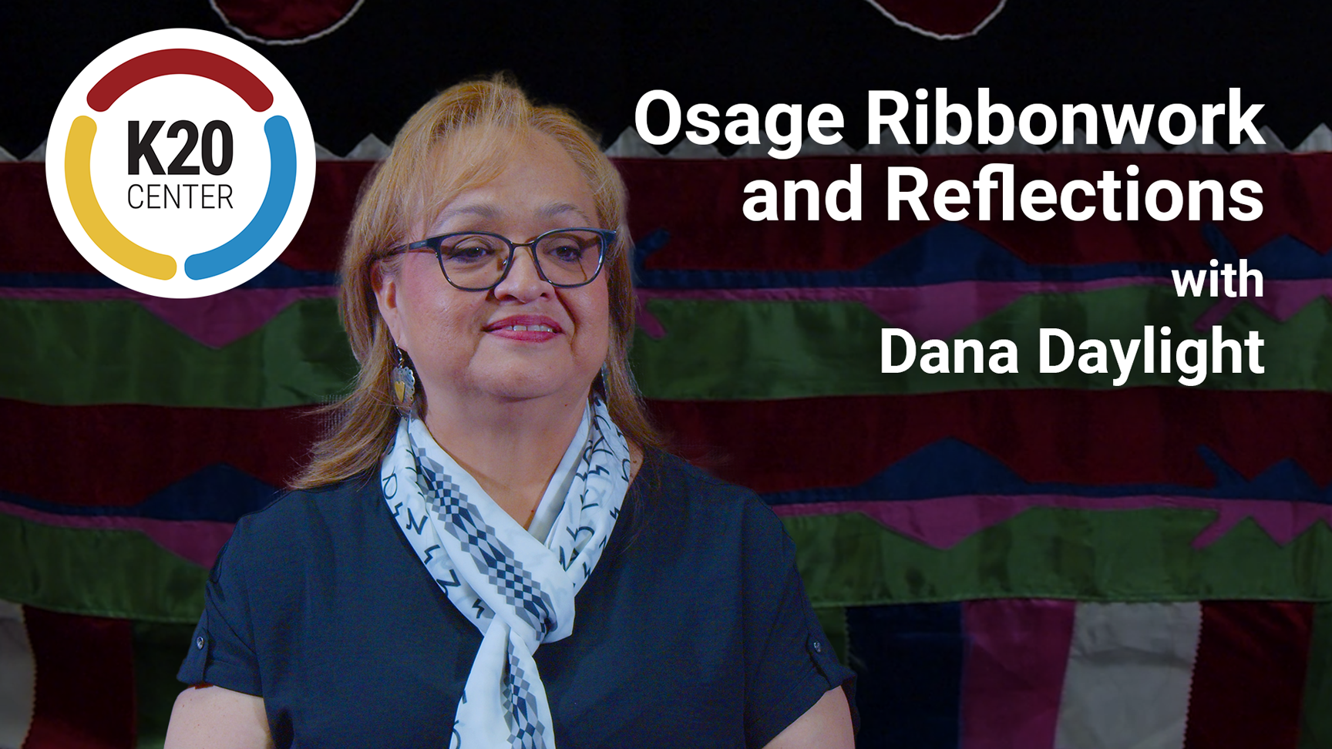
Osage Ribbonwork and Reflections
Notes:
K20 Center. (2023, July 5). Osage ribbonwork and reflections [Video]. YouTube. https://youtu.be/CCU7hBirn9c?si=hDNjlL8FbxcZELAV

Slide 7

Osage Ribbon Work and Reflections
Think about what Dana Daylight shared about her culture and the mathematics of her ribbonwork. Discuss with your partner the following:
What is one new thing you learned?
What is one thing that you already knew?
Notes:
K20 Center. (n.d.). Elbow Partners. Strategies. https://learn.k20center.ou.edu/strategy/116

Slide 8
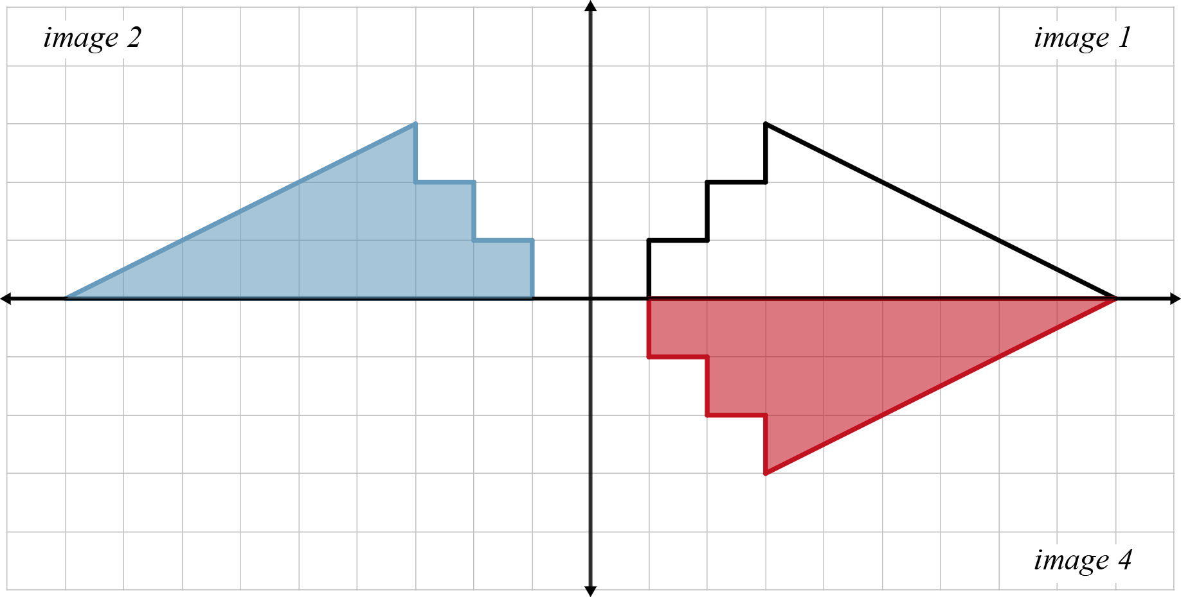
Exploring Ribbonwork
Work individually to complete the pattern
on the graph. Then answer the following prompts:
How did you complete the pattern?
Describe how the preimage transformed into image 2.
Describe how the preimage transformed into image 4.

Slide 9
Exploring Ribbon Work
Work with a partner to complete the tables and answer questions 4-7 on your handout.

Slide 10
Guided Notes
Let’s complete the Guided Notes together.

Slide 11


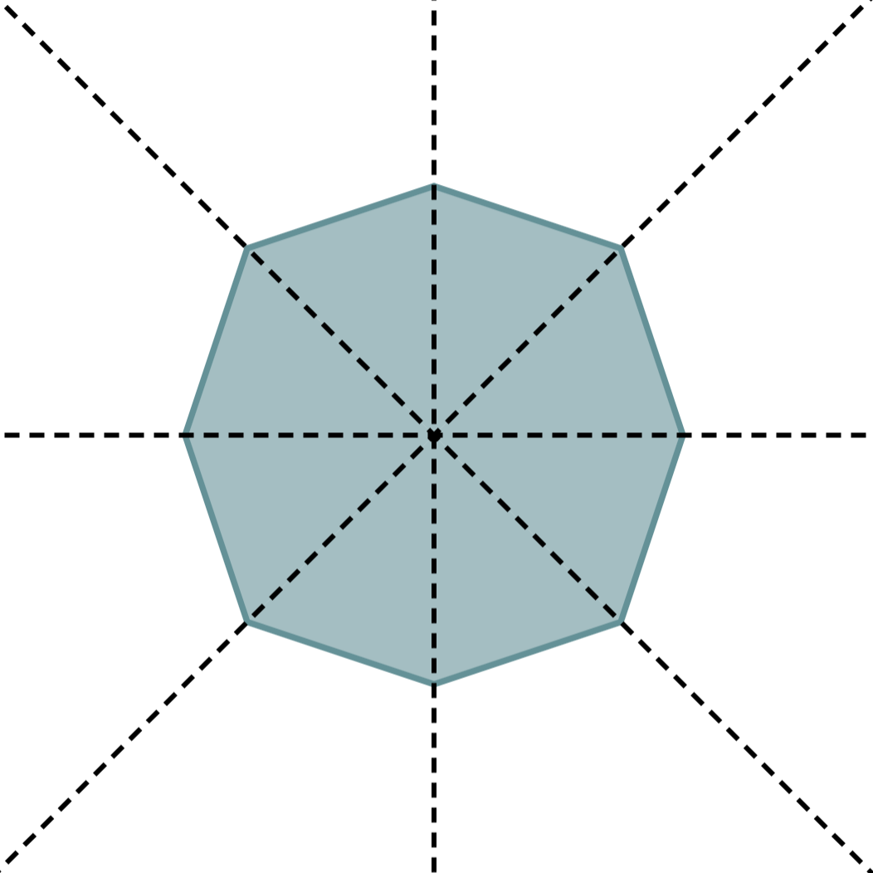
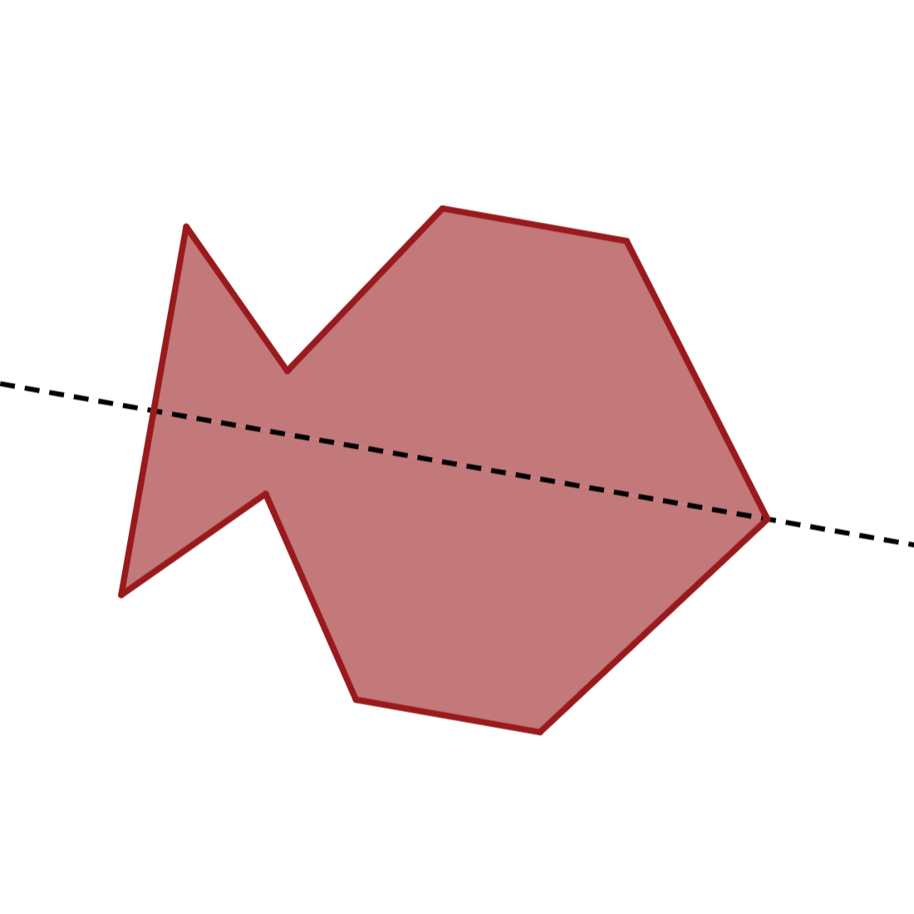
Seeing Symmetry
A line of symmetry cuts a figure into two mirror images.

Slide 12
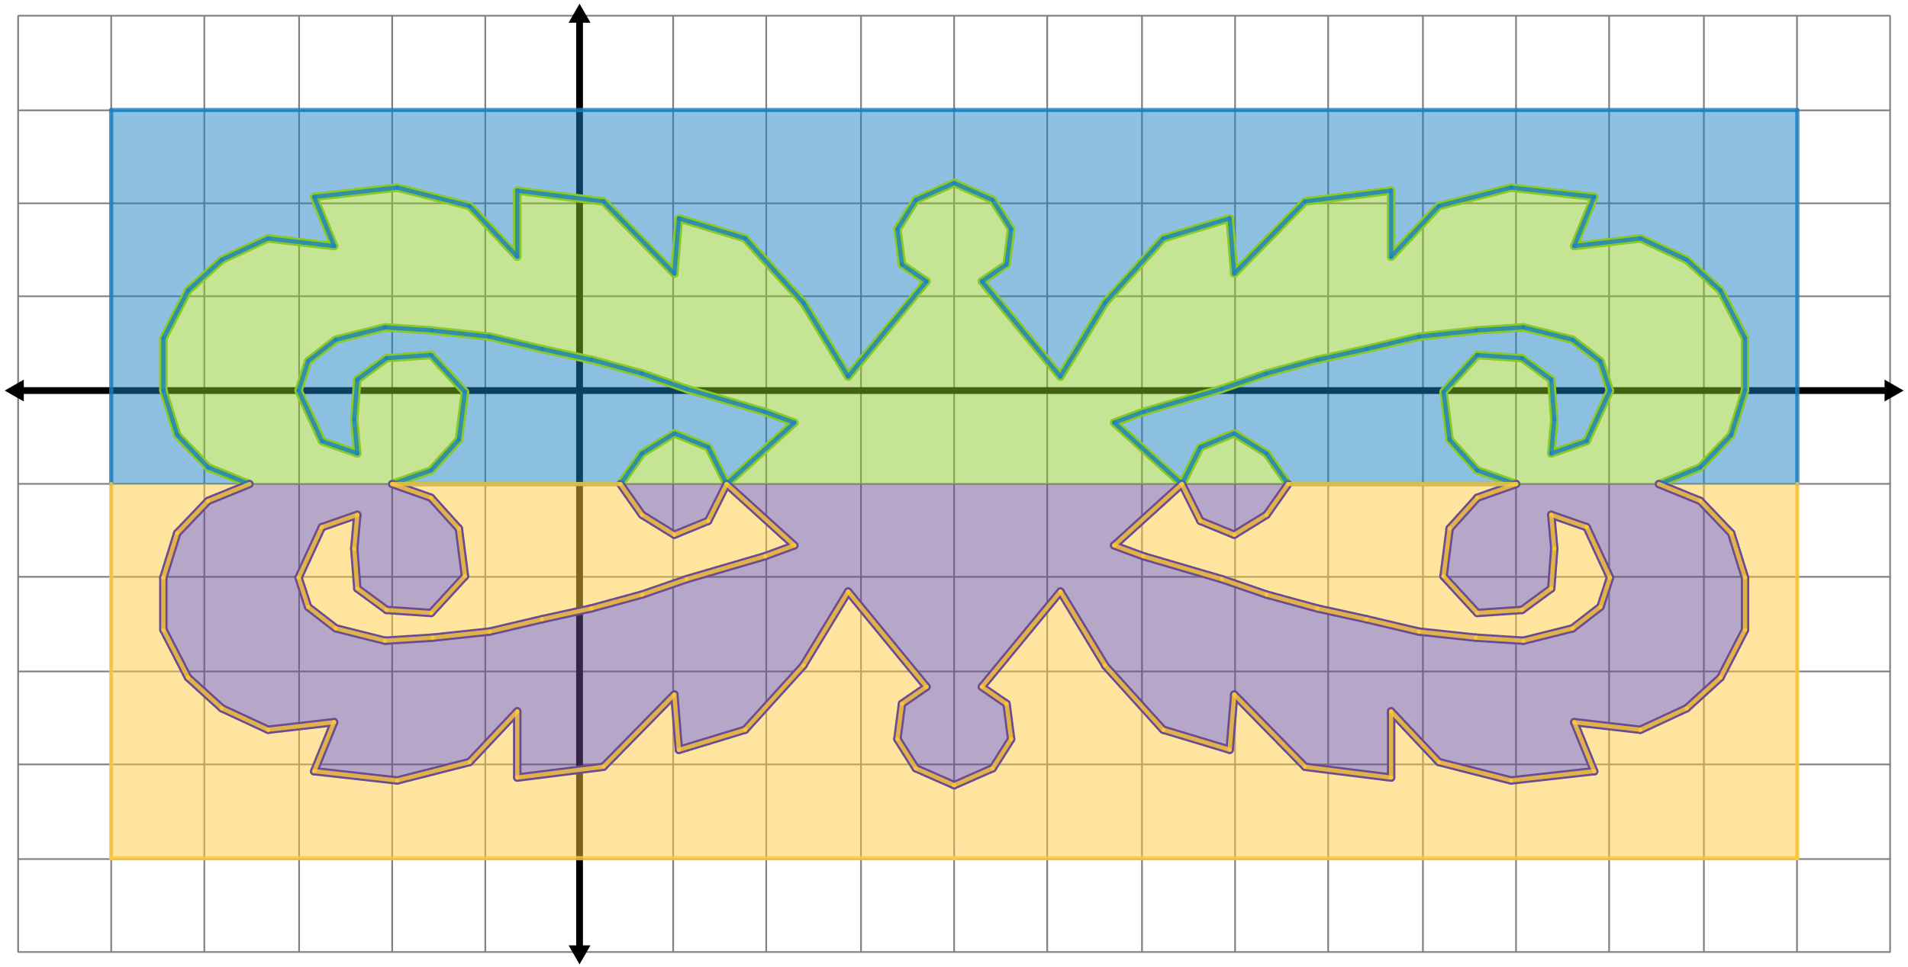
Seeing Symmetry: Question 1
What the line(s) of symmetry does the figure have?

Slide 13
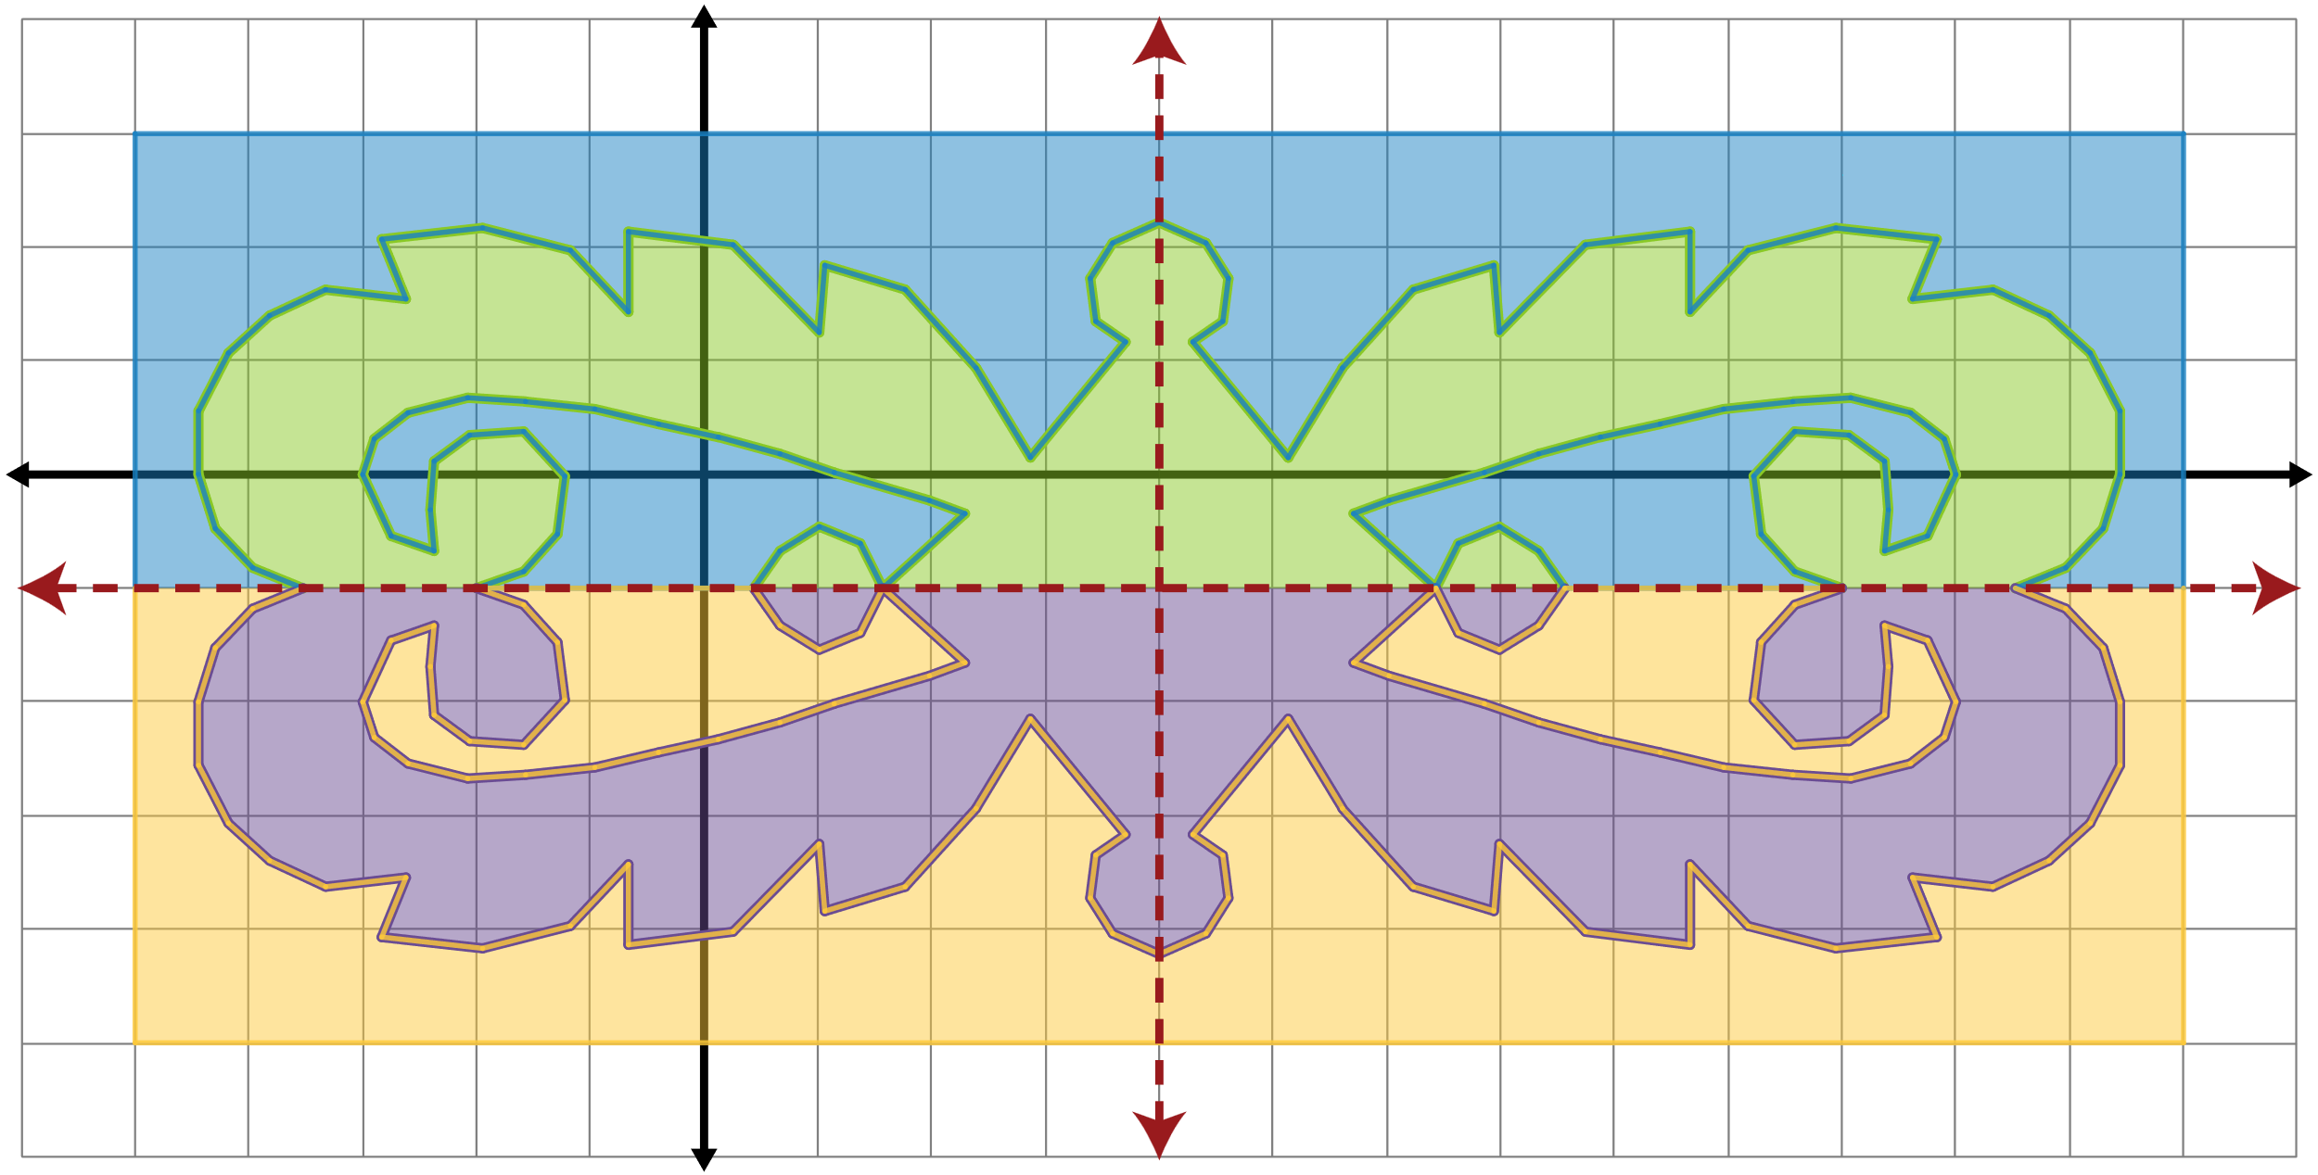
Seeing Symmetry: Question 1 (Solution)
The lines of symmetry are
x = 4 and y = –1.

Slide 14
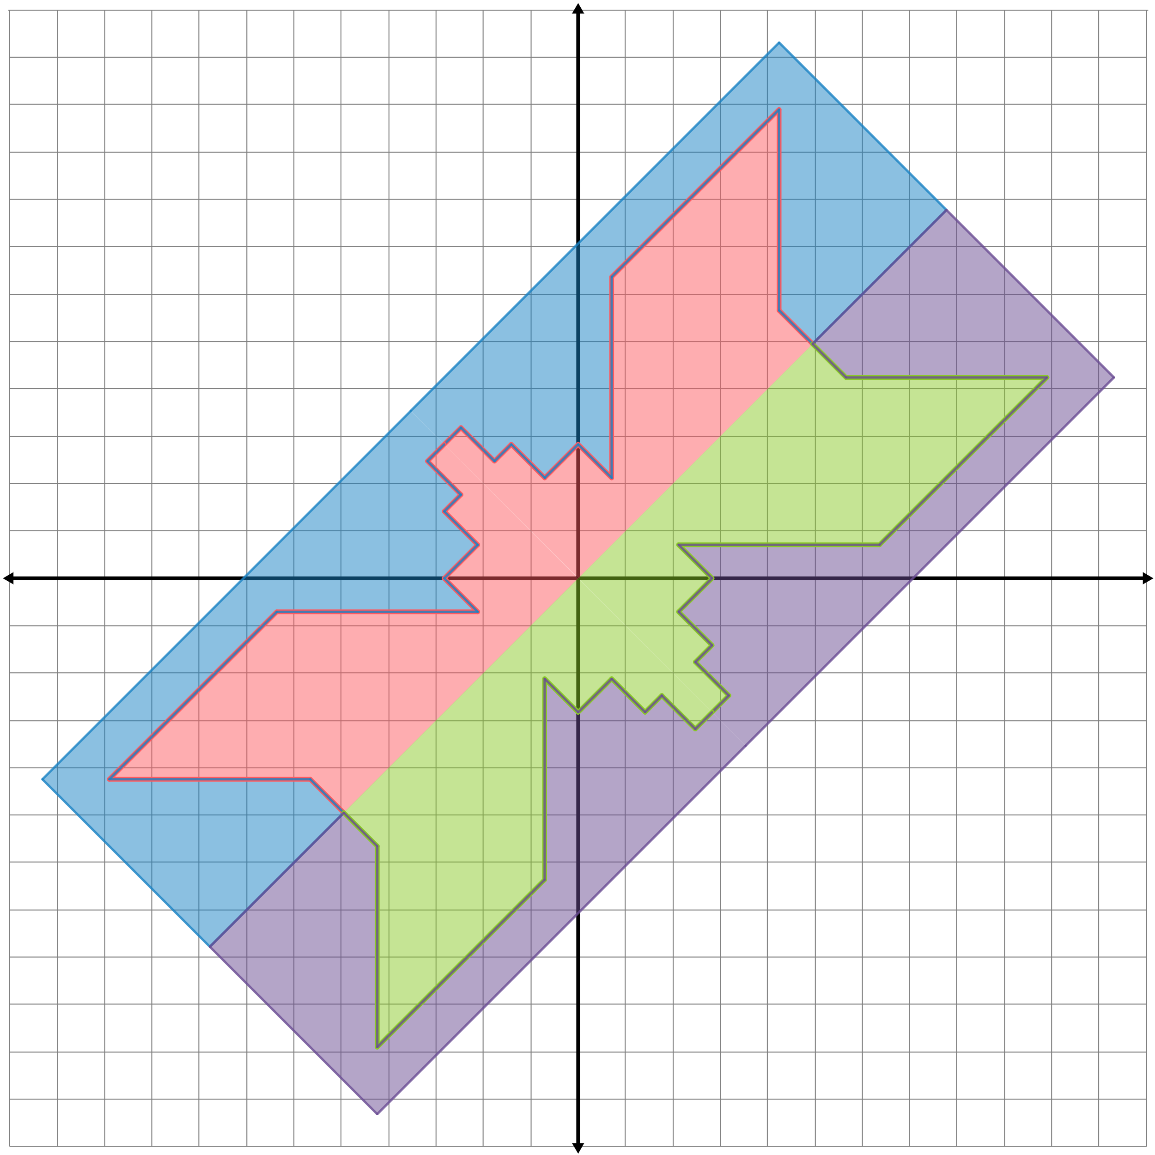
Seeing Symmetry: Question 2
What the line(s) of symmetry does the figure have?

Slide 15
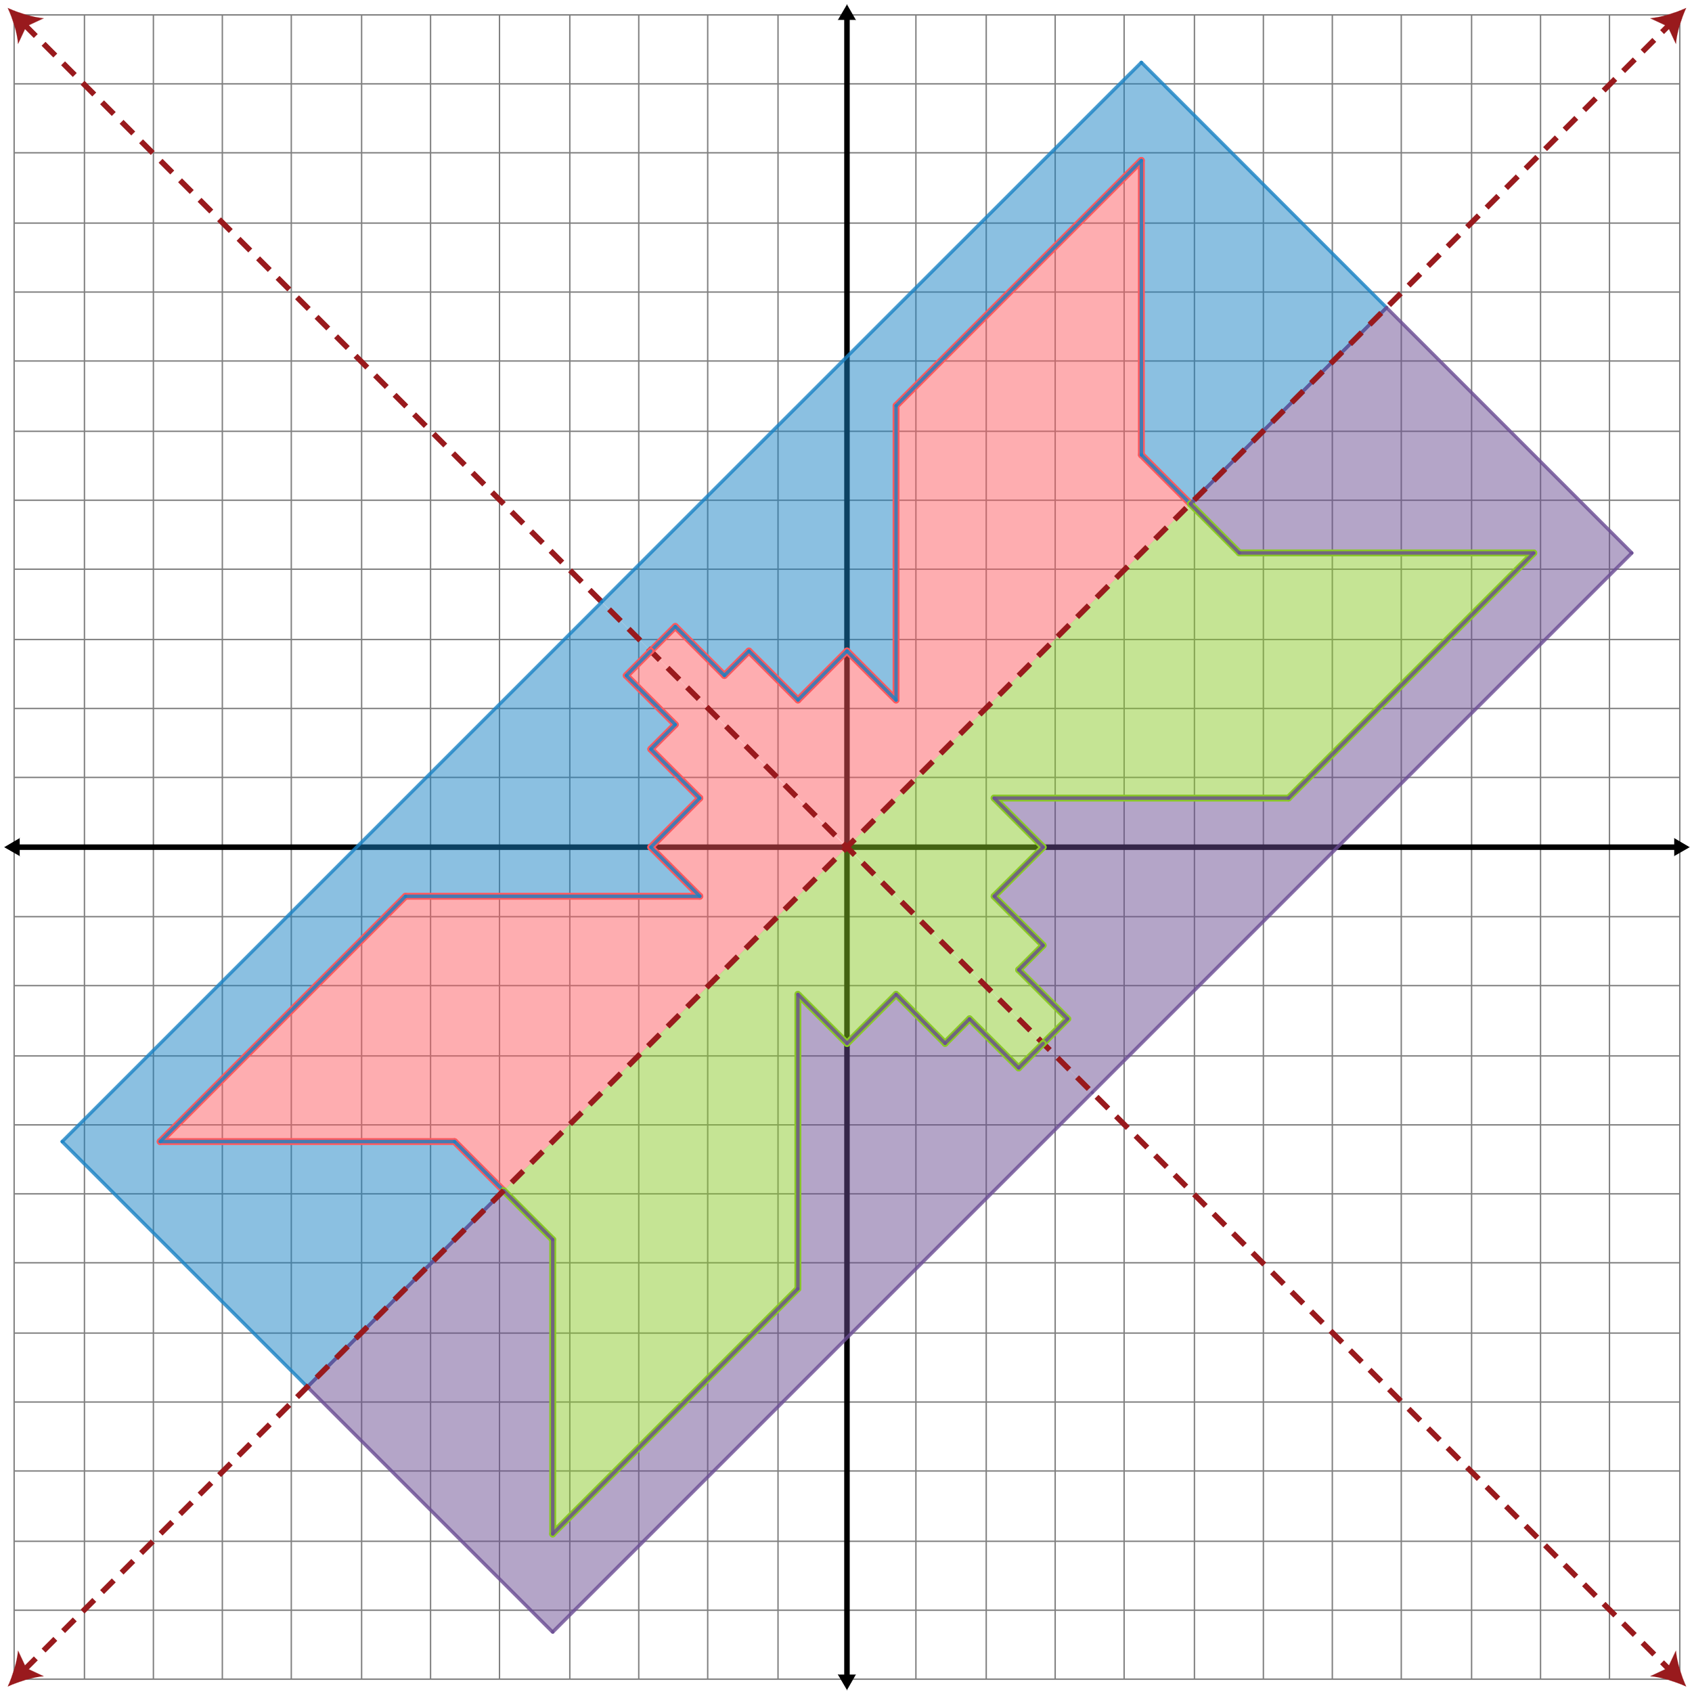
Seeing Symmetry: Question 2 (Solution)
The lines of symmetry are
y = x and y = –x.

Slide 16
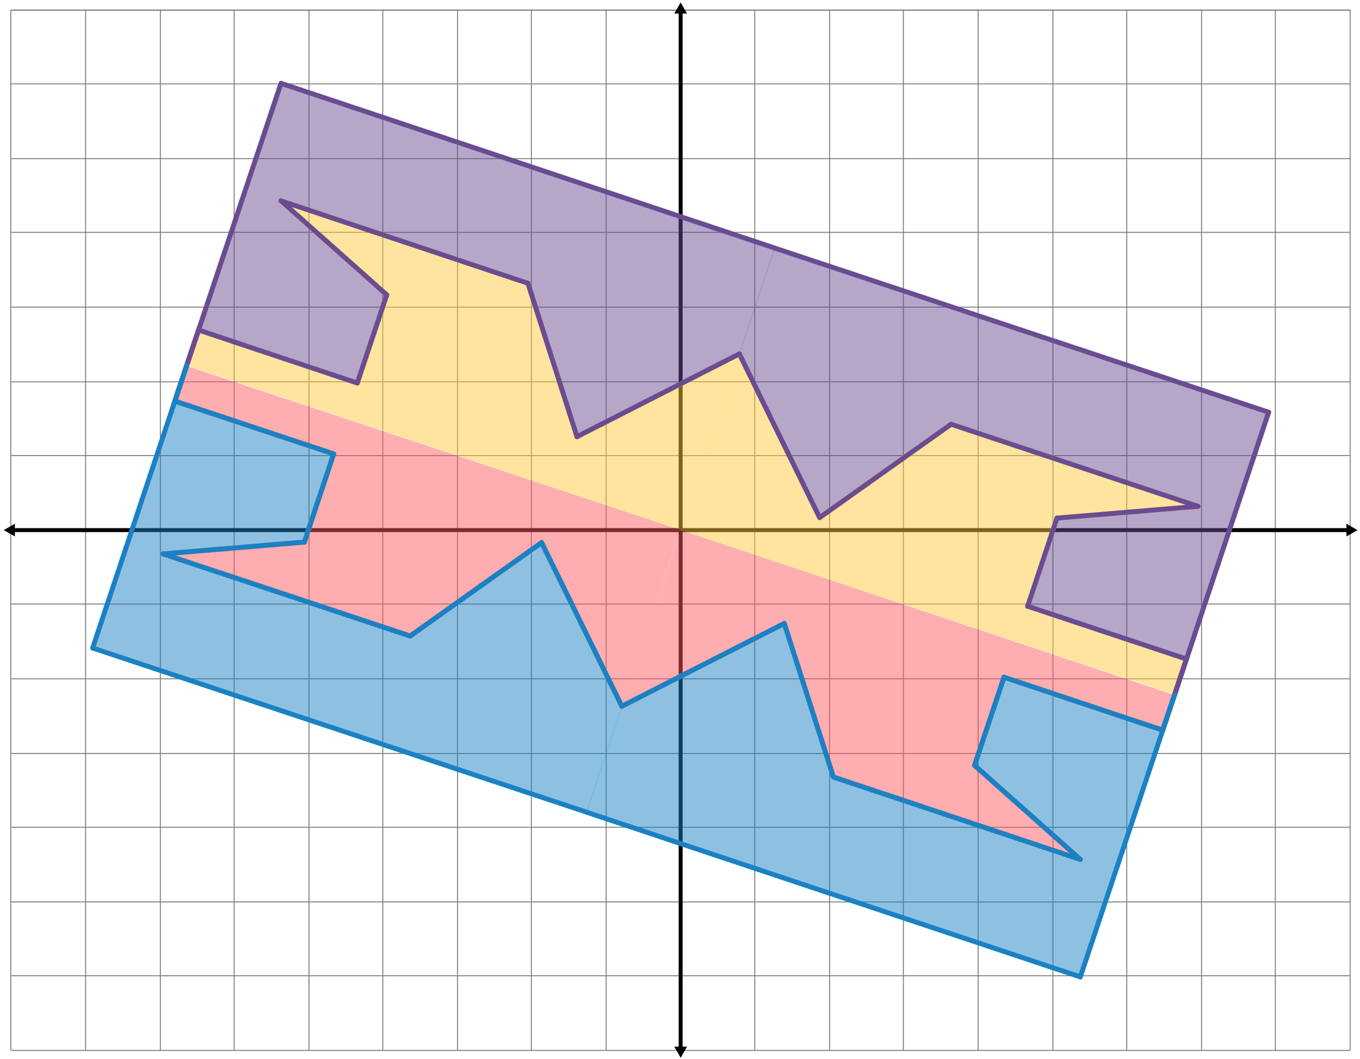
Seeing Symmetry: Question 3
What the line(s) of symmetry does the figure have?

Slide 17

Seeing Symmetry: Question 3 (Solution)
The lines of symmetry are

Slide 18
Symmetry in Our World
Where else do you see reflective symmetry?
Think of something that is in this room or something that is familiar to you that has only 1 line of symmetry.
Think of something that is in this room or something that is familiar to you that has zero lines of symmetry.
What is an example of something that has 2 lines of symmetry? What about more than 2 lines of symmetry?

Slide 19
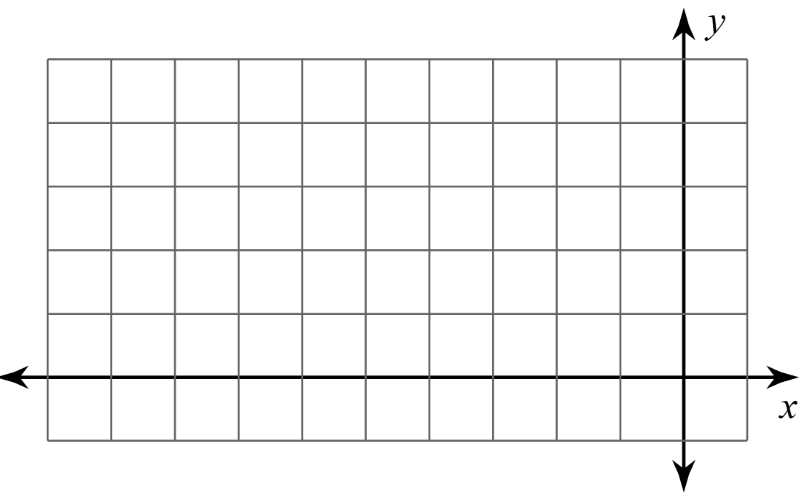
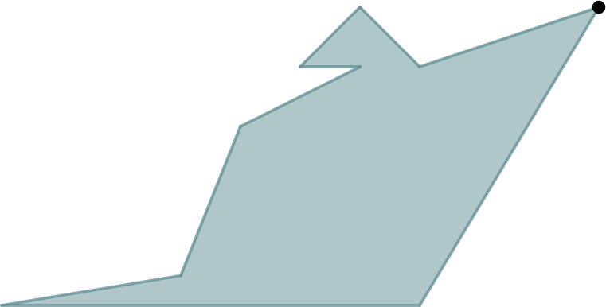
Perfecting Patterns: Step 1
Write your name on your paper for Student A.
Create your own preimage
design in Quadrant II.
  Be creative!
Notes:
K20 Center. (n.d.). Pass the Problem. Strategies. https://learn.k20center.ou.edu/strategy/151

Slide 20
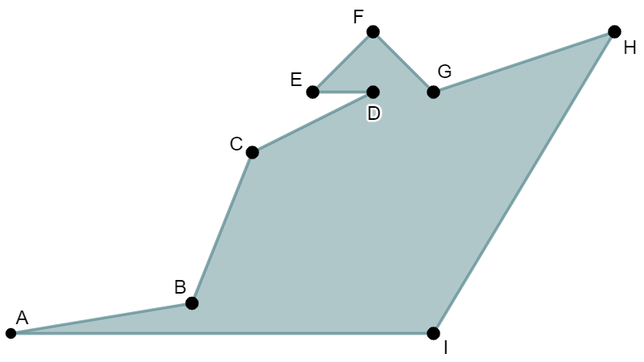
Perfecting Patterns: Step 2
Pass your paper to your right. You are now Student B.
Label the vertices of
Student A’s design.
Imagine their preimage is
reflected over the x-axis.
Create a table and identify
the new corresponding ordered pairs.
Notes:
K20 Center. (n.d.). Pass the Problem. Strategies. https://learn.k20center.ou.edu/strategy/151

Slide 21
Perfecting Patterns: Step 3
Pass your paper to your right. You are now Student C.
Check Student B’s work.
Imagine the preimage is
reflected over the y-axis.
Create a table and identify
the new corresponding
ordered pairs.
Notes:
K20 Center. (n.d.). Pass the Problem. Strategies. https://learn.k20center.ou.edu/strategy/151

Slide 22
Perfecting Patterns: Step 4
Pass your paper back to Student A.
Copy your preimage onto a piece of graph paper.
Plot the points from Student B’s and Student C’s tables.
Are their points reflections of the vertices of your preimage?
Notes:
K20 Center. (n.d.). Pass the Problem. Strategies. https://learn.k20center.ou.edu/strategy/151

Slide 23
Perfecting Patterns: Step 5
Complete your design in Quadrant IV by using the
reflective symmetry of your choice:
over the x-axis or over the y-axis.
Use 4 colors to color your ribbonwork design. Remember to contrast light and dark colors like the Osage tribe does.
Cut out your ribbonwork and use it as a bookmark!
Notes:
K20 Center. (n.d.). Pass the Problem. Strategies. https://learn.k20center.ou.edu/strategy/151

Slide 24

Over the Line
What are the coordinates of the point B′
after reflecting B(1, –3) over the line x = –7?
Notes:
K20 Center. (n.d.). Bell Ringers and Exit Tickets. Strategies. https://learn.k20center.ou.edu/strategy/125

Slide 25
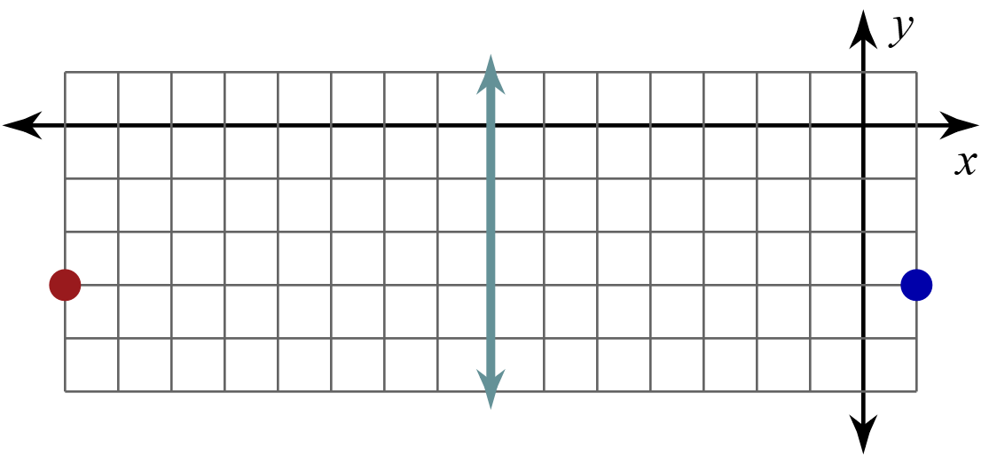
Over the Line (Solution)
x = –7 is a vertical line, so this is a horizontal reflection.
This means that the x-value will change and the y-value will not change.
B(1, –3) is 8 units to the right of x = –7, so B′ needs to be 8 units to the left of x = –7.
Therefore, B′ is at (–15, –3).
Notes:
K20 Center. (n.d.). Bell Ringers and Exit Tickets. Strategies. https://learn.k20center.ou.edu/strategy/125

