Slide 2
Traditional Transformations, Part 3
Rotations: Plains Star Quilts

Slide 3
Essential Question
How are transformations and symbolism used through indigenous cultures?

Slide 4
Lesson Objectives
Represent coordinate-plane transformations graphically, algebraically, and verbally.
Apply transformations to solve problems.

Slide 5

Plains Star Quilts
You are about to watch a video of
Crystal Pewo Lightfoot talking about her
tribal culture and craft of making Star Quilts.
After the video, you will write two hashtags to represent:
  a cultural aspect you learned
  a mathematical concept you learned
Notes:
K20 Center. (n.d.). GramIt. Strategies. https://learn.k20center.ou.edu/strategy/2554

Slide 6
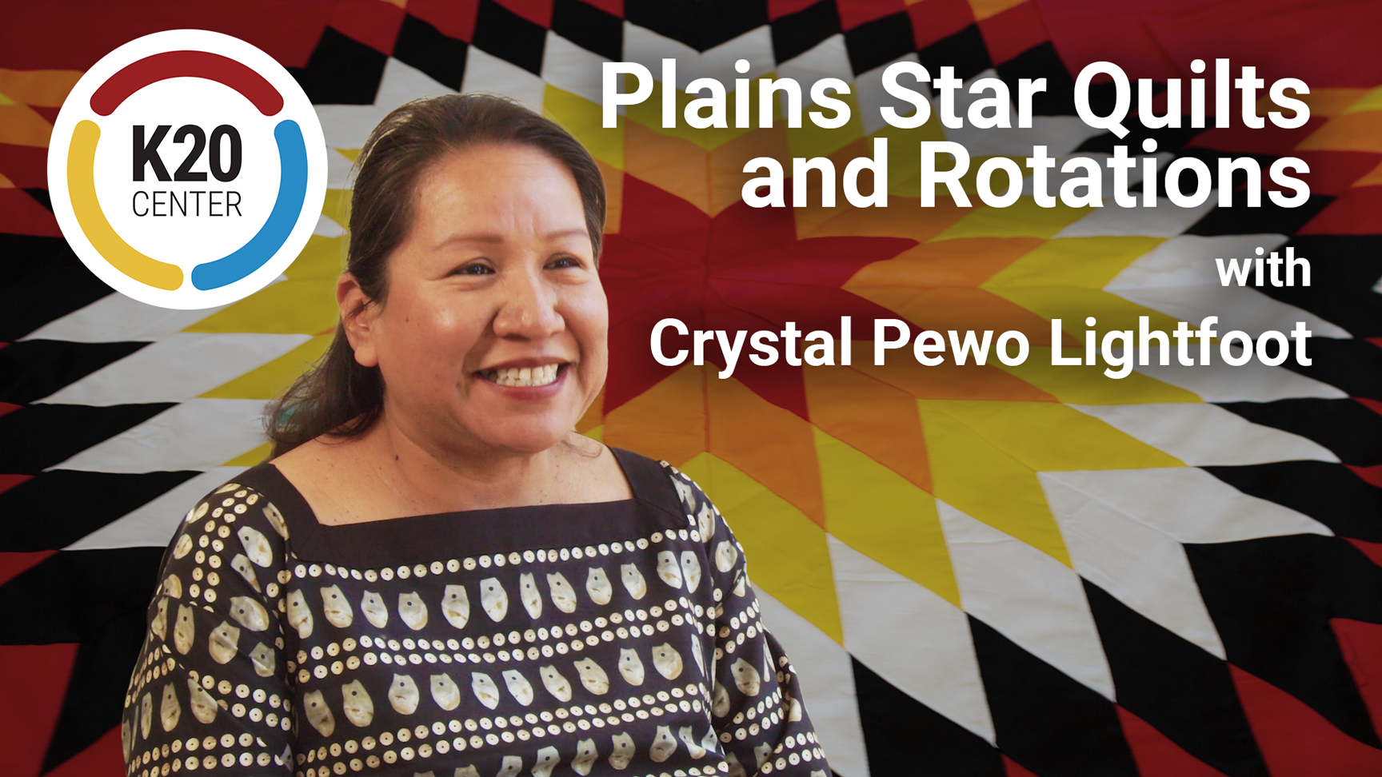
Plains Star Quilts and Rotations
Notes:
K20 Center (2023, July 5). Plains star quilts and rotations [Video]. YouTube. https://youtu.be/YJxmt0dt3mw

Slide 7
Plains Star Quilts
Write two hashtags to represent:
a cultural aspect you learned
a mathematical concept you learned
Notes:
K20 Center. (n.d.). GramIt. Strategies. https://learn.k20center.ou.edu/strategy/2554

Slide 8
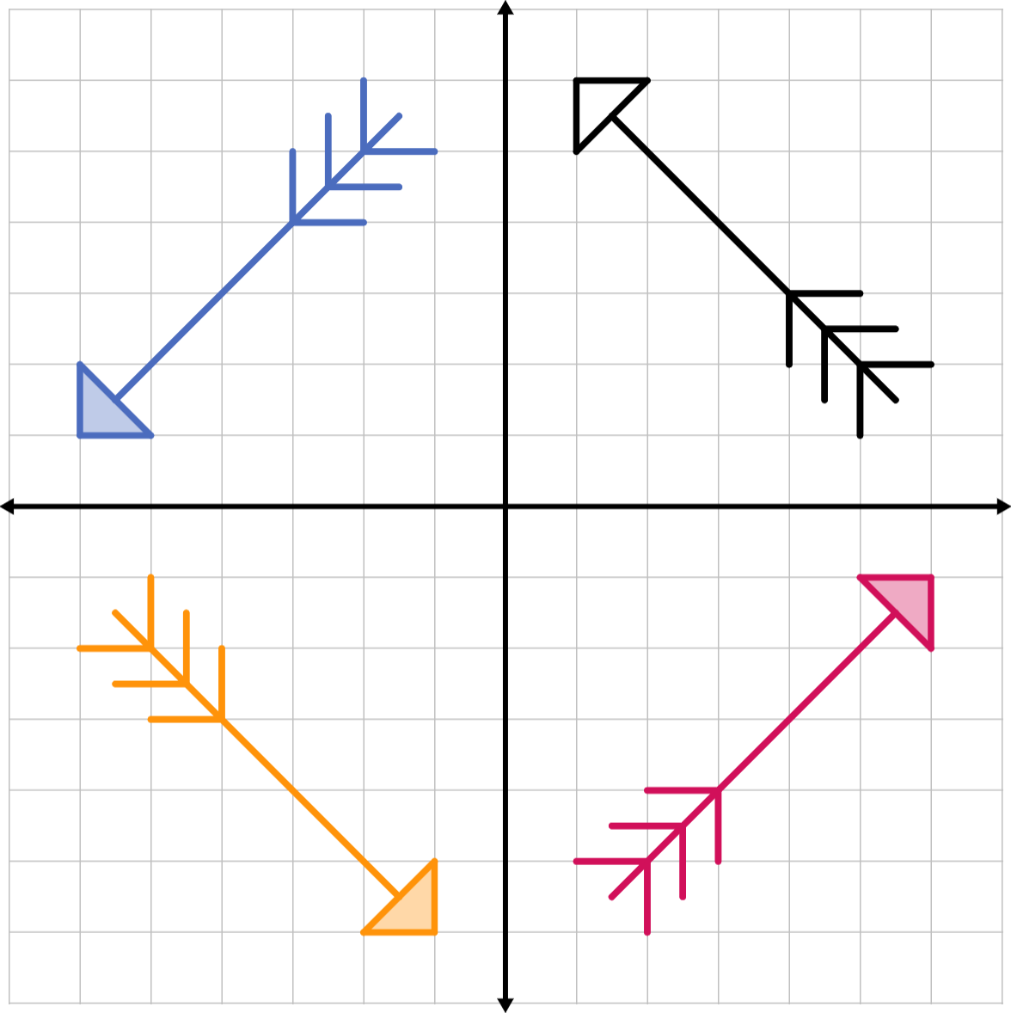
Tribal Transformations
Work with your partner to complete each table.
Try your best to write an algebraic rule for each transformation.
Describe how each image was transformed from the preimage.

Slide 9
Guided Notes
Let’s complete the Guided Notes together.

Slide 10
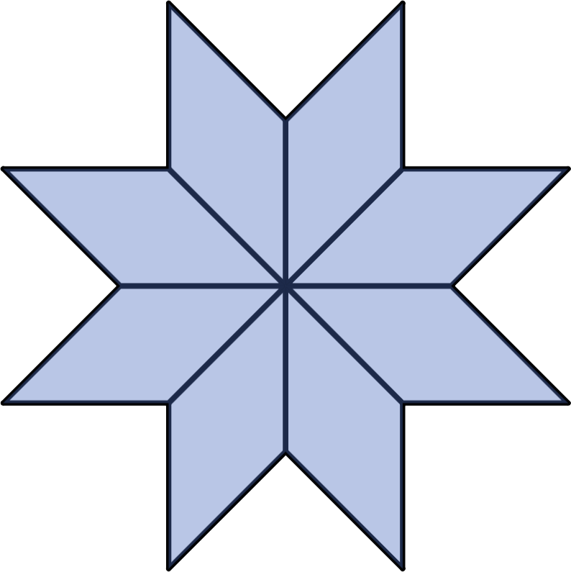
Seeing Symmetry
A figure has rotational symmetry
if the figure can be rotated about
its center and remains the same.
This center is known as the
center of symmetry.
  The angle of rotation cannot be a
  multiple of 360°.

Slide 11
Seeing Symmetry in Our World
Where else do you see rotational symmetry?
Think of something that is in this room or something else that is familiar to you that has rotational symmetry.

Slide 12

Star Quilt Transformations
Label 1 rhombus as the preimage.
Select three additional colors, one for each transformation: translation,
reflection, and rotation.
Color-code your star quilt to
indicate which transformation
is applied to produce the rhombus.
  By the end of this activity, some rhombi may be left uncolored.

Slide 13
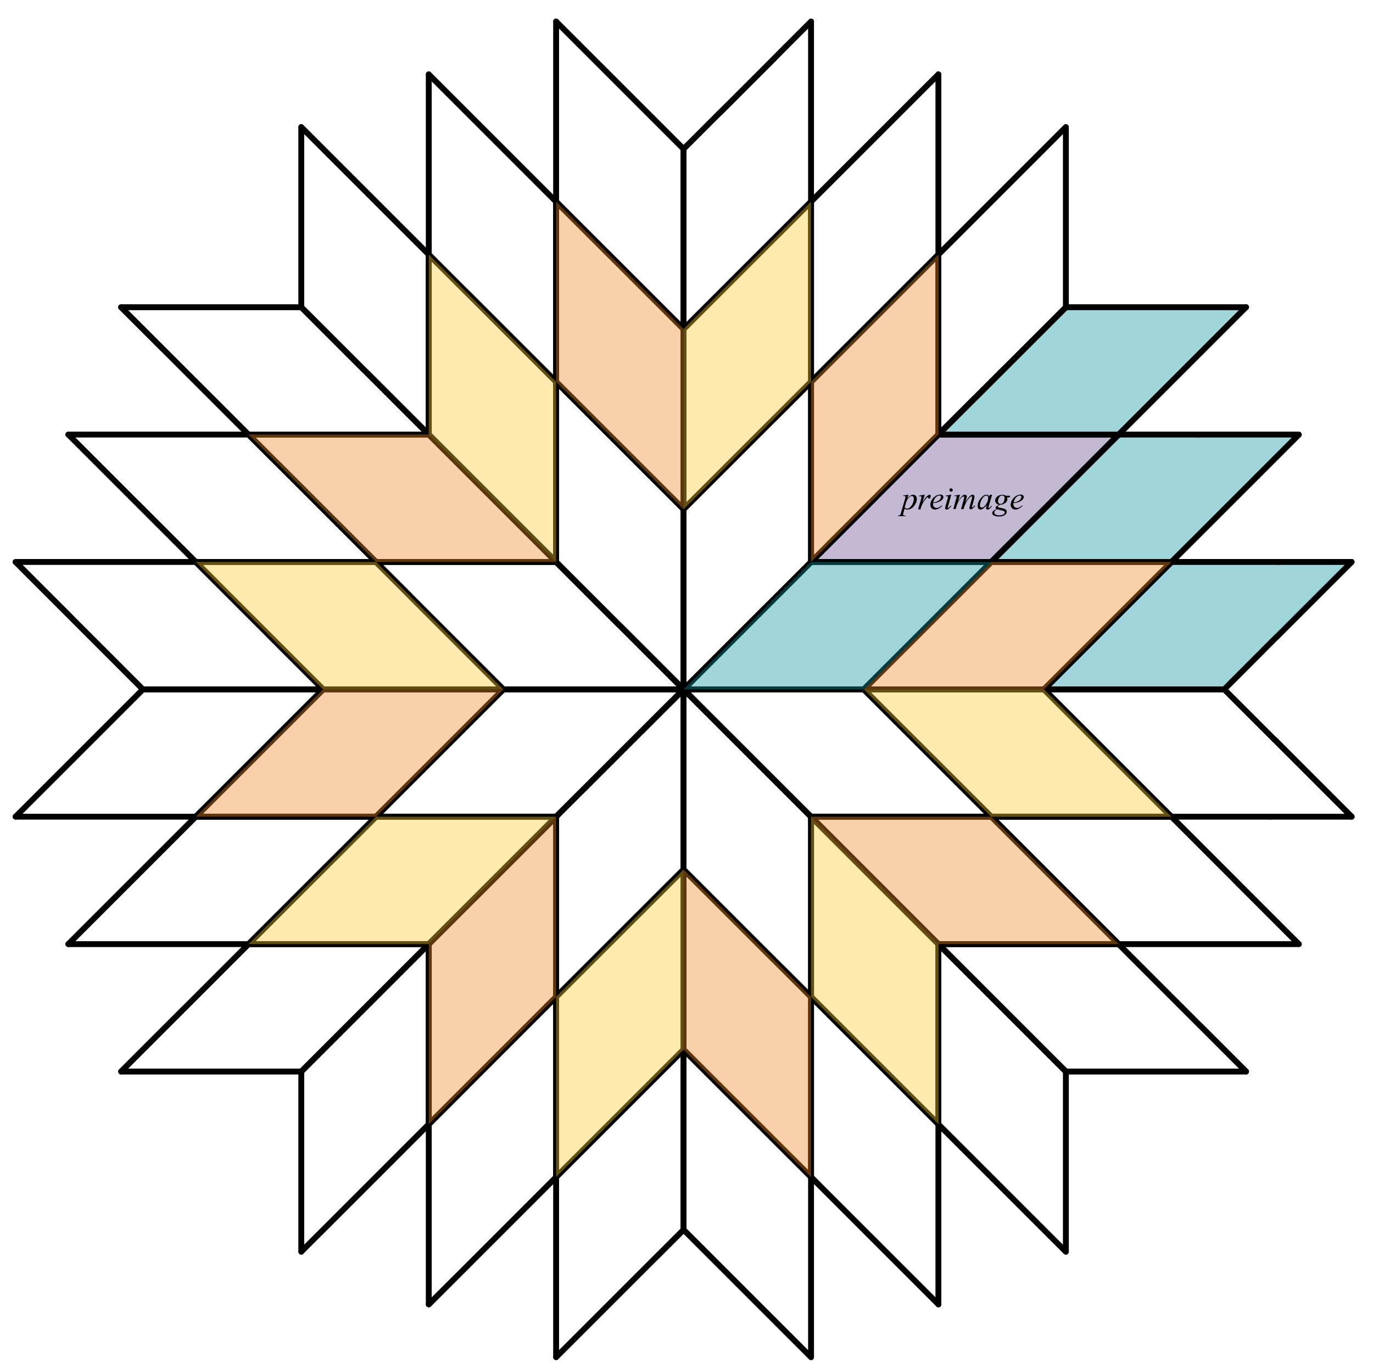
Star Quilt Transformations (Sample Response)
Preimage | Translation | Reflection | Rotation

Slide 14
Creating Quilt Blocks: Overview
Create a unique quilt block that is inspired by the Plains Star Quilt.
Your design may be a tessellation but is not required to be.
You will create a preimage then work with your neighbors to rotate it about the origin for three different degree measurements.
Notes:
K20 Center. (n.d.). Pass the Problem. Strategies. https://learn.k20center.ou.edu/strategy/151

Slide 15
Creating Quilt Blocks: Step 1
Create your own preimage polygon in Quadrant III.
Label at least four vertices.
Notes:
K20 Center. (n.d.). Pass the Problem. Strategies. https://learn.k20center.ou.edu/strategy/151

Slide 16
Creating Quilt Blocks: Step 2
Pass your paper to the person on your right.
Use your neighbor’s preimage and rotate it 270° about the origin.
Draw the rotated figure.
Label the corresponding vertices.
Notes:
K20 Center. (n.d.). Pass the Problem. Strategies. https://learn.k20center.ou.edu/strategy/151

Slide 17
Creating Quilt Blocks: Step 3
Pass your paper to the person on your right.
Check the accuracy of the image drawn in Quadrant II.
Use the preimage in Quadrant III, rotate it 180° about the origin.
Label the corresponding vertices.
Notes:
K20 Center. (n.d.). Pass the Problem. Strategies. https://learn.k20center.ou.edu/strategy/151

Slide 18
Creating Quilt Blocks: Step 4
Pass your paper to the person on your right.
Check the accuracy of the image drawn in Quadrant I.
Use the preimage in Quadrant III, rotate it 90° about the origin.
Label the corresponding vertices.
Notes:
K20 Center. (n.d.). Pass the Problem. Strategies. https://learn.k20center.ou.edu/strategy/151

Slide 19
Creating Quilt Blocks: Step 5
Pass your paper to the person on your right.
Check the accuracy of the image drawn in Quadrant IV.
Does your quilt block have rotational symmetry?
Notes:
K20 Center. (n.d.). Pass the Problem. Strategies. https://learn.k20center.ou.edu/strategy/151

Slide 20

Exit Ticket
If point B(–3, 1) is rotated 180° around
point A(2, –1), what are the point’s
new coordinates?
Notes:
K20 Center. (n.d.). Bell Ringers and Exit Tickets. Strategies. https://learn.k20center.ou.edu/strategy/125

Slide 21
Exit Ticket (Solution)
To get from point A to point B, we
would go left 5 and up 2 units.
A rotation of 180° means that we go the opposite direction, so to get from point A to point B′, we need to go right 5 and down 2 units.
This means that point B′ is at (7, –3).
Notes:
K20 Center. (n.d.). Bell Ringers and Exit Tickets. Strategies. https://learn.k20center.ou.edu/strategy/125

