Slide 2
Traditional Transformations, Part 4
Dilations: Beadwork

Slide 3
Essential Question
How are transformations and symbolism used through indigenous cultures?

Slide 4
Lesson Objectives
Represent coordinate-plane transformations graphically, algebraically, and verbally.
Apply transformations to solve problems.

Slide 5
Beadwork
Notes:
K20 Center. (2023, July 5). Beadwork [Video]. YouTube. https://youtu.be/szdE303Sdqk

Slide 6
Beadwork
Discuss what you learned from the video.
Why is beadwork made?
How could someone represent their culture with beadwork?
Why do you think she uses a larger bead to make a larger design?
Notes:
K20 Center. (n.d.). Elbow Partners. Strategies. https://learn.k20center.ou.edu/strategy/116

Slide 7
Exploring Transformations: Part A
Go to the GeoGebra activity: geogebra.org/m/ecyvtdfg
Spend time exploring the GeoGebra applets and see how things work.
Use the GeoGebra applets and follow the directions to complete Part A (the front) of your handout.
What does k seem to do?
What does point Z seem to do?

Slide 8
Exploring Transformations: Part B
As you follow the directions in GeoGebra for Part B, review your responses for Part A.
Do they still hold true?
Do any need revision?
Make changes to Part A as needed.
What does k seem to do?
What does point Z seem to do?

Slide 9
Exploring Transformations: Part C
Use the GeoGebra Part C applet and follow the directions to complete Part C (on the back) of your handout.
What did you notice about the lines through the vertices?
What did you notice about the ratios of the side lengths?
What do you think this means?

Slide 10
Exploring Transformations: Part D
Use the GeoGebra Part D applet and follow the directions to complete Part D (on the back) of your handout.
What did you notice about the distances from point Z to the preimage compared to the distances from point Z to the image?
What do you think this means?

Slide 11
Exploring Transformations: Prediction Time
What do you think happens when k < 0?

Slide 12
Guided Notes
Let’s complete the Guided Notes together.

Slide 13
Dilations in Our World
Where else do you see dilations?
Think of something that is in this room or something that is familiar to you that relates to dilations.

Slide 14
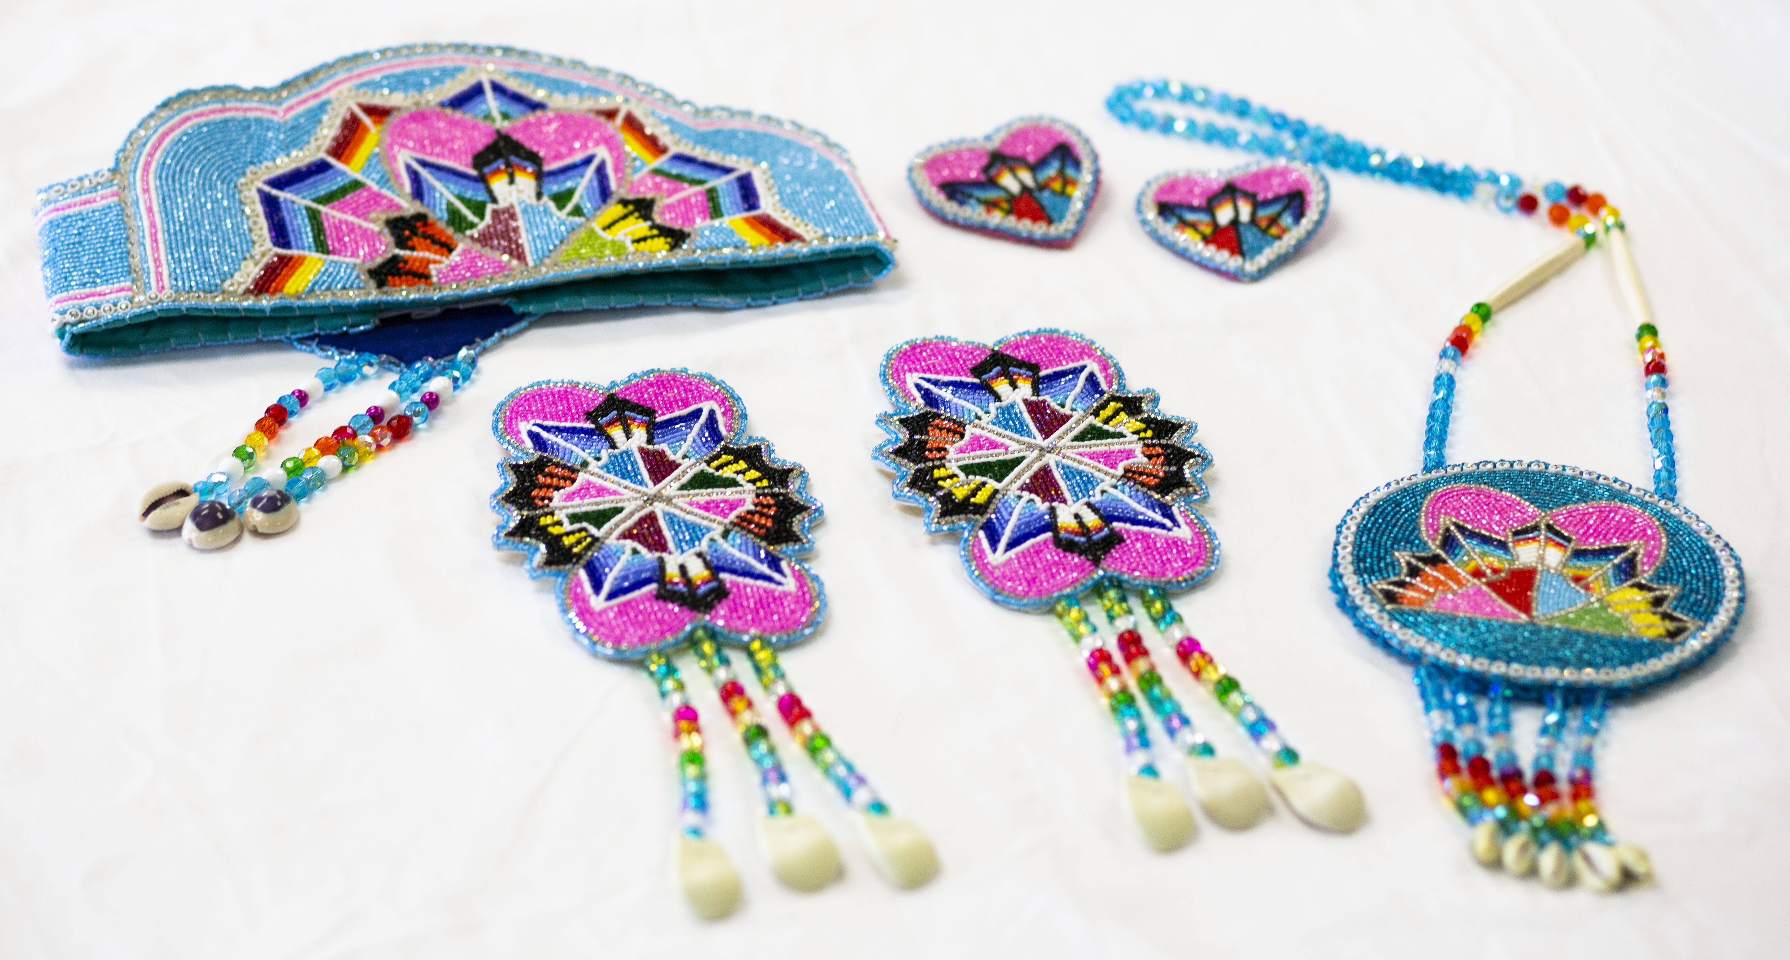
Designing Beadwork
Create your own beadwork design.
Imagine that it would be worn around the wrist or cuff like a bracelet.
Be sure that your preimage is a polygon with 6 vertices.
Label your vertices.
Notes:
McDaniels-Gomez, P. (2022). [Beadwork]. Oklahoma, USA.

Slide 15
Designing Beadwork
Trade papers.
Create a complementary vest design for your partner using a dilation.
Dilate your partner’s design using k = 2.
Label the corresponding vertices.

Slide 16
Dilation Exit Ticket
Consider the transformation of the standard (x, y) coordinate plane that maps each point (x, y) to the image (kx, ky) for a certain positive constant, k. This transformation maps (4, 16) to (1, 4).
To what image does this transformation map (–12, 4)?
Notes:
K20 Center. (n.d.). Bell Ringers and Exit Tickets. Strategies. https://learn.k20center.ou.edu/strategy/125

Slide 17
Dilation Exit Ticket (Solution)
If (4, 16) maps to (1, 4), then we find the scale factor by finding the ratio of the image to preimage:
Then multiply the x-values and y-values of the point (– 12, 4) by k (or divide by 4 in this case).
This means that (– 12, 4) maps to (–3, 1).
Notes:
K20 Center. (n.d.). Bell Ringers and Exit Tickets. Strategies. https://learn.k20center.ou.edu/strategy/125

