Slide 2
Traditional Transformations, Part 5
Compositions of Transformations: Fashion Design

Slide 3
Essential Question
How are transformations and symbolism used through indigenous cultures?

Slide 4
Lesson Objectives
Represent coordinate-plane transformations graphically, algebraically, and verbally.
Apply transformations to solve problems.

Slide 5

Apparel Designing and Culture
Notes:
K20 Center. (2023, July 5). K20 ICAP - Apparel designing and culture [Video]. YouTube. https://youtu.be/nKjKx2iDJnM

Slide 6

Card Sort
Go to student.desmos.com.
Sort the cards into one of the following categories:
  Translations
  Reflections
  Rotations
  Dilations
Make sure each category has at least 2 cards.
Be ready to explain your reasoning.
Notes:
K20 Center. (n.d.). Card Sort. Strategies. https://learn.k20center.ou.edu/strategy/147

Slide 7

Card Sort: Helpful Tips
Use full-screen mode.
  Click the expanding arrows in the center of the top pane of the window.
Organize the cards as if they were on your desk.
Condense or expand a stack of cards.
  Click the arrow at the bottom of the stack.
Click on a card to enlarge that image.
Notes:
K20 Center. (n.d.). Card Sort. Strategies. https://learn.k20center.ou.edu/strategy/147

Slide 8

Identity Chart
Next to the arrows, write what you have
learned about indigenous culture while
studying transformations. Consider the following:
What forms of artwork were showcased?
How do indigenous tribes continue to practice their culture today?
What have you learned about First American cultures?
How do the artists use math to create their art?
Notes:
K20 Center. (n.d.). Identity Chart. Strategies. https://learn.k20center.ou.edu/strategy/2729

Slide 9
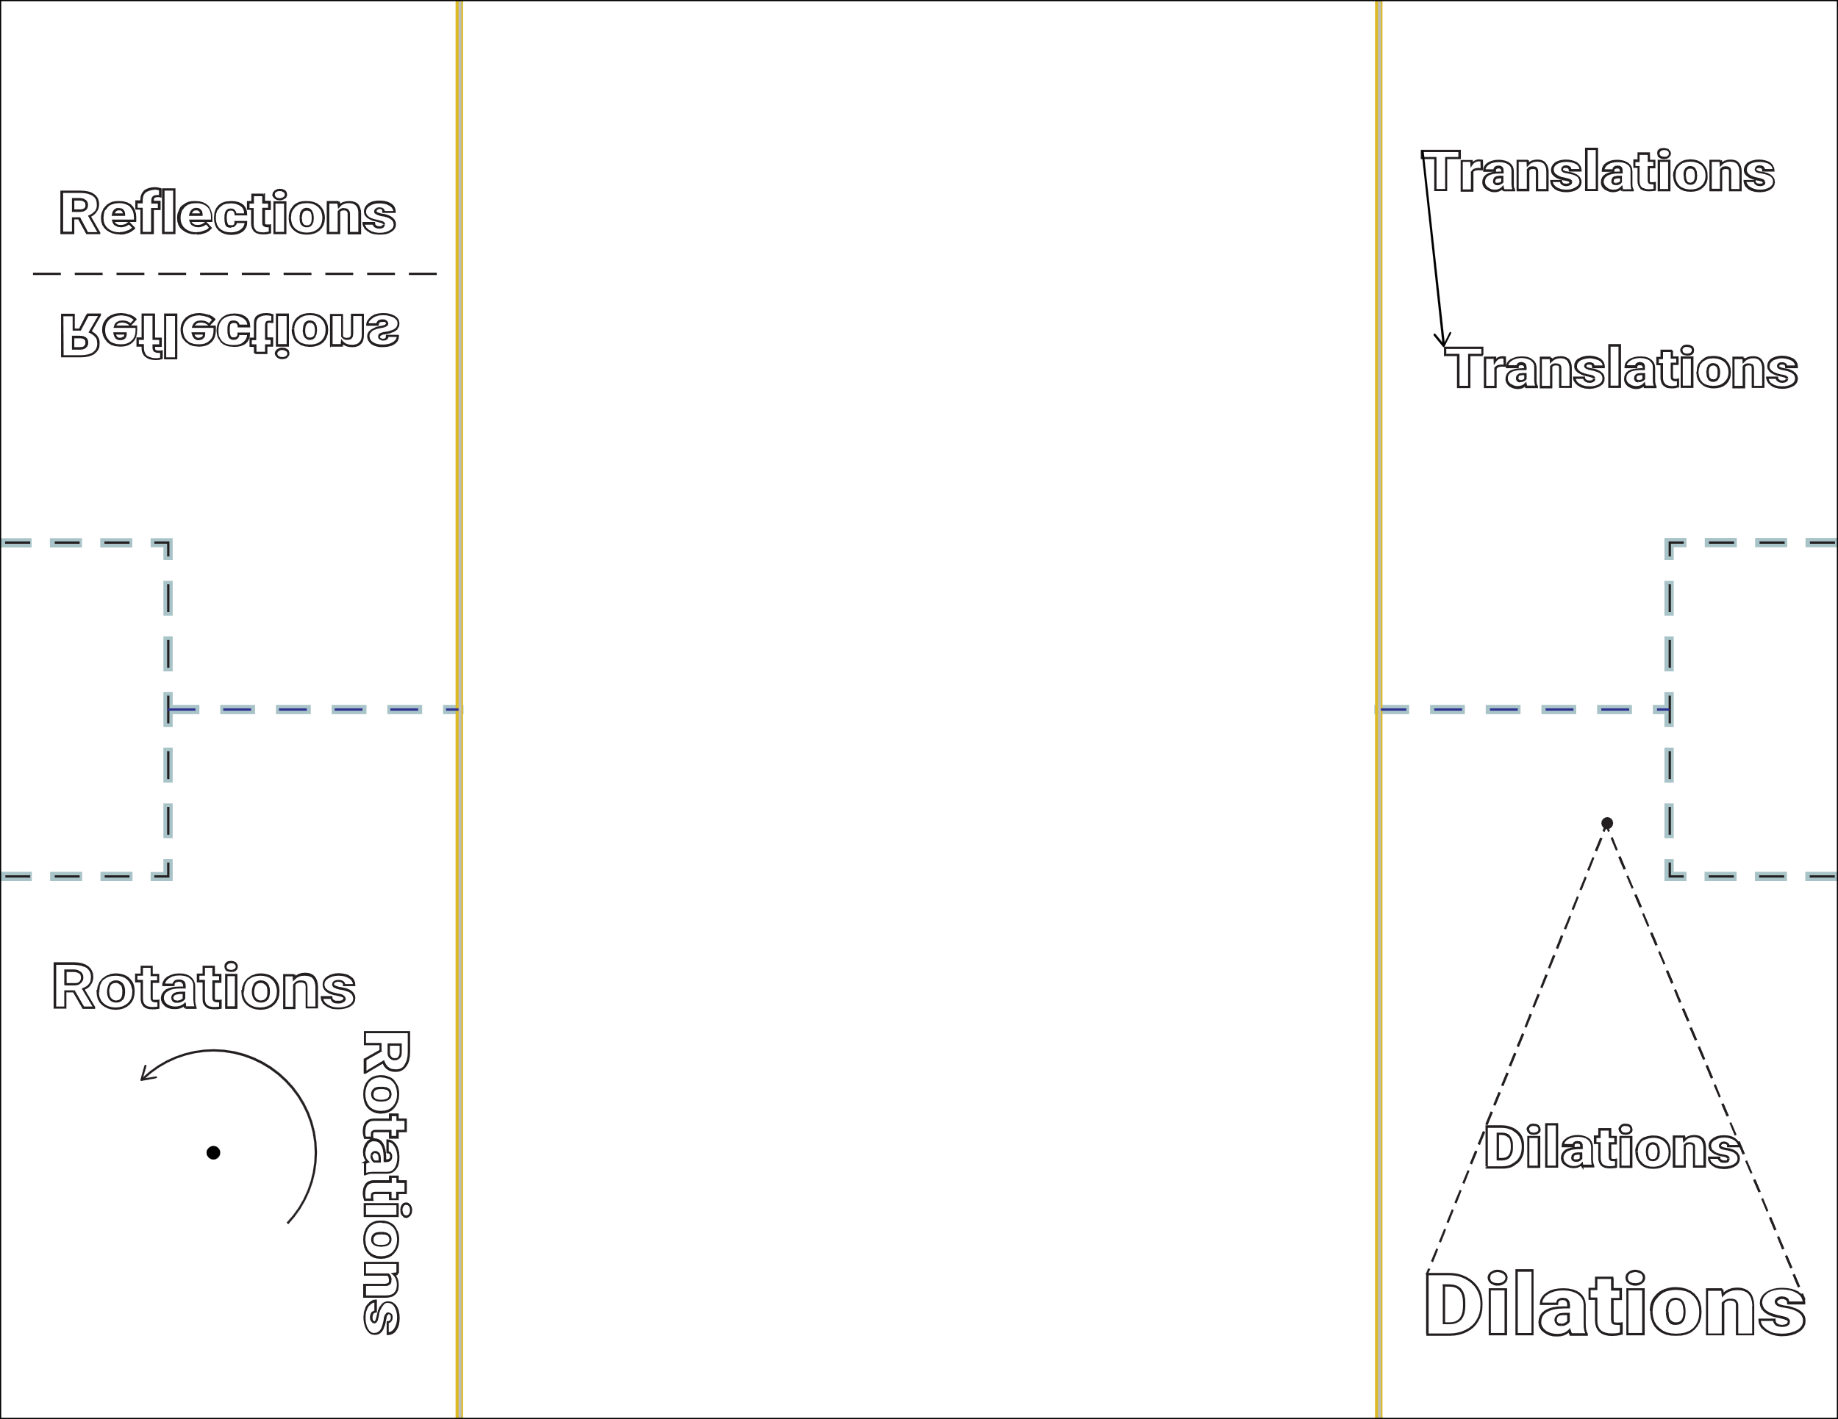
Foldable
Create your foldable:
Cut along the dashed lines* and fold along the solid lines.
*Do not cut the dashed lines near “Reflections”
or “Dilations.”

Slide 10
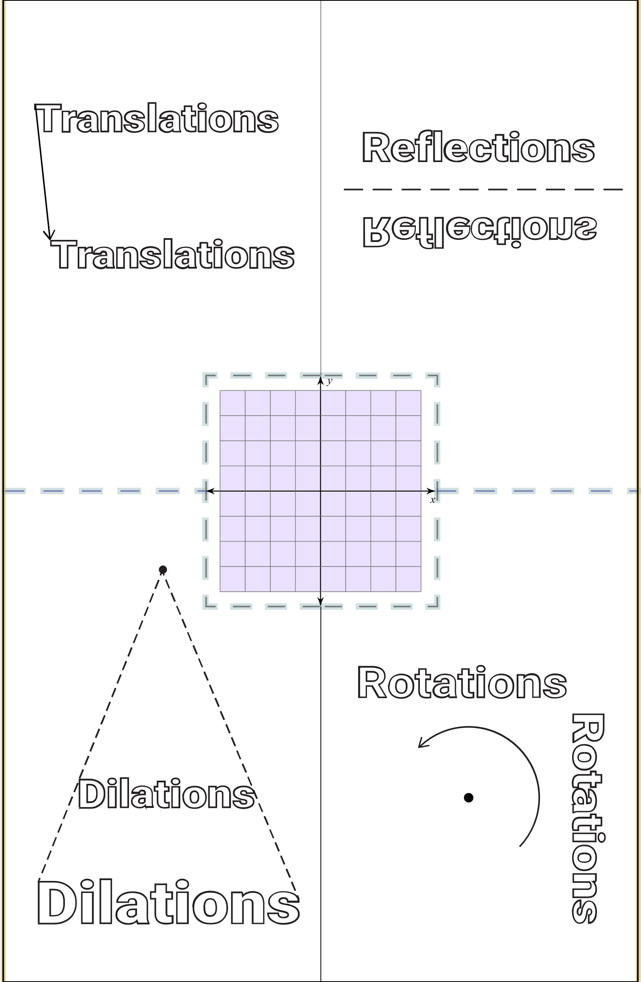
Foldable
Draw a preimage in the center. Label at least 3 vertices.

Slide 11
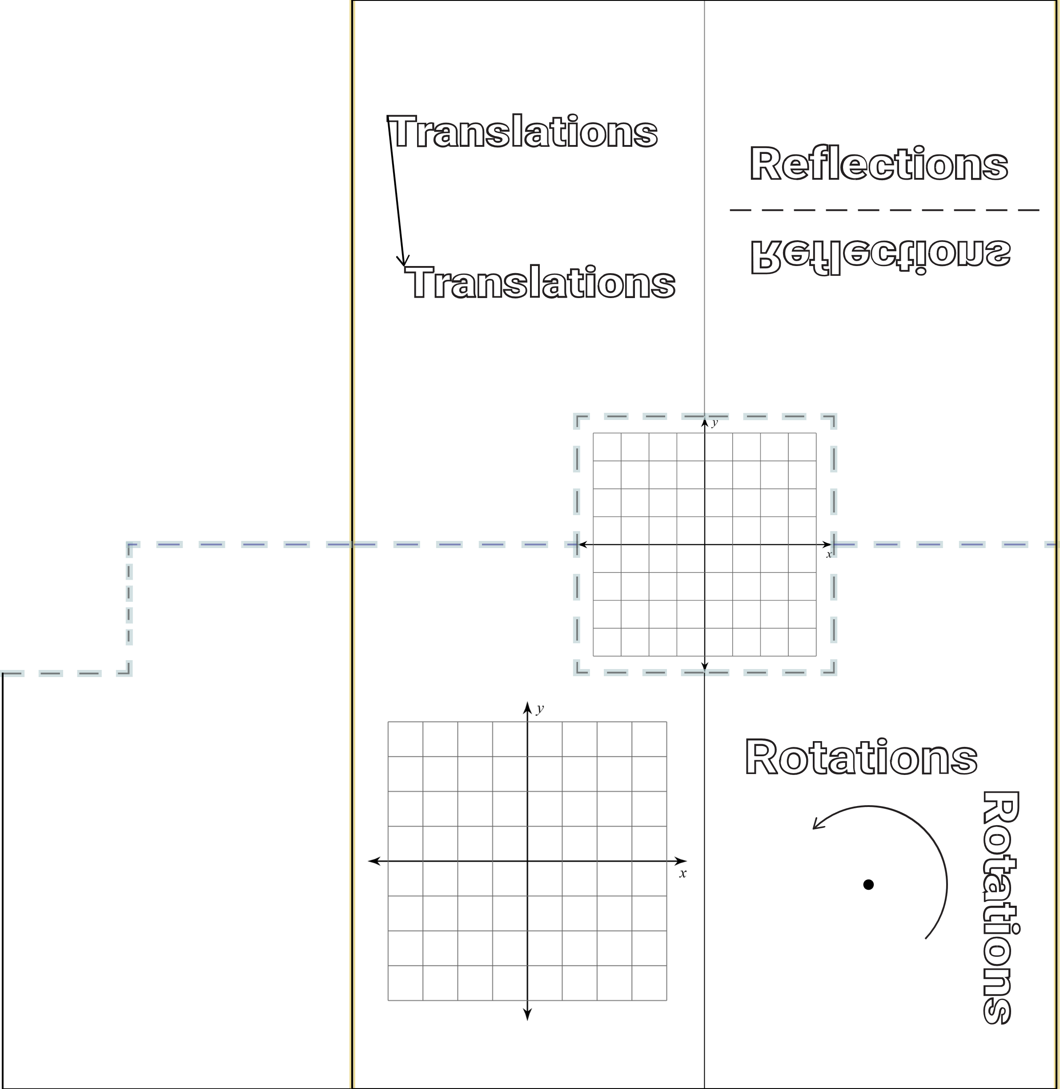
Foldable
Apply each transformation to your preimage individually by creating your own question and solution.
Write the rules for
the transformation
inside each flap.

Slide 12
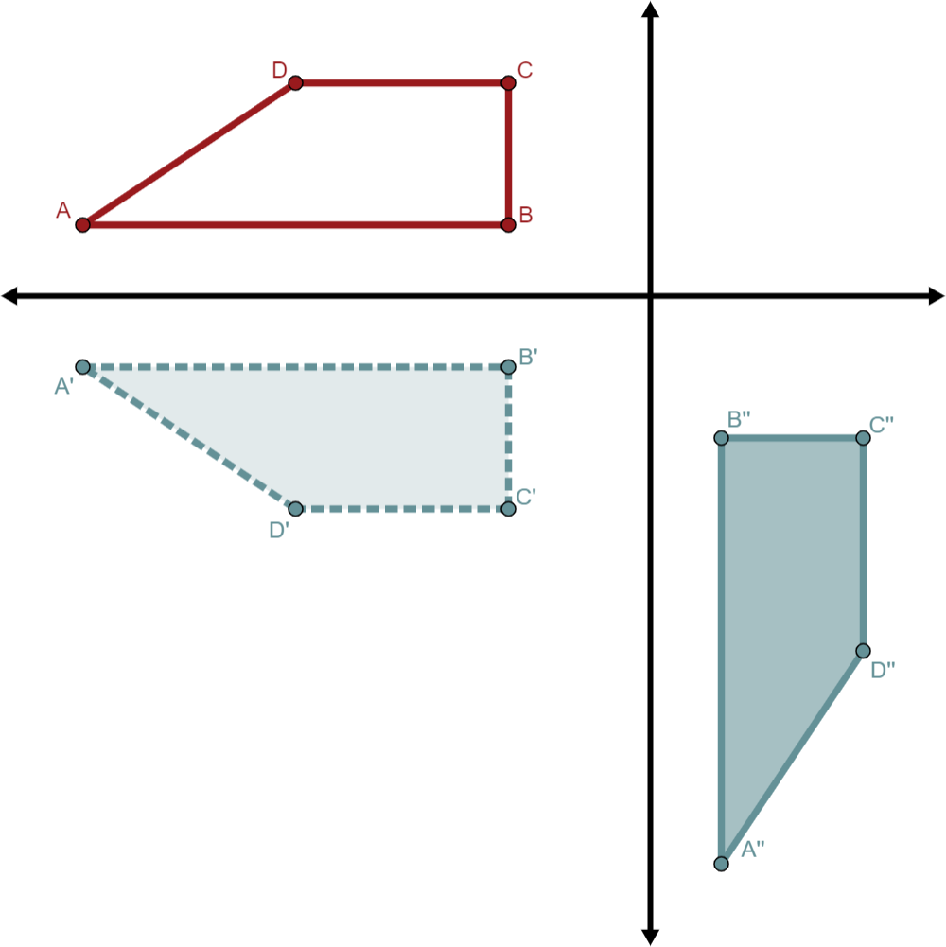
Compositions of Transformations
When there is more than
one transformation applied
to a figure
Example: A preimage reflected over
the x-axis and then rotated 90° about the origin

Slide 13
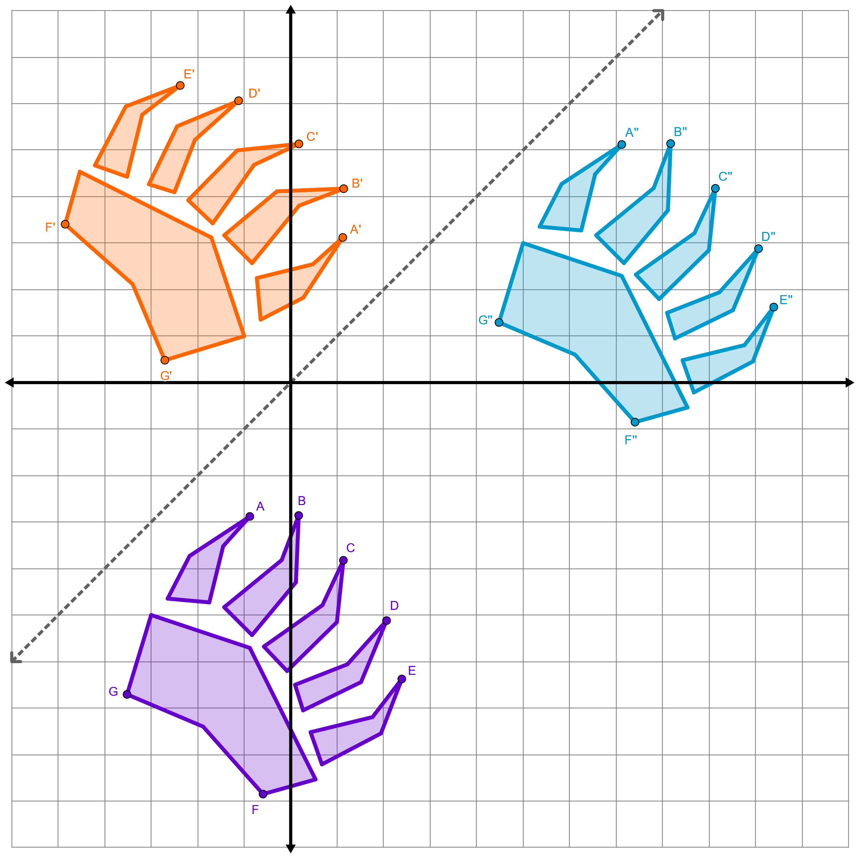
Compositions of Transformations
A glide reflection is a specially
named composition of a translation and a reflection where the translation vector is parallel to the line of reflection.
A common example of this is footprints, like the bear paw prints to the right.

Slide 14
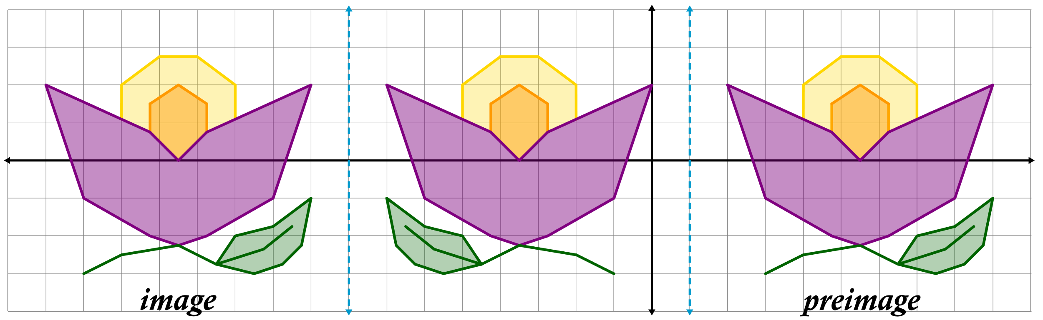
Multiple Transformations: Example 1
In certain cases, a composition of transformations can be represented by a single transformation. Describe two different ways to transform the preimage into the image.

Slide 15
Multiple Transformations (Solution)
The preimage was reflected over the line x = 1, then reflected over x = –8.
The preimage was translated 18 units left.

Slide 16
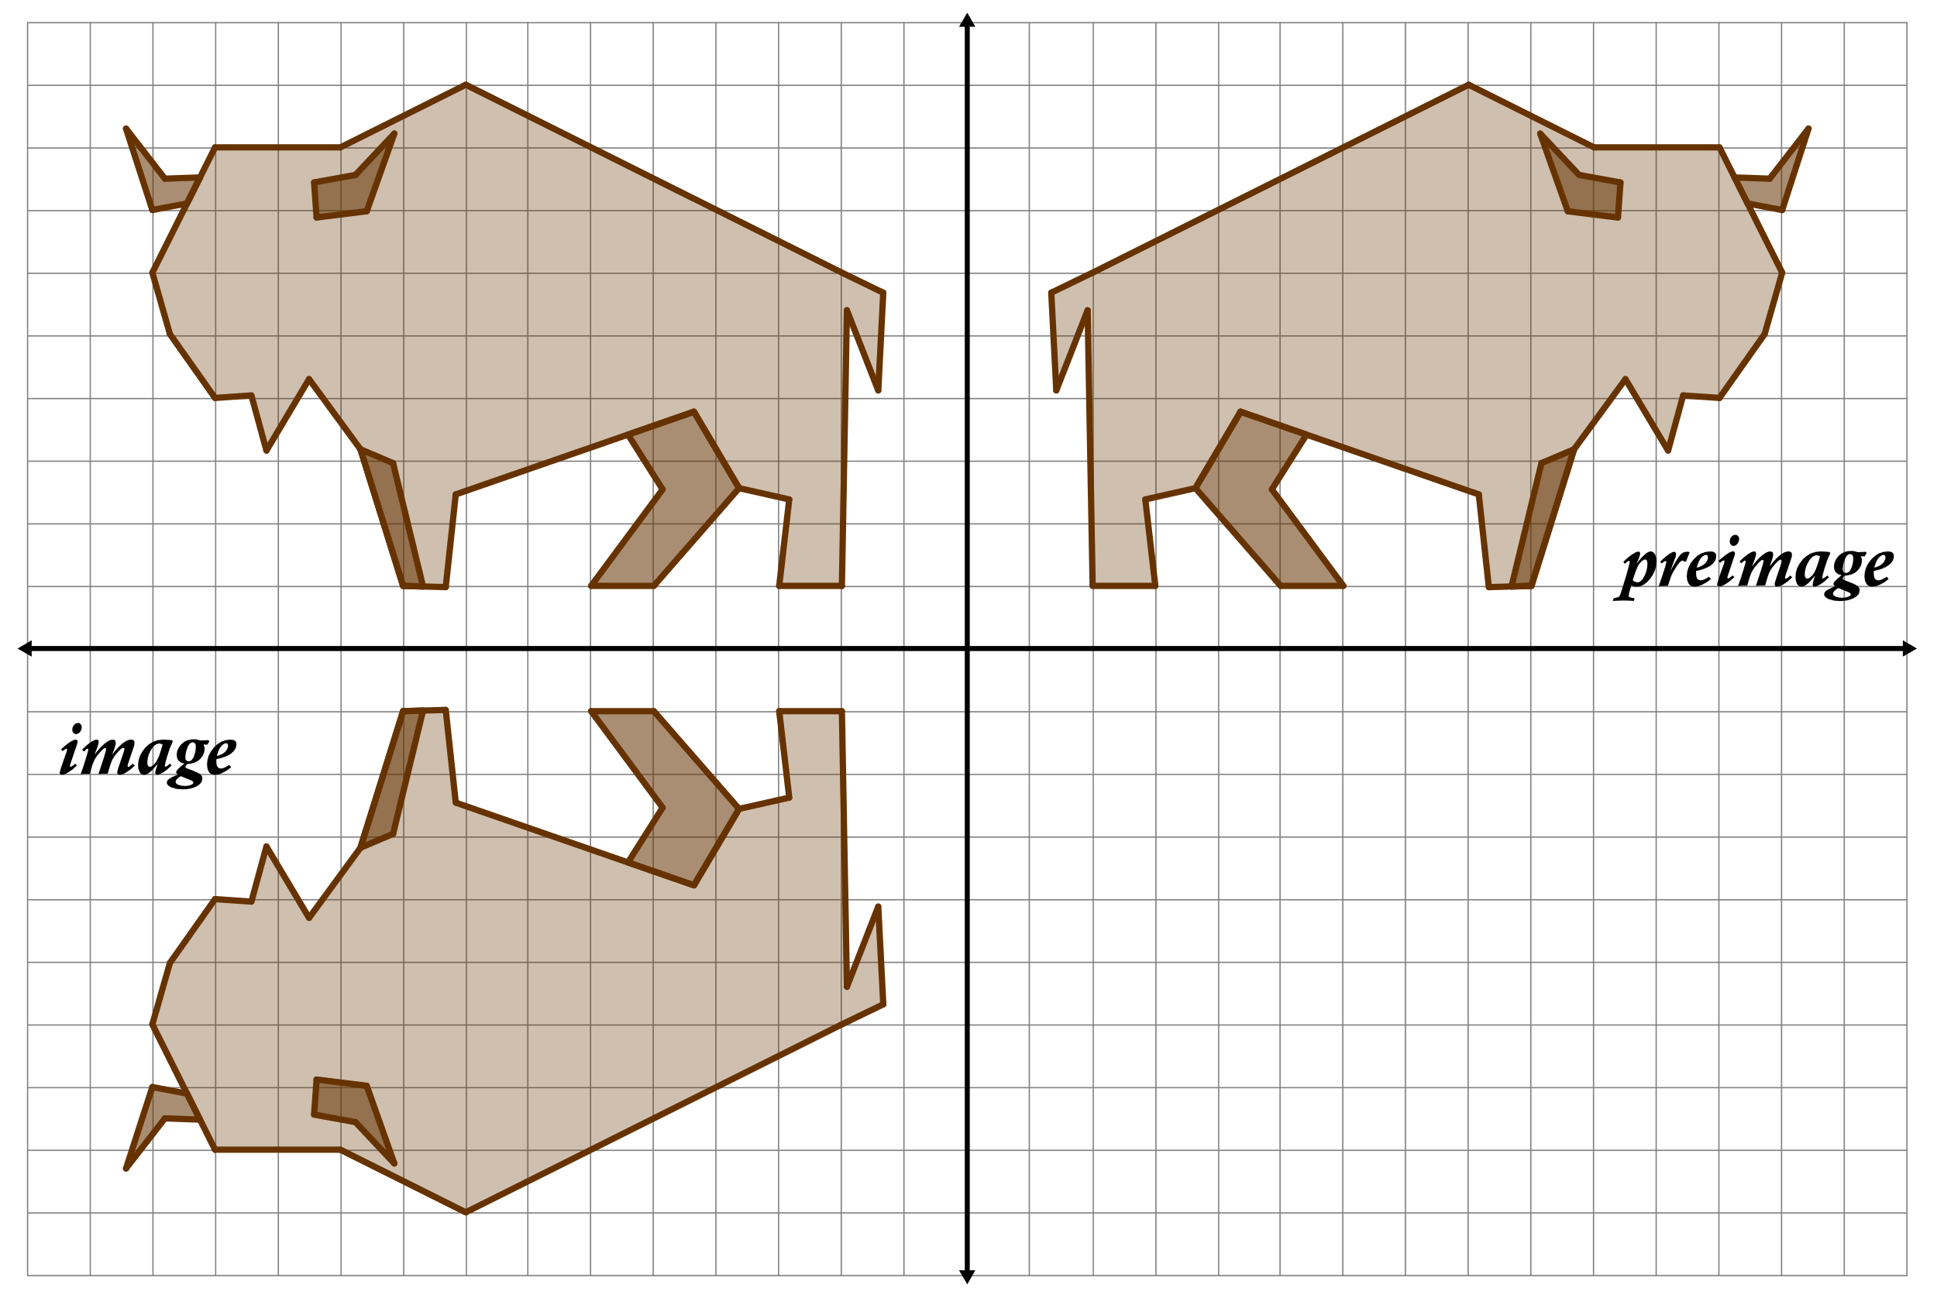
Multiple Transformations: Example 2
Describe two different ways to transform the preimage into the image.

Slide 17
Multiple Transformations (Solution)
The preimage was reflected over the y-axis, then reflected over the x-axis.
The preimage was rotated 180°.

Slide 18
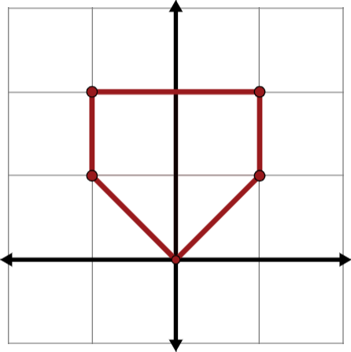
Transformation Puzzle
Work with your partner and use what you have learned about transformations to solve the puzzle.

Slide 19
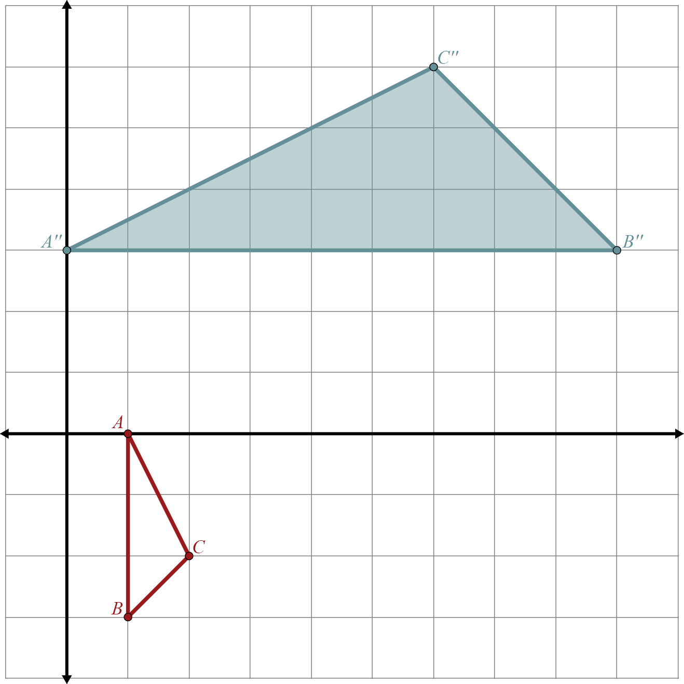
Composition Exit Ticket
Use the unshaded preimage and shaded image to determine the unknown transformation.
First Transformation:
Second Transformation:
Rotate 90° about the origin
Notes:
K20 Center. (n.d.). Bell Ringers and Exit Tickets. Strategies. https://learn.k20center.ou.edu/strategy/125

Slide 20
Composition Exit Ticket (Solution)
We need to begin by identifying the coordinates of the image.
 | Image
Notes:
K20 Center. (n.d.). Bell Ringers and Exit Tickets. Strategies. https://learn.k20center.ou.edu/strategy/125

Slide 21
Composition Exit Ticket (Solution)
Now we need to undo the last transformation.
We know the algebraic rule for
a 90° rotation is
Notes:
K20 Center. (n.d.). Bell Ringers and Exit Tickets. Strategies. https://learn.k20center.ou.edu/strategy/125

Slide 22
Composition Exit Ticket (Solution)
This means that x-value for Point B′′ is the opposite of the y-value for point B′: 9 = –y.
So, for point B′: y = –9
and x = 3.
Repeat this for the
remaining points.
Notes:
K20 Center. (n.d.). Bell Ringers and Exit Tickets. Strategies. https://learn.k20center.ou.edu/strategy/125

Slide 23
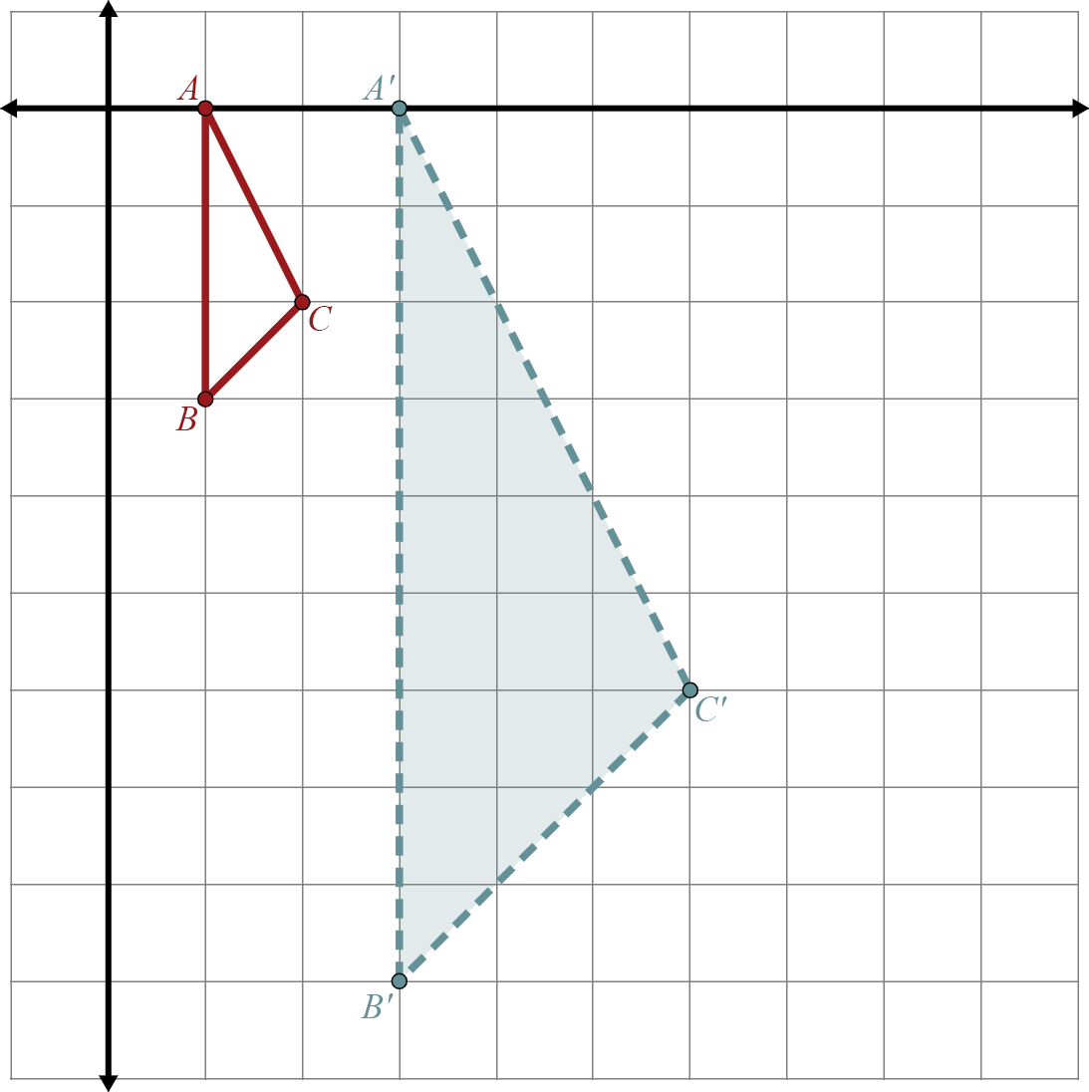
Composition Exit Ticket (Solution)
Now compare what we found with the preimage coordinates.
Notes:
K20 Center. (n.d.). Bell Ringers and Exit Tickets. Strategies. https://learn.k20center.ou.edu/strategy/125

Slide 24
Composition Exit Ticket (Solution)
What pattern do you notice?
Notes:
K20 Center. (n.d.). Bell Ringers and Exit Tickets. Strategies. https://learn.k20center.ou.edu/strategy/125

Slide 25
Composition Exit Ticket (Solution)
The first transformation was a dilation by a scale factor of 3.
Notes:
K20 Center. (n.d.). Bell Ringers and Exit Tickets. Strategies. https://learn.k20center.ou.edu/strategy/125

