Slide 2
You Are My Sunshine
Photosynthesis

Slide 3
Essential Question
How does energy guide function?

Slide 4
Lesson Objectives
Determine how organisms capture and store free energy from physical sources (the sun) for use in biological processes (photosynthesis).
Evaluate the contributions of photosynthesis and the capturing of light in the creation of man-made technology.
Construct explanations based on scientific evidence as to how the interaction of subcellular structures provides essential function.
Investigate the best pigment for light absorption and its level of efficiency for photosynthesis.

Slide 5

Toy Observation
Why is this happening?
Write 2–4 sentences to explain what you’re observing.
Turn and share with a partner.

Slide 6

Lab Time
As always, do your best to work quickly, but don’t go so fast that you trip over yourself.
From beginning to end, this should take the entire class period.
When you finish the data collection, start on the post-lab questions.

Slide 7
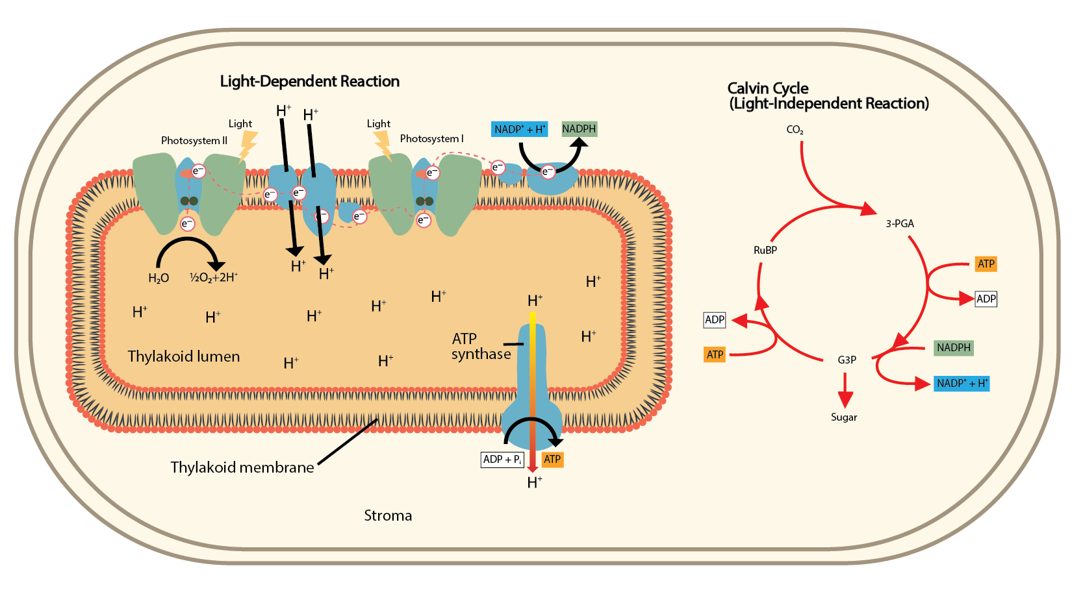
Light-Dependent and -Independent Reactions

Slide 8
Think-Pair-Share
6 CO₂ + 6 H₂0 → C₆H₁₂O₆ + 6 O₂
Consider the reaction for photosynthesis and how it relates to your lab data. Write your answers to the following questions:
In the lab, where did the carbon dioxide come from?
What role did the light play? What did the light do?
What did you observe that let you know photosynthesis was occurring? How does that fit into the equation?
In the water solution, do you think the leaf disks were still
making sugar? Why or why not?
Notes:
After students finish writing their answers, have them each turn to a partner and share their answers. After students discuss with their partners, have a whole-class discussion about their responses.
Strategy: K20 Center. (n.d.). Think-Pair-Share. Strategies. https://learn.k20center.ou.edu/strategy/139

Slide 9

Photosynthesis Beyond the Plant
In your group, read your assigned article using the CUS and Discuss strategy:
  Circle things you don’t understand.
  Underline details that support the main idea.
  Star the main idea.
After reading, discuss with your group what you marked and why.
Notes:
Strategy: K20 Center. (n.d.). CUS and discuss. Strategies. https://learn.k20center.ou.edu/strategy/162

Slide 10

Two-Minute Documentary
Make a two-minute documentary to share the findings of your article.
You will present your documentary to the class, so put effort into it and make it something you can be proud of!
Notes:
Strategy: K20 Center. (n.d.). Two-minute documentaries. Strategies. https://learn.k20center.ou.edu/strategy/177

