Slide 2
Scene Things Differently
Character Portrayal on Stage Versus Film

Slide 3
Essential Question
Why do actors and actresses portray characters differently for stage and film when drawing from the same source material?

Slide 4
Lesson Objectives
Identify differences in character portrayal based on the medium.
Analyze character portrayals.
Determine the most appropriate portrayal for the situation and the medium.

Slide 5


Choice Board: Compare & Contrast
Navigate to the choice board and choose a play that interests you.
As you watch the clips, think about the different choices the performers made and complete the T-Chart.
Notes:
K20 Center. (2020, September 16). Choice boards. Strategies. https://learn.k20center.ou.edu/strategy/73
K20 Center. (2020, September 16). T-chart. Strategies. https://learn.k20center.ou.edu/strategy/86

Slide 6

Get Ready for Your Close-Up
After reading the article by David Vegh, answer each of the following questions on a separate sticky note.
Write one word that summarizes the reading.
Write a phrase that summarizes the reading.
Write a sentence that summarizes the reading.
Notes:
K20 Center. (2020, September 16). Three sticky notes. Strategies. https://learn.k20center.ou.edu/strategy/153
Vegh, D. (2023). Get ready for your close-up: Tips for transitioning from stage to screen acting. Dramatics. https://dramatics.org/get-ready-for-your-close-up/

Slide 7

Monologues
In groups of three, review the available monologues:
Select one monologue.
Divide it so each person only reads a portion.
After reading, share with the group what happened in the section you read.
Notes:
K20 Center. (2020, September 16). Jigsaw. Strategies. https://learn.k20center.ou.edu/strategy/179

Slide 8
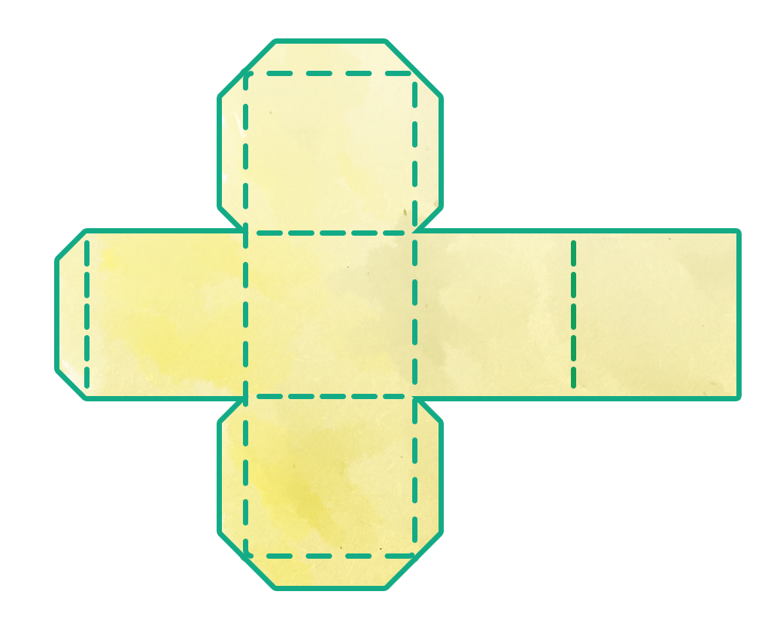
Make a Scene
In your small groups, perform the following steps:
Assemble 3 randomizer cubes:
  1 for setting,
  1 for production format,
  1 for time period.
Cut along the solid lines.
Fold on the dotted lines.
Tape or glue the edges together.

Slide 9
Make a Scene: Digital Version
In your small groups
Go to k20.ou.edu/modifyscene.
Click “Shuffle Cards.”
Click “Draw” for each modifier.

Slide 10

Make a Scene
Record your randomized setting, production format, and time period.
Write out your monologue and include notes on direction.
Underline any changes you make to the dialogue.
Notes:
**If we update the narrative to ask teachers to delete the version of the randomizer they will not need (paper or digital), this slide will become slide 9.

Slide 11

How Am I Feeling? What Am I Thinking?
On a sticky note, answer the two questions:
How am I Feeling?
What am I Thinking?
Place your sticky note on the wall before you leave.
Notes:
K20 Center. (2020, September 16). How am I feeling? What am I thinking? Strategies. https://learn.k20center.ou.edu/strategy/187

