Slide 1
Scene Things Differently
Character Portrayal on Stage Versus Film

Slide 2
Choice Board
Choose a play from slides 3-14. Watch the two YouTube videos associated with your chosen play.
Each video will have the same scene portrayed by different actors or the same actor in different media.
Please select the text link to view the videos.
Notes:
K20 Center. (2020, September 16). Choice boards. Strategies. https://learn.k20center.ou.edu/strategy/73

Slide 3
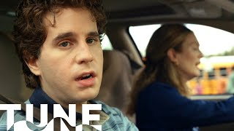
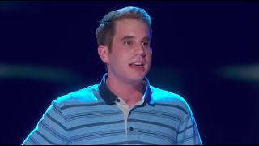
Dear Evan Hansen
Film | Stage
film version | stage version
Notes:
TUNE - Musical Moments. (2022, April 25). Waving through a window (Ben Platt) | Dear Evan Hansen (2021) | TUNE [Video]. YouTube. https://www.youtube.com/watch?v=C6nn-ZnN70o
Curtis, M. H. (2022, January 23). Dear Evan Hansen | 2017 Tony Awards [Video]. YouTube. https://www.youtube.com/watch?v=3CC2818ahEw&t=37s

Slide 4
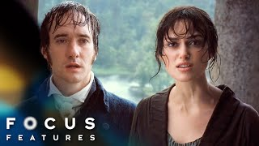
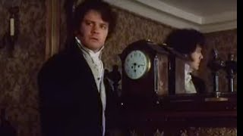
Pride and Prejudice
Film w/Keira Knightley | Film
film (version 1) | film (version 2)
Notes:
Focus Features. (2022, February 23). Pride & prejudice | Elizabeth rejects Mr. Darcy in the rain [Video]. YouTube. https://www.youtube.com/watch?v=YlETBQHBm9w
BBC Studios. (2008, February 11). Darcy confesses his love | Pride and prejudice | BBC Studios [Video]. YouTube. https://www.youtube.com/watch?v=JF3ueHjUc3k

Slide 5
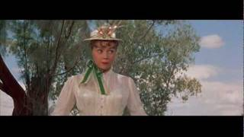
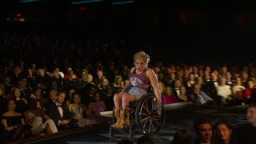
Oklahoma!
Film | Stage
film version [00:12-01:04] | stage version [00:00-01:40]
Notes:
DFDalton1962. (2011, May 25). Oklahoma! - I cain’t say no [Video]. YouTube. https://www.youtube.com/clip/UgkxU3Kt1POqB53PYZyujbuk4EU7LH9CT3h3
CBS. (2019, June 9). The cast of Oklahoma! performs “I cain’t say no/ Oklahoma” at the 2019 Tony Awards [Video]. YouTube. https://www.youtube.com/watch?v=FxFS8okUqKk

Slide 6
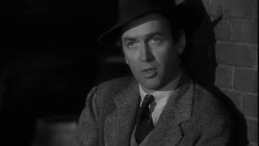
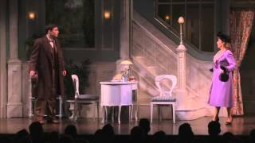
Harvey
Film w/Jimmy Stewart | Stage w/Jim Parsons
film version [03:06-04:31] | stage version [05:11-06:47]
Notes:
t a. (2018, February 5). Harvey - Alley scene [Video]. YouTube. https://www.youtube.com/watch?v=U1SxcbMBdxU&t=186s
notyoda73. (2012, June 6). Jim Parsons & Harvey - First look [Video]. YouTube. https://www.youtube.com/watch?v=z9fQq3DakUg&t=311s

Slide 7
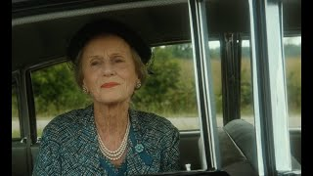
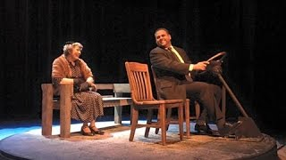
Driving Miss Daisy
Film | Stage
film version [00:55-01:38] | stage version [40:20-41:16]
Notes:
Screen Themes. (2021, April 20). Driving Miss Daisy (1989) - Lunch break scene [1080p] [Video]. YouTube. https://www.youtube.com/watch?v=tgebG8yEJWQ&t=54s
Torgerson, J. T. (2016, June 28). Driving Miss Daisy [Video]. YouTube. https://www.youtube.com/clip/UgkxItivDHXzt6bNJyAjfjF9TdM3tSFdOBij

Slide 8
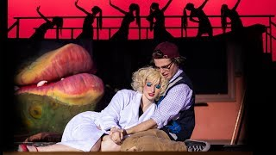
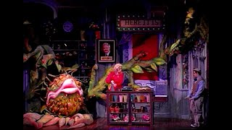
Little Shop of Horrors
Stage | Stage
stage version 1 [25:37-26:17] | stage version 2 [26:24-27:10]
Notes:
Unionville HS Musical. (2019, May 25). Little shop of horrors (full), Unionville High School musical 2019 [Video]. YouTube. https://www.youtube.com/watch?v=R0ktWzohhnA&t=1537s
Iverson, R. (2020, February 6). AMTSJ Little shop of horrors [Video]. YouTube. https://www.youtube.com/clip/UgkxvIve-rdwYdrAe1vHK--AJPjhr5I6ptEk

Slide 9

Little Women
Film w/Timothee Chalamet | Film w/Christian Bale
Comparison Video Timothee Chalamet [00:08-02:55] Christian Bale [03:12-06:04]
Notes:
Binge Society. (2021, November 23). Little women: Laurie proposes to Jo | Original vs. remake [Video] YouTube. https://www.youtube.com/watch?v=xms50vFYnG8

Slide 10
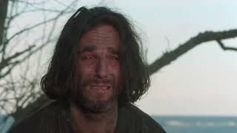
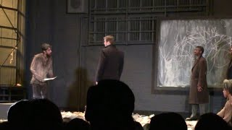
The Crucible
Film | Stage
film version | stage version
Notes:
Alexansher. (2022, October 3). “Because it is my name!” [Video]. YouTube. https://www.youtube.com/watch?v=SmneeIeh-TQ
Barkly, K. (2021, November 12). Ben Whishaw - “Because it is my name!” (The crucible) [Video]. YouTube. https://www.youtube.com/watch?v=n7NYzjRdcYM&t=40s

Slide 11

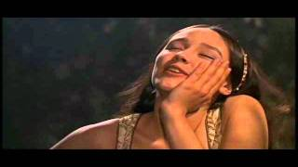
Romeo + Juliet
Film (1996) | Film (1968)
film version [00:00-01:03] | film version [01:42-03:00]
Notes:
MOV Clips. (2020, August 15). Romeo and Juliet(1996) - Pool romance [Video]. YouTube. https://www.youtube.com/watch?v=XitK-lUjyzc
shakeoutloud. (2011, December 4). Balcony scene from Romeo & Juliet [Video]. YouTube. https://www.youtube.com/watch?v=S0qao2xINsE&t=103s

Slide 12

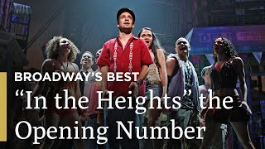
In the Heights
Film | Stage
film version | stage version
Notes:
Warner Bros. Pictures. (2021, June 6). In the heights - First 8 minutes [Video]. YouTube. https://www.youtube.com/watch?v=8HAR3QBuiiU&t=410s
Great Performances | PBS. (2020, August 5). “In the heights” the opening number | Chasing Broadway dreams | Broadway’s best | Great Performances [Video]. YouTube. https://www.youtube.com/watch?v=RrIAUhmQsXM

Slide 13
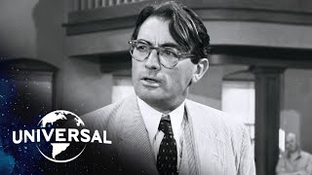

To Kill a Mockingbird
Film | Staged Reading
film version | staged reading version
Notes:
Universal Pictures. (2020, January 22). To kill a mockingbird | Atticus Finch’s closing argument [Video]. YouTube. https://www.youtube.com/watch?v=tNxrnOC_WTs&t=19s
Live from Here. (2019, April 21). Jeff Daniels performs a scene from ‘To kill a mockingbird’ | Live from here with Chris Thile [Video]. YouTube. https://www.youtube.com/watch?v=JjTlHvbZ4L8&t=55s

Slide 14
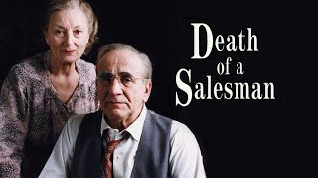
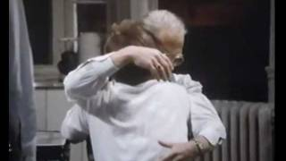
Death of a Salesman
Film (1996) | Film (1985)
film version (1996) | film version (1985)
Notes:
Hayes, S. (2022, September 4). BBC - Death of a salesman - Warren Mitchell - by Arthur Miller - BBC Drama 1996 [Video]. YouTube. https://www.youtube.com/watch?v=6Jh1SWS1dHY&t=7314s
Piazza, T. (2011, July 13). Death of a Salesman Hoffman [Video]. YouTube. https://www.youtube.com/watch?v=a1lazBK1Pec

