Slide 2
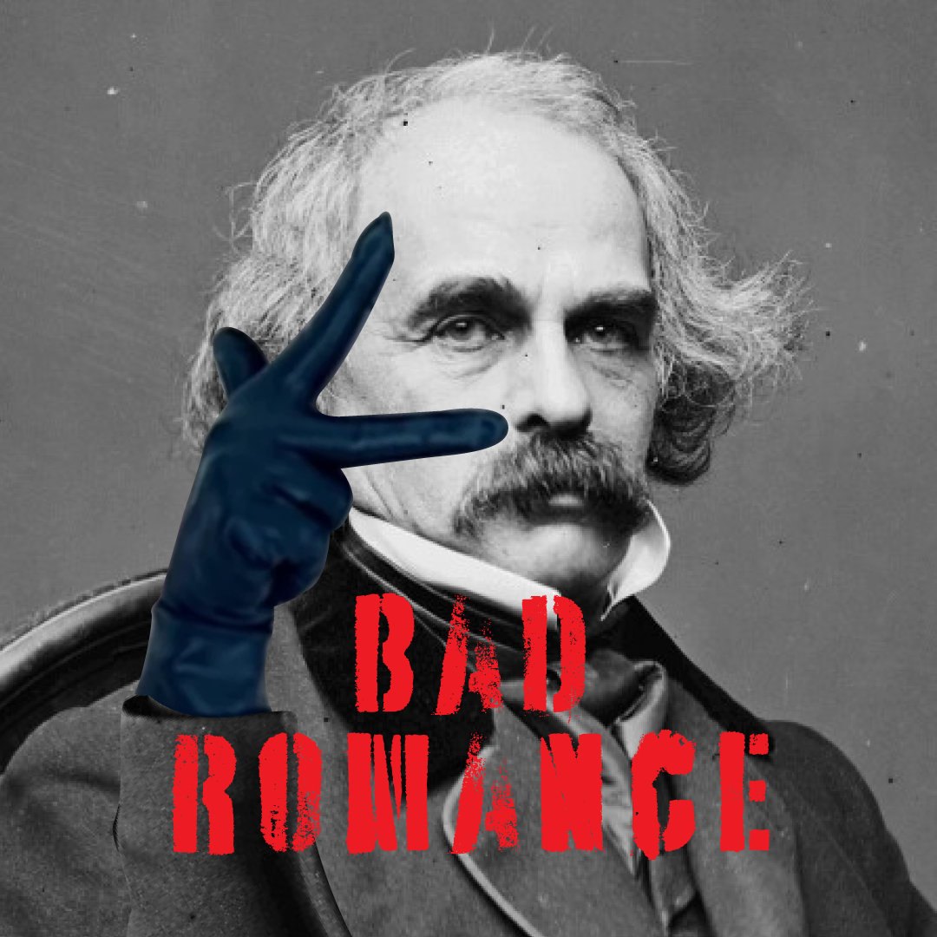
Bad Romance
Transcendentalism vs. Dark Romanticism

Slide 3
Essential Questions
How do the elements of Gothic literature reflect the dark side of romanticism?
How does the “American Identity” change during the Romantic time period?

Slide 4
Learning Objectives
Identify characteristics of the subgenre dark romanticism.
Compose an op-ed via blackout poetry that analyzes how the characteristics enhance your comprehension.

Slide 5
Card Sort
With your partner, read the quotes on the cards.
Sort the cards into two groups:
Transcendentalism
Dark Romanticism

Slide 6
Transcendentalism or Dark Romanticism?
There are certain queer times and occasions in this strange mixed affair we call life when a man takes this whole universe for a vast practical joke, though the wit thereof he but dimly discerns, and more than suspects that the joke is at nobody's expense but his own."
— Herman Melville (Moby-Dick)

Slide 7
Transcendentalism or Dark Romanticism?
If the stars should appear one night in a thousand years, how would men believe and adore; and preserve for many generations the remembrance of the city of God which had been shown! But every night come out these envoys of beauty, and light the universe with their admonishing smile."
— Ralph Waldo Emerson (Nature and Selected Essays)

Slide 8
Transcendentalism or Dark Romanticism?
His eye was like the eye of a vulture, the eye of one of those terrible birds that watch and wait while an animal dies, and then fall upon the dead body and pull it to pieces to eat it.”
― Edgar Allan Poe, The Tell-Tale Heart

Slide 9
Transcendentalism or Dark Romanticism?
I would prefer not to."
— Herman Melville (Bartleby, the Scrivener: A Story of Wall Street)

Slide 10
Transcendentalism or Dark Romanticism?
For it matters not how small the beginning may seem to be: what is once well done is done forever.”
― Henry David Thoreau, Civil Disobedience

Slide 11
Transcendentalism or Dark Romanticism?
I do know that for the sympathy of one living being, I would make peace with all. I have love in me the likes of which you can scarcely imagine and rage the likes of which you would not believe. If I cannot satisfy the one, I will indulge the other.”
― Mary Shelley, Frankenstein

Slide 12
Transcendentalism or Dark Romanticism?
The happiest man is he who learns from nature the lesson of worship"
— Ralph Waldo Emerson (Nature)

Slide 13
Transcendentalism or Dark Romanticism?
The universe is wider than our views of it."
— Henry David Thoreau (Walden & Civil Disobedience)

Slide 14
Jigsaw
In your group of three, you will split up the articles.
There are three articles to choose from:
Dark Romanticism & American Renaissance
Dark Romanticism Study Guide
New World Encyclopedia - Dark Romanticism

Slide 15
Jigsaw
Connect with those who read the same article as you and discuss the following:
Takeaways from the article;
Characteristics of the subgenre, Dark Romanticism.

Slide 16
Jigsaw
In your original group of three, each person should share what you learned from your reading.

Slide 17
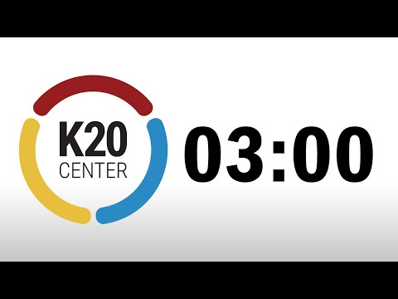
Affinity Process
What are some common characteristics of the subgenre, Dark Romanticism?
Answer this question on your sticky notes.
Each separate answer should have its own sticky note.

Slide 18
Affinity Process
With your partner:
Read through your sticky notes.
Group any sticky notes that are similar together into a category.
Label that category.

Slide 19
Affinity Process
With your group:
Read through your sticky notes.
Group any sticky notes that are similar together into a category.
Label that category.

Slide 20
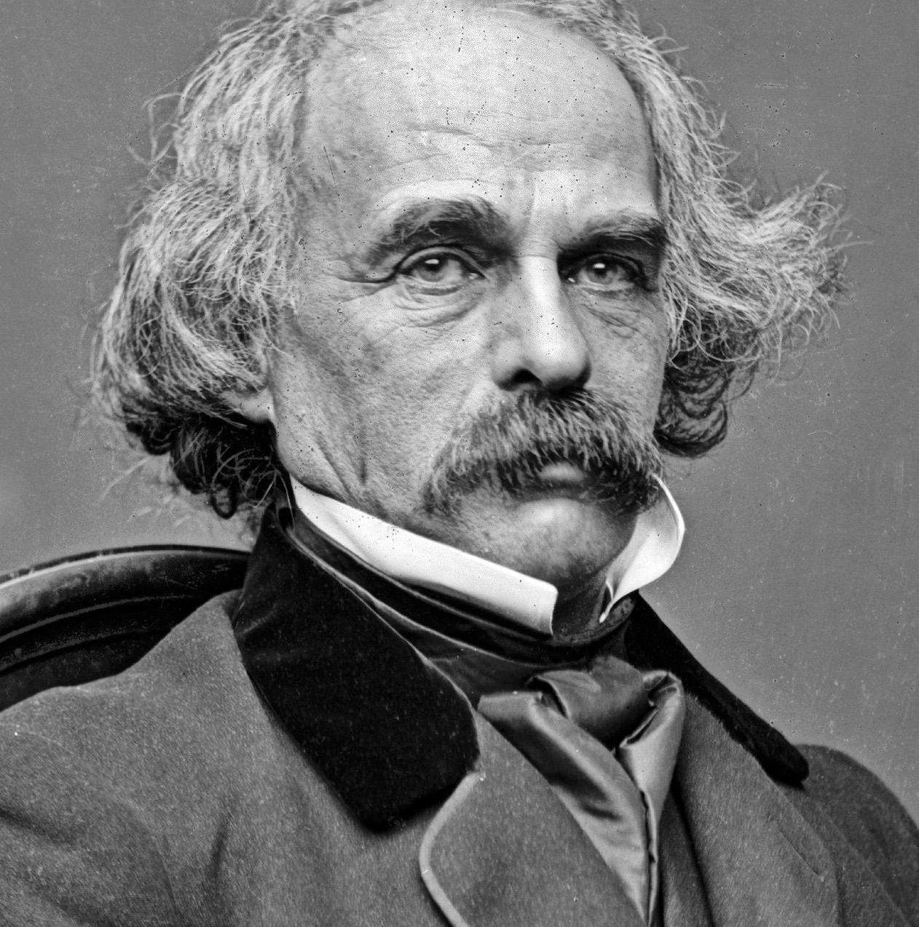
Nathaniel Hawthorne
Born: July 4, 1804, in Salem, Massachusetts;
Died: May 19, 1864;
Published his first novel, Fanshawe, in 1828;
Published The Scarlet Letter in 1850.
Notes:
https://commons.wikimedia.org/wiki/File:Nathaniel_Hawthorne_by_Brady,_1860-64.jpg

Slide 21
Why-Lighting
Read the two stories written by Nathaniel Hawthorne
Using a highlighter, highlight anything that is an example of Dark Romanticism.
Using a pen/pencil, write the characteristic of Dark Romanticism the example matches with.

Slide 22
Why-Lighting
With a partner, compare annotations.
What did you highlight that was the same? Different?
Discuss your “why” for highlights that differ.
How do these two stories meet the characteristics of Dark Romanticism?

Slide 23
Blackout Poetry
Read through the excerpt of The Scarlet Letter.
Lightly circle words that seem most significant to the piece or convey the most meaning to you.
Write those words down in order as you read them from top to bottom and left to right.
If you are happy with the words you chose and you feel like they represent the piece, take a black permanent marker and place a box around each word. Leave the word itself untouched.
Finally, go back through the piece of writing and black out the rest of the words, leaving only the words you chose untouched.

Slide 24
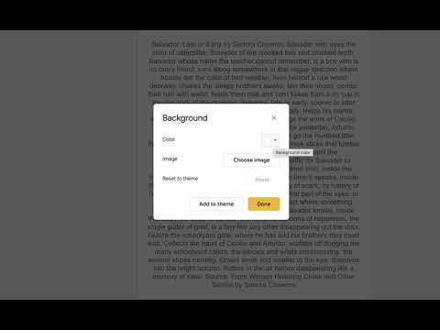
Notes:
YouTube. (2021). Blackout Poetry - Google Slides. YouTube. Retrieved February 24, 2023, from https://www.youtube.com/watch?v=ADnAmvqXMRU.

Slide 25
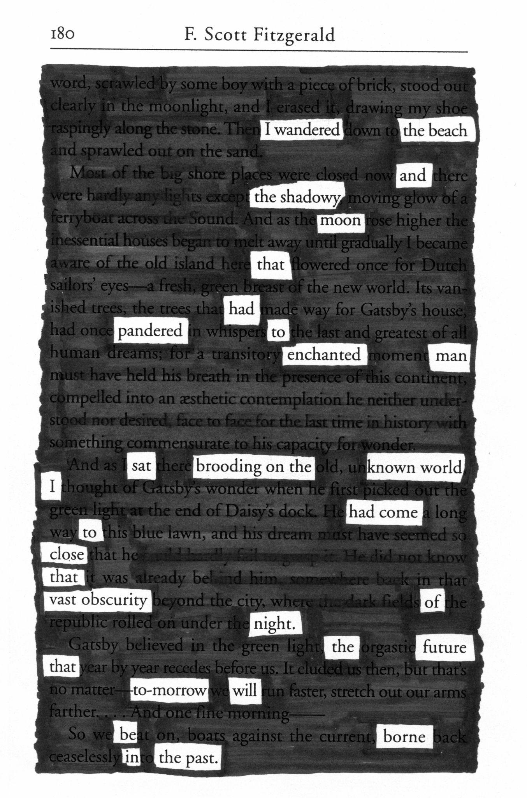
Notes:
https://www.flickr.com/photos/fncll/15474592616/in/photostream/

Slide 26
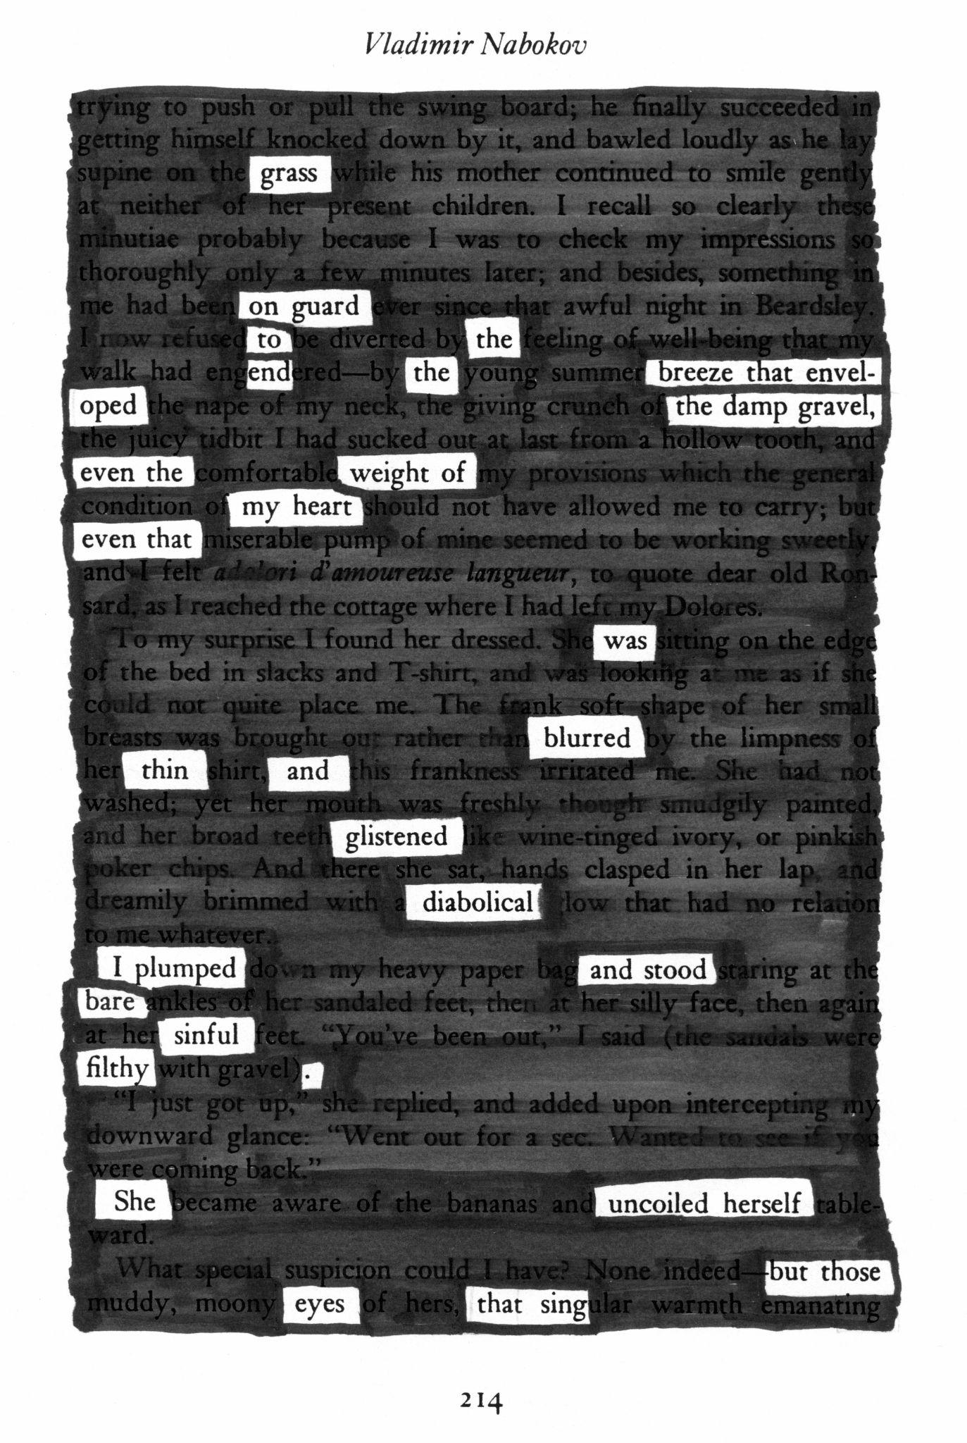
Notes:
https://www.flickr.com/photos/fncll/15474595366

Slide 27
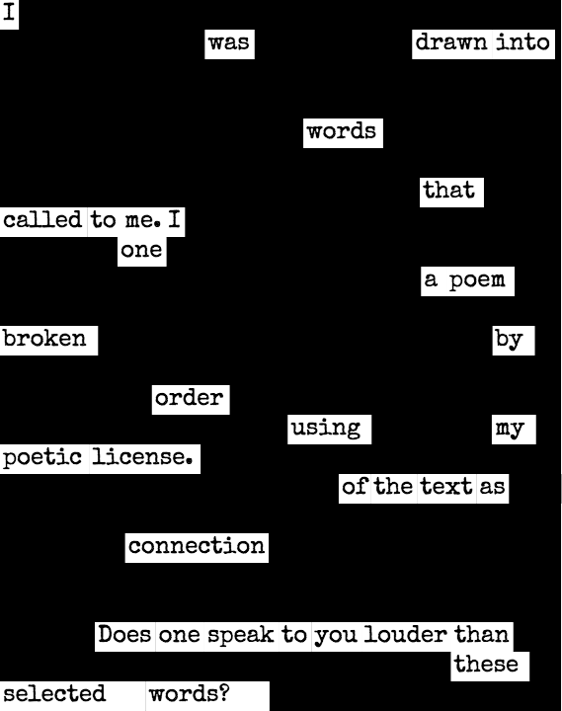
Notes:
https://commons.wikimedia.org/wiki/File:%D0%91%D0%BB%D0%B5%D0%BA%D0%B0%D1%83%D1%82_%D0%BF%D0%BE%D0%B5%D0%B7%D1%96%D1%8F.png

Slide 28
Blackout Poetry
Read through The Scarlet Letter.
Lightly circle the words that help you answer the question:
How does Nathaniel Hawthorne demonstrate the qualities and characteristics of Dark Romanticism through his writing?
Complete the Blackout Poetry process.

