Slide 1
Writing with Water Cryptids

Slide 2
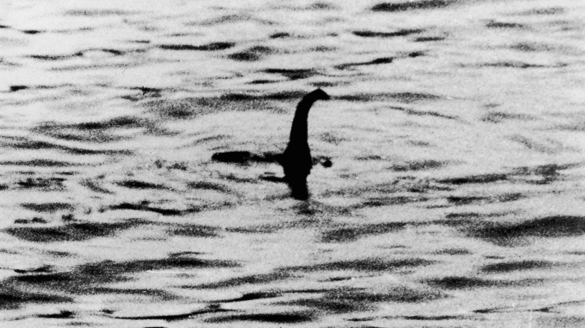
Caption This
Look closely at this image, paying attention to all the details.
Create a 1–3 sentence caption to explain what is happening in the image.
Share your caption with an Elbow Partner.
Notes:
Wetherell, M. A. “Duke.” (2019). The Loch Ness Monster. Wikimedia Commons. Retrieved July 4, 2023, from https://commons.wikimedia.org/wiki/File:Loch_Ness_Monster-1.jpg.

Slide 3
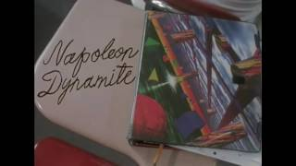
Napoleon Dynamite - Nessie
Notes:
Elylv. (2017, July 21). Napoleon Dynamite - Nessie. YouTube. https://www.youtube.com/watch?v=93CIrSkeoCg

Slide 4
Essential Question
How do authors use similar tropes but come up with different variations of the same character?

Slide 5
Learning Objectives
Compose informative essays with sentence variety to create clarity and concision.

Slide 6
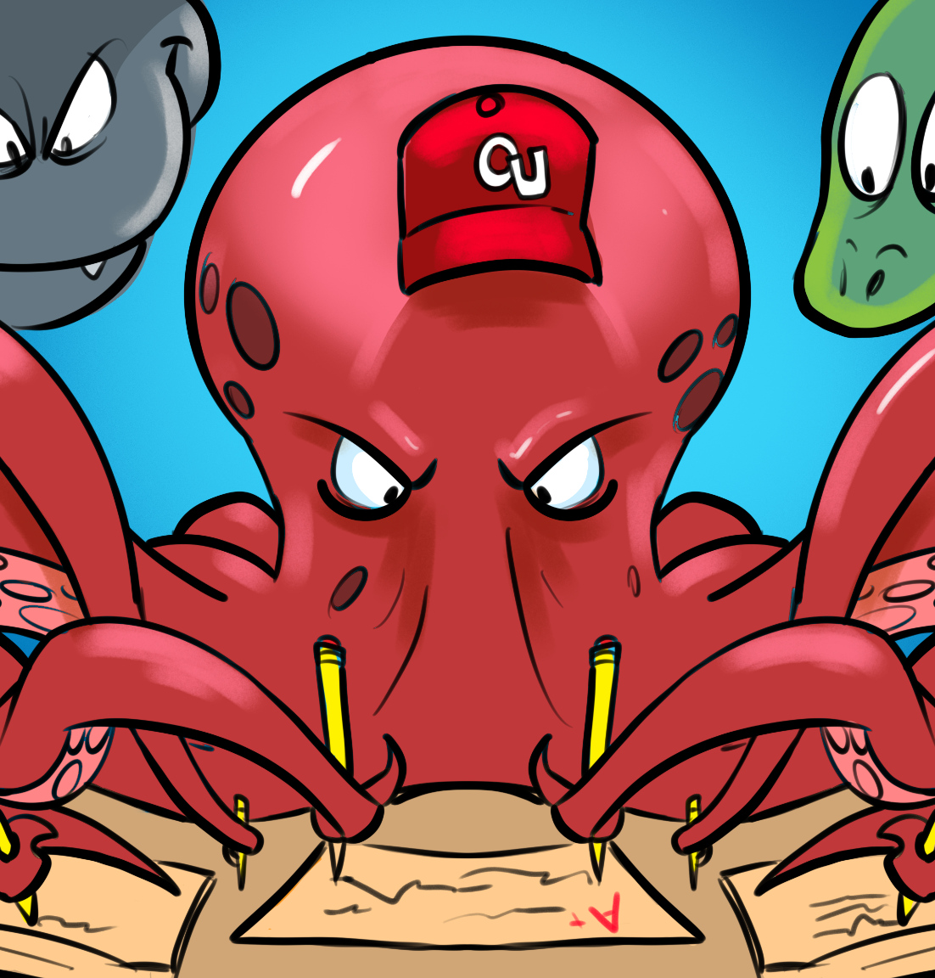
Trope
[trohp]
noun
A recurring theme or motif, as in literature or art:
The heroic trope.
A convention or device that establishes a predictable or stereotypical representation of a character, setting, or scenario in a creative work:
From her introduction in the movie, the character is nothing but a Damsel in Distress trope.

Slide 7
Overview
Your goal in this activity is to identify the requirements for informative writing through exploration, observation, and analysis. Keep your notes—they'll come in handy later.

Slide 8
Paired Text H-Chart
Observe the image silently. What do you think is happening in this photo?
Read the essay explaining the image on the next page.
Reflect on what you read and how it relates to the image on your H-Chart.
Do you think the essay gives you enough information to understand what is happening?

Slide 9
Notes:
Link to the interactive activity: https://k20center.ou.edu/e-learning/monster-monday/?scene=canada

Slide 10
Ogopogo
In the right column of the “H,” write down your observations as you read the text.
Does the writing give you enough information to understand what was happening in the image?
What do you notice about the writing?
What questions do you have?

Slide 12
Ogopogo
After interacting with the second image:
Did the writing help you make sense of the second picture?
Do you have a good understanding of what was happening as you moved the magnifying glass around?
Write down your thoughts about the writing and the image in your H-Chart.

Slide 13
Notes:
Link to the interactive activity: https://k20center.ou.edu/e-learning/monster-monday/

Slide 14
Loch Ness Monster
In the left column of the “H,” write down your observations as you read the text.
Does the writing give you enough information to understand what was happening in the image?
What do you notice about the writing?
What questions do you have?

Slide 16
Loch Ness Monster
After interacting with the second image:
Did the writing help you make sense of the second picture?
Do you have a good understanding of what was happening as you moved the magnifying glass around?
Write down your thoughts about the writing and the image in your H-Chart.

Slide 17
Paired Text H-Chart
As you read each writing sample, you may have noticed differences between them.
In the center of your H-Chart, write down the following:
How are the writing samples similar or different?
What does one have that the other doesn’t?
What makes one an exemplary essay?

Slide 18
Paired Text H-Chart
Review what you wrote down on your H-Chart.
On the back, list what requirements and steps you believe are necessary for good informative writing based on what you observed.

Slide 19
With a partner, review your list. If they listed something you didn't, make sure to add it to your list.

Slide 20
Tell Me Everything
Think back to what you and your partner discussed and what you listed on the back of your paper.
Tell me everything you know about informative writing.

Slide 21
What does an exemplar informative essay include?
Begin with a clear and focused topic
Create a strong and arguable thesis statement
Use specific facts and details to support your points
Organize your writing in a logical and easy-to-follow structure
Vary your sentence structure and word choice to make your writing clear and concise
Maintain a formal tone throughout your writing

Slide 22
Introduce Topics
Topic Sentence: This sentence states the subtopic discussed in the paragraph as it relates to the thesis.
Evidence #1: This is a quote or paraphrase that supports the subtopic and is properly cited.
Explanation #1: This explains the quote or paraphrase, and why it is important to the subtopic. Usually it is two to three sentences long.
Evidence #2: This is another quote or paraphrase that supports the subtopic and is properly cited.
Explanation #2: This explains the second quote or paraphrase, and why it is relevant to the subtopic.

Slide 23
What is a thesis statement?
A short and straightforward statement that summarizes the main idea of an essay or paper.
It can be one or two sentences added at the end of the introduction paragraph.
It is used to inform the audience about a variety of things, including:
The essay’s main argument or discussion
The essay's purpose
The author's perspective on a specific topic

Slide 24
Types of Thesis Statements
Narrative: Begins with an anecdote or example.
Unusual Fact or Startling Statistic: Captures the reader’s interest and makes them want to read on.
Quotation: Quotes a relevant or interesting quote from a reputable source, literature, or directly from a historical figure.
Explanatory: Tells the reader why the topic is noteworthy.
Summary: Gives the reader an overview of the topic.
Rhetorical Question: Asks a question the paper will answer.
Definition: Defines a term for the reader if the paper makes use of that term in an important way.
Historical: Gives a brief history of the key points of the topic.
Specialized: Connects with the reader in a special way to make them want to read on.

Slide 25
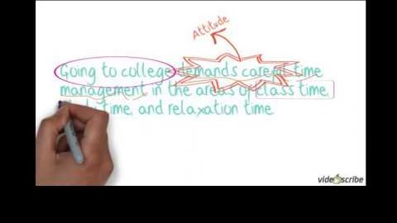
Thesis Statements
Notes:
Video source: Tulsaccprof. (2012, Dec. 17). Writing an effective thesis statement [Video]. YouTube. https://www.youtube.com/watch?v=4sx42_C10zw

Slide 26
Formulating a Thesis Statements
Research Question | How do authors use similar tropes but come up with different variations of the same character?​
Topic | Water cryptids
Claim | The Loch Ness Monster is one of the original water cryptids, but there are many more out there.​
Main Points | The Loch Ness Monster is unique.​ The Loch Ness Monster has a storied past. The Loch Ness Monster has a host of modern searches and sightings.​
Thesis Statement | Nessie is a mythological creature with a unique description, storied past, and a host of modern searches and sightings.

Slide 27
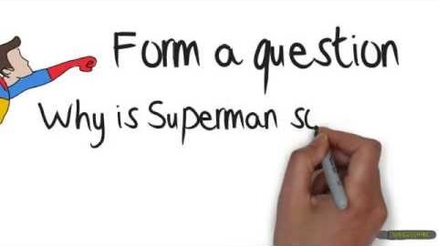
More About Thesis Statements
Notes:
Video source: Andrew. (2013, April 21). How to write a thesis for beginners [Video]. YouTube. https://www.youtube.com/watch?v=wCzuAMVmIZ8

Slide 28
Incorporating Evidence
Choose the right type of evidence.
Use quotation marks sparingly.
Paraphrase or summarize the evidence.
Include a topic sentence.
Explain the significance of the evidence.
Use a proper citation.
Follow a consistent citation style.
Avoid plagiarism.
Use a variety of sources and evidence.
Balance the use of evidence.
Notes:
Bailey, H. (2022, December 30). 10 Tips For Effectively Incorporating Evidence In Your Essay. Essay Freelance Writers. https://essayfreelancewriters.com/blog/tips-for-effectively-incorporating-evidence-in-your-essay

Slide 29
Choose the Right Type of Evidence
A-CLAP Strategy for Resources
Authority: Is there an author, editor, publisher, or institution provided? Does the individual or organization list their qualifications or credentials?
Currency: Is there a date that shows when the source was published or last updated? Keep in mind that not knowing the date of publication for factual or statistical information can call its accuracy into question.
Leaning: Look for objective sources that present information with a minimum of bias and without the intention to persuade. If a debatable issue is covered, are both sides presented?
Accuracy: Based on the reading you have already done on the subject, can you corroborate this information with other sources? Is factual information referenced in footnotes or a "Works Cited" list?
Purpose: Judge whether the source is geared to a scholarly or nonprofessional audience. Is the information relevant to your needs? If online, use the URL or other linked websites to help you determine its purpose.
Assess the reliability of each source you use in your research.
Notes:
Bailey, H. (2022, December 30). 10 Tips For Effectively Incorporating Evidence In Your Essay. Essay Freelance Writers. https://essayfreelancewriters.com/blog/tips-for-effectively-incorporating-evidence-in-your-essay

Slide 30
Using Quotation Marks
Quotation marks allow you to quote the original wording of a source directly.
Use quotation marks sparingly and only when the original wording is relevant or powerful.
Introduce the quotation with a clear topic sentence that explains the purpose of the quote and how it supports your thesis.
Don’t forget to follow proper citation styles!
Notes:
Bailey, H. (2022, December 30). 10 Tips For Effectively Incorporating Evidence In Your Essay. Essay Freelance Writers. https://essayfreelancewriters.com/blog/tips-for-effectively-incorporating-evidence-in-your-essay

Slide 31
Paraphrasing or Summarizing
Restating someone else’s words in our own way. When paraphrasing, it is important to maintain the meaning of the original sentence.
Delete unnecessary words.
Replace words and phrases with synonyms.
Change the order of words or phrases.

Slide 32
Organized Structure
Introduction
Background Information
Thesis Statement
Main Body Paragraphs
Conclusion

Slide 33
Paragraph Template
Topic sentence: State your main point in relation to the topic. If you are writing an essay, this is the first point you made in your thesis statement.
Concrete Detail/Quote #1:
Support your topic sentence with a strong quote and cite it properly.
Commentary/Analysis: Explain why or how the concrete detail supports your topic sentence. This is typically 2-3 sentences in length.
Concrete Detail/Quote #2:
Support your topic sentence with a strong quote and cite it properly.
Commentary/Analysis: Explain why or how the concrete detail supports your topic sentence. This is typically 2-3 sentences in length.
Conclusion Statement: Wrap up the paragraph and transition to the next topic.

Slide 35
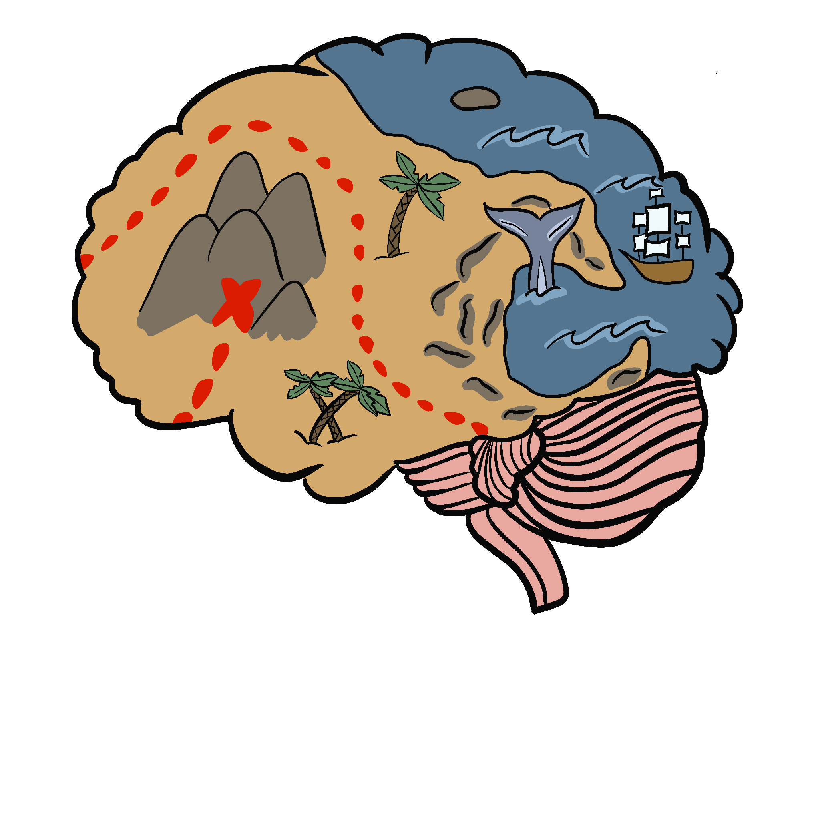
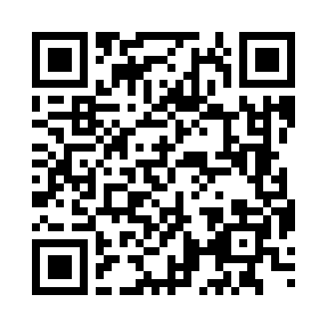
Mind Maps
Choose a resource from the Wakelet to learn more about the Oklahoma Octopus.
As you read, create a Mind Map of the important information you’re gathering.

Slide 36
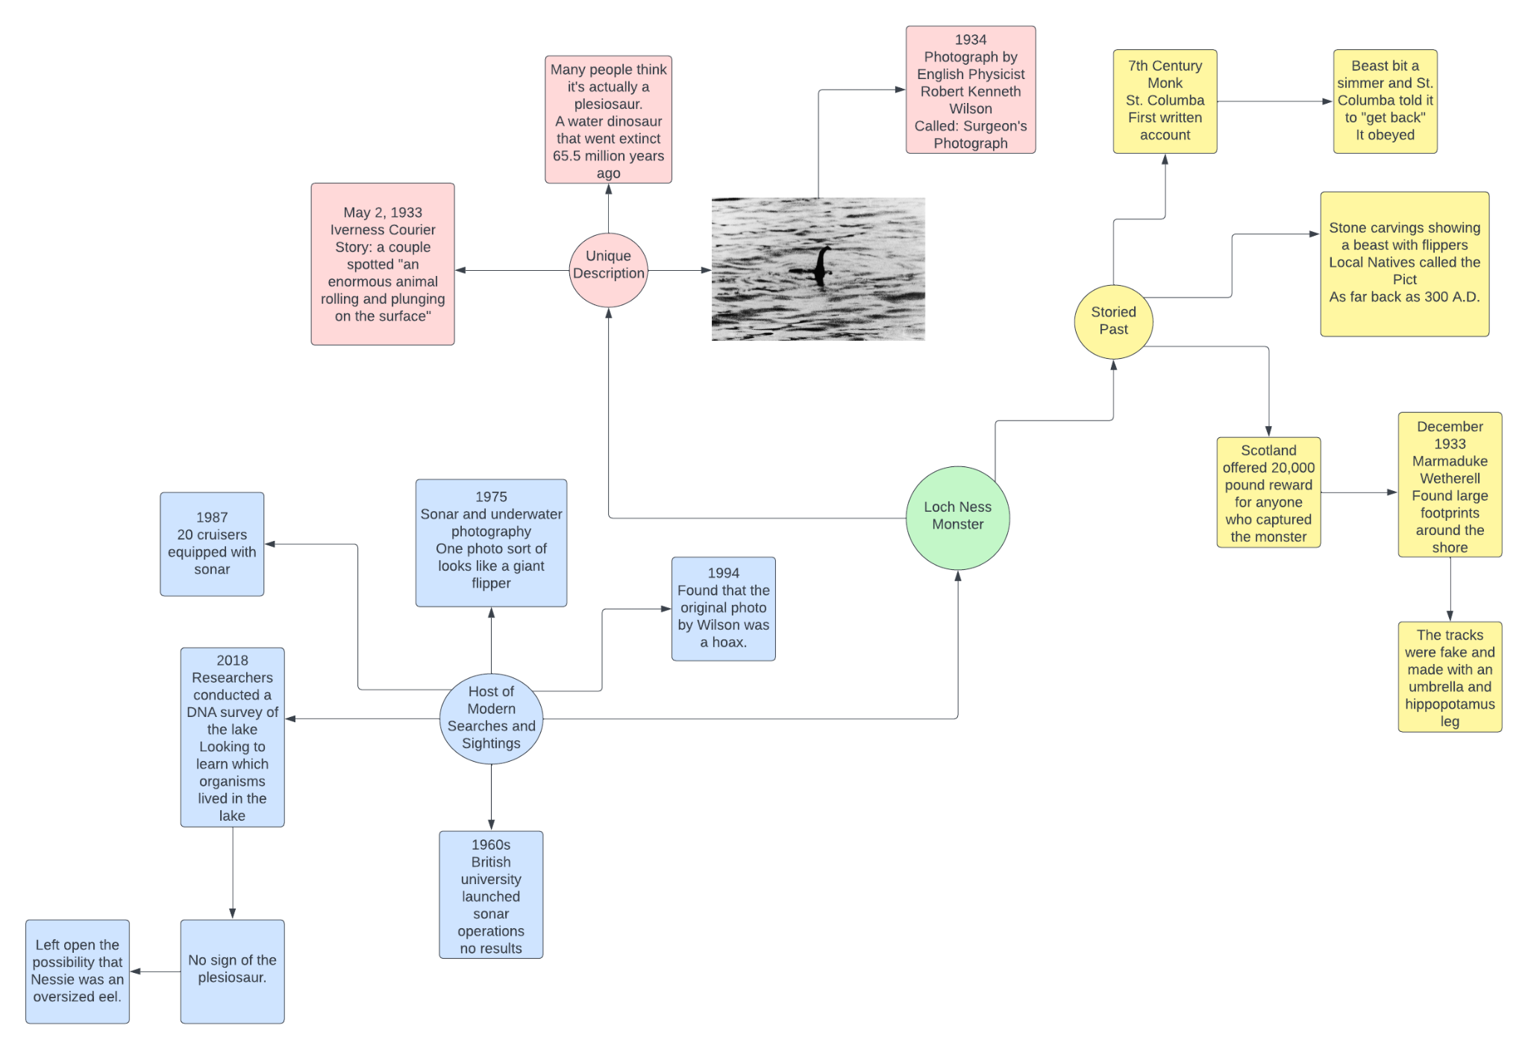

Slide 38
Peer Review
Review a partner’s writing using the Informative Writing Checklist. Take notes on the checklist.
Score each area on the checklist as:
Advanced
Intermediate
Beginning
Make sure to give your partner specific feedback for why you gave them the score you did. This will help both of you develop your informative writing skills.

