Slide 2
Moonward Bound
The Space Race

Slide 3
Essential Questions
What was the Space Race?
What was its impact on the United States and the world?

Slide 4
Lesson Objectives
Investigate the circumstances during the Cold War which led up to and occurred during the Space Race.
Examine the stories of individuals who played an active role in or were affected by the Space Race.

Slide 5

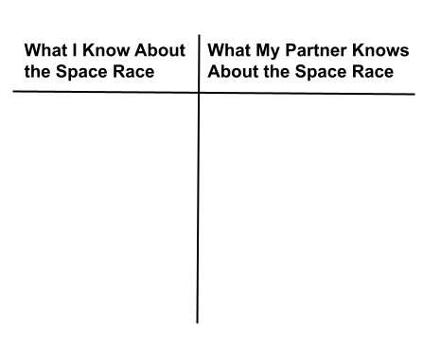
30-Second Expert
Divide and label your paper as shown in the illustration.
Notes:
K20 Center. (2021, July 30). 30-second expert. Strategies. https://learn.k20center.ou.edu/strategy/1048

Slide 6

30-Second Expert
First, take a few minutes to write down everything you know about the Space Race in the left column.
Next, turn to your partner and take a few minutes to write down everything they know about the Space Race in the right column.
Notes:
K20 Center. (2021, July 30). 30-second expert. Strategies. https://learn.k20center.ou.edu/strategy/1048

Slide 7

S-I-T
Read over the quotes from American astronauts, Russian cosmonauts, scientists, and politicians.
Record your thoughts.
  What is surprising to you?
  What is interesting to you?
  What is troubling to you?
Notes:
K20 Center. (2021, February 12). S-I-T (Surprising, interesting, troubling). Strategies. https://learn.k20center.ou.edu/strategy/926

Slide 8


Space Race Timeline
Click on the link to the timeline.
Read the first 3 entries covering the years from 1945-1955.
Explore the section of the timeline assigned to your group.
  Group 1: July 30, 1955 - Jan. 31, 1961
  Group 2: April 12, 1961 - June 3, 1965
  Group 3: Feb. 3, 1966 - July 17, 1975
Notes:
K20 Center. (2021, July 19). Fishbone. Strategies. https://learn.k20center.ou.edu/strategy/1664

Slide 9
Space Race Timeline (continued)
In the “Moon” space, write down the key outcome of your section of the timeline.
In each of the 3 spaces above the rocket, list a factor that helped the US achieve the outcome.
Next to each factor, list examples that show how the factor led to the outcome.
Repeat this process for the USSR in the 3 spaces below the rocket.
Notes:
K20 Center. (2021, July 19). Fishbone. Strategies. https://learn.k20center.ou.edu/strategy/1664

Slide 10
Donna Shirley
Donna is an aeronautical engineer and the former head of the Mars Exploration Program at NASA’s Jet Propulsion Laboratory.
She grew up in Wynnewood and went to college at the University of Oklahoma.
She was responsible for designing and building the Mars Rovers.
She is an advocate for increasing diversity and representation in STEM fields.

Slide 11
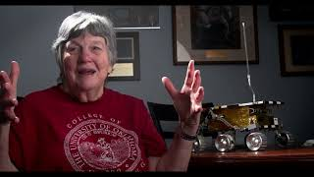
ICAP: Interview with Donna Shirley
Notes:
K20 Center. (2023, March 7). K20 ICAP - Moonward bound [Video]. YouTube. https://youtu.be/JZgVzrLKltQ

Slide 12

3-2-1
What are 3 things you learned about having a career in the aeronautics industry?
What are 2 things you would do if you wanted to pursue a career in a STEM field, such as aeronautical engineer?
What is 1 thing Shirley said that really resonated with you?
Notes:
K20 Center. (2020, September 16). 3-2-1. Strategies. https://learn.k20center.ou.edu/strategy/117

Slide 13

Exit Ticket
              NASA has announced the start of the Artemis program, which may have people landing on the Moon as soon as 2027.
              Do you think we should go back to the Moon?
              Explain your answer.
Notes:
K20 Center. (2020, September 16). Bell ringers and exit tickets. Strategies. https://learn.k20center.ou.edu/strategy/125

