Slide 2
How Will I Pay For My Car?
A Lesson for Personal Financial Literacy
Standard 7: Understanding Loans

Slide 3


Which Price is Right?
$27,999
$50,900
$35,690
$14,995
Notes:
Image source:
DeJong, M. (2017, September). Ford Mustang, Red. Pixabay. https://pixabay.com/photos/ford-mustang-red-exempt-and-edited-2767124/

Slide 4
Essential Questions
What are the procedures and responsibilities of borrowing money?
What procedures and responsibilities should be considered when borrowing money to buy a car?

Slide 5

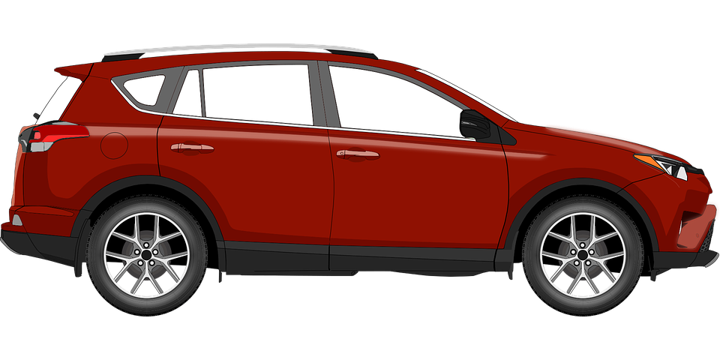
Elbow Partner Discussion
What are the pros and cons of buying a new car versus a used car?
2012 Hyundai Accent
$9,998 - 78,000 miles
2020 Hyundai Accent
from $15,295 - 0 miles
Notes:
Image sources:
Bastos, G. (2017 June). Car. Pixabay. https://pixabay.com/vectors/car-vei-vehicle-automobile-toyota-2404064/
OpenClipart-Vectors. (2016 November). Automobile. Pixabay. https://pixabay.com/vectors/automobile-car-blue-auto-1300458/

Slide 6

Elbow Partner Discussion
What additional costs should you consider when purchasing a car?

Slide 7
Additional Car Costs
Car title
Car tag
Interest rate on a car loan
Car insurance
Cost of gas

Slide 8
Car Loan Options
Bank loan
Payday loan company
Credit union
Car dealership

Slide 9
How do these lending options differ?
Bank loan
Payday loan company
Credit union
Car dealership
Source: www.investopedia.com
Will loan money to anyone quickly but with very high interest rates and fees.
Requires collateral (car) and/or a good credit score.
Finds a lender for you but you may pay a hidden fee for the service.
Must be a member of this lending agency to borrow any money from them.

Slide 10
Predatory Lending
Predatory lending refers to lending practices that convince a borrower to accept unfair terms through deceptive or exploitative actions. As a result, the borrow often ends up with a loan they do not need or cannot afford.
Predatory loans have high interest rates and high fees. These benefit the lender at the expense of the borrower.

Slide 11
2012 Hyundai Accent
$9,998 - 78,000 miles
2020 Hyundai Accent
from $15,295 - 0 miles
Notes:
Image sources:
Bastos, G. (2017 June). Car. Pixabay. https://pixabay.com/vectors/car-vei-vehicle-automobile-toyota-2404064/
OpenClipart-Vectors. (2016 November). Automobile. Pixabay. https://pixabay.com/vectors/automobile-car-blue-auto-1300458/

Slide 12

The Hidden Issues of Car Buying
Use the Internet to do your research.
Create a Window Notes poster for one of the following issues:
  Upside-down payments
  Non-payment of a car loan
  Bad credit score

Slide 13
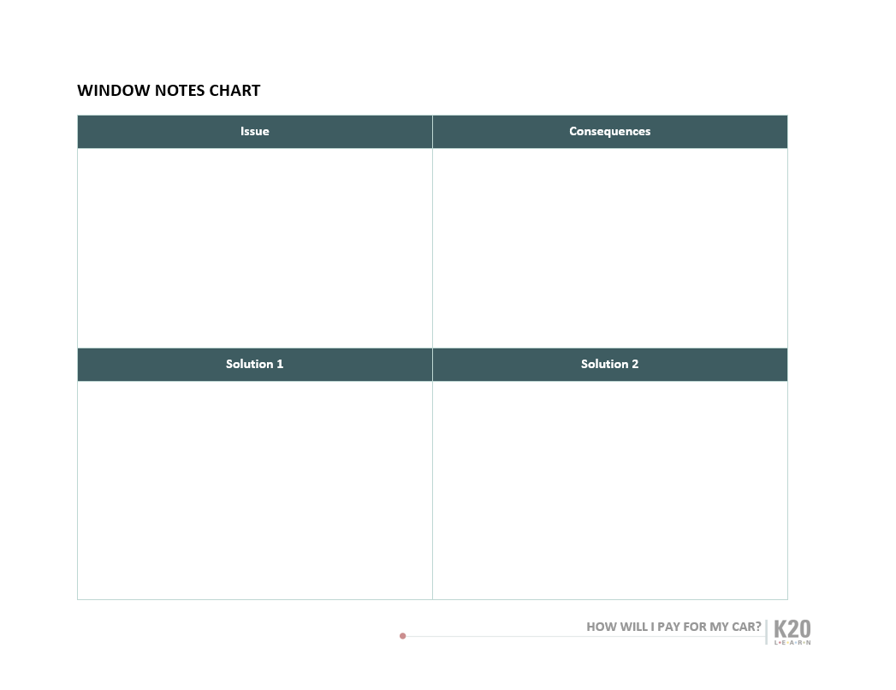
Window Notes

Slide 14
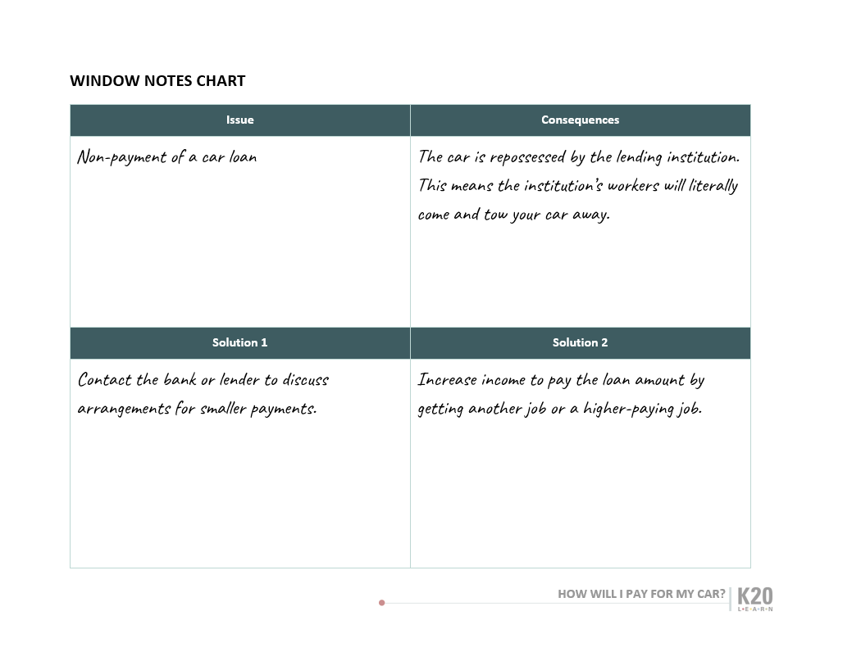

Slide 15
Class Discussion
How does non-repayment of loans, like a car loan, impact individuals, families, businesses, and the broader economic system as a whole?

