Slide 2
Responding to the Unthinkable
Introduction to the Holocaust

Slide 3
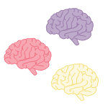
Collective Brain Dump
Take a few minutes to write down a list of the things you know happened during the Holocaust.
In small groups, share your list with each other and add anything you didn’t know to your list.
Share what you learned with the class.
Notes:
K20 Center. (n.d.). Collective brain dump. Strategies. https://learn.k20center.ou.edu/strategy/111

Slide 4
Essential Question
What were the events that led to and occurred during the Holocaust and how did the world respond to it?

Slide 5
Lesson Objectives
Interpret the reactions of survivors, victims, and liberators during the Holocaust.
Examine the causes and effects of the Holocaust and the impact that they had on the U.S. and the world.
Use a timeline to interpret the order of events that led up to and occurred during the Holocaust.

Slide 6
I Notice, I Wonder
In the top-left quarter of your Guided Notes sheet, write the things you notice about the film as you watch it.
After the film ends, write down in the top-right quarter anything you might be wondering about the film.
Notes:
K20 Center. (n.d.). I notice, I wonder. Strategies. https://learn.k20center.ou.edu/strategy/180
Singer, M. (2015, October 6). Pigeon trigger film Holocaustmov [Video]. YouTube. https://youtu.be/UyeAYtI1Xzw

Slide 7
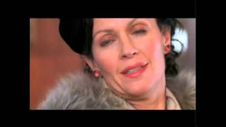
Pigeon
https://youtu.be/UyeAYtI1Xzw
Notes:
Singer, M. (2015, October 6). Pigeon trigger film Holocaustmov [Video]. YouTube. https://youtu.be/UyeAYtI1Xzw
Facing History and Ourselves. (2022, April 14). Pigeon. https://www.facinghistory.org/resource-library/pigeon

Slide 8
I Notice, I Wonder
In the bottom-left quarter of your Guided Notes sheet, write things you notice about your page of the timeline as you read it.
Share what you learned with your group and write a few things you learned from them in the Notice section.
After sharing, write down in the bottom-right quarter anything you might be wondering about what happened during the Holocaust.
Notes:
K20 Center. (n.d.). I notice, I wonder. Strategies. https://learn.k20center.ou.edu/strategy/180
K20 Center. (n.d.). Jigsaw. Strategies. https://learn.k20center.ou.edu/strategy/179

Slide 9
Fishbone
Review the notes you have taken on the key events that occurred during the Holocaust.
Then, identify six key contributing factors leading up to the Holocaust.
Write each factor in the corresponding space of your handout.
Notes:
K20 Center. (n.d.). Fishbone. Strategies. https://learn.k20center.ou.edu/strategy/1664

Slide 10
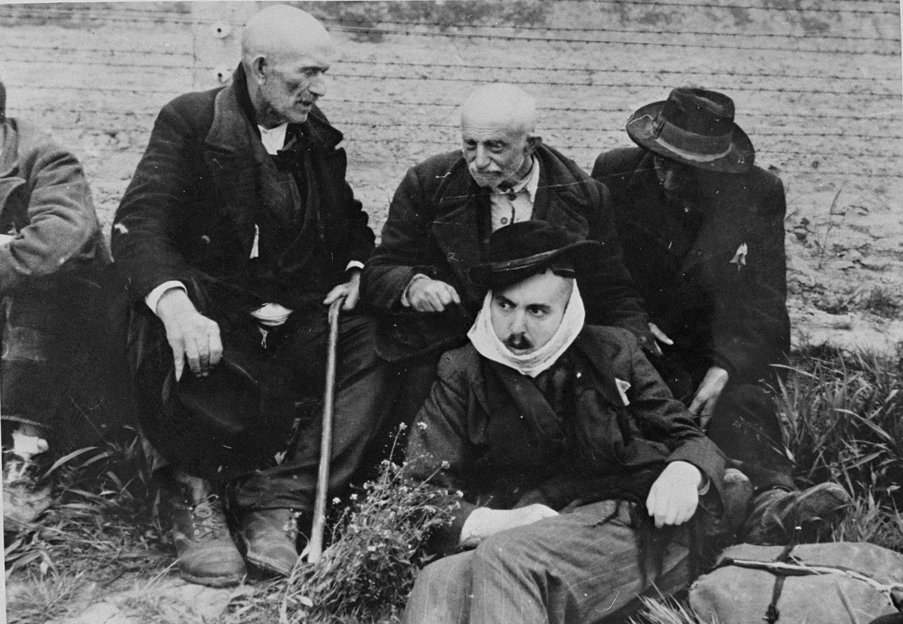
Survivor/Victim Profiles
Choose two survivors and/or victims from the US Holocaust Memorial Museum Identification Cards.
On a piece of paper, write their name and summarize their experiences.
Share what you learned about them with your classmates.
Notes:
United States Holocaust Memorial Museum. (n.d.). Elderly Jewish men from Subcarpathian Rus sit on the grass in Auschwitz-Birkenau prior to being sent to the gas chambers.
Photograph | Photograph Number: 77287. https://collections.ushmm.org/search/catalog/pa9359

Slide 11
How Am I Feeling? What Am I Thinking?
After evaluating the events leading up to the Holocaust and the effects it had on many people, answer the following questions:
How are you feeling about what you have learned?
What do you think are the reasons the United States and other Allied nations wanted to hold Germany accountable?
Notes:
K20 Center. (n.d.). How am I feeling? What am I thinking? Strategies. https://learn.k20center.ou.edu/strategy/187

