Slide 2
Diamonds, Not Just a Girl’s Best Friend
Comparing the Quilts of Indigenous Plains People with Tessellations of M.C. Escher

Slide 3
Sketchnotes
As you watch the video, take visual notes. These can be:
Images
Dots
Lines
Arrows
Diagrams
Your notes should include the following:
Main idea
Key information
New knowledge

Slide 5
Essential Questions
How can an artist use the principles of design to create effective art?
How can the principles of design help an artist convey mood and meaning?

Slide 6
Learning Objectives
Students will be able to:
Understand the Principles of Design
Analyze the artwork in the Plains Tribes’ quilts

Slide 7
Lakota Quilt History
On a blank piece of paper, draw a T-Chart and label it with the following:
What I Know About This
What I Learned From My Partner
Once you’re done reading, fill in the “What I Know About This” column with everything you remember from the reading.
What I Know About This | What I Learned From My Partner

Slide 8
Lakota Quilt History
Share what you wrote with your partner. You have 30 seconds!
Summarize what your partner shared with you in the “What I Learned From My Partner” column.

Slide 9
Diamond Art Instructions
Lightly trace the pattern onto your paper
Make a design in the style of the Plains tribes quilt patterns

Slide 11
Principles of Design

Slide 12
Balance
A distribution of visual weight on either side of the vertical axis.
Symmetrical balance uses the same characteristics.
Asymmetrical balance uses different but equally weighted features.

Slide 13
Emphasis or Focal Point
Used to make certain parts of an artwork stand out. It creates a center of interest or focal point. It is the place in which an artist draws your eye to first.

Slide 14
Contrast
Difference in theme, imagery, and color to strengthen the other principles of the piece.
The arrangement of opposite elements in a composition so as to create visual interest.
Light versus dark
Rough versus smooth
Small versus large

Slide 15
Movement
How the eye moves through the composition, leading viewer attention from one aspect of the work to another.
Using line, shape, and form to create the illusion of motion.

Slide 16
Pattern
Systematic and repetitive use of the same motif or design.
The repetition of specific visual elements such as a unit of shape or form.
A method used to organize surfaces in a consistent regular manner.

Slide 17
Rhythm
Regular repetition or alteration of elements to build interest and create cohesion through aspects like elements, shapes, colors, or patterns with intentional subtle variations.

Slide 18
Unity
Using compositional elements to create harmony and wholeness to a work.
Visually pleasing agreement among the elements in a design.
The feeling that everything in the work of art works together and looks like it fits.

Slide 19
Variety
Using compositional elements to create tension and dissonance in a work.

Slide 20
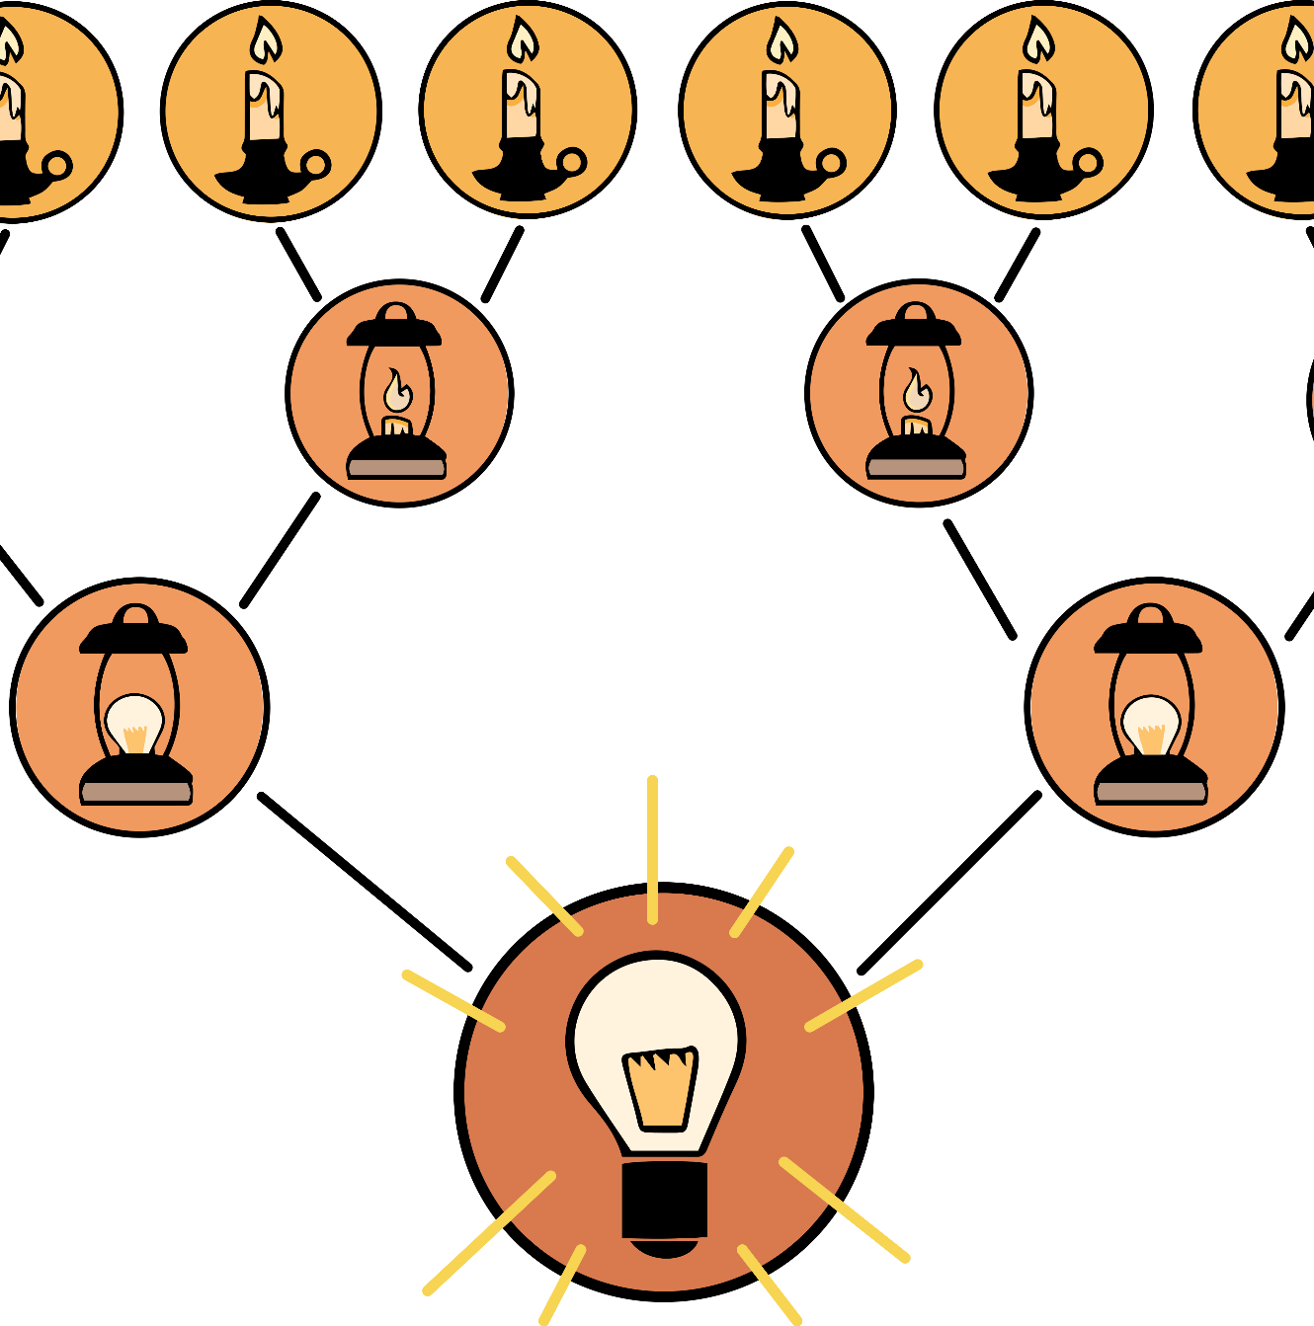
8-Up
Think about your quilt design activity.
What three words best describe the design you created?

Slide 21
8-Up
With your group:
Read through your sticky notes.
Come to a consensus on three words that best describes the quilt design activity.

Slide 22
8-Up
With your new group:
Read through your sticky notes.
Come to a consensus on two words that best describes the quilt design activity.

Slide 23
8-Up
With your new group:
Read through your sticky notes.
Come to a consensus on two words that best describes the quilt design activity.
After three minutes, as a class, we will decide on one word that best describes the quilt design activity

Slide 24
The Principles of Design
Balance
Emphasis/Focal Point
Contrast
Movement
Pattern
Rhythm
Unity
Variety

Slide 25
Sticky Bars
Place your sticky note on the board under the Principle of Design that best represents your tessellation design.
With those who selected the same principle as you, discuss why you believe it is the most applicable design to your work.

Slide 26
Gallery Walk
Review your peers art work around the room.
Write a positive review on a sticky note for at least one of the designs.

Slide 27
It’s OPTIC-al
On your paper, write OPTIC down the left side.
O- write observations about the visuals you see
P- list the parts, or details, you notice
T- assess the title
How does it relate?
If there is no title, give it one
I- determine the interrelationships of the visuals
How do they work together?
C- come to a conclusion about the image

Slide 28
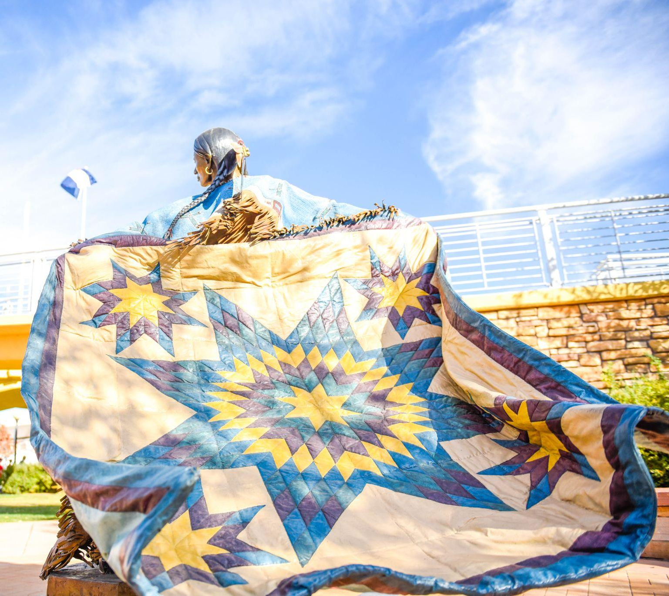
It’s OPTIC-al
On your paper, write OPTIC down the left side.
O- write observations about the visuals you see
P- list the parts, or details, you notice
T- assess the title
How does it relate?
If there is no title, give it one
I- determine the interrelationships of the visuals
How do they work together?
C- come to a conclusion about the image
Notes:
ACWA, P. (2018). Pueblo River Walk Sculpture of the Lakota Sioux Tribe. flickr. Retrieved July 6, 2023, from https://www.flickr.com/photos/acwa/45058507815.

Slide 29
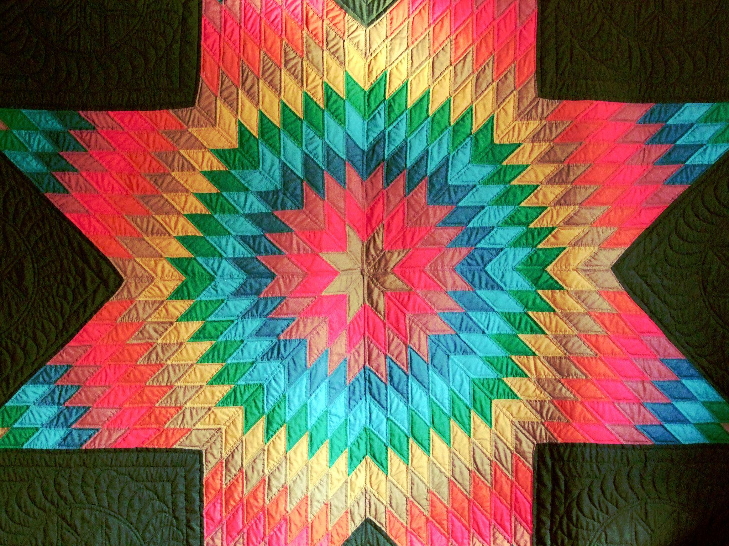
It’s OPTIC-al
On your paper, write OPTIC down the left side.
O- write observations about the visuals you see
P- list the parts, or details, you notice
T- assess the title
How does it relate?
If there is no title, give it one
I- determine the interrelationships of the visuals
How do they work together?
C- come to a conclusion about the image
Notes:
Elstef. (2020). Star shaped patch sewing. PXhere. Retrieved July 6, 2023, from https://pxhere.com/en/photo/1605062#google_vignette.

Slide 30
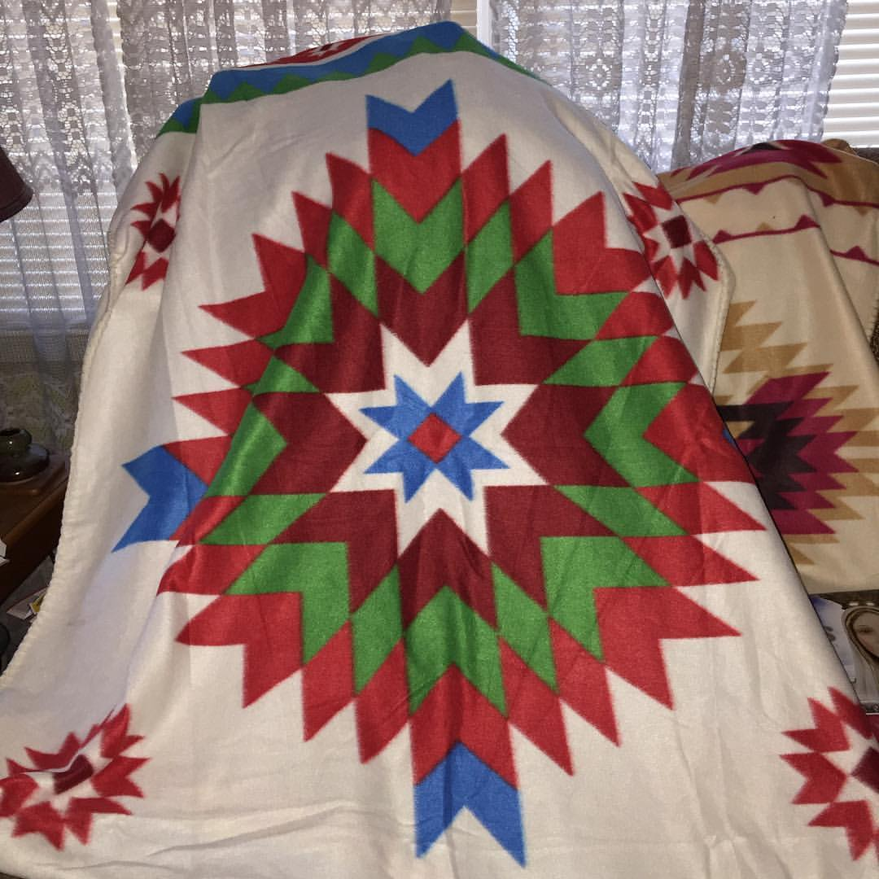
It’s OPTIC-al
On your paper, write OPTIC down the left side.
O- write observations about the visuals you see
P- list the parts, or details, you notice
T- assess the title
How does it relate?
If there is no title, give it one
I- determine the interrelationships of the visuals
How do they work together?
C- come to a conclusion about the image
Notes:
Alter, T. (2016). I got another blanket from the Northern Cheyenne and Crow Missions I support. flickr. Retrieved July 6, 2023, from https://www.flickr.com/photos/78428166@N00/30414560965.

