Slide 2
Yours, Mine, and Ours Part 2
Powers of the Federal Government and the States

Slide 3
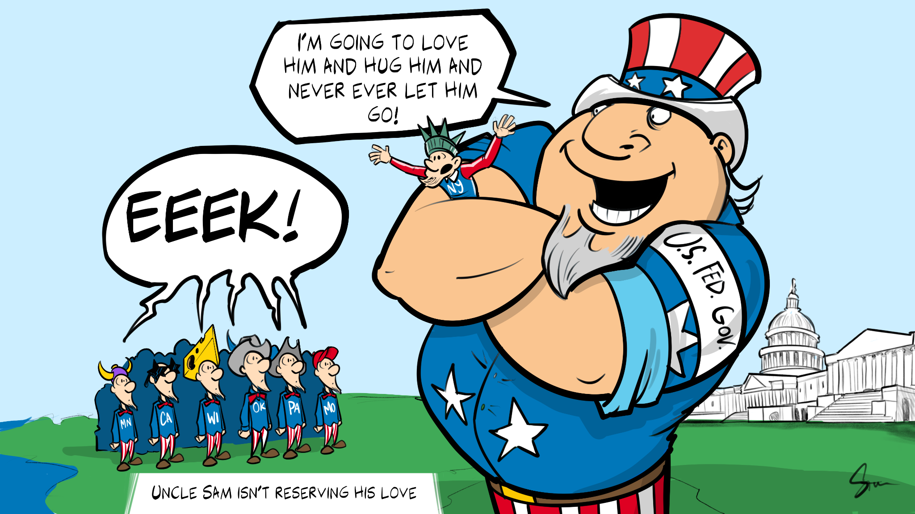
Bell Ringer
Write down 3 observations you notice about the cartoon.
Notes:
K20 Center. (n.d.). Bell ringers and exit tickets. Strategies. https://learn.k20center.ou.edu/strategy/125

Slide 4
Essential Question
How is power shared in a federal system?

Slide 5
Lesson Objective
Explain the powers that are exclusively for the federal government, the states, and shared between both.

Slide 6
Powers Readings
Pass out each half-page reading to a member of your group.
Write down a description of each power and an example.
Share what you have learned with your group.
Fill in your notes as you listen to the other group members.
Notes:
K20 Center. (2020). Jigsaw. Strategy. https://learn.k20center.ou.edu/strategy/179

Slide 7
Reflection Questions
Why are the powers of the government divided?
How do the federal government and the states have to work together?
What potential struggles could come from the way power is divided between the federal government and the states?

Slide 8
Powers of the Government
Power | Notes
Enumerated (Expressed) | Coin money and borrow money. Set up a military, declare war, and approve treaties. Issue copyrights and patents. Maintain the post office. Set up and maintain the citizenship process.
Implied | Found in the Necessary and Proper Clause. Set a minimum wage. Establish a draft. Punish tax evasion and mail fraud.

Slide 9
Powers of the Government
Power | Notes
Denied | Suspend habeas corpus Bill of Attainder Pass Ex Post Facto laws Grant nobility titles
Reserved | Conduct elections Maintain an education system Grant licenses Regulate businesses
Concurrent | Power to pass laws Collect taxes and borrow money Punish criminals and set up courts Regulate trade

Slide 10
Powers Illustrations
Shh! Keep your power a secret!
Create an illustration that describes the governmental power you were assigned.
Use your notes to help you illustrate the power.
Notes:
K20 Center. (n.d.). Masterpiece Match-Up. Strategies. https://learn.k20center.ou.edu/strategy/2218

Slide 11
Powers Illustrations
View each illustration that describes a governmental power.
Take notes over what you see.
Make an informed guess about what power each illustration is describing.
Notes:
K20 Center. (n.d.). Masterpiece Match-Up. Strategies. https://learn.k20center.ou.edu/strategy/2218

Slide 12
https://www.youtube.com/watch?v=1ROJjabQpO8
Notes:
YouTube. (2020, November 10). South Dakota v. Dole | Bri's homework help series. YouTube. Retrieved March 16, 2023, from https://www.youtube.com/watch?v=1ROJjabQpO8

Slide 13
South Dakota v. Dole
How did the Congress use their power to change the drinking age in the states?
In your opinion, should drinking age be decided at the federal level or left up to each state?
What other ways could Congress influence the states to change their laws?

Slide 14
Justified True or False
Choose any ten statements out of the fifteen listed.
Read each statement and decide whether it or not it would be allowed by the federal government according to the US Constitution.
Mark True for yes and False for no.
Explain your reason for choosing true or false.
Notes:
K20 Center. (n.d.). Justified True or False. Strategies. https://learn.k20center.ou.edu/strategy/174

