Slide 2
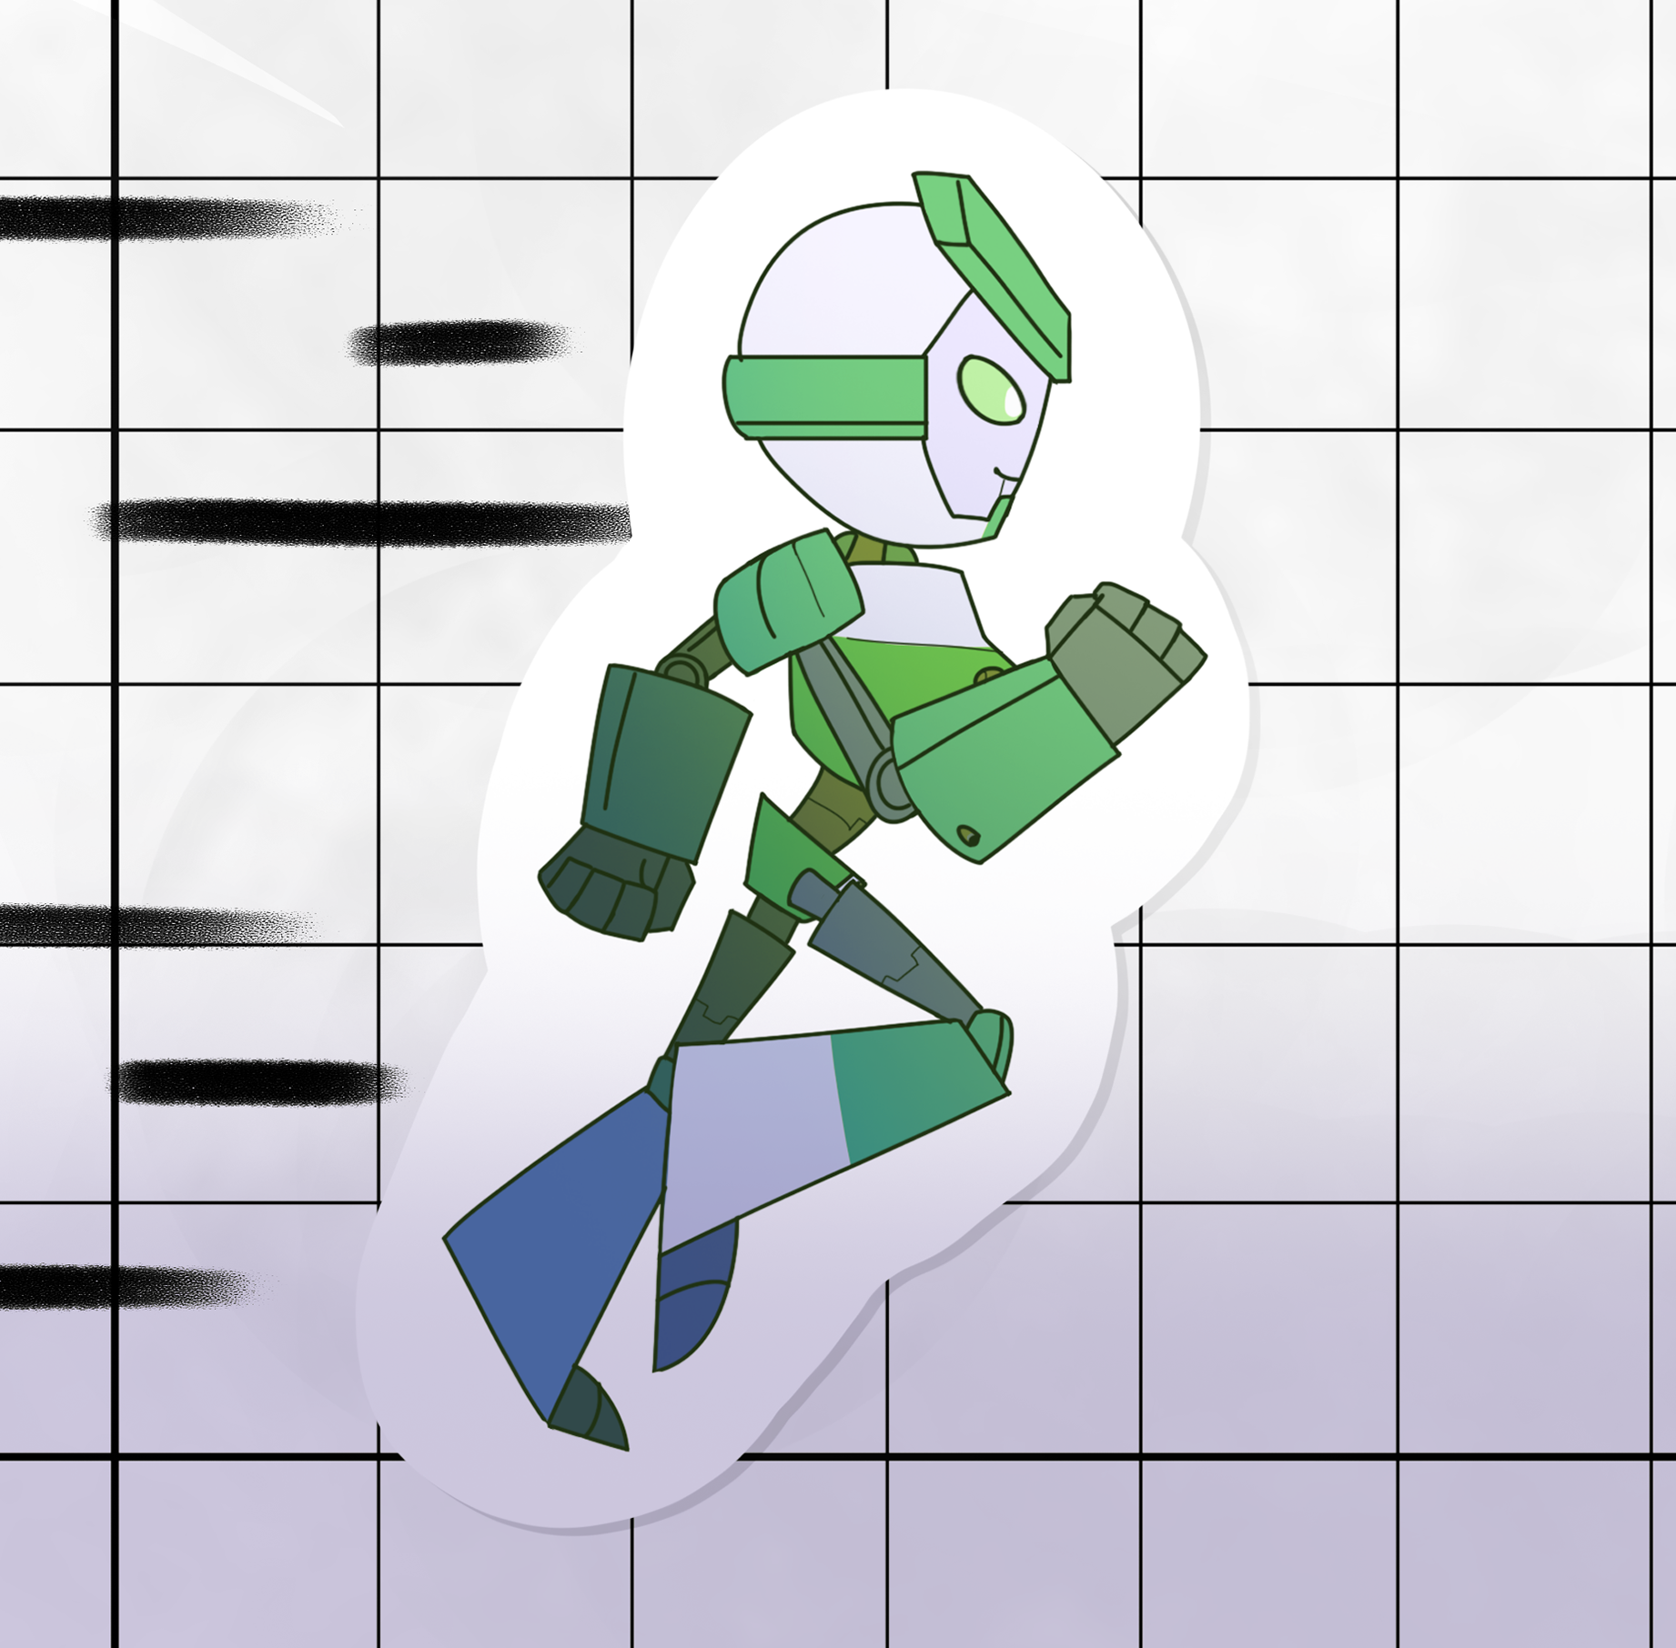
Transformers, Part 1
Function Transformations

Slide 3
Essential Question
How are the transformations of parent graphs related?

Slide 4
Learning Objectives
Analyze basic transformations on a variety of parent graphs.
Generalize patterns to create rules for function transformations.

Slide 5

Think-Pair-Share
Compare the following equations:
Notes:
K20 Center. (n.d.). Think-Pair-Share. Strategies. https://learn.k20center.ou.edu/strategy/139

Slide 6
Discussion
Why does changing the y-intercept do something different from changing the slope?

Slide 7
Exploring Graphs: Observations
In Part I, make predictions, then graph the different absolute value functions.
  Use a handheld graphing calculator or go to desmos.com.
Make notes about how each graph is different from the parent graph.
  Use mathematical reasoning and terms.
In Part II, make predictions, then graph the different quadradic functions.

Slide 8
Exploring Graphs: Discussions
What were the changes to the absolute value function based on the handout?
What were the changes to the quadratic function handout?
What are the general rules of transformations?

Slide 9
Create Your Own
Work together to create the following:
  Absolute Function Equation (no graph)
  Absolute Function Graph (no equation)
  Quadratic Function Equation (no graph)
  Quadratic Function Graph (no equation)
Once you have created those four components, switch with another group and have them find the equation if given a graph or create the graph if given the equation.

Slide 10
Challenge Question
Graph the following equation.
How does the negative symbol affect the graph?
Notes:
K20 Center. (n.d.). Think-Pair-Share. Strategies. https://learn.k20center.ou.edu/strategy/139

Slide 11
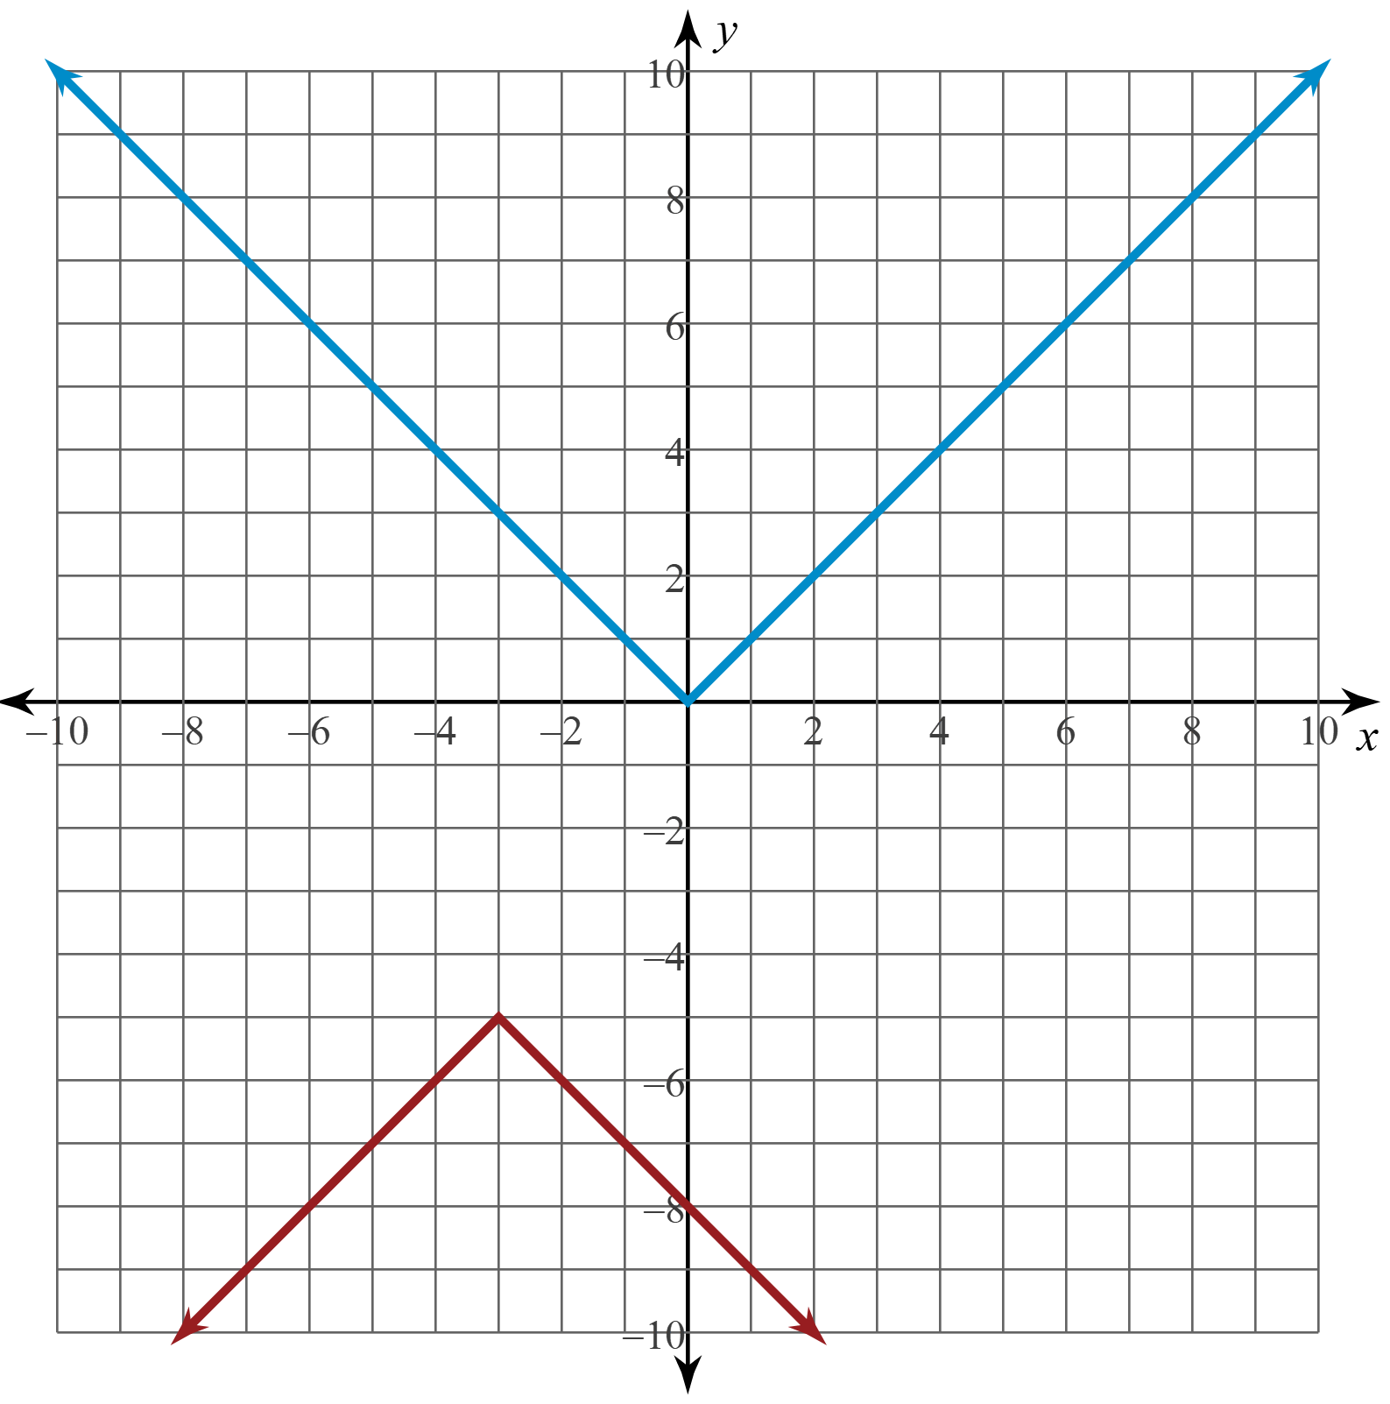
Challenge Question
(Graph)

