Slide 2
Les Stéréotypes Alimentaires
Examining Stereotypes in French Cuisine

Slide 3
Essential Questions
What are stereotypes?
How does learning about other cultures affect our conception of others?

Slide 4
Lesson Objectives
Students will investigate common stereotypes around French food.
Students will examine culinary aspects of French culture and design their own food menu.

Slide 5
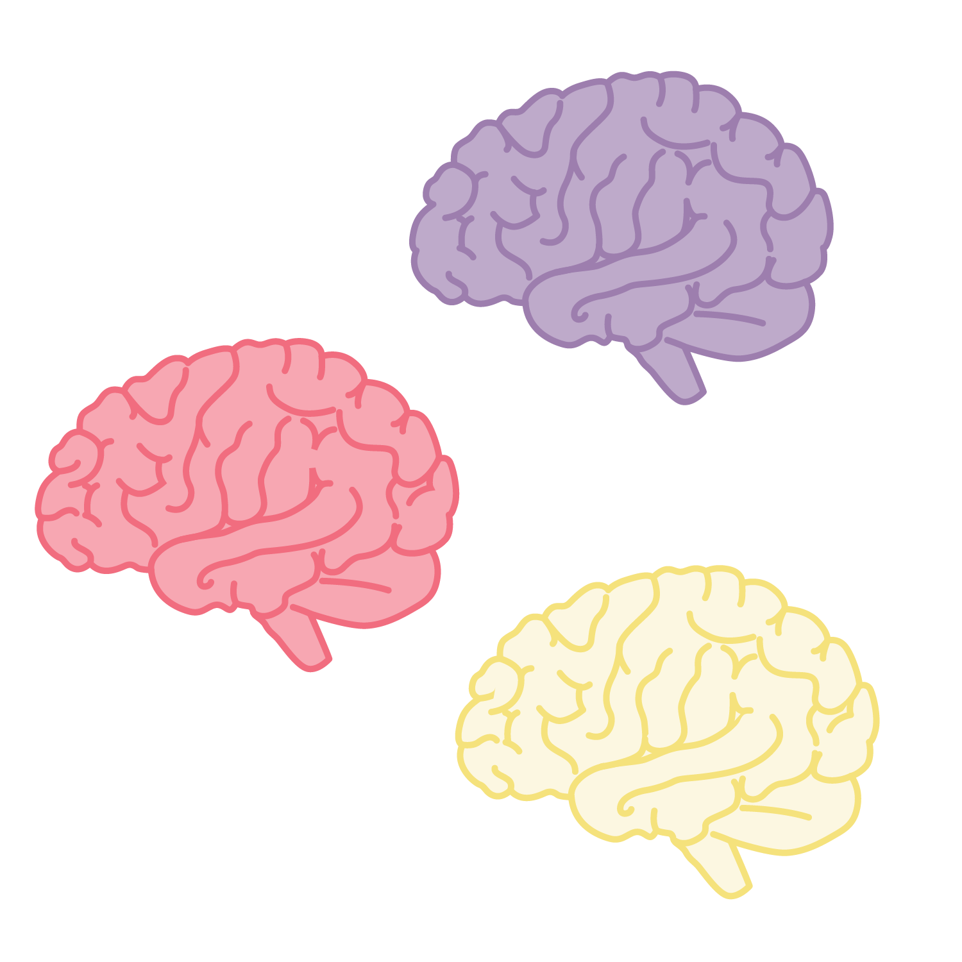

Collective Brain Dump with Mentimeter
Scan the QR code, or follow the link below, and answer the following question: “What are stereotypes?”
insert link and QR here
Notes:
K20 Center. (n.d.). Collective brain dump. Strategies. https://learn.k20center.ou.edu/strategy/111
K20 Center. (n.d.). Mentimeter. Tech Tools. https://learn.k20center.ou.edu/tech-tool/645

Slide 6

I Think / We Think
Using your handout, answer the two following questions:
  “What are some characteristics of French food?”
  “What kinds of foods do you think French people like to eat?”
Record your answers on the “I Think…” side of your page.
Find a small group and discuss your answers. Write the group responses on the “We Think…” side of the page.
Notes:
K20 Center. (n.d.). I think / We think. Strategies. https://learn.k20center.ou.edu/strategy/141

Slide 7

T-Chart
American Food | French Food
Notes:
K20 Center. (n.d.). T-chart. Strategies. https://learn.k20center.ou.edu/strategy/86

Slide 8

Food Clichés in Emily in Paris
Notes:
Edukale by Lucie. (2020, November 13). EMILY IN PARIS FOOD STEREOTYPES: true or false? French nutritionist reacts! | Edukale [Video]. YouTube. Retrieved March 16, 2023, from https://www.youtube.com/watch?v=5QCMQOxmJjM&t=429s

Slide 9

“Worst French Food” video
Notes:
Easy French. (2021, May 15). Famous French food French people actually hate | Easy French 128 [Video]. YouTube. Retrieved March 16, 2023, from https://www.youtube.com/watch?v=nLX8-ORCS-4

Slide 10
T-Chart Revisited
American Food | French Food
Notes:
K20 Center. (n.d.). T-chart. Strategies. https://learn.k20center.ou.edu/strategy/86

Slide 11
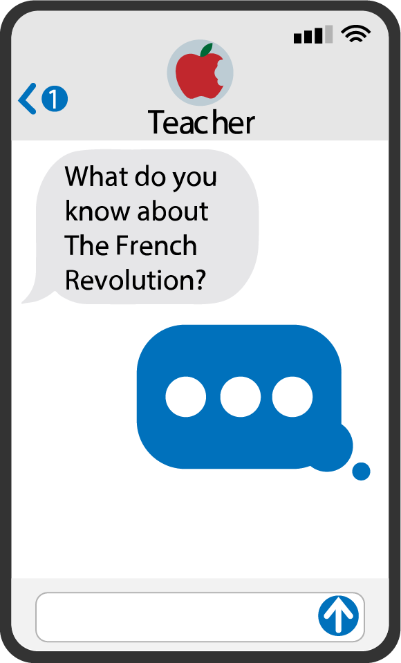
Quick Write
Take ten minutes to answer the prompt:
  “What are stereotypes? How do they affect the ways we think about and treat each other? Do stereotypes help us get to know people? If not, how can you move beyond stereotypes when learning about different peoples and cultures?”
Focus on content; don’t worry too much about grammar.
Notes:
K20 Center. (n.d.). Quick write. Strategies. https://learn.k20center.ou.edu/strategy/1127

Slide 12
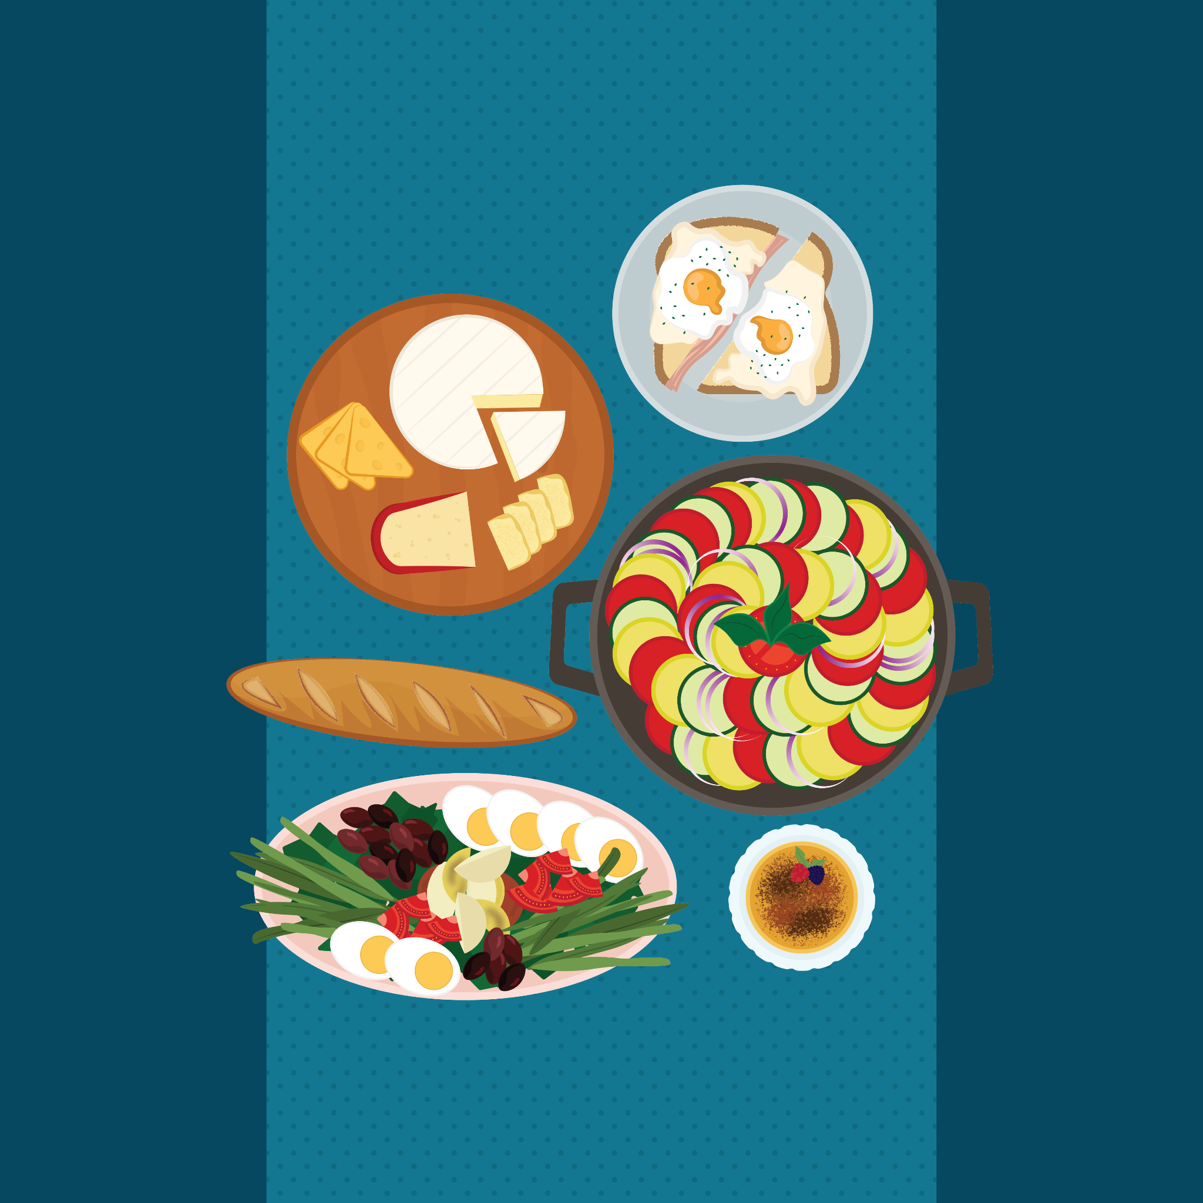
French Dinner Handout
Read through the instructions on your handout.
Plan a traditional French meal for your friends.

