Slide 2
Phenology & Climate Change
Lesson 1: Insect Activity and Migration Timing

Slide 3
Essential Question
How do insect activity and migration change seasonally?
Why is the timing of seasonal insect activity and migration important?

Slide 4
Lesson Objectives

Slide 5
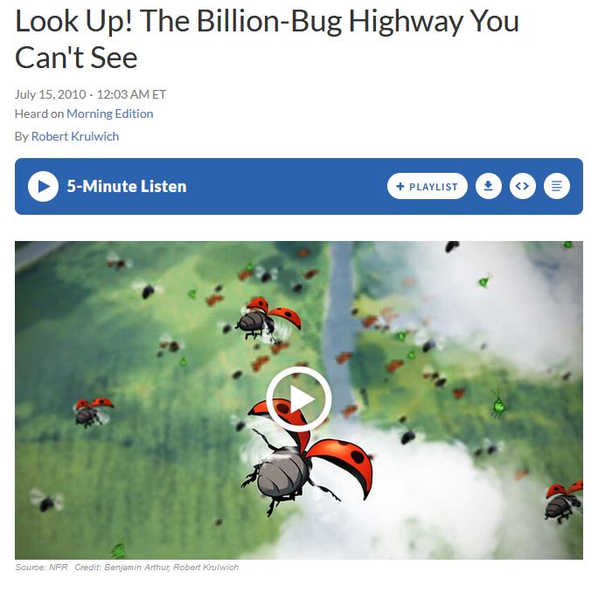
Billion-Bug Highway
As you listen to the story, write down any questions you have on individual sticky notes.
Notes:
https://www.npr.org/sections/krulwich/2011/06/01/128389587/look-up-the-billion-bug-highway-you-cant-see

Slide 6
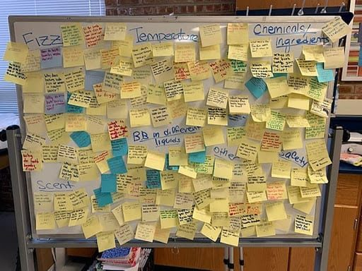
Driving Question Board
Everyone stand up
Each person will share one question at a time
If one of your questions is shared by someone else, you can set it aside
Once all your questions have been shared, sit down
Notes:
https://www.openscied.org/wp-content/uploads/cc_resize/dqb-bath-5c731-0x384.jpeg

Slide 7
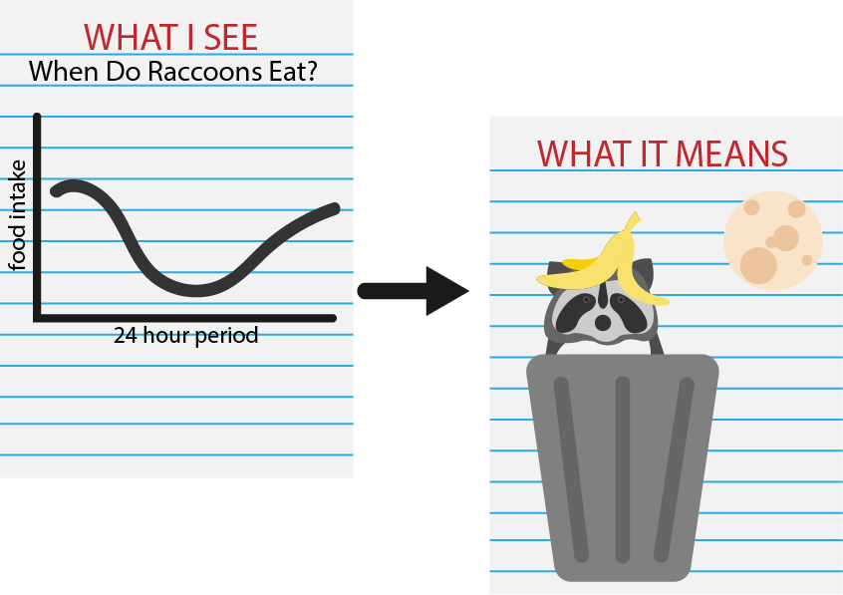
What I See - What it Means (WIS-WIM)
What I See: Make observations about what you see on the graph(s) and annotate them.
What It Means: Interpret the meaning of each observation you made.
In a sentence or two, explain what the figure communicates.

Slide 8
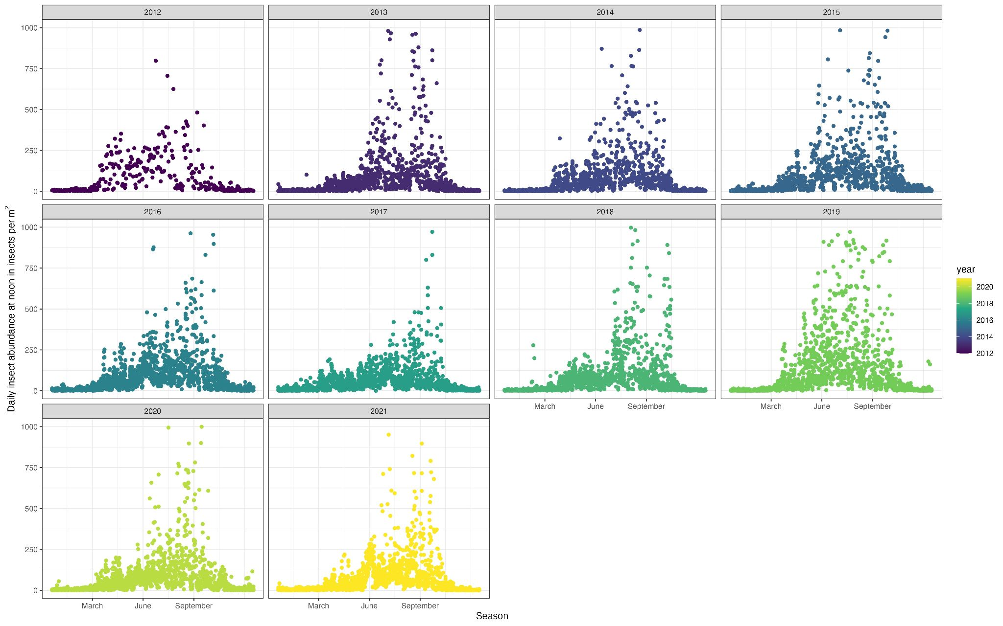

Slide 9
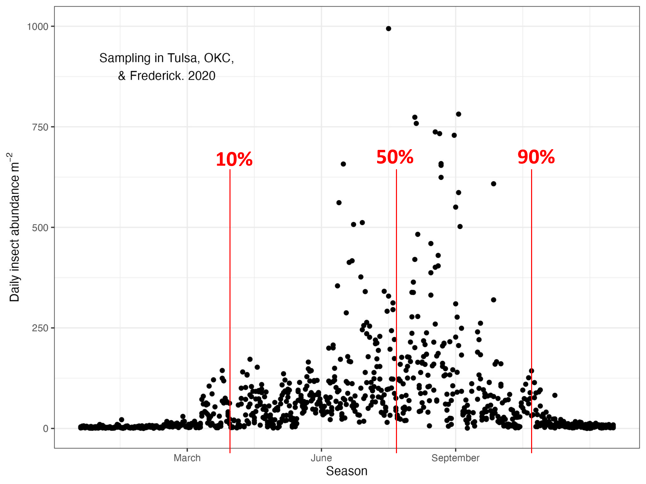
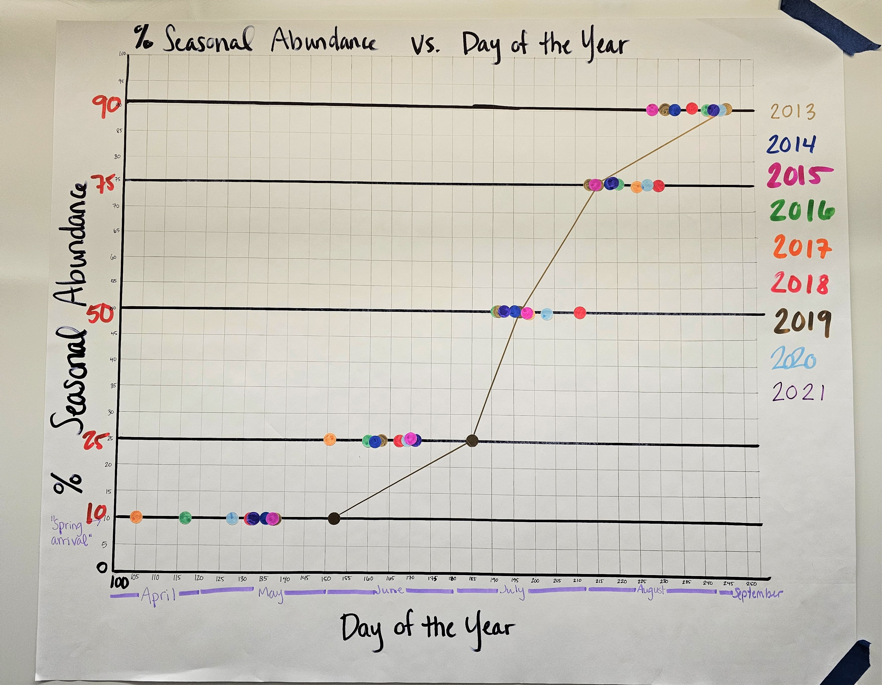
How are the graphs related?
Notes:
The left graph shows a daily measurement of insect abundance across 3 sampling locations in Oklahoma in 2020. From this annual data, researchers calculated the points at which 10%, 25%, 50%, 75%, and 90% of insects were detected over the entire year (10, 50, and 90 pictured as red lines). These percentages are what students plotted on the group graph (example pictured on the right).

Slide 10
Insect migration
migration: movement of animals from one area to another in response to changes in season or the environment
dispersal: movement of organisms away from their birthplace/parent(s)
Almost every insect order has some high-altitude, long-distance migrants
Many long-distance migrants are crop pests
Some insect taxa have life stages with mass flights
Movement of insects has consequences for ecosystem services.
Notes:
Close to the ground, larger and stronger flying insects such as monarchs or bumblebees are moving. For less strong flyers they use air pressure to ascend to higher levels where wind assistance allows them to move hundreds of miles across the landscape, crossing water bodies and entire continents. Some of the insects in the air are long distance dispersers. Those coming from far include insects that show up in your fields in March. Many insects occur in higher levels of the aerosphere without moving long distances across the landscape. For some taxa, there are distinct life stages where insects take to the air in high abundances, such as grasshopper swarms, and mayfly emergence, and mating ant and termite flights. This movement of insects represents an influx of herbivores or predators or parasitoids, seeding next generations. It has important ramifications for the flow of nutrients and biomass, and for gene flow, as well as transport of pathogens or pollen.

Slide 11
Why migrate?
Why might long-distance migration be risky?
Risk of dying along the way
May not find suitable habitat
High cost to develop strong muscles & large wings and store energy
Most likely in species that develop quickly, produce many offspring, and invest little in each individual
These life history traits can quickly make use of new favorable habitats

Slide 12
Why migrate?
Make use of a much larger range of habitats that aren’t available in the winter
Reduce rates of parasitism
Increase gene flow
Spread out the risk of predation, competition, varied habitat quality
Notes:
Spread reproductive effort across multiple locations, reducing the risk of predation, competition, changes in habitat quality

Slide 13
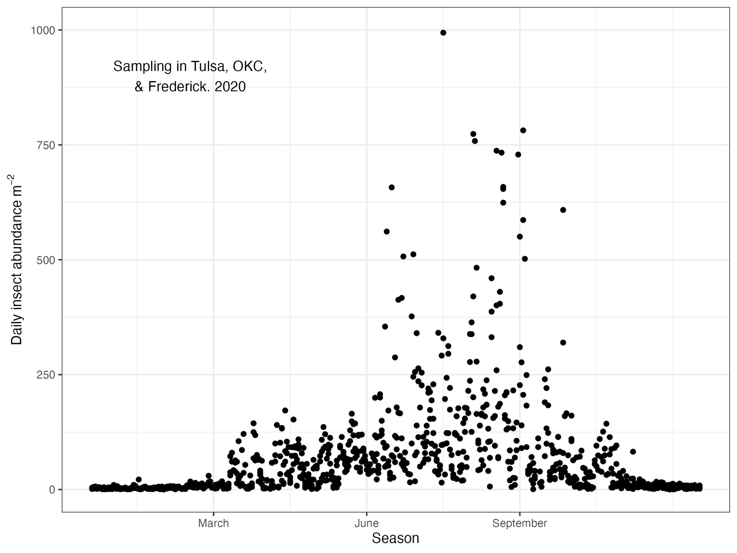
Phenology
phenology: timing of seasonal life history events
Plant green-up, bird hatch date, migration, insect emergence, etc.
Closely linked to the environment because phenology needs to match when resources are available

Slide 14
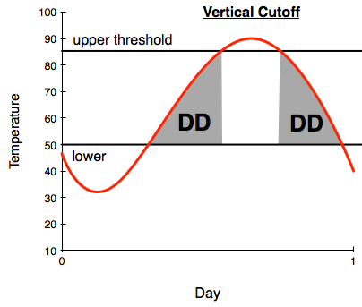
Degree days
The number of days within a specific temperature range (DD)
Some insect phenology is affected by degree days, not just temperature itself (especially development)

Slide 15
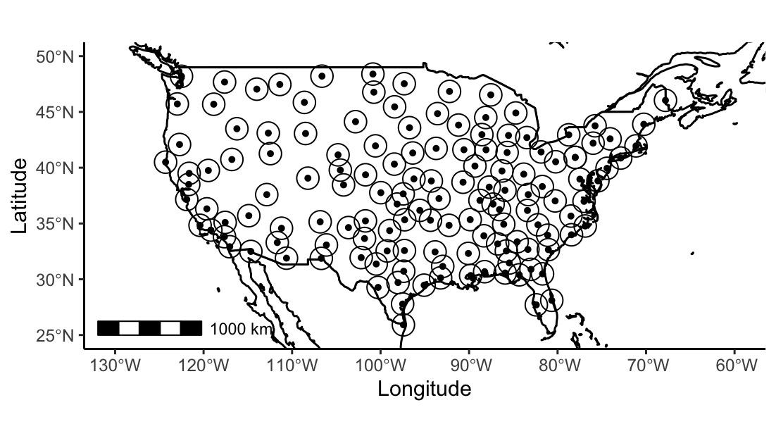
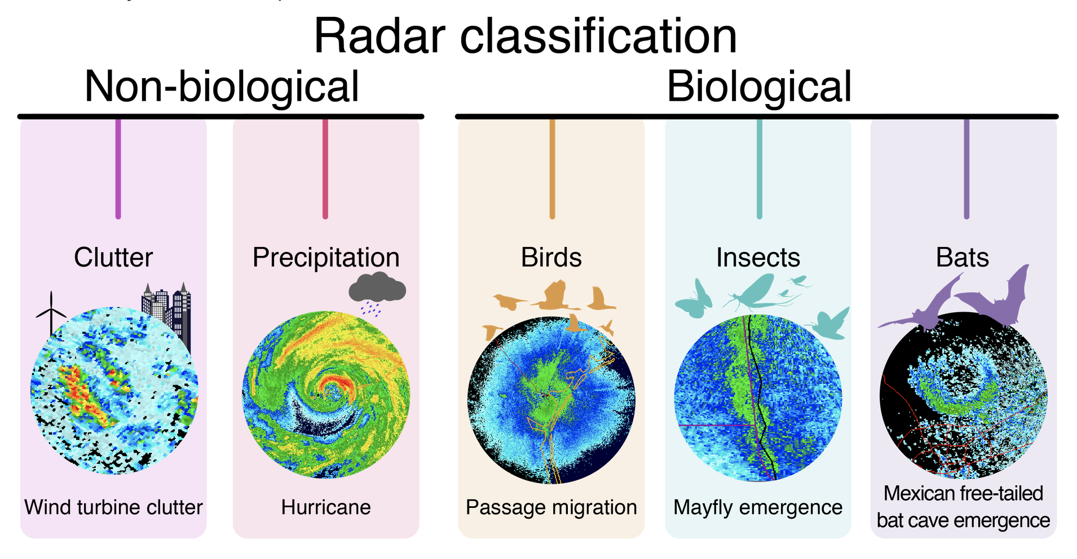
Detecting organisms on radar
Notes:
Weather radar is a technology that sends out radiowaves, and when these waves encounter water drops in the air, some of the energy of that wave is reflected back. The radar receives and can use that signal to tell us something about where water drops in the air are located, what direction they are moving etc. Given that animals are 70-90% water, insects are little more than a drop of water wrapped in an exoskeleton.
There are 140 radar sites across the contiguous united states.
First image: Types of things which can be detected/identified from radar data
Second image: Map of US weather radar stations in lower 48 (NEXRAD)

Slide 16
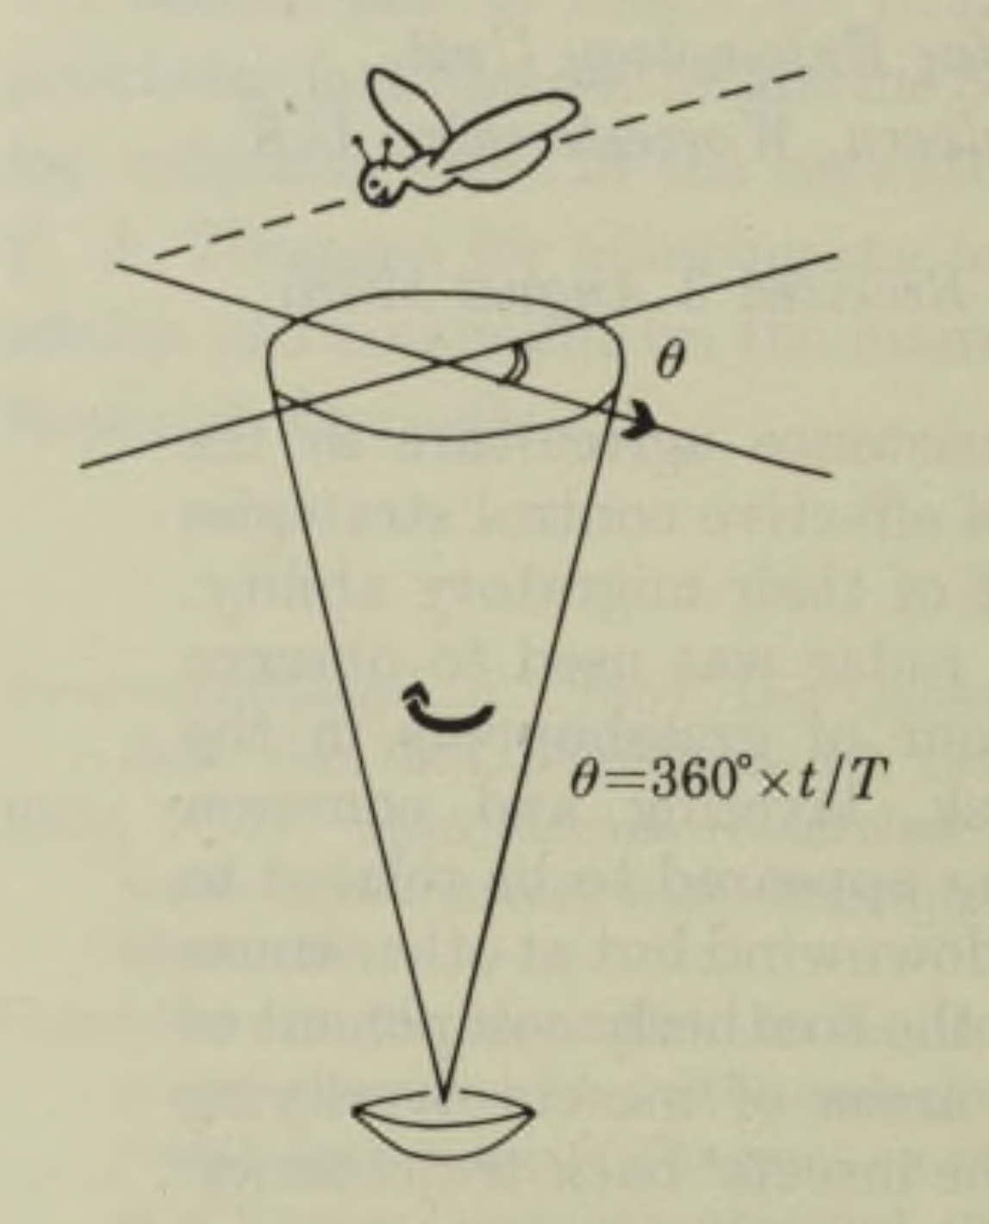
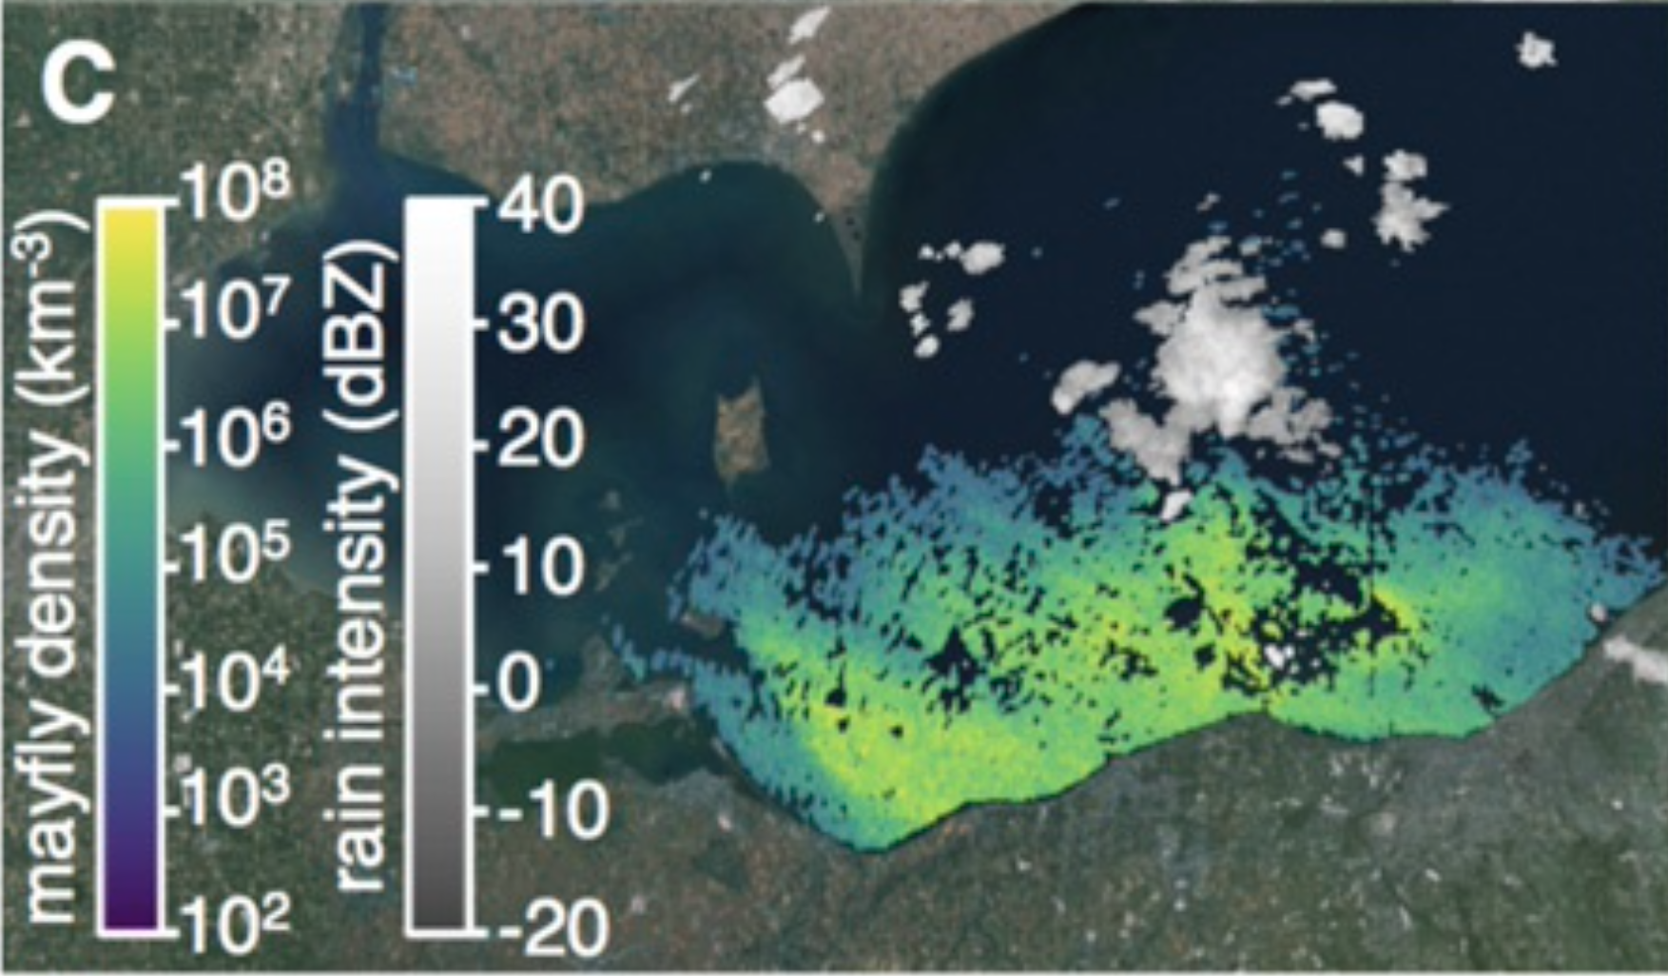
Detecting organisms on radar
Notes:
In the past decades, we have made massive advances in signal filtering and processing to distinguish animals from precipitation. Radar is commonly used to track migrating birds. In the past couple years, additional strides have been made to do the same for insects. Radar has long been used to monitor insects – starting with entomological radar in the early 20th century.
First image: Forecasting bird migration at continental scales. (Van Doren & Horton 2018, Science)
Second images: Sketch of the geometry of vertical looking radar. (Riley & Reynolds 1979, Proc. Royal. Soc. London B.); Biomass and nutrient flows in mayfly emergence flights. (Stepanian, Entrekin et al 2020, PNAS)

Slide 17
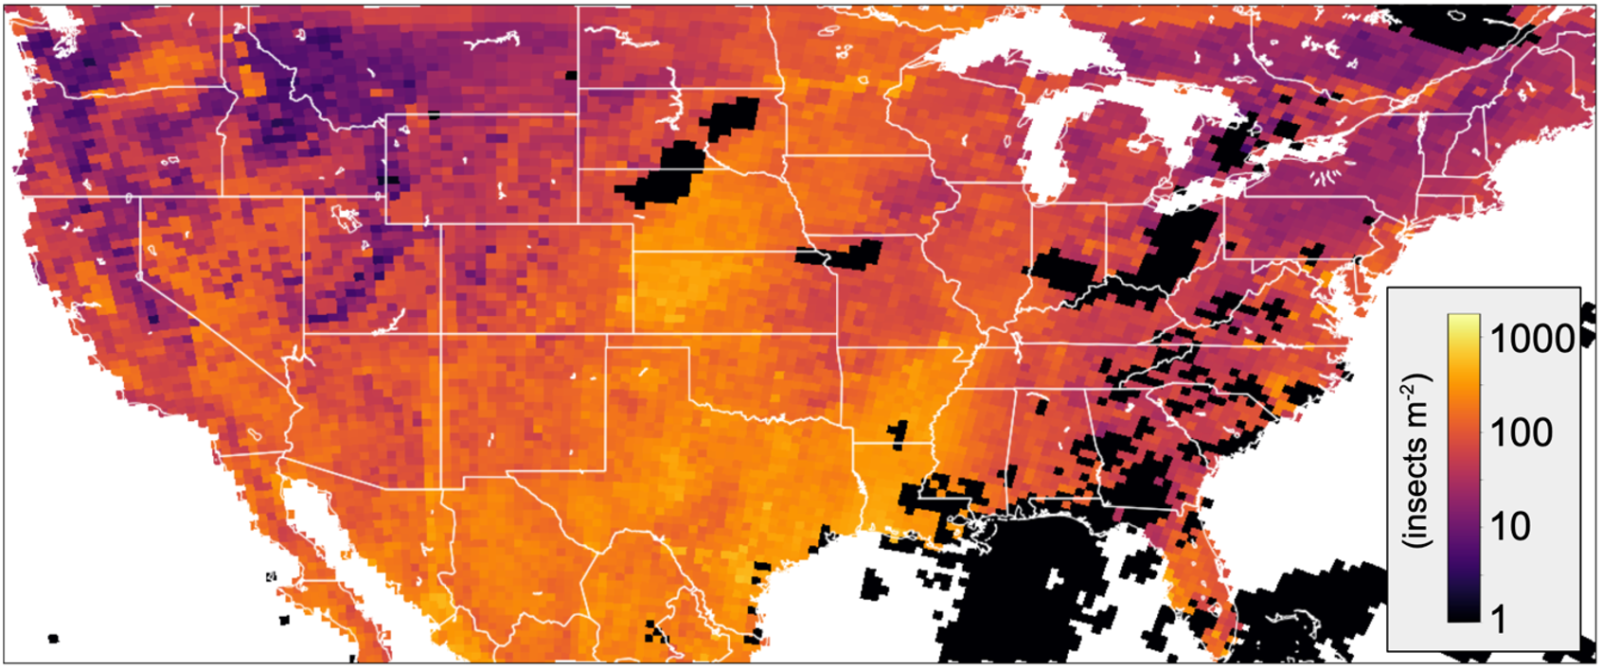
Noon, August 25, 2021: a quadrillion insects in the air = 10,000,000,000,000,000 insects (10¹⁵)

Slide 18
Driving Question Board
Can we answer any of our questions?
Do we need to adjust our themes/grouping?

Slide 19
Big Ideas

Slide 20
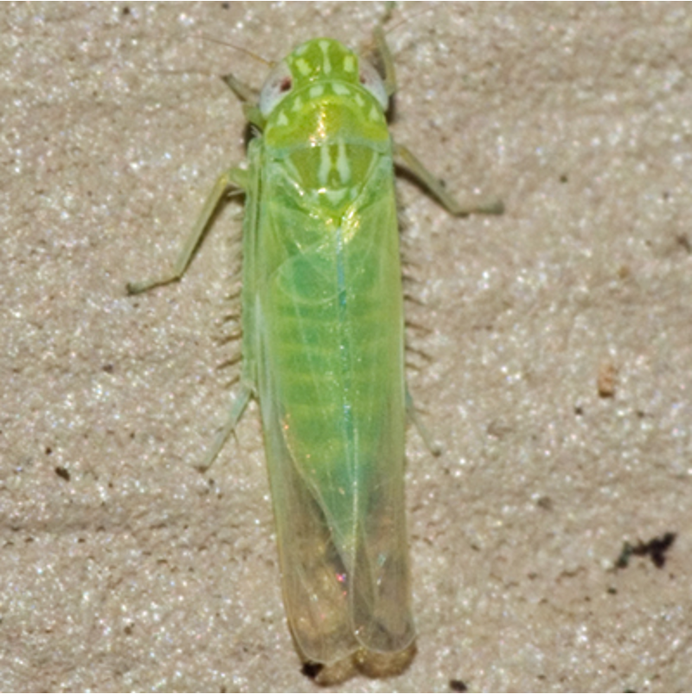
Potato Leaf Hoppers
Eat over 200 plant species
Important agricultural pest
Reproduce more than once in a single season
1st offspring in early spring feed on new plant growth

Slide 21
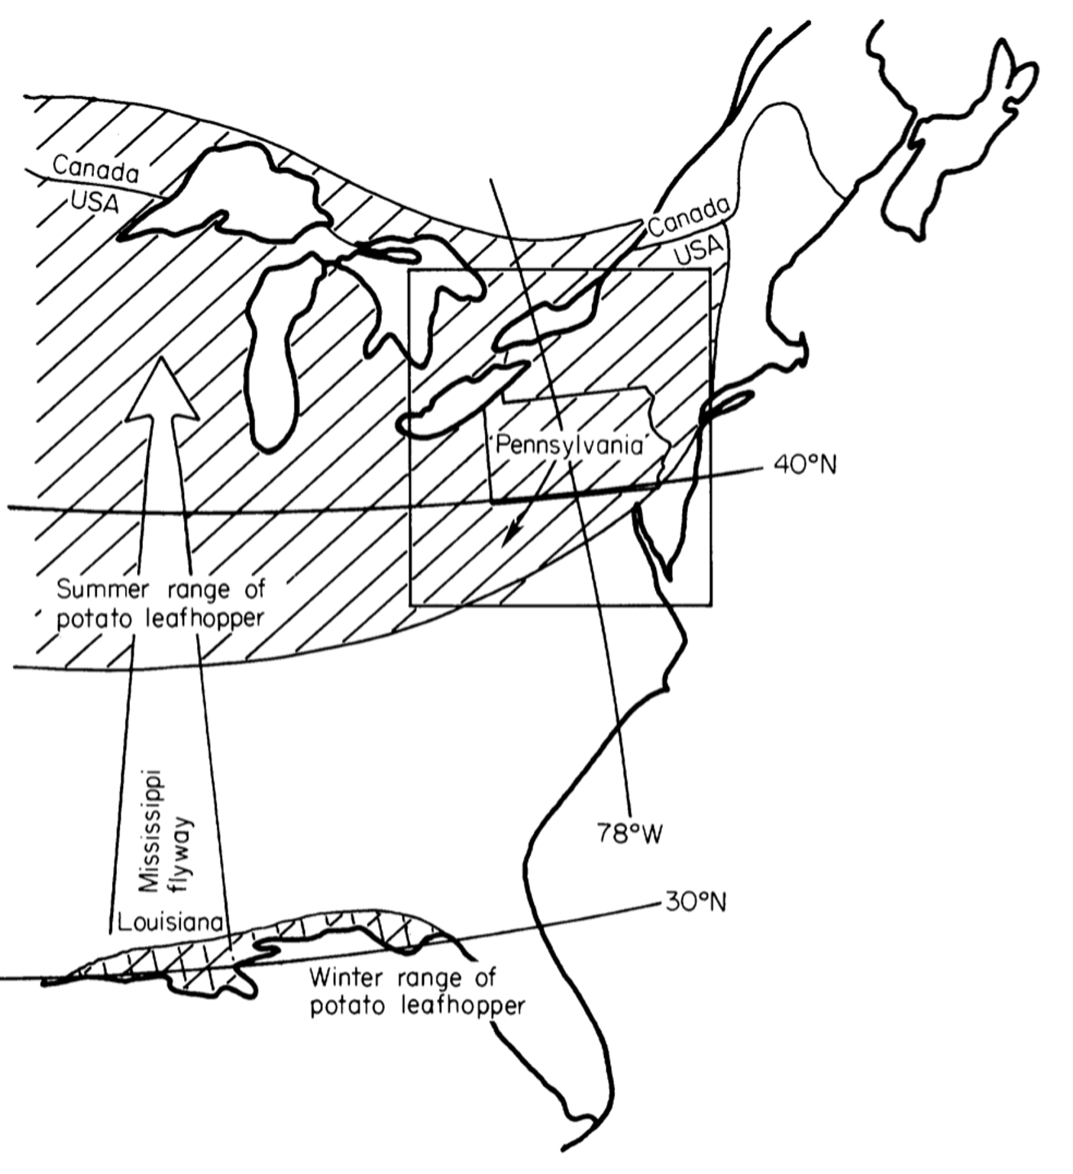
Potato Leaf Hoppers
Summer range
1st generation only migrates north once
The leafhoppers moving further north throughout the season are later generations of offspring
3rd
2nd
1st
Winter range
Notes:
1st generation migrates up Mississippi valley on wind fronts
Image modified from Taylor & Reling 1986 (p. 1105?)

Slide 22
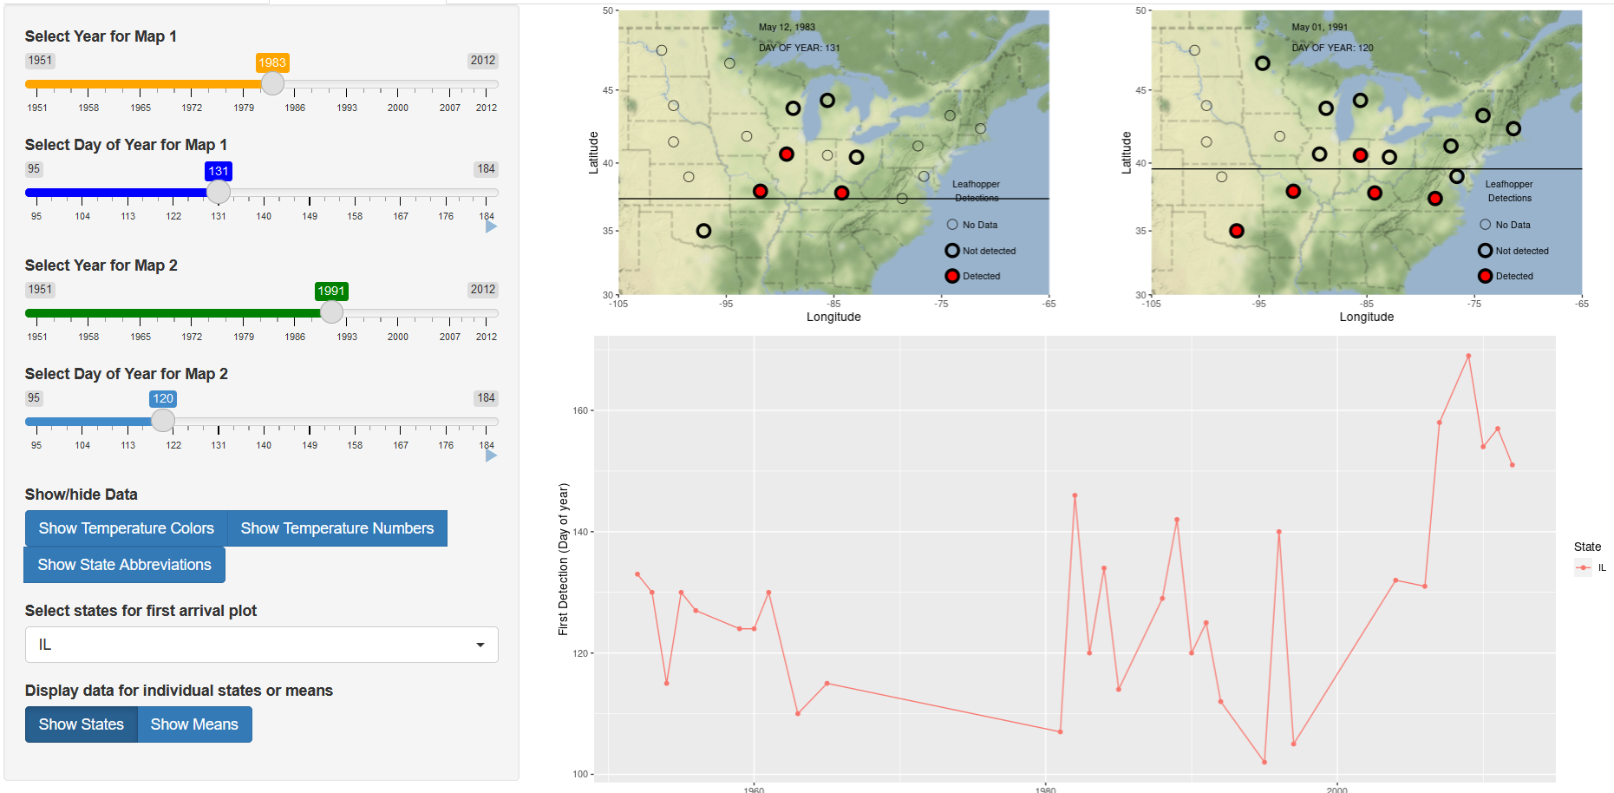
Potato Leafhopper Migration
bit.ly/3XM2K6P
Map 1
Pick a year early in the time series.
Move the Day of the Year slider.
Make observations about how the map changes over time.
Map 2
Pick a different year later in the time series.
Repeat steps 2-3 above.
Compare your observations between the data sets.
Notes:
https://aeroecology.shinyapps.io/Birds_Bugs_and_Phenology/

Slide 23
Potato Leafhopper Migration
What patterns or trends did you observe in leaf hopper appearance within a single year?
What patterns or trends did you observe between the two years you compared?

Slide 24
Potato Leafhopper Migration
Are leafhoppers altering their migration phenology? How do you know?
Do they always migrate only from north to south?
Why might one location not have leafhoppers until later in the year, if a more northern location already has them?
How might insect life history influence these patterns?
Why might scientists be interested in insect seasonal activity and migration data?

Slide 25
Driving Question Board
Can we answer any of our questions?
Should we remove any?
What other information do we need to answer our questions?
Notes:
https://www.openscied.org/wp-content/uploads/cc_resize/dqb-bath-5c731-0x384.jpeg

Slide 26
Big Ideas

Slide 27
Six-Word Memoir
In exactly six words, summarize the most important thing you’ve learned about insect phenology.

