Slide 2
Phenology & Climate
Bird Activity and Migration

Slide 3
Objectives
Analyze data to understand bird migration patterns.
Connect bird life history and annual cycles to their migration patterns.

Slide 4
Essential Questions
How do bird activity and migration change seasonally?
Why is the timing of seasonal bird activity and migration important?

Slide 5
Why are we talking about birds?
What are some relationships between insects and birds?

Slide 6
Why are we talking about birds?
Birds are a trophic level above insects
Insects are a food resource for some birds
Aerial insectivores: birds that eat insects while they fly

Slide 7
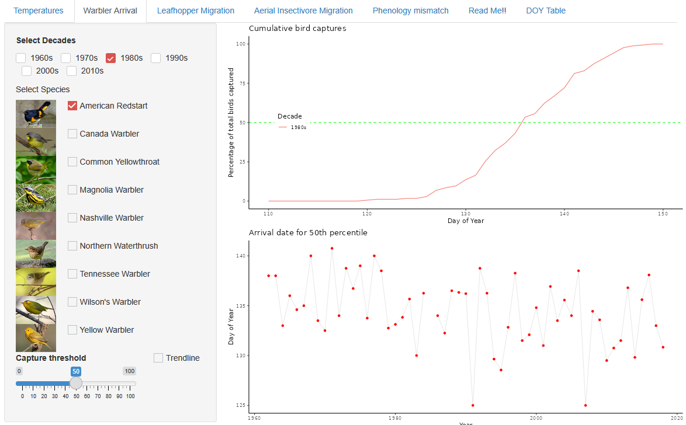

Shiny: Warbler Arrival
k20.ou.edu/6i

Slide 8

Warbler Arrival: I Notice, I Wonder
As you explore the model, make note of things you notice and things you wonder.
Record the things you wonder about/questions you have on individual sticky notes for the driving question board.
Focus on identifying patterns in the data over time

Slide 9
Warbler Arrival: I Notice, I Wonder
Pick one or more species and change the capture threshold to see how day of year patterns change (bottom graph).
Pick one or more species and see how the capture % changes across different decades (top graph).
Pick one of the graphs to look at and compare two or more species by looking at their data individually.

Slide 10
Warbler Arrival
Are there any species that show evidence of changing arrival times?
How is warbler arrival changing over time, in general?
What factors might impact birds’ migration arrival time?

Slide 11

Driving Question Board
What new questions do we have?
Notes:
K20 Center. (n.d.). Driving question board. Strategies. https://learn.k20center.ou.edu/strategy/1511

Slide 12
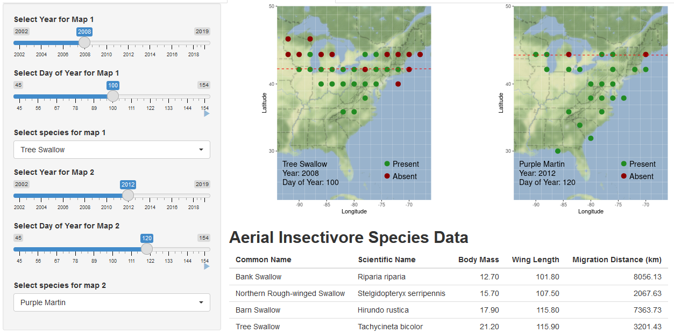
Shiny: Aerial Insectivore Migration
Which species tends to be the earliest to complete its northward migration?

Slide 13
Aerial Insectivore Migration
How did you reach your conclusion about which species gets to the north first?
What is the best way to evaluate arrival time for a species? Why?

Slide 14

Aerial Insectivore Migration
What are some factors that would affect the timing of birds’ migration north?
Notes:
K20 Center. (n.d.). Collective brain dump. Strategies. https://learn.k20center.ou.edu/strategy/111

Slide 15
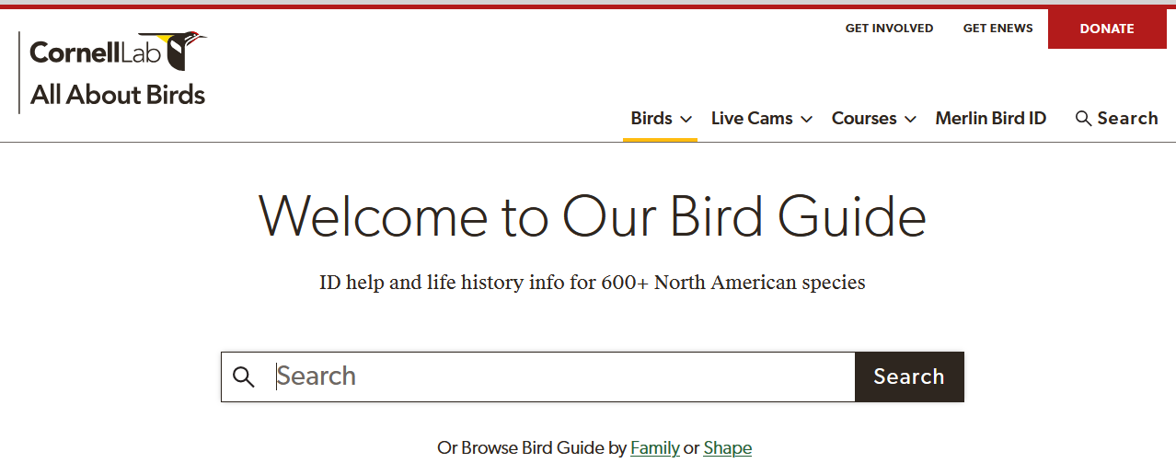

Aerial Insectivore Life History
All About Birds
https://k20.ou.edu/6j

Slide 16
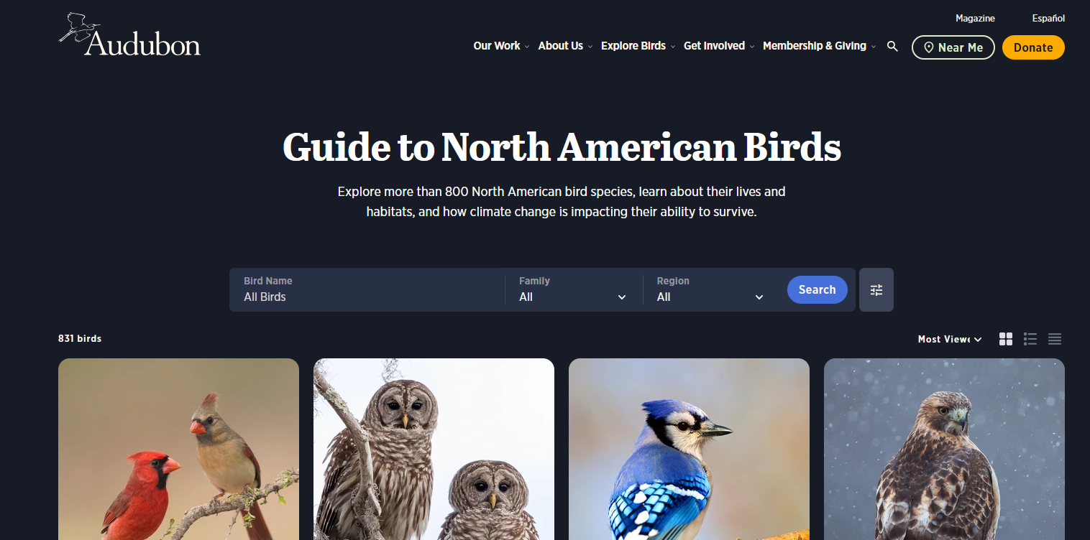

Aerial Insectivore Life History
All About Birds
Audubon Guide
https://k20.ou.edu/6j
https://k20.ou.edu/6k

Slide 17
Driving Question Board
Can we answer any of our questions?
Do we need to adjust our themes/grouping?
Notes:
K20 Center. (n.d.). Driving question board. Strategies. https://learn.k20center.ou.edu/strategy/1511

Slide 18
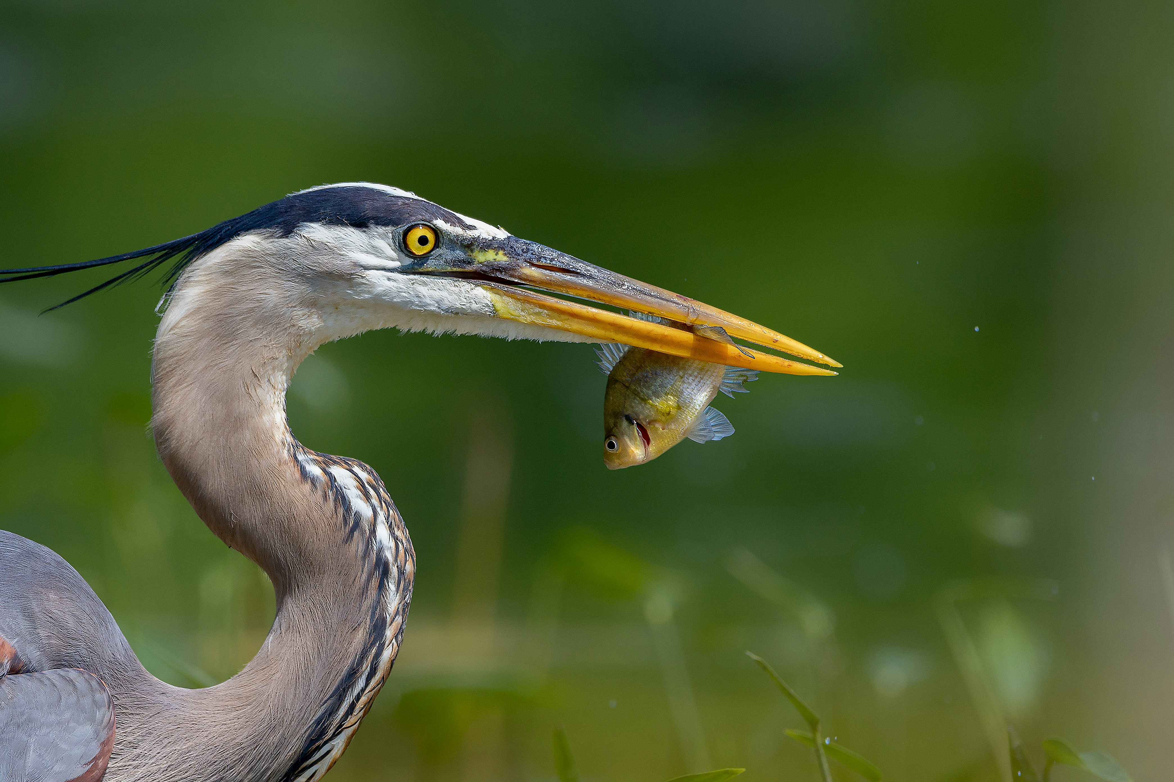
Bird Life History
Life history describes different characteristics of an organism that help it survive and reproduce.
Includes things like habitat use, diet, behavior, and breeding characteristics
Notes:
Yera, R. (2022). Blue heron eating lunch [Photograph]. Unsplash. Retrieved from https://unsplash.com/photos/a-bird-with-a-fish-in-its-mouth-yMzFdPGkbPo

Slide 19
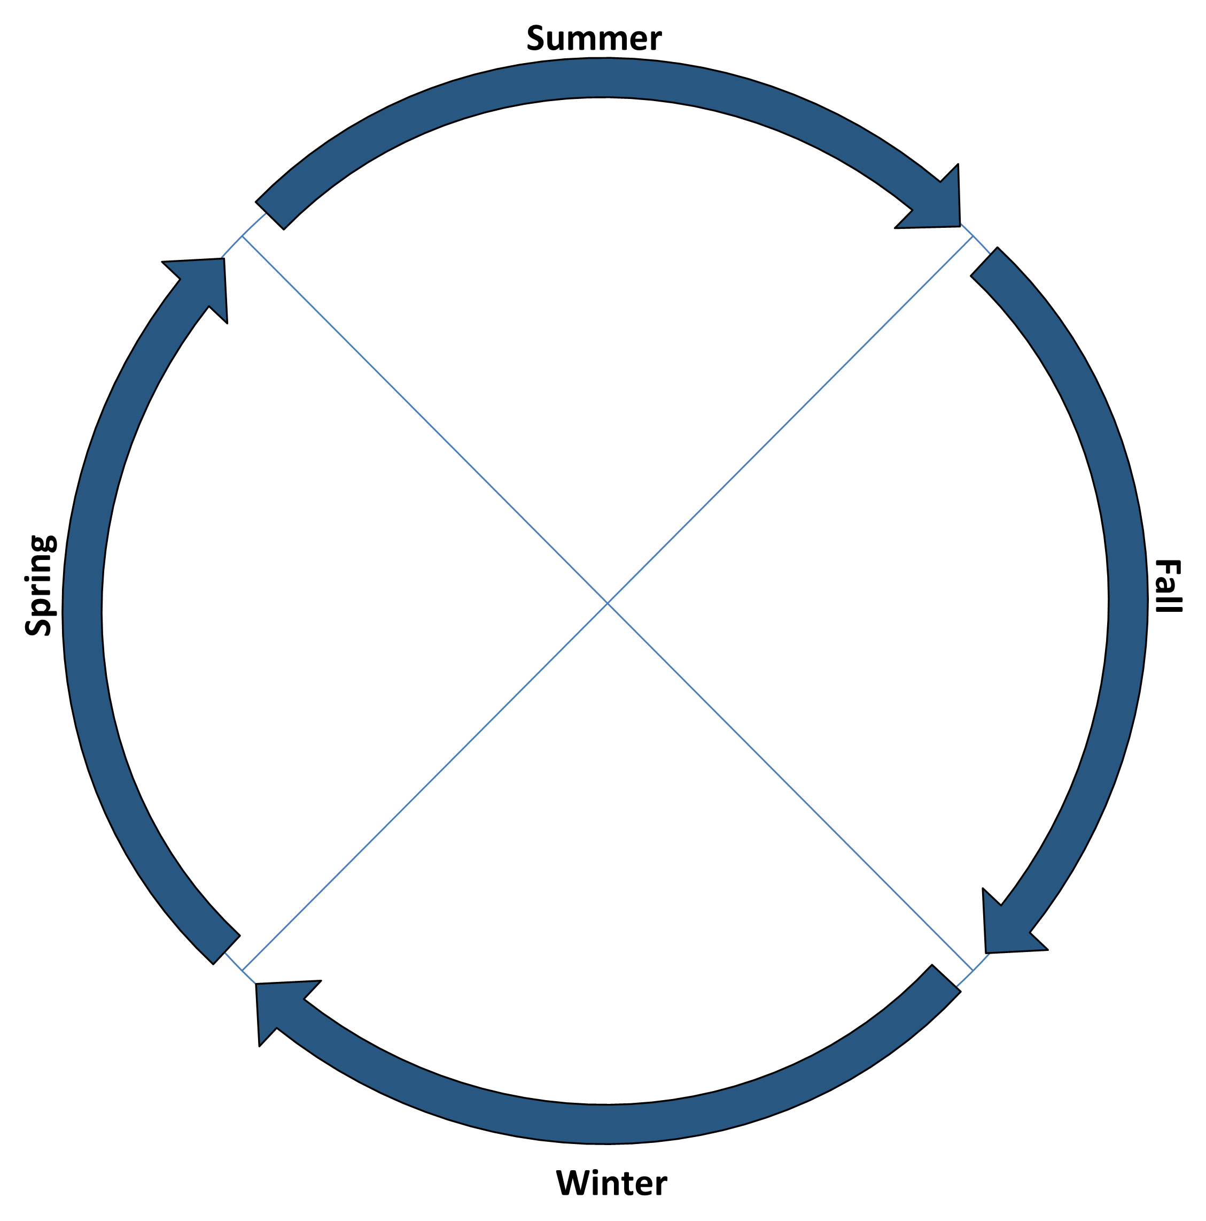
Bird Life History: Annual Cycle
Describes the phases of growth and behavior of organisms over an entire year
In migrating birds, the focus is on breeding and non-breeding seasons and migration

Slide 20
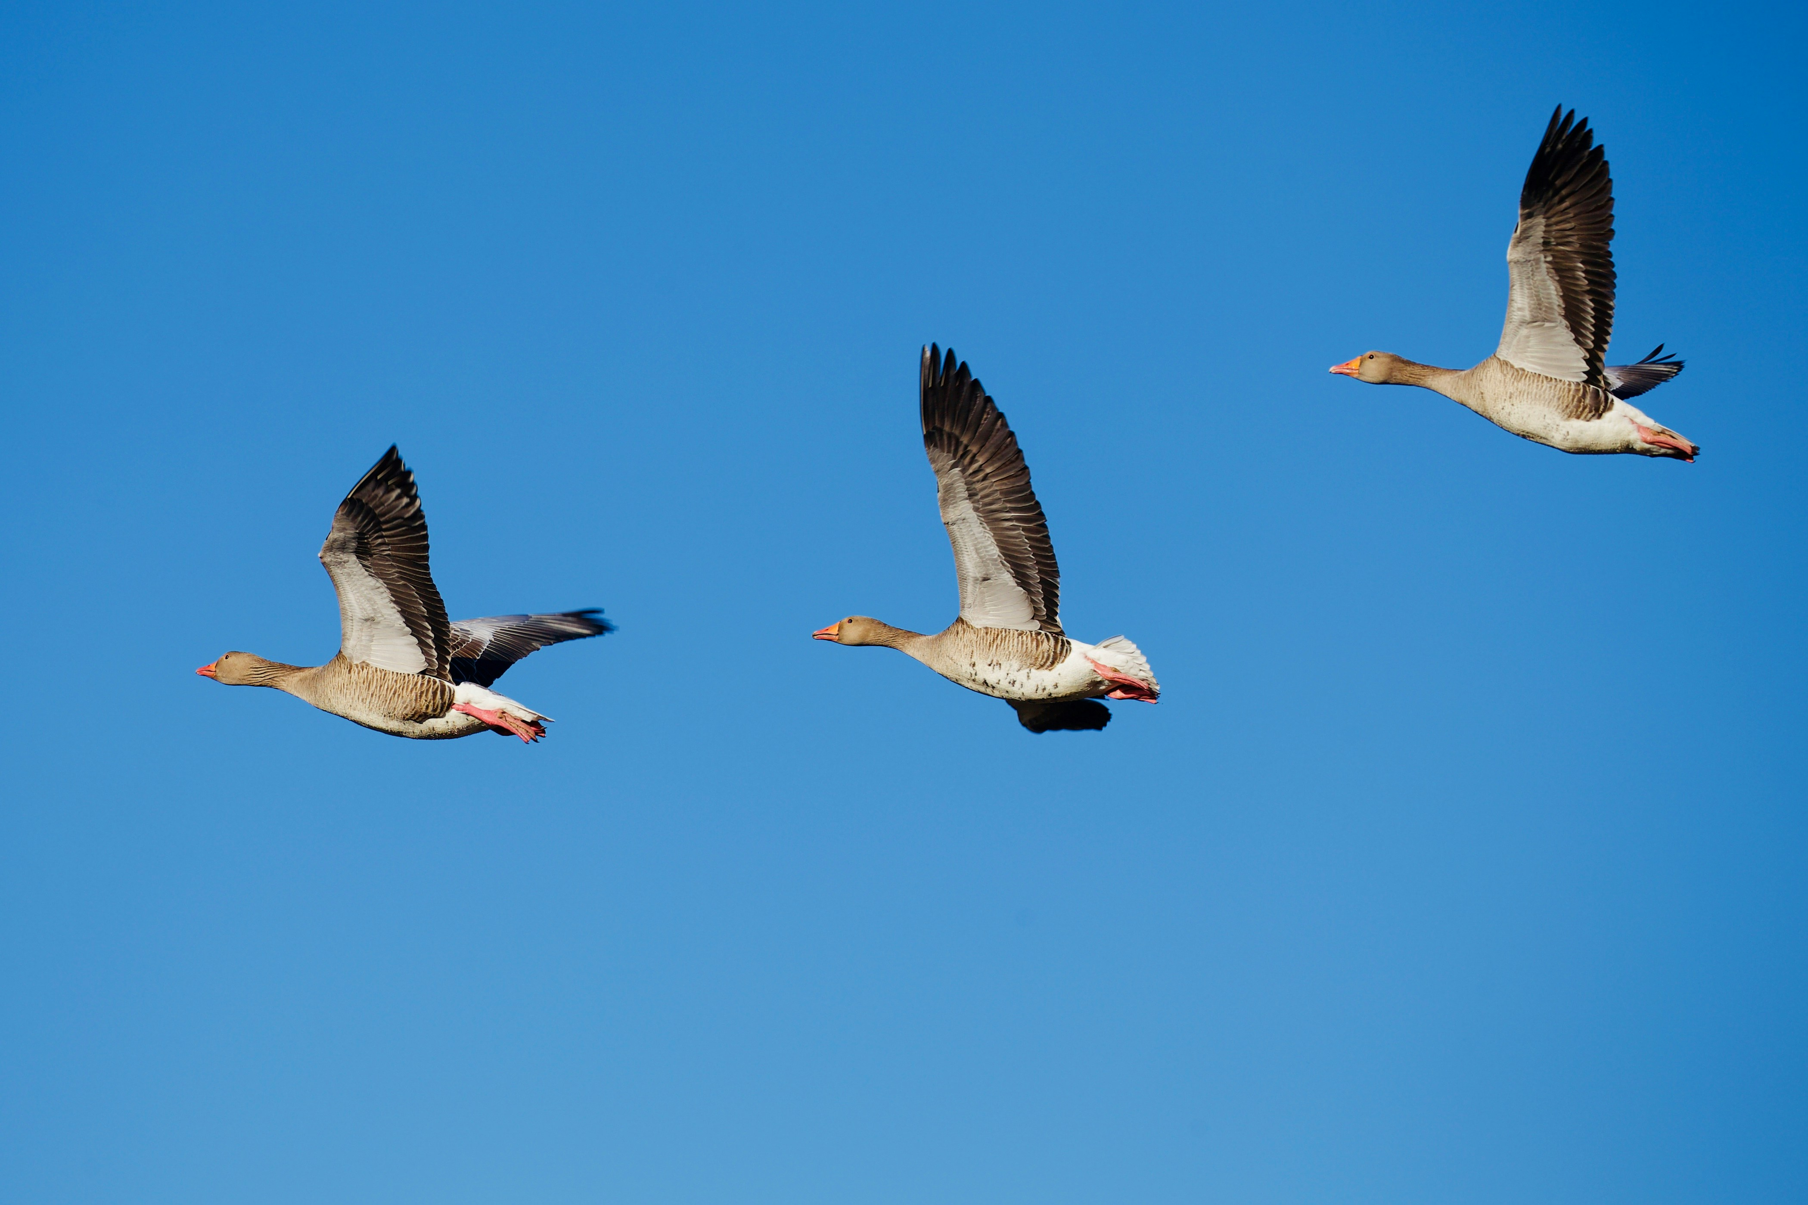
Bird Life History: Migration
Birds migrate to optimize the conditions they live in
Some conditions are changing temperature, day length, and available resources
Resources include food and nesting locations
Notes:
Wainscoat, J. (2019). A classic formation [Photograph]. Unsplash. Retrieved from https://unsplash.com/photos/three-gray-seagulls-in-flight-tnNmKOkZHaU

Slide 21
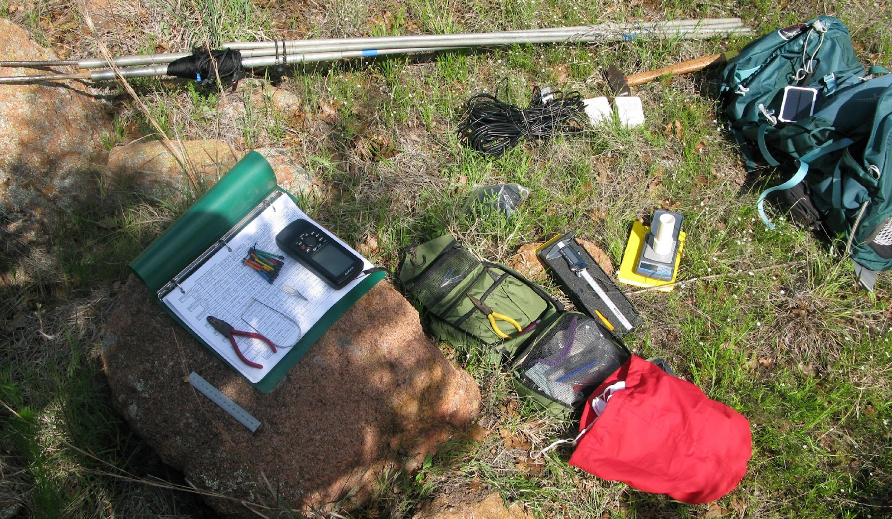
Tracking Birds and Collecting Data
Many ways to collect and track bird data, including:
  At a distance
  In the hand
  Remotely
  Community science
Notes:
Cimprich, P. (n.d.). Remote tracking equipment [Photograph]. Unpublished photo.

Slide 22
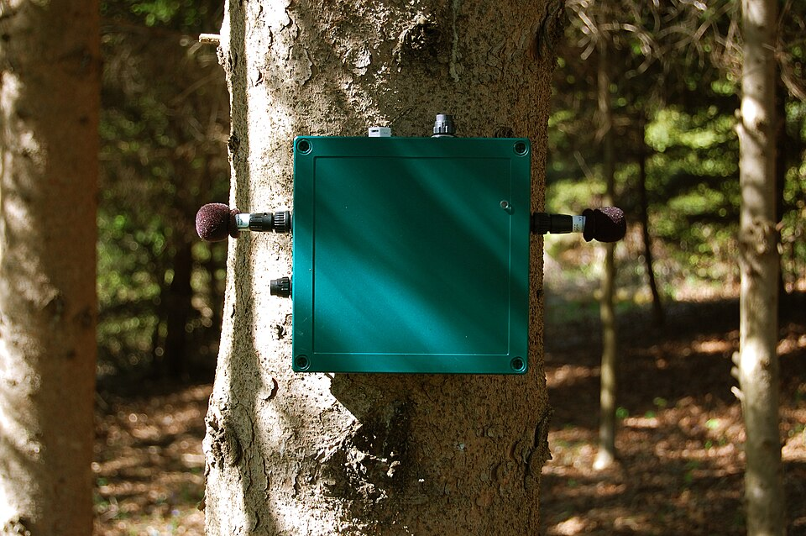
At a Distance
Count individual birds seen or heard at specific locations
Monitor nests
Record bird sounds with mounted audio recording devices
Notes:
Audio recording devices (“Automated Recording Units”) are often similar to trail cameras, in that they are mounted for long term recording, but of audio instead of video.
Monkachino (2011, Feb. 22) Song meter on tree [Photograph]. Wikipedia. Retrieved from https://en.wikipedia.org/wiki/File:Song_Meter_on_tree.JPG.

Slide 23
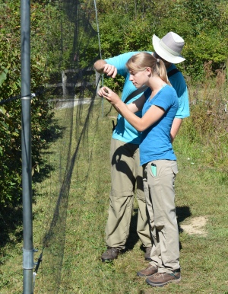
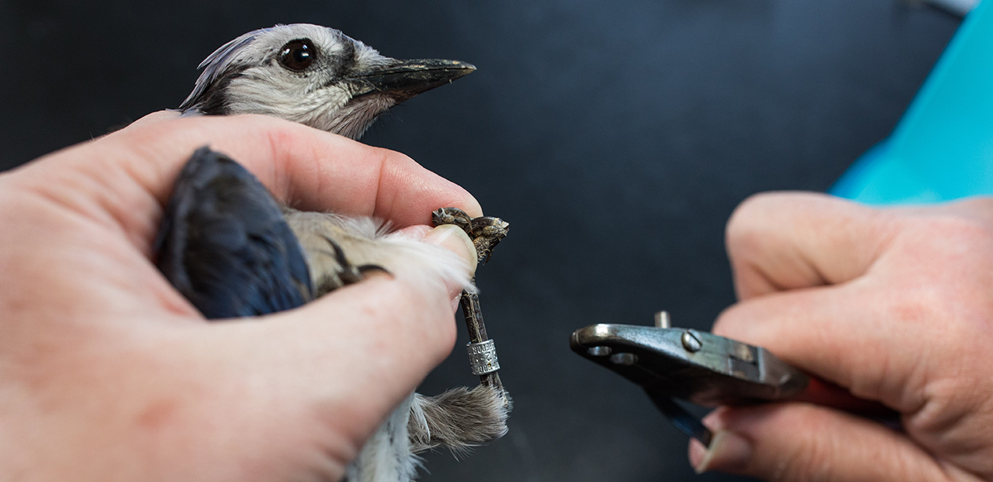
In the Hand
Catch birds, often with mist nets
Take measurements and tissue samples
Band birds and attach tracking devices
Notes:
Mist nets are fine mesh nets, similar to hair nets but higher quality, which are difficult for birds to spot. Birds fly into the nets and get caught in pockets built into the net. Researchers carefully remove the birds from the nets to band and collect data. Data include detailed body measurements and blood, feathers, claw clippings, or fecal samples. Body measurements are used in a variety of ways, and the tissue samples allow researchers to do genetic and isotope analysis and monitor bird resource use and gut microbes.
After measurements and tissues are collected the birds are banded (or their existing bands are recorded with their data). Bird banding is done at specific hours by experienced banders who attach small metal rings to the ankles of birds for future identification. This allows researchers to recapture birds over time, which produces data sets that can be used to assess breeding or migration patterns, population trends, demographics, migration phenology, habitat use, and survivorship, among others.
The Warbler Arrival data on the Shiny app come from the long-term banding activities at Powdermill Nature Reserve Avian Research Center
Unknown. (n.d). Bird receiving identification band [Photograph]. Powdermill Nature Reserve Avian Research Center: Banding Workshops. Retrieved from https://powdermillarc.org/banding-workshops/
Unknown. (n.d). Removing bird from a mist net [Photograph]. Powdermill Nature Reserve Avian Research Center: Banding Workshops. Retrieved from https://powdermillarc.org/banding-workshops/

Slide 24
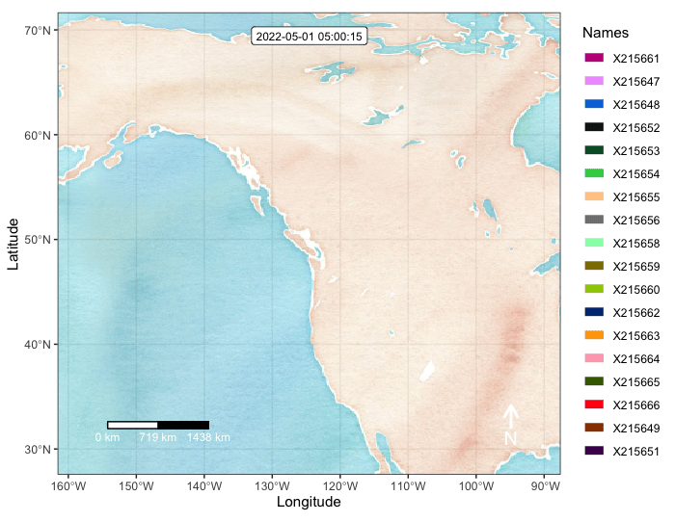
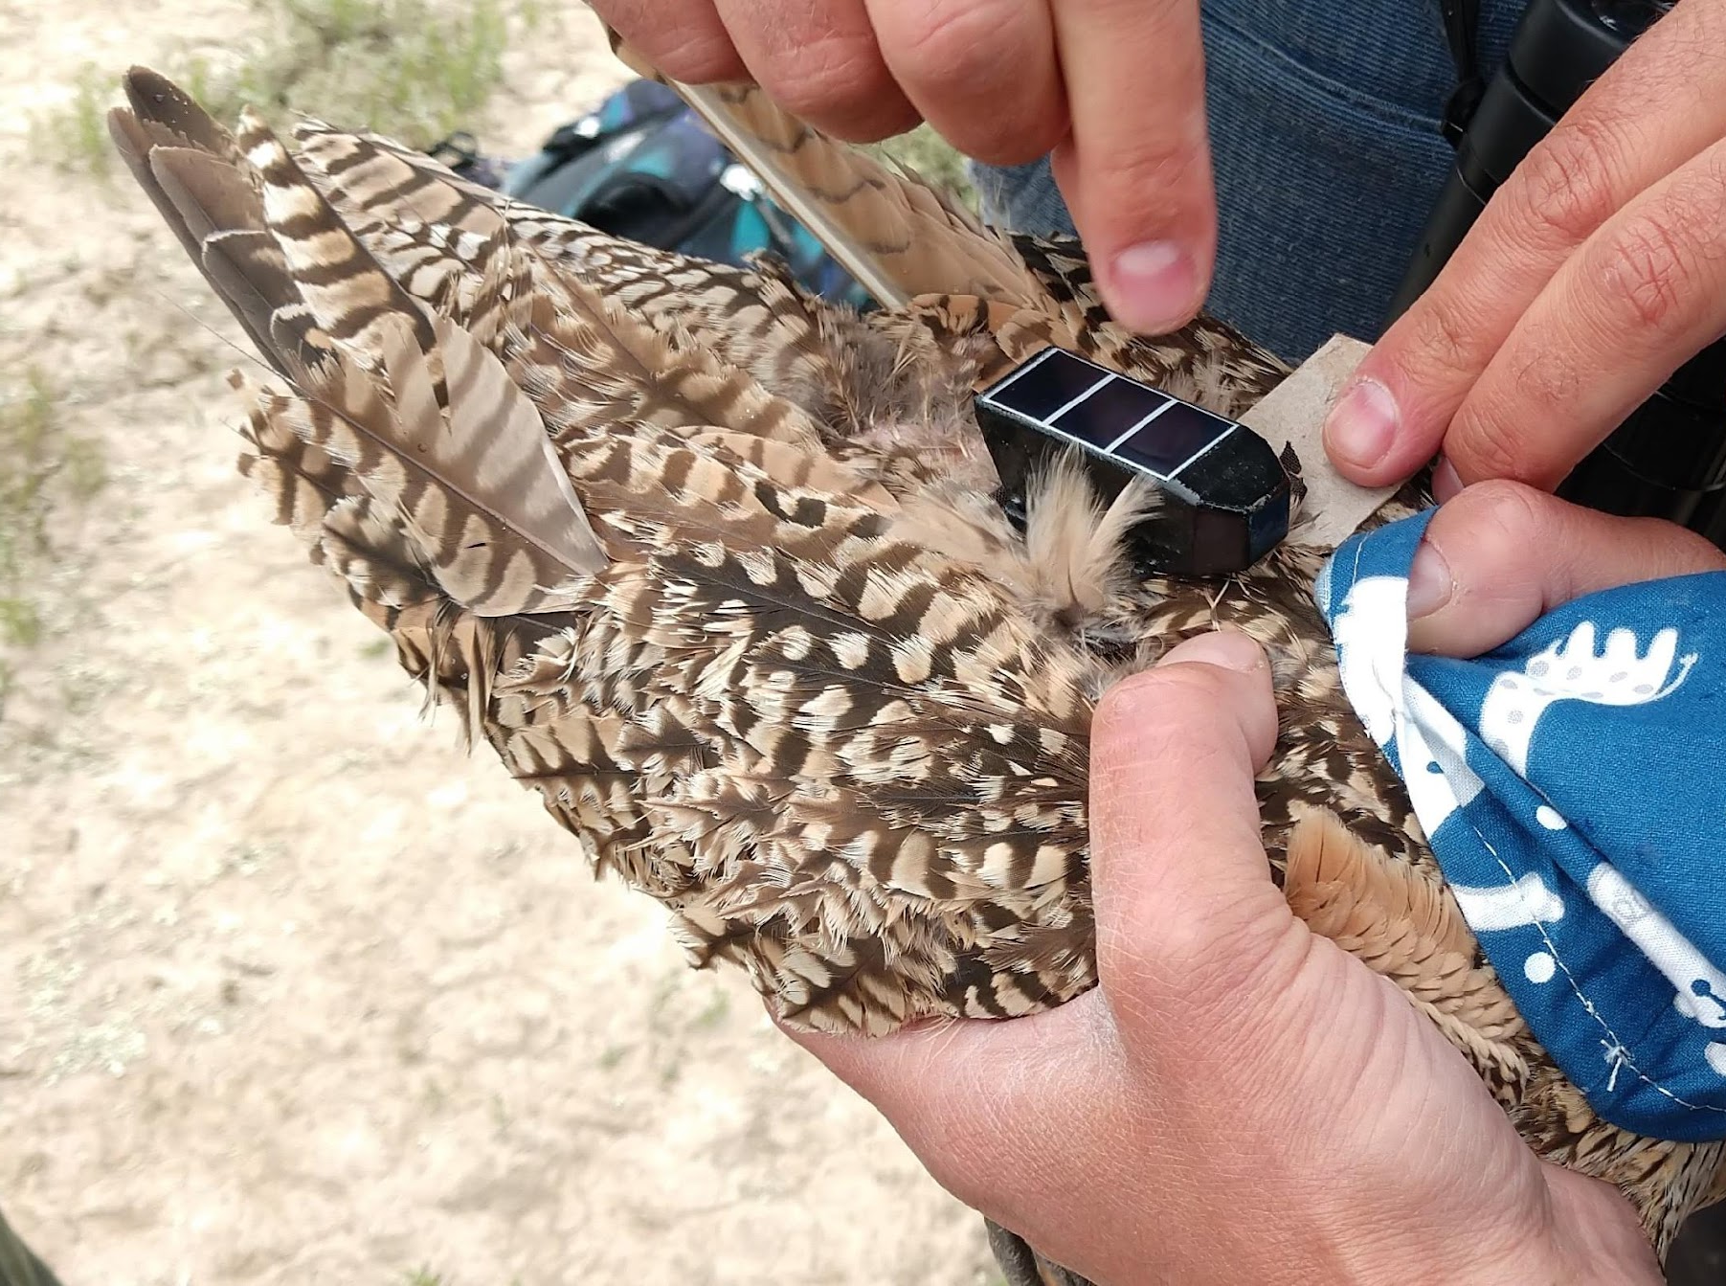
Remote Tracking
Tracking devices which record geographic location and other data
Using radar
  Similar to recording insects on radar
Notes:
One example of “at a distance” sampling via citizen science is the annual Christmas Bird Count. For more information, including how to participate, see https://www.audubon.org/answers-your-top-questions-about-christmas-bird-count
Cimprich, P. (n.d.). Timelapse of bird migration from remote tracking data [Animation]. Unpublished animation.
Cimprich, P. (n.d.). Remote tracker attached to a bird [Photograph]. Unpublished photo.

Slide 25
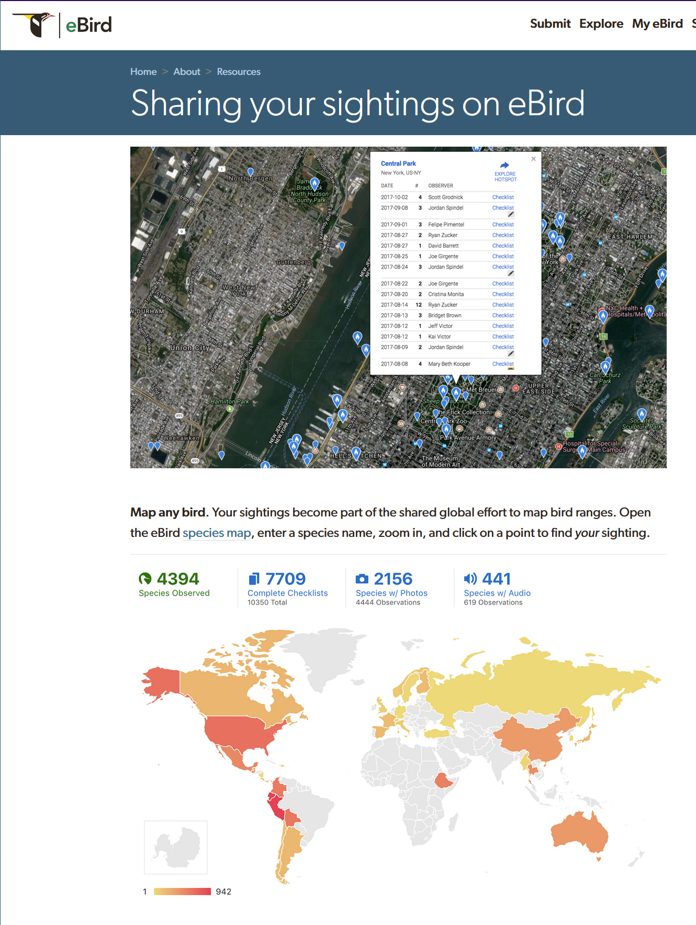
Community Science
At a distance sampling
eBird
  Birders record the number of different bird species in a location and upload it to an online database
Notes:
Aerial Insectivore Migration on the Shiny App uses eBird data
Another example of “at a distance” sampling via community science is the annual Christmas Bird Count.

Slide 26
Bird Life History and Shiny Data
How might bird life history explain the patterns you observed in the Shiny data?
Why might arriving earlier or later to their breeding location impact birds’ reproductive success?

Slide 27
Bird Life History and Shiny Data
How does bird migration differ from insect migration?
What is the relationship between insect activity/arrival and bird migration?

Slide 28
Big Ideas
What big science ideas have we learned so far?

Slide 29
Shiny: Aerial Insectivore Migration
Map 1
Pick a bird species.
Pick a year and move the Day of the Year slider.
Make observations about how the map changes over time.
Repeat for additional years and make observations about how the map changes across years.
Map 2
Pick a different species.
Repeat steps 2-4.
Collect additional data using any comparisons you want.
Look for patterns and trends among the data sets.

Slide 30
Aerial Insectivore Migration
What patterns or trends did you observe within a single year? Between years?
What patterns or trends did you observe between multiple species?
Is there evidence for changes in migratory timing among these species?
How does this data set compare to the leafhopper data set?

Slide 31
Relationship between insects and birds
INSERT YOUR CLASS-SPECIFIC INSTRUCTIONS HERE

