Slide 2
Phenology and Climate
Phenological Mismatch

Slide 3
Objectives
Analyze temperature data to understand bird migration patterns.
Use a model to understand phenology mismatch.

Slide 4
Essential Questions
How does long-term temperature change affect bird migration?
In what ways does a phenology mismatch affect bird carrying capacity?

Slide 5
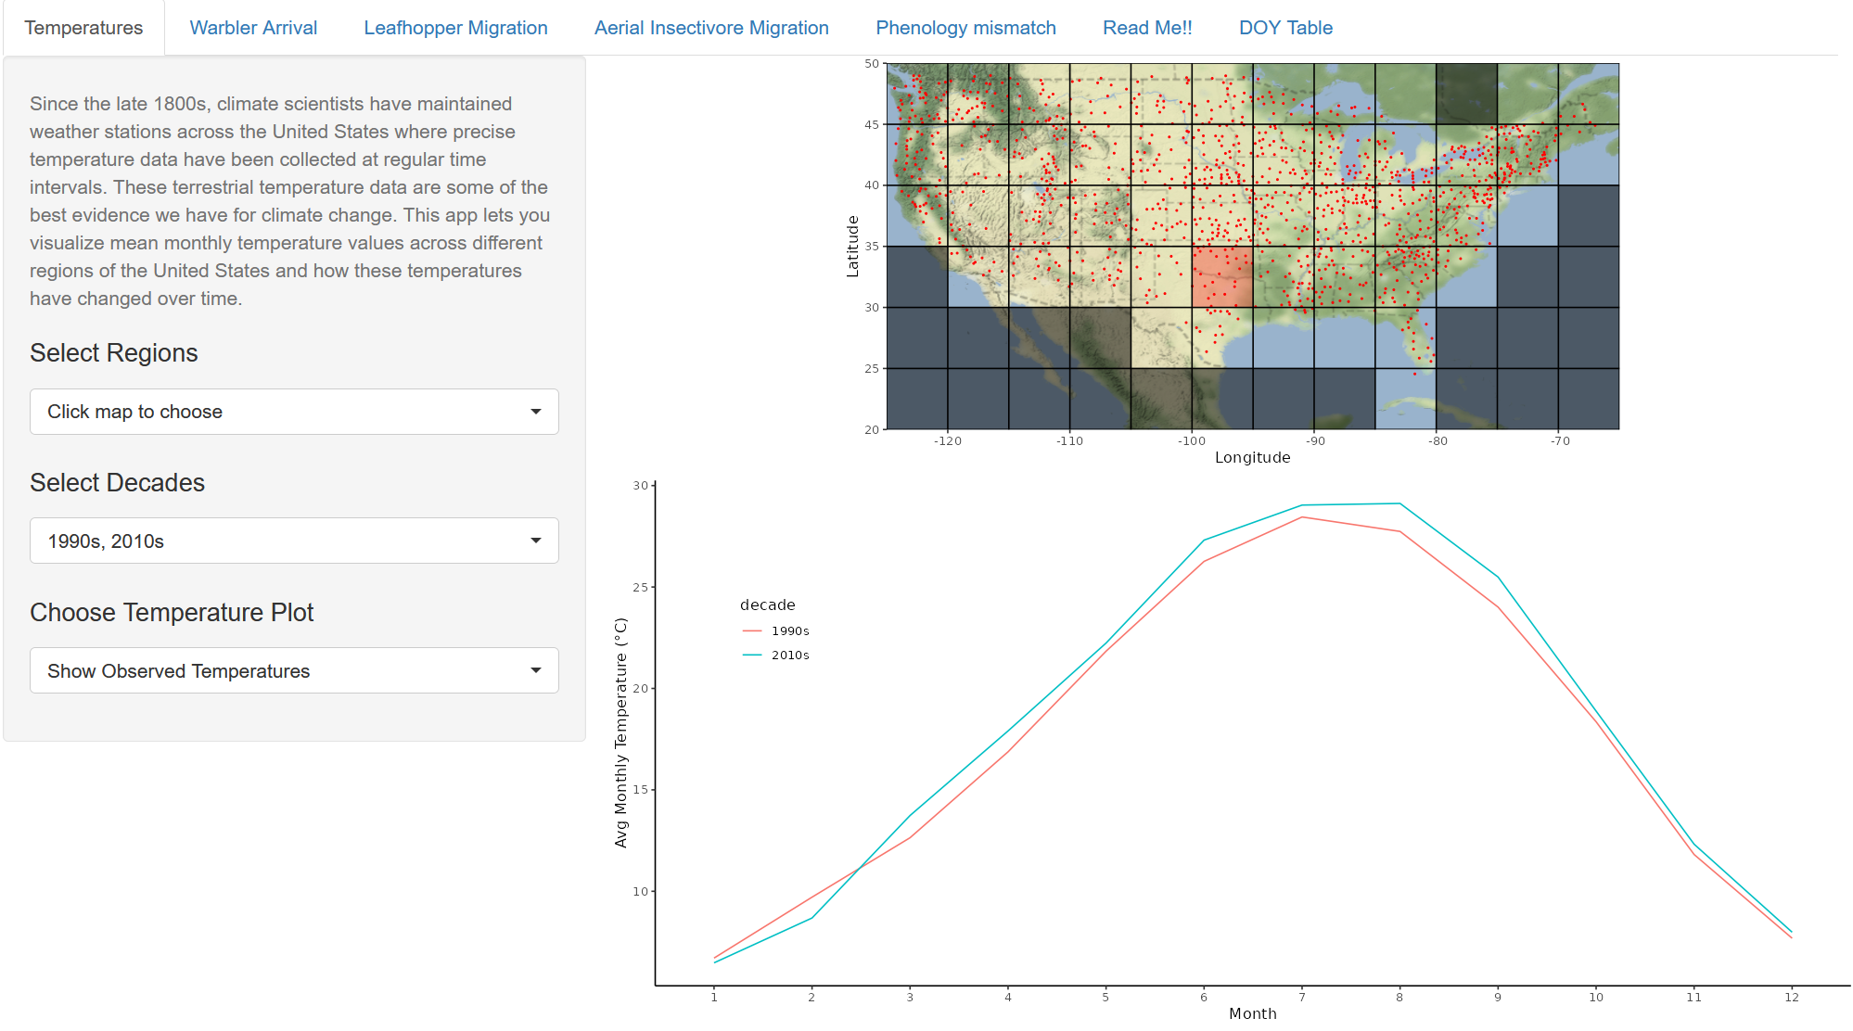
Shiny: Temperatures

Slide 6
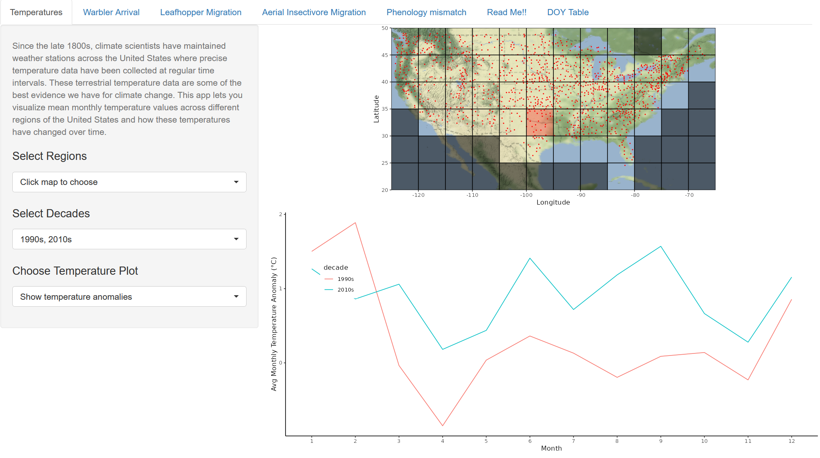
Shiny: Temperatures

Slide 7
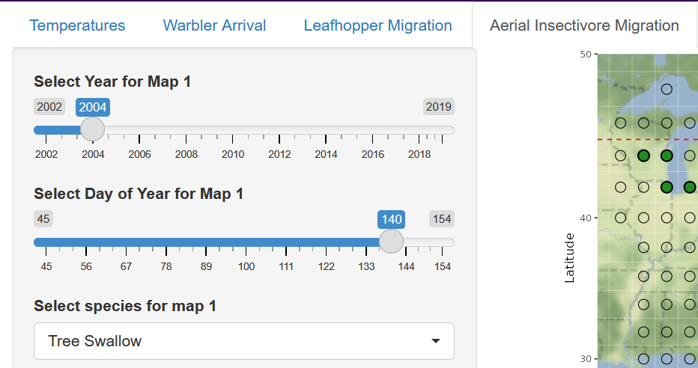
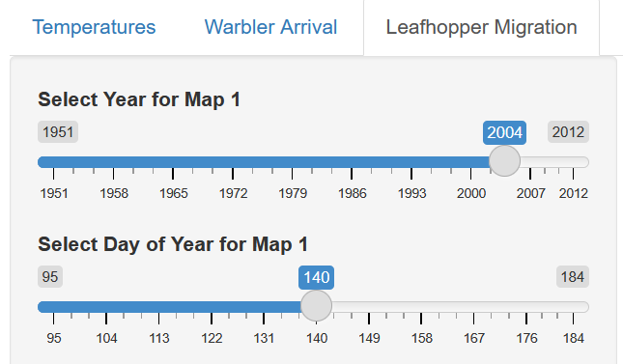
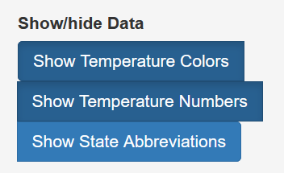
Shiny: Aerial Insectivores & Leafhoppers
Select a year before 2012 and any day of year
Match the year and day, and show Temperature Colors and/or Numbers

Slide 8
Temperature Changes
In what ways, if any, are leafhoppers and migratory birds responding to temperature?

Slide 9

How I Know It
“What I Know” includes the patterns you identify and the conclusions you draw
“How I Know It” is an explanation of the data you are using and how it supports your claims in the other column

Slide 10
Leafhoppers & Aerial Insectivores
Is the rate of advance more rapid for birds or insects? Why?
What problems might be caused by the difference in arrival time between birds and insects?
Did the models support or refute your hypothesis?
What evidence would you need to feel confident your hypothesis was correct?

Slide 11

Driving Question Board
What new questions do we have?
Can we answer any of our questions?
Notes:
K20 Center. (n.d.). Driving question board. Strategies. https://learn.k20center.ou.edu/strategy/1511

Slide 12
Climate
The long-term weather pattern of a region
  A desert has high daytime temperatures and low precipitation
  A rainforest has consistent high temperature and high precipitation
Temperature and precipitation are the easiest climate characteristics to examine

Slide 13
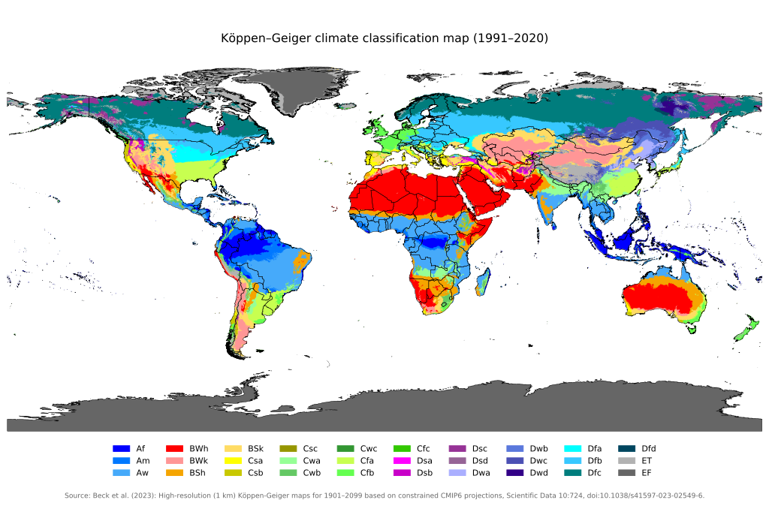
Climate classification
Notes:
Beck, H. E., McVicar, T. R., Vergopolan, N., Berg, A., Lutsko, N. J., Dufour, A., Zeng, Z., Jiang, X., van Dijk, A. I. J. M., & Miralles, D. G. (2023). High-resolution (1 km) Köppen-Geiger maps for 1901–2099 based on constrained CMIP6 projections. Scientific Data, 10, 724. https://doi.org/10.1038/s41597-023-02549-6

Slide 14
Climate variability and change
Climate variability refers to changes in climate that last longer than a single event (e.g., a warmer than average summer rather than a short-term heat wave)
Climate change refers to changes in climate averages that last for very long periods of time (e.g., over decades)

Slide 15
Climate change and life history
Long-term changes in climate can affect organisms’ life history
May cause changes to
  Migration time and distance
  Geographical range
  Reproductive timing
  Resource availability

Slide 16
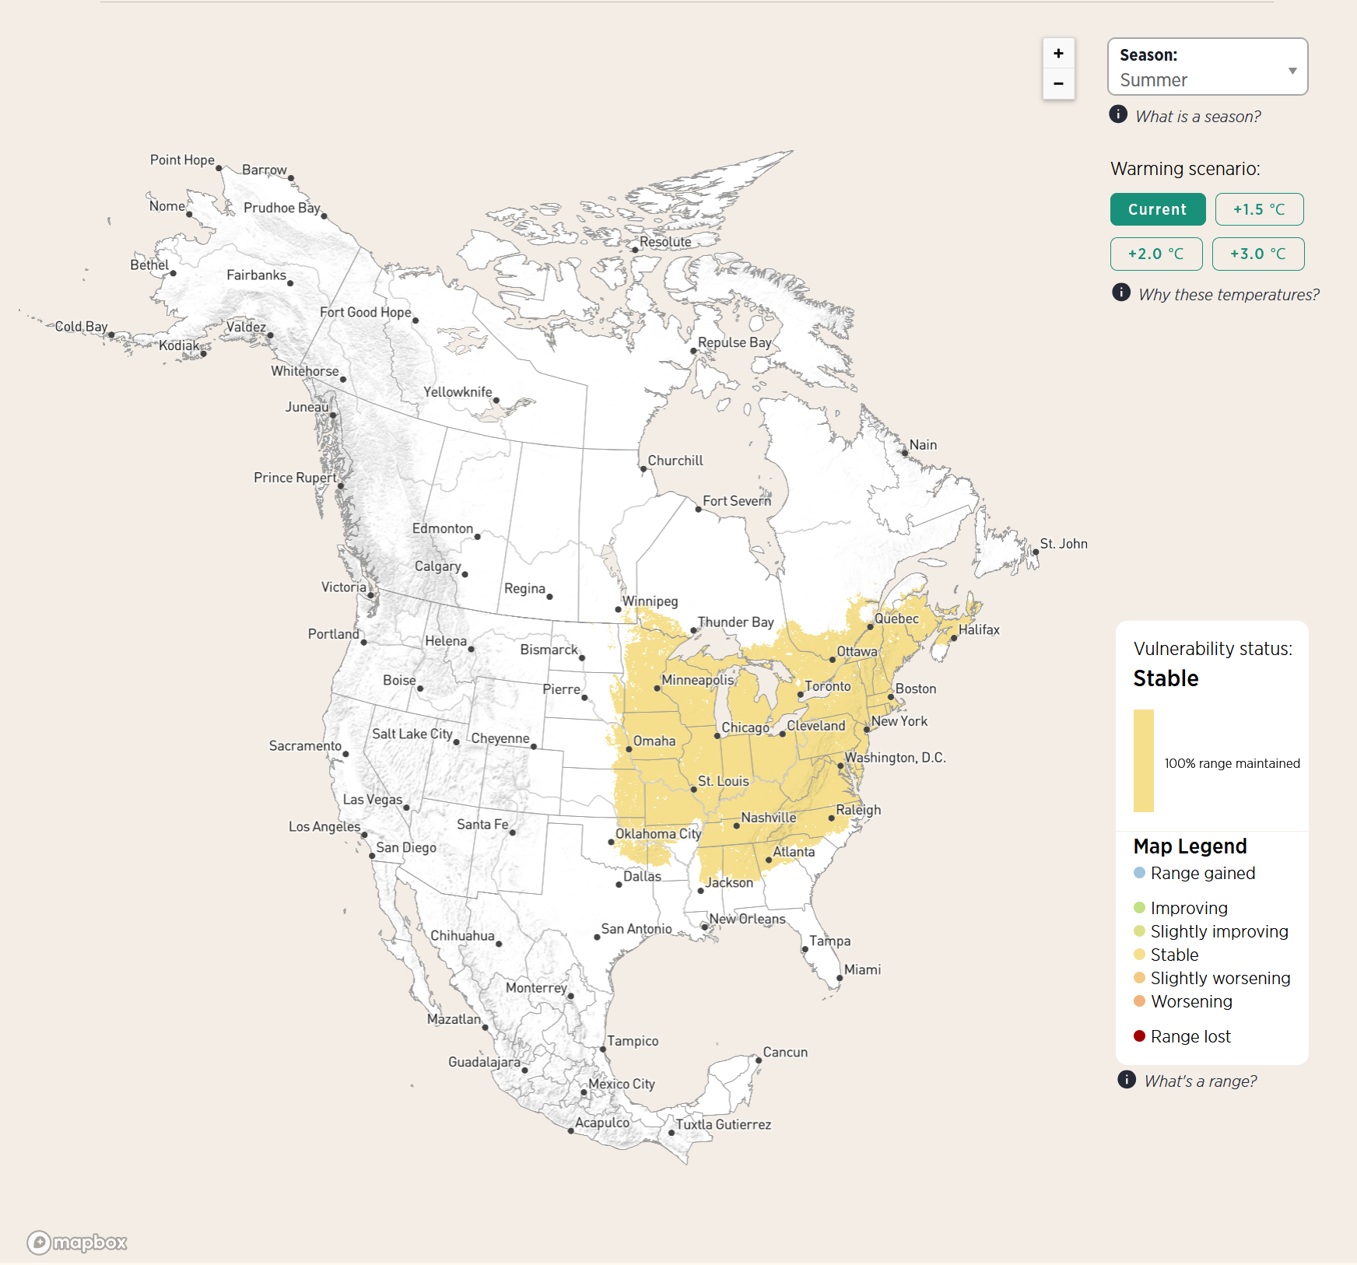
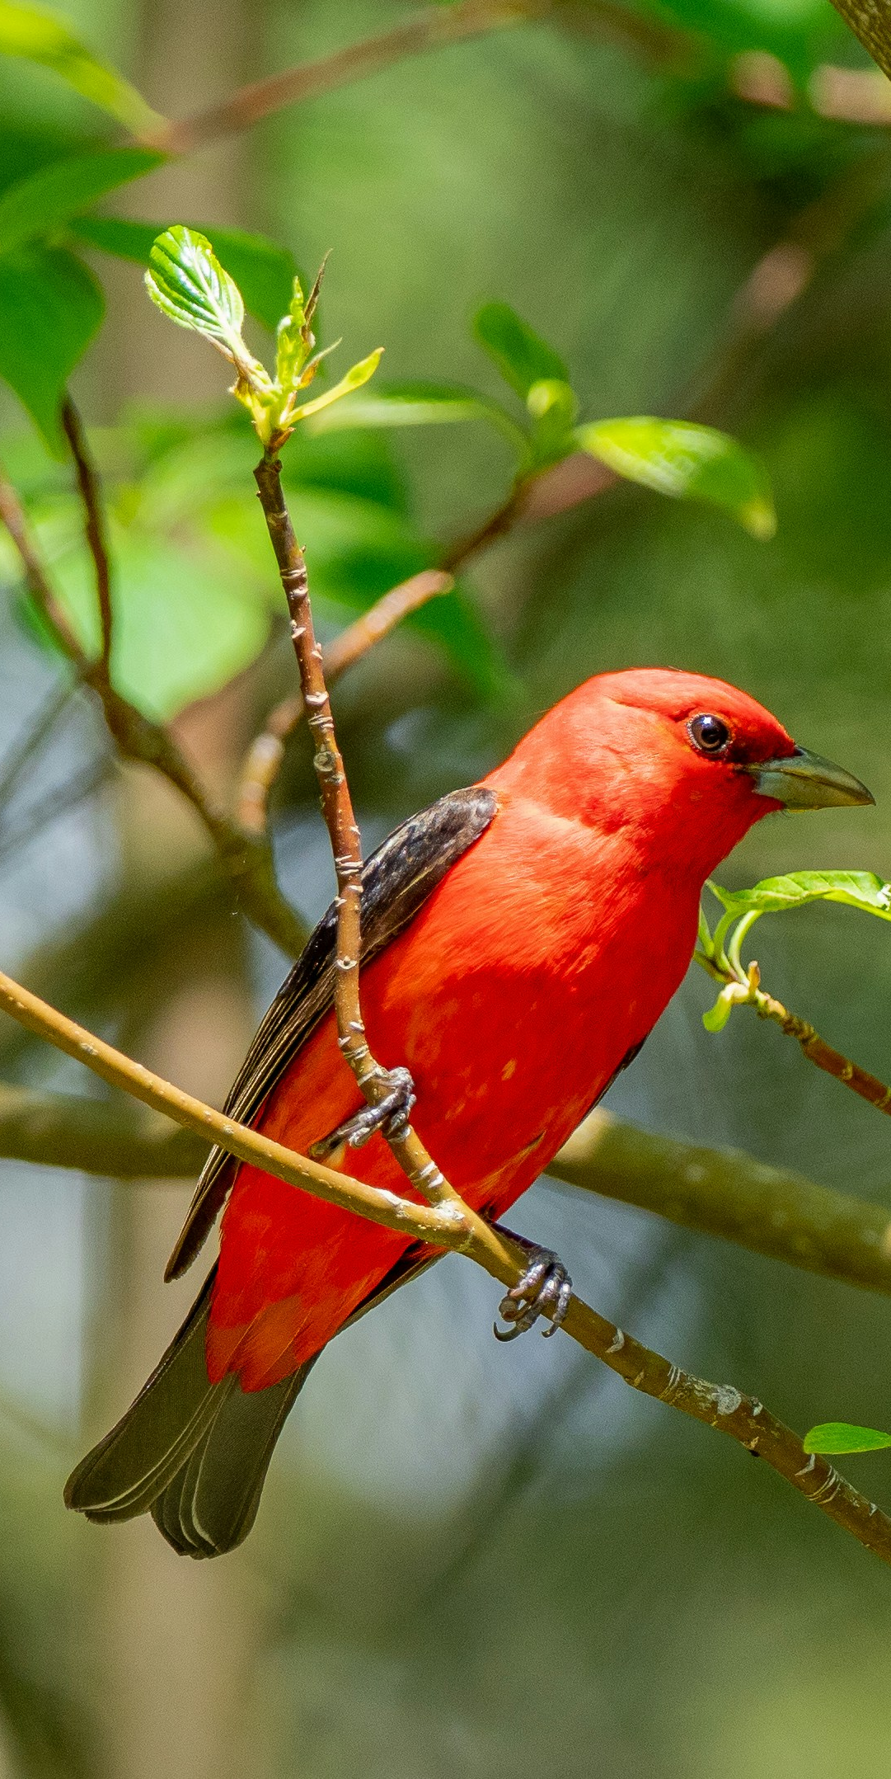
Current Temperatures
Notes:
Unknown. (2025). Scarlet tanager: Climate map [Figure]. Audubon. Retrieved from https://www.audubon.org/field-guide/bird/scarlet-tanager#bird-climate-vulnerability
Bouchard, P. (April 9, 2021). Scarlet Tanager. Unsplash. Retrieved from: https://unsplash.com/photos/red-cardinal-perched-on-tree-branch-during-daytime-eDs6MwXcRgg

Slide 17
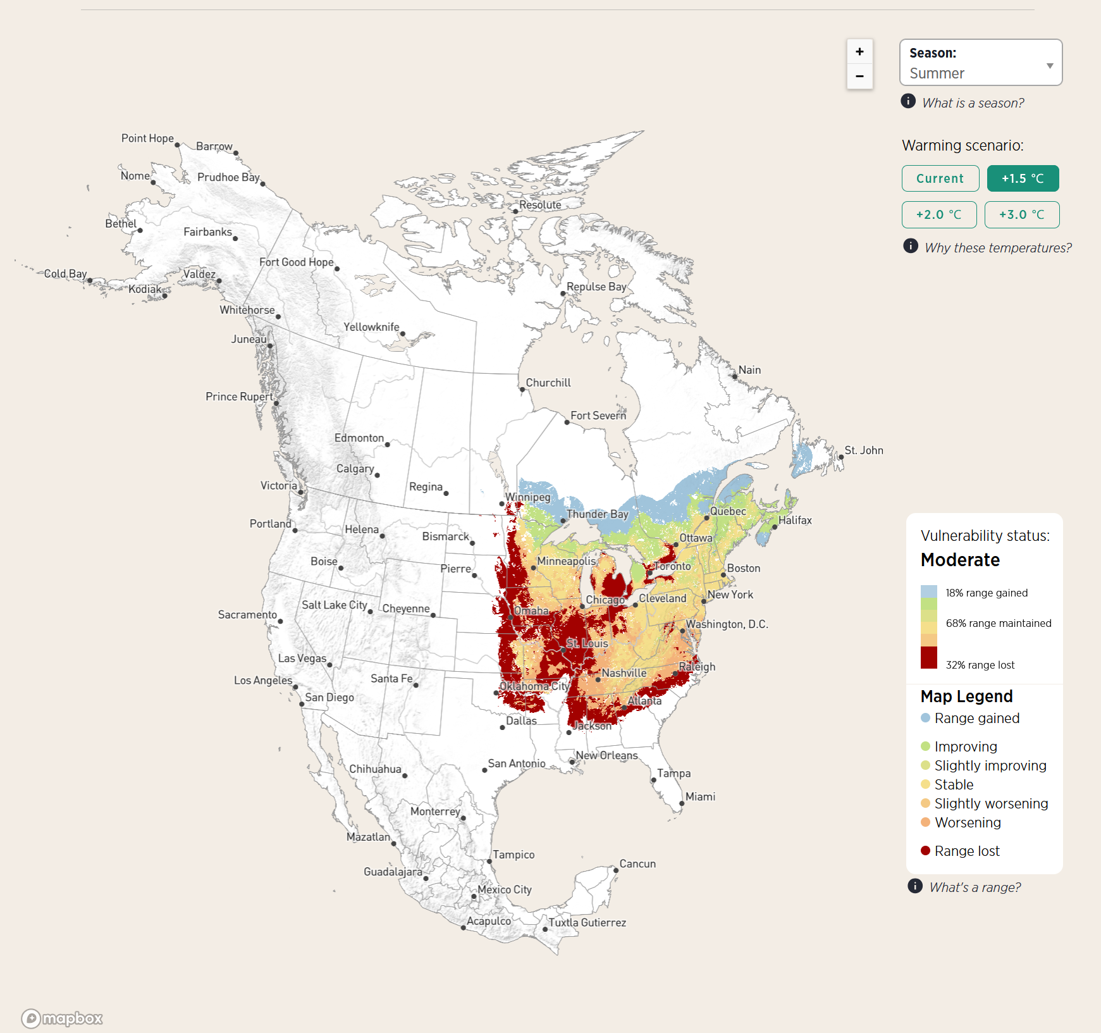
+1.5°C Warmer
Notes:
Unknown. (2025). Scarlet tanager: Climate map [Figure]. Audubon. Retrieved from https://www.audubon.org/field-guide/bird/scarlet-tanager#bird-climate-vulnerability
Bouchard, P. (April 9, 2021). Scarlet Tanager. Unsplash. Retrieved from: https://unsplash.com/photos/red-cardinal-perched-on-tree-branch-during-daytime-eDs6MwXcRgg

Slide 18
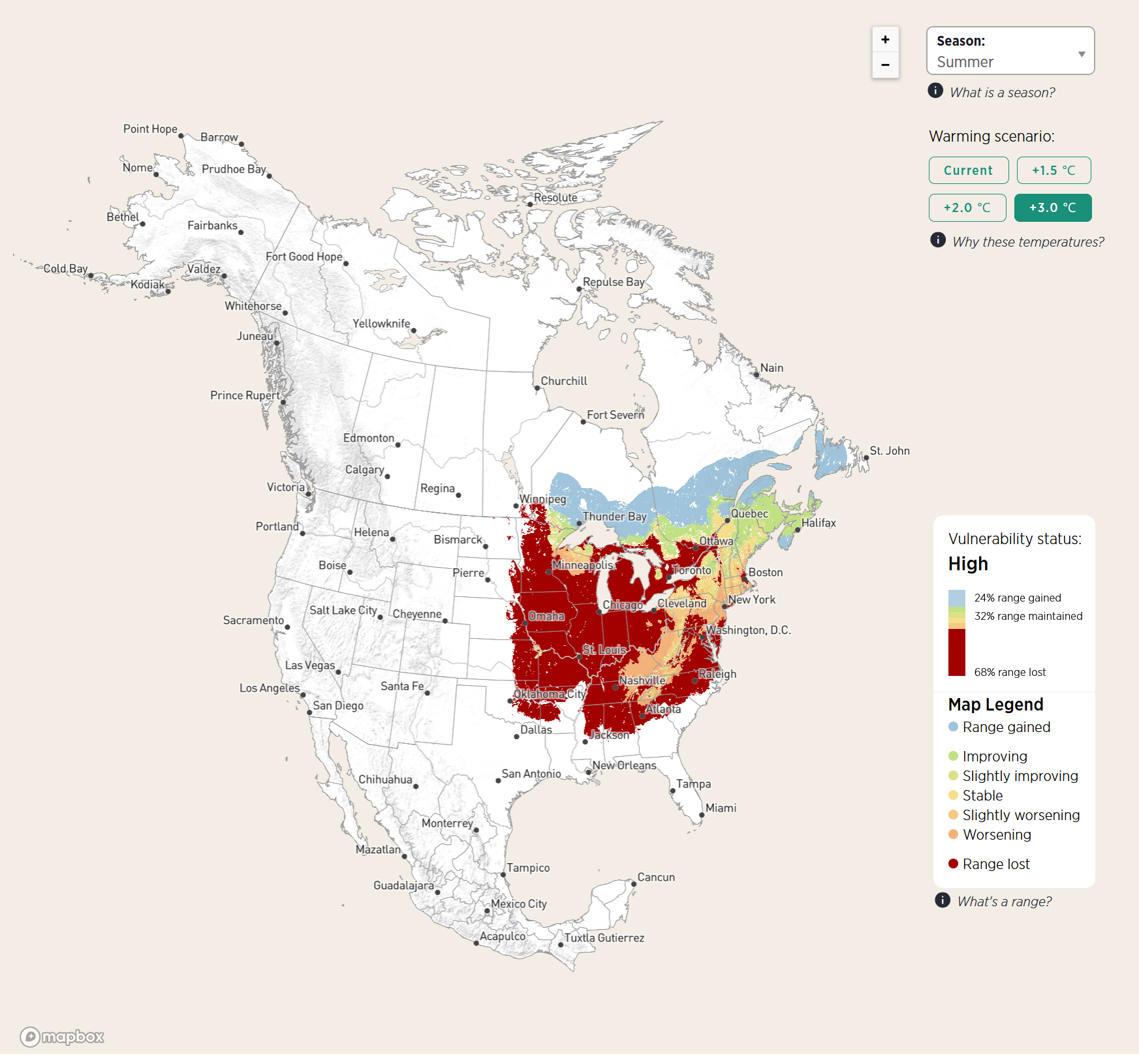
+3°C Warmer
Notes:
Unknown. (2025). Scarlet tanager: Climate map [Figure]. Audubon. Retrieved from https://www.audubon.org/field-guide/bird/scarlet-tanager#bird-climate-vulnerability
Bouchard, P. (April 9, 2021). Scarlet Tanager. Unsplash. Retrieved from: https://unsplash.com/photos/red-cardinal-perched-on-tree-branch-during-daytime-eDs6MwXcRgg

Slide 19
Climate change and life history
If a species can’t respond quickly or match their timing to temperature change, how might that affect the species in the long-term?
How would a population be affected by individual animals’ abilities to respond to changes in temperature?

Slide 20
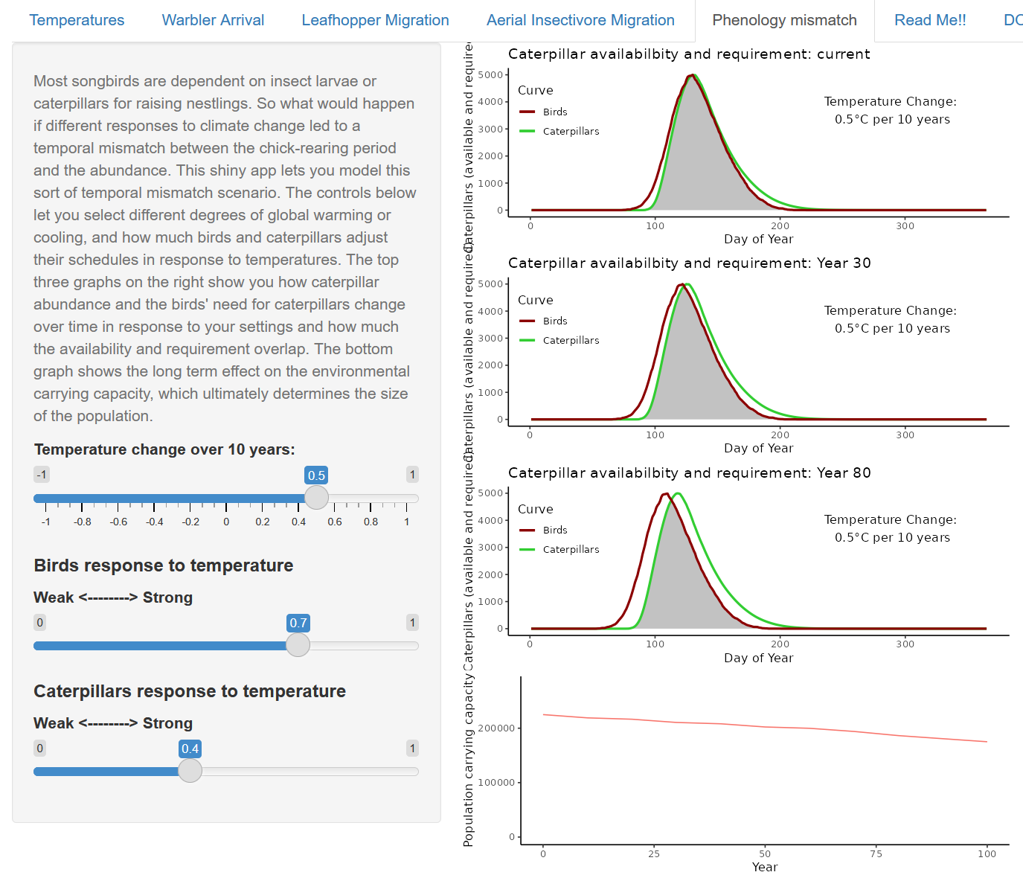
Shiny: Phenology Mismatch

Slide 21
Phenology Mismatch
How does the rate of change affect the results of the model?
How does life history (i.e., caterpillar and bird sensitivity to temperature) affect the results of the model?

Slide 22
Phenology Mismatch
Phenology mismatch happens when a resource an organism needs isn’t available at the time they need it
In Shiny, caterpillars are the resource birds need
If the caterpillars are at their highest numbers before or after the time birds need them the most, there is a mismatch

Slide 23
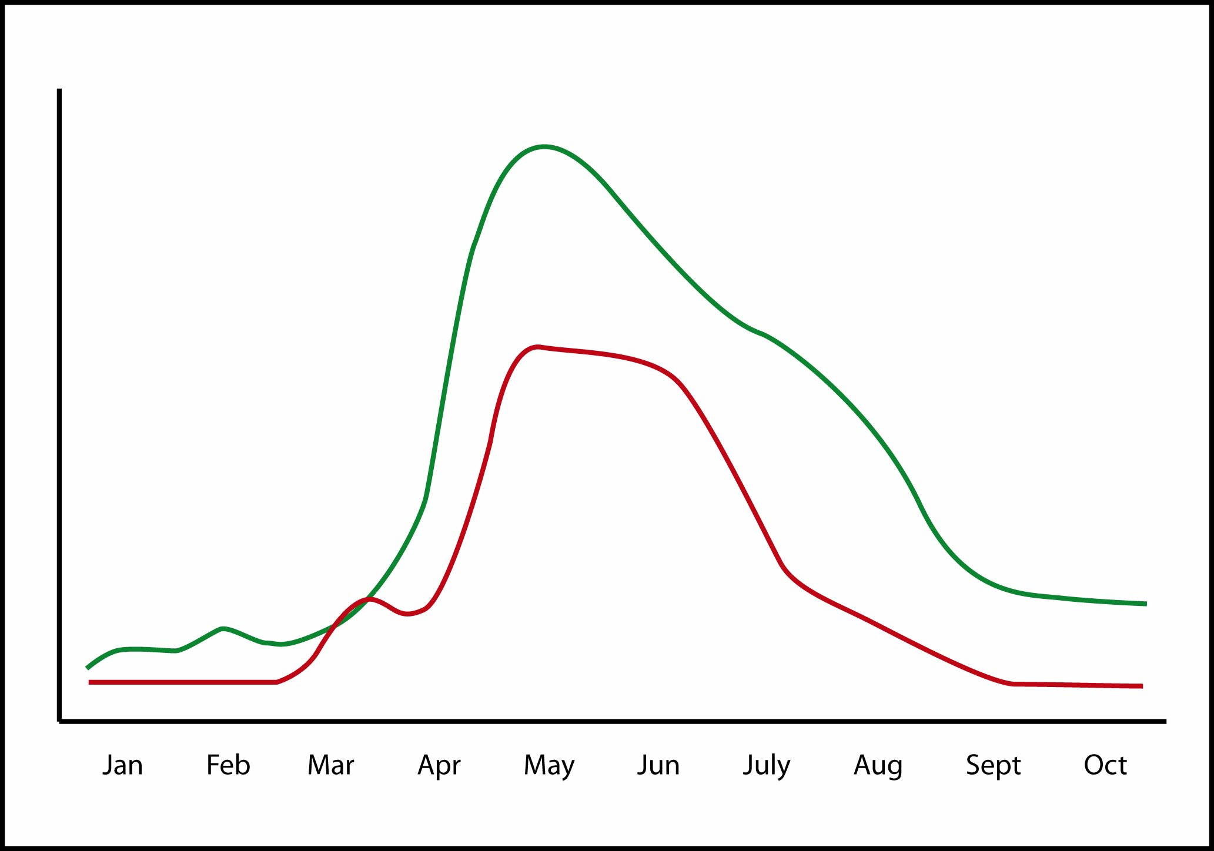
Phenology Mismatch
A mismatch in resource availability and the demands of reproduction may contribute to declines in migratory species.
Resource
availability
Demands of
Reproduction
Notes:
Bridge, E. (2023). Matching supply and demand [Figure]. Unpublished.
For most migratory birds, it is imperative that they time their reproductive effort such that it coincides with peak resource availability. Since birds must initiate the breeding cycle well in advance of peak resource availability, they must effectively make a prediction about when that peak will materialize. And the peak can vary from year to year and can be subject to long term shifts due to climate change. Many birds have an internal clock that tells them when migration and reproduction should begin, but birds use cues from their environment to improve their estimates.

Slide 24
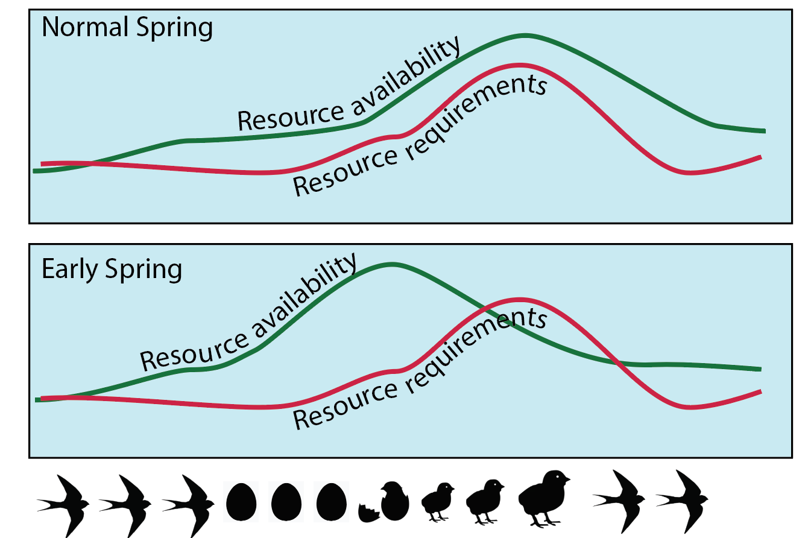
Phenology Mismatch
Notes:
Bridge, E. (2023). Timing of resource availability and resource requirements [Figure]. Unpublished.

Slide 25
Driving Question Board
What new questions do we have?
Can we answer any of our questions?
Notes:
K20 Center. (n.d.). Driving question board. Strategies. https://learn.k20center.ou.edu/strategy/1511

Slide 26
Big Ideas
What big science ideas have we learned so far?

Slide 27

Exit Ticket
In what ways does a phenology mismatch affect bird carrying capacity?
  Use data to support your answer.
What Shiny model do you have the most confidence in, and why?
Notes:
K20 Center. (n.d.). Bell ringers and exit tickets. Strategies. https://learn.k20center.ou.edu/strategy/125

