Slide 2
Function Rationally
Investigating Graphs of Rational Functions

Slide 3
Essential Questions
What is a rational function?
What might we use a rational function to model?

Slide 4
Lesson Objectives
Graph rational functions.
Analyze the relationship between the equation of a rational function and its graph.

Slide 5
Agree or Disagree?
A house cat can crawl farther out on a tree branch than a firefighter.
Do you agree or disagree with this statement and why?

Slide 6
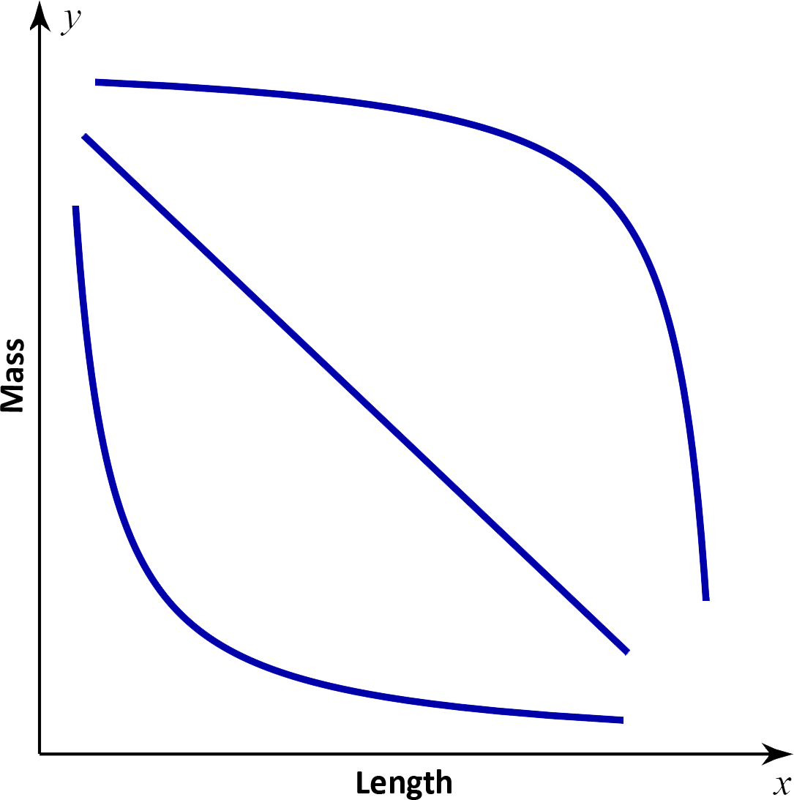
Mass vs. Length Graph
C
Let’s say we want to know how
much mass it would take to break
a tree branch at a specific point.
In other words, what if we wanted to
know how far out on the branch it is
safe for the cat or for the firefighter to go?
B
A

Slide 7
Mass vs. Length Graph
C
We could measure the distance
from that point to the tree trunk
and call it the length.
If we did this at multiple points,
what do you think the relationship
between the mass and length would look like on a graph?
  Is curve A, B, or C the best model for this situation?
B
A

Slide 8
Why Does It Matter?
Why might it be important to know how much mass it takes before a branch breaks at a given length?
  Who may need to know this relationship and why?
  Are there similar real-world applications?

Slide 9
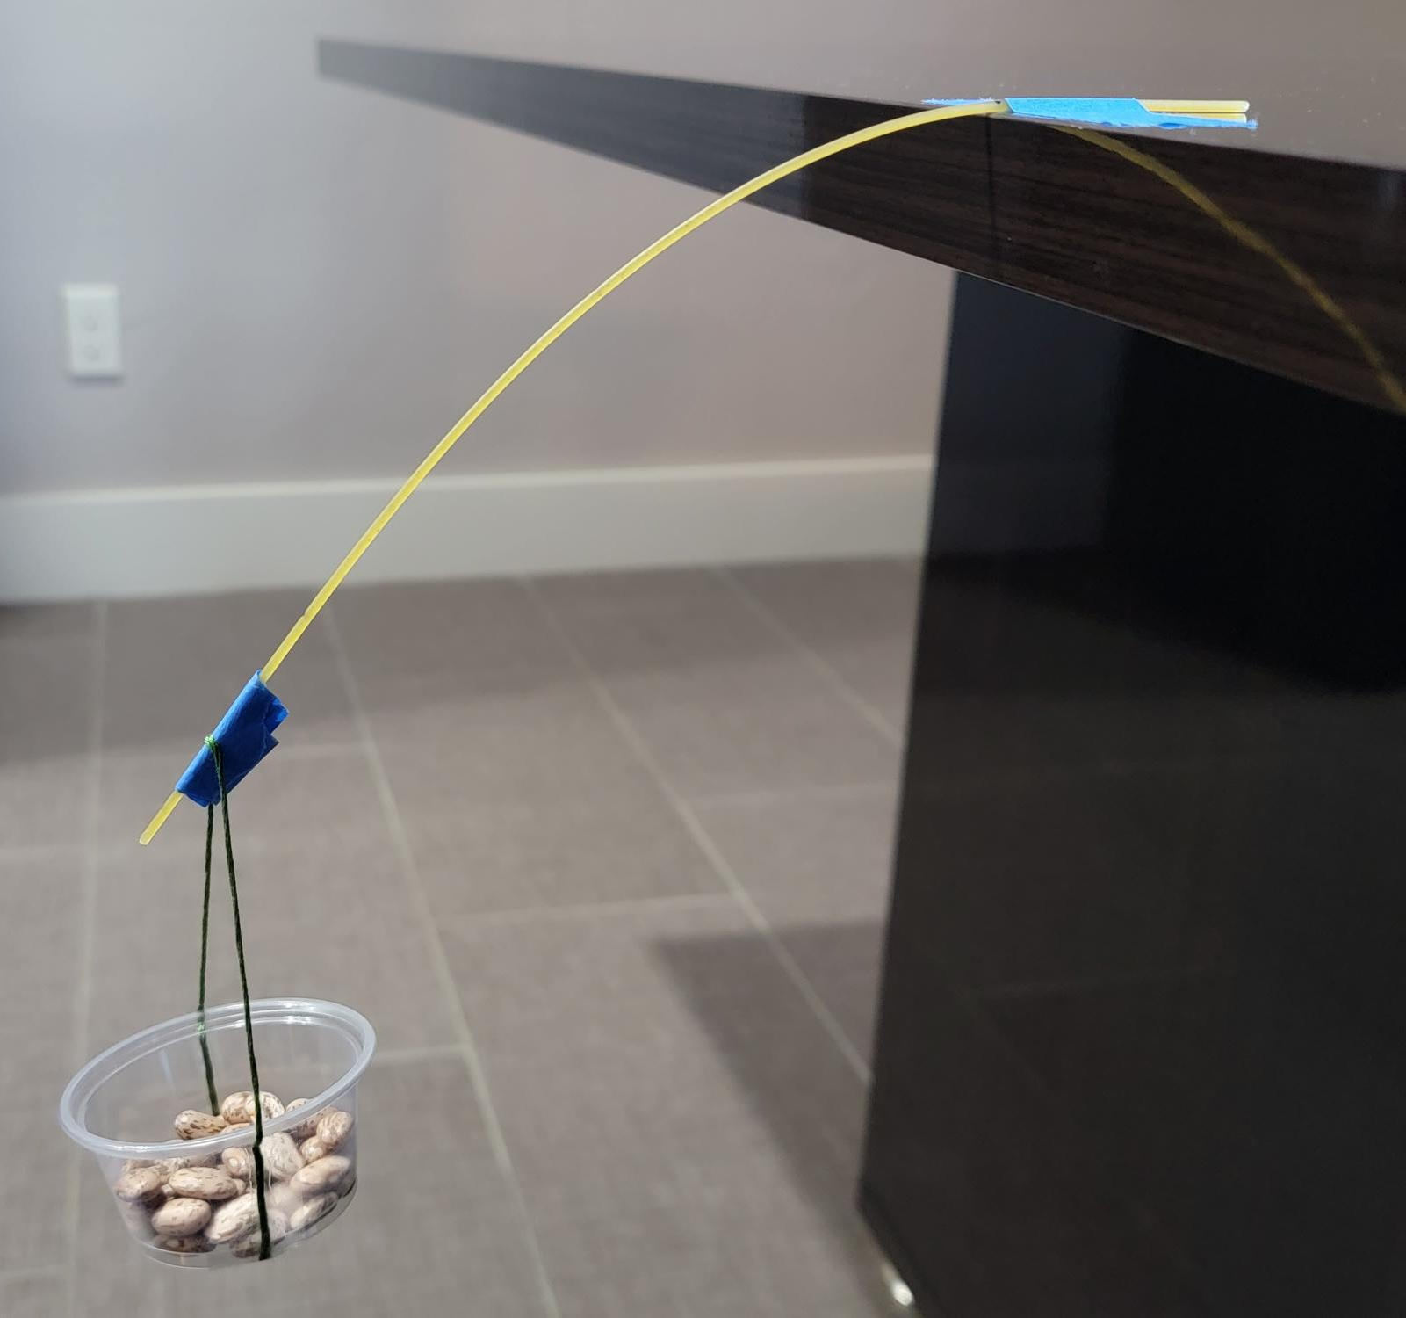
Pasta Branches: Overview
Let’s perform an experiment and gather
data to determine what the mass vs.
length graph would look like.
In groups of 3, you will hang a plastic cup on a spaghetti noodle at different lengths and add weights until the noodle breaks.
You will record your data and use Desmos to
determine the which shape best models your data.

Slide 10
Pasta Branches: Roles
The counter is responsible for counting and placing the dried beans into the cup.
The recorder is to verify the count after the noodle breaks and record the data.
The catcher is responsible for placing hands under the cup to catch the container with beans (otherwise, they will be all over the floor and difficult to find/count).

Slide 11
Pasta Branches: Materials
Gather the following materials:
Tape
Permanent Marker
Ruler
5 Dry Spaghetti Noodles
1 Piece of String
1 Plastic Cup Almost Full of Dried Beans

Slide 12
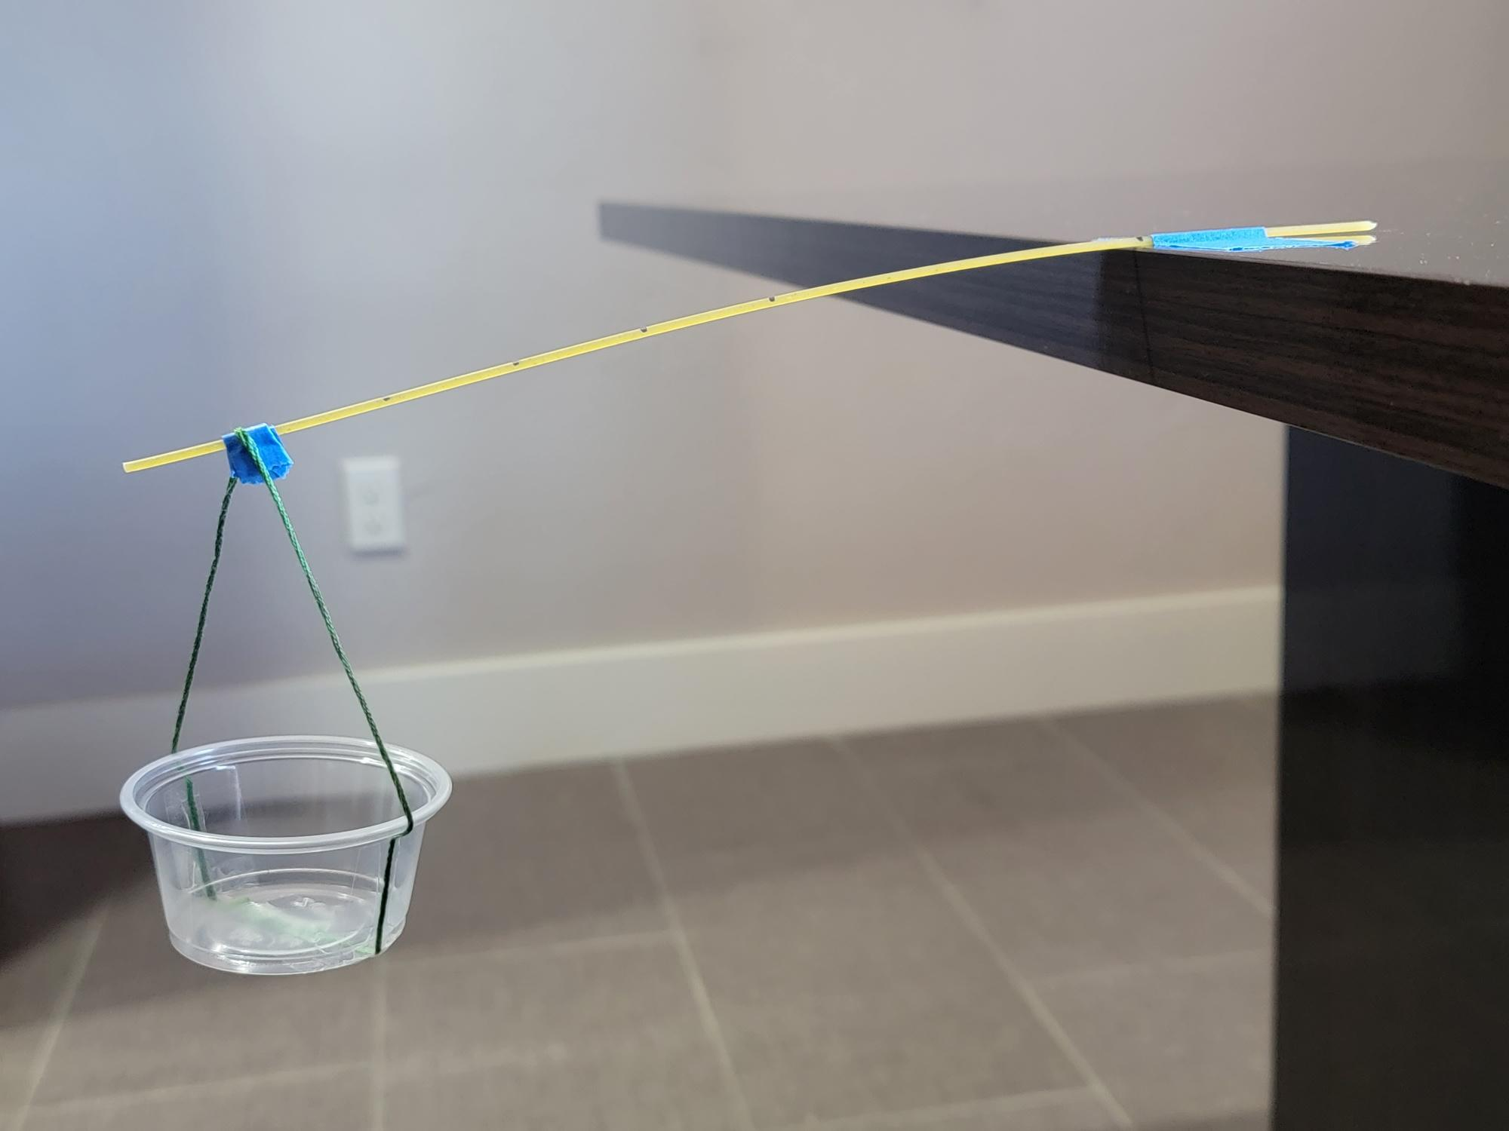
Pasta Branches: Procedure

Slide 13
Pasta Branches: Results
Go to desmos.com.
Click “Graphing Calculator.”
Press the plus sign in the top-left corner and add a table.
Enter your data from your handout into the table.

Slide 14
Pasta Branches: Results
C
Looking at your data in Desmos,
which graph most closely matches
the shape of your data points?
Did this match your prediction from
earlier? Discuss with a partner.
Use the graph to complete the following statement:
  As the distance from the tree trunk (length) increases,
  the mass it takes to break the branch ________.
B
A

Slide 15
Pasta Branches: Results
Create a curve in Desmos that models your data:
In the 2nd input row, type: y1~a/x1-h→+k
The result should look like:
Desmos will also display the values for a, h, and k that are specific to the curve generated to fit your data.

Slide 16
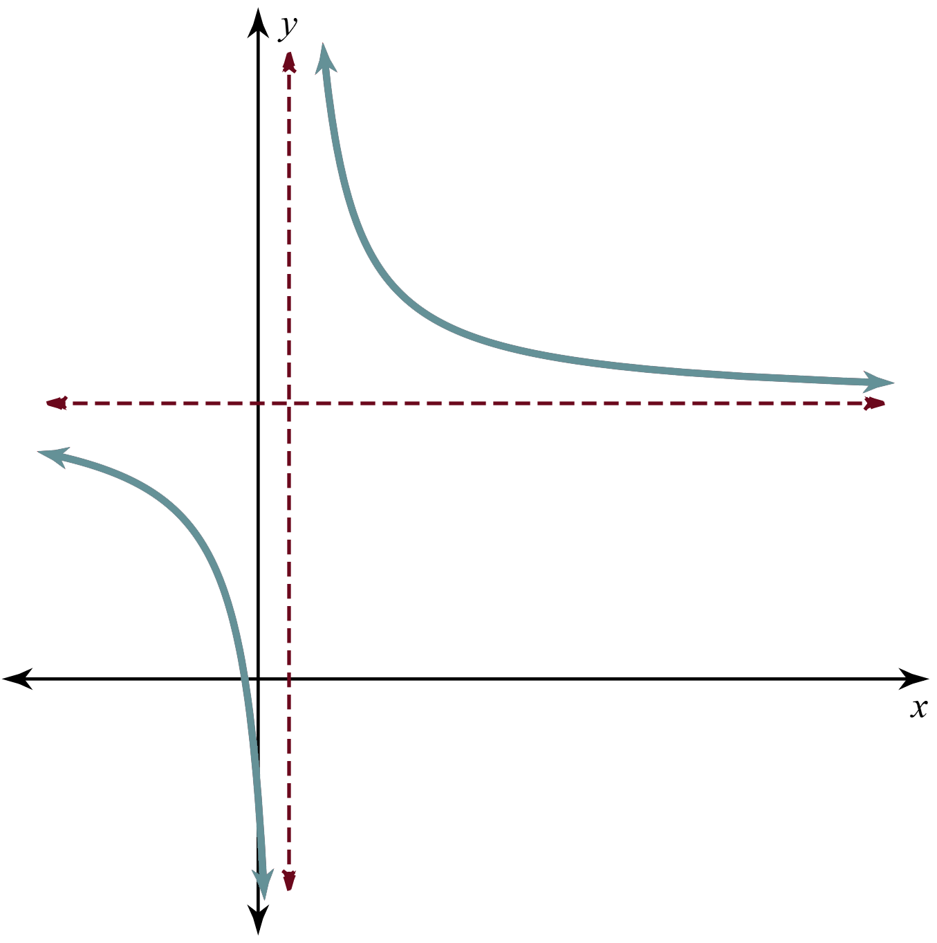
Rational Functions
The graph on your screen is known as a hyperbola.
Notice that it has two branches and two asymptotes.
A hyperbola is the name of the graph of a simple rational function of the form:

Slide 17
Desmos: Marbleslide
Navigate to https://student.desmos.com.
Enter code.
Follow the directions on each screen and adjust the rational functions to get the marbles to go through the stars.
  Record your thinking on your Note Catcher handout.

Slide 18



It Says, I Say, and So
It Says: Circle what you changed.
I Say: How did that change the graph?
And So: Use your Note Catcher to explain how
a, h, and k affect the graph.

