Slide 2
Coffee and Corpses
Exponential Decay

Slide 3
Essential Question
How is exponential decay applicable to the real world?

Slide 4
Lesson Objective
Explore exponential functions by investigating exponential decay.

Slide 5
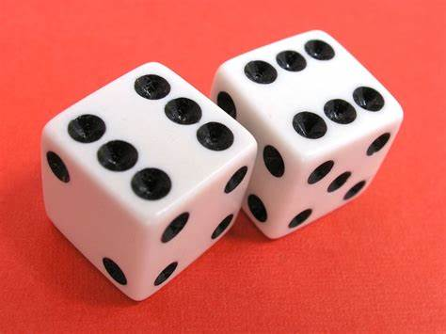
Discussion
If each of us rolled a six-sided die and had to sit out when we rolled a one, how many people will still be standing after five rounds?
After completing the activity, does your prediction match the graph?
Does this type of graph look familiar to you?
Notes:
Free Images Live. (n.d.). 1877 Lucky dice. [Digital Image]. Creative Commons. https://www.freeimageslive.co.uk/free_stock_image/luckydicejpg
Strategy Link: https://learn.k20center.ou.edu/strategy/139
Optional Tech Tool Link: https://learn.k20center.ou.edu/tech-tool/2317

Slide 6
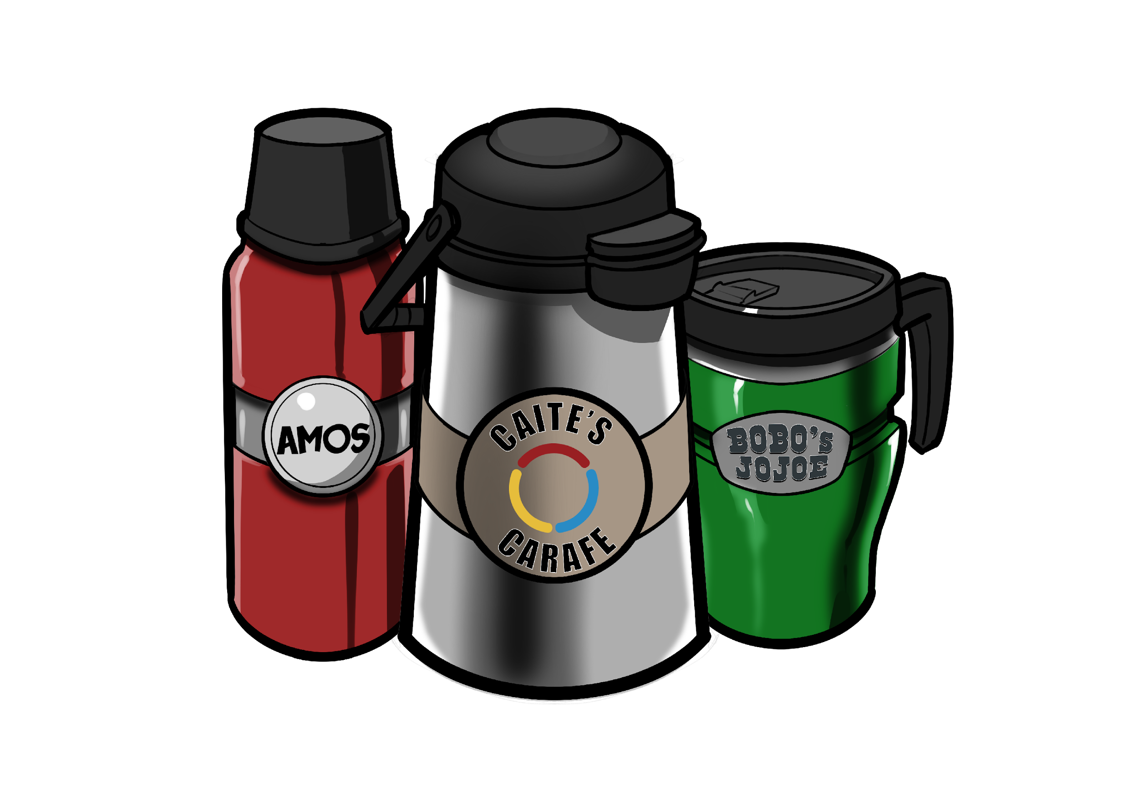
Need Your Help!
Moondoe’s Coffee wants to sell refillable thermal mugs for its environmentally conscious consumers.
The coffee shop has determined that, in order for their coffee to taste its best, it must be brewed between 200°F and 220°F.
To be safe to drink, however, it must cool to 180°F.
Help Moondoe’s coffee research thermal mugs to make the best purchase for their business!

Slide 7
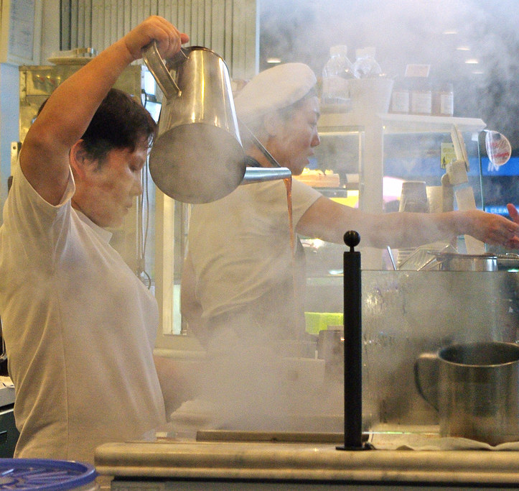
Discussion
Based on the information provided and your mathematical reasoning, which mug do you believe Moondoe’s Coffee should buy?
Be prepared to explain your choice.
Present your argument and include your work.
We will vote for the best mug choice at the end!
Notes:
Brewer, L. A., (n.d.). Steaming hot coffee. [Digital Image]. Creative Commons. https://search.creativecommons.org/photos/44e1a23e-69ac-49d1-b1e4-af71e8de46ddcreativecommons.org)

Slide 8
Exponential Decay
Definition | Equation
Graph | Example

Slide 9
Exponential Decay
Definition | Equation
Graph | Example
A quantity gets smaller over time.

Slide 10
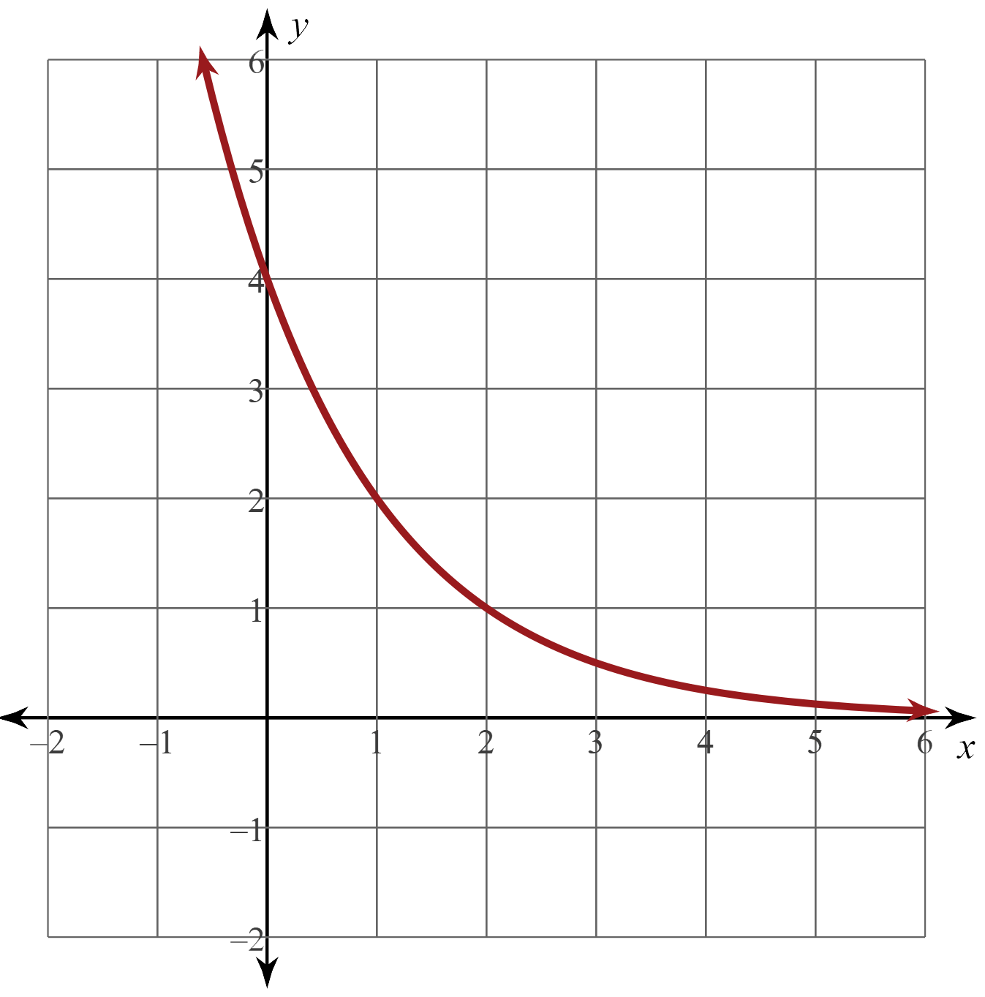
Exponential Decay
Definition | Equation
Graph | Example
A quantity gets smaller over time.

Slide 11
Exponential Decay
Definition | Equation
Graph | Example
A quantity gets smaller over time.

Slide 12
Exponential Decay
Definition | Equation
Graph | Example
A quantity gets smaller over time.
The atmospheric pressure at sea level is 1013 hPa and will decrease at a rate of 12% over time.

Slide 13
K20 ICAP: Coffee and Corpses
Notes:
K20 Center. (n.d.). Timothy Dwyer: Death Scene Investigator. ICAP video. YouTube. https://www.youtube.com/watch?v=uqCnMBZN9Sw

Slide 14
Connection to the Real-World
How do employers use exponential decay in their everyday life.
Why is it important?
Conduct research on the application of exponential decay.
Be prepared to discuss what you found.
Notes:
Giangrandi.ch. (n.d.). Learn exponents online. [Virtual Image]. https://www.ixl.com/math

Slide 15
Connection to the Real-World
Find a partner or organize a group of three. In each group, do the following:
Take turns discussing your research and the application to exponential decay.
On the bottom of your paper, write a short paragraph about what you thought exponential decay was before today.
Now after further understanding, describe in a separate paragraph what exponential decay actually is.
How does this concept apply to the world around you?
Notes:
Strategy Link: https://learn.k20center.ou.edu/strategy/137

