Slide 1
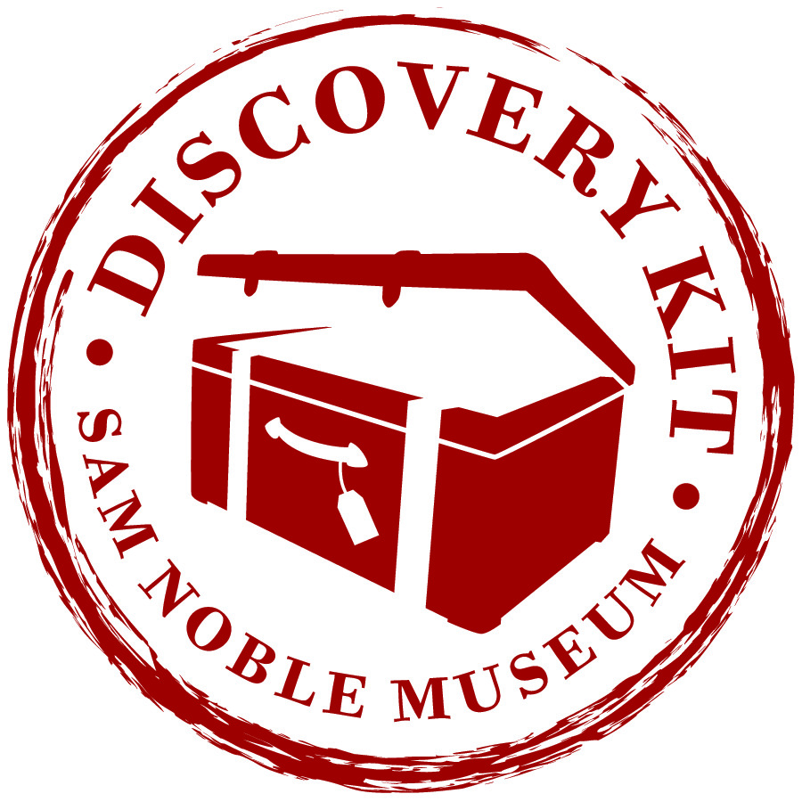
Task Cards for Stations— Looking Back in Time Using Fossil Evidence
Teacher Directions:
Print off the task cards for each station
Laminate if possible.
Place the task card with the matching specimen or photo at a station or desk.

Slide 2
Station 1: Similarities and Differences
1. Find Station 1 in your Discovery Notebook.
2. Look at the two specimens carefully with the hand lens.
3. Make sketches from your observation of each trilobite in your notebook.
4. Write about how these two specimens are similar.
5. Now, write about how they are different.
6. You can also label and show those differences in your drawings.

Slide 3
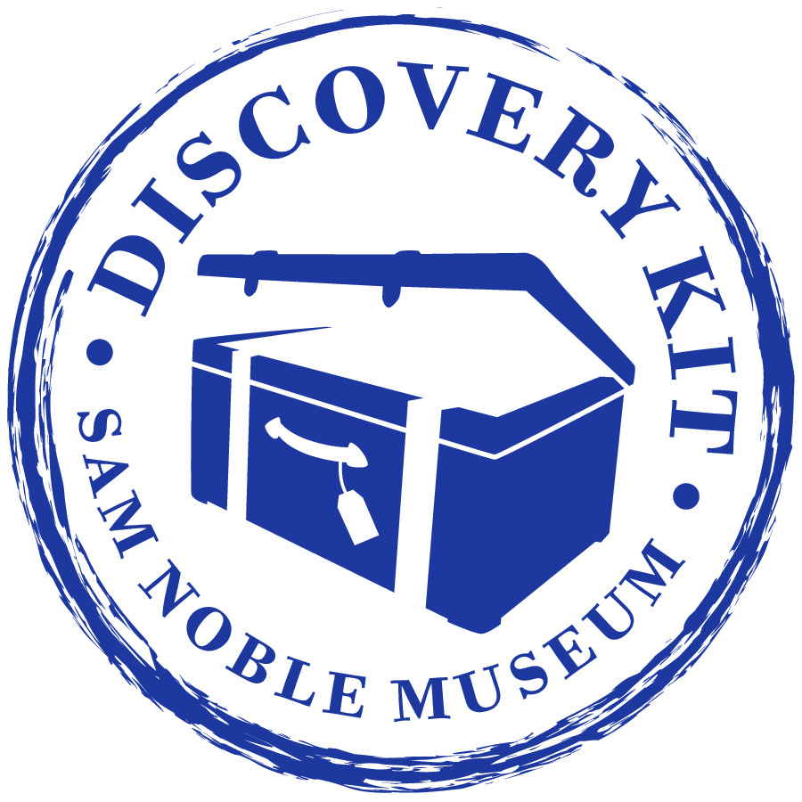
Station 2: Observation and Inferences
1. Find Station 2 in your Discovery Notebook.
2. Look at the two specimens carefully with the hand lens.
3. In your notebook: Make a list characteristics you notice about the T-rex tooth. Then make a list of what you notice about the Killer Toe from the Deinonychus.
4. Based on your observations of the specimens, what inferences can you make about the animal when it was alive. Write these in your notebook.

Slide 4
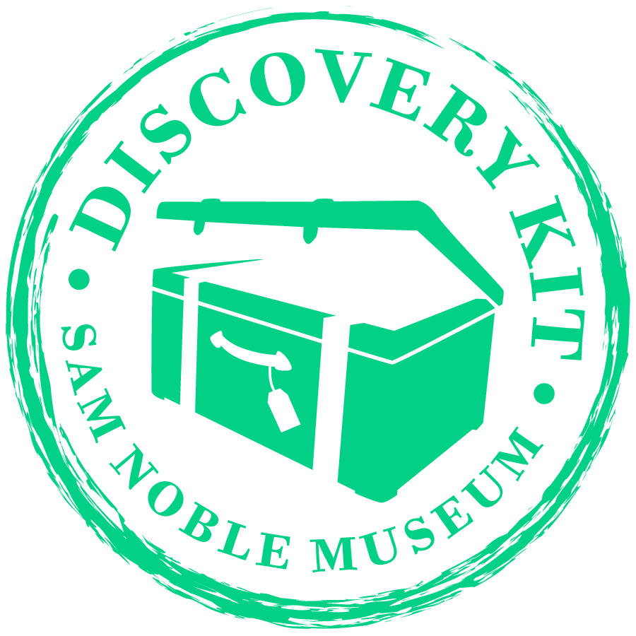
Station 3: Making Inferences Based on Evidence
1. Find Station 3 in your Discovery Notebook.
2.Make observations about the Apatosaurus vertebra and the Ichthyosaur vertebra. Record these in your notebook.
3. Make an inference about which animal lived on land and which lived in water.
4. Write or draw to explain your reasoning using evidence from the specimens you observed.

Slide 5
Station 4: Inferences Based on Evidence
1. Find Station 4 in your Discovery Notebook.
2. Write down the names of the two specimens.
3. Take the playdough and press each tooth specimen separately into
the play dough.
4. Look at the teeth indentations and infer whether each animal is a carnivore or an herbivore.
5. Share your thoughts about your reasoning.

Slide 6
Station 5: Predictions
1. Find Station 5 in your Discovery Notebook.
2. Make a detailed sketch of the Trimerorhachis in your notebook, making sure to sketch the placement of the eyes in the skull.
3. Make a prediction about the advantage that the placement of the eyes might have for this animal. Record your ideas in your notebook.

Slide 7
Station 6: Structure and Function
1. Find Station 6 in your Discovery Notebook.
2. Make a detailed sketch of the specimen in your notebook, making sure to sketch the placement of the eyes in the skull.
3. Discuss with your partner why this placement might be an advantage for the animal.

Slide 8
Station 7: Reading Station
1. Read and think about how the placement of eyes on a skull can be helpful or not helpful to an animal.
2. Now look at your drawings from Stations 5 and 6 and make a claim about the advantages or disadvantages the animals’ eye placement gives the animal.
3. Write your claims on Station 5 and Station 6 notebook pages.

Slide 9
Station 8: Structure and Function
1. Find Station 8 in your Discovery Notebook.
2. Look at the skull.
3. Sketch the specimen’s skull, making sure to place the eyes, and nostrils in the correct location.
4. Using your observations, where do you think the animal might have lived having eyes and nostrils on the top of its head?

Slide 10
Station 9: Collecting Data Like a Paleontologist
Data Collection List
Write the name of the specimen: Ammonite.
Location where the sample was found.
Length of the skull in cm.
Width of the skull in cm.
Skull features: Does it have rings or curves on it? If yes, please describe the rings or curves.
Where are the eyes placed?
Measure the distance between the ridges on the body. This will show you growth per year!
Additional notes or observations:
Find
Find Station 8 in your Discovery Notebook.
Use
Use the measurement tools provided to collect and
Record
record data about this specimen.

