Slide 2
Fire: Friend or Foe?

Slide 3
Essential Question
How does fire impact prairie ecosystems?

Slide 4
Learning Objectives
Identify the importance of prairies.
Recognize the impact of fire on prairies.

Slide 5
Three Sticky Notes
Access the Jamboard.
Look at the images of prairie ecosystems on slides 2-5.
Add three sticky notes containing adjectives you thought of while looking at the pictures.
Insert QR Code or Link to your class Jamboard Here
Notes:
K20 Center. (2022). Google jamboard. Strategies. https://learn.k20center.ou.edu/tech-tool/2336
K20 Center. (2022). Three sticky notes. Strategies. https://learn.k20center.ou.edu/strategy/153
https://jamboard.google.com/d/1cOykXlS6oqqS2DxxSSEREG6qrIEImxGKMKdGoQVuA_U/viewer

Slide 6
Adjectives
[ˈa-jə-tiv]
noun
A word or phrase naming an attribute, added to or grammatically related to a noun to modify or describe it.
Example: Margot wore a bright yellow dress and a beautiful hat to match.

Slide 7
Three Sticky Notes
Access the Jamboard.
Look at the images of fire on slides 8-12.
Add three sticky notes containing adjectives you thought of while looking at the pictures.
Insert QR Code or Link to your class Jamboard Here

Slide 8
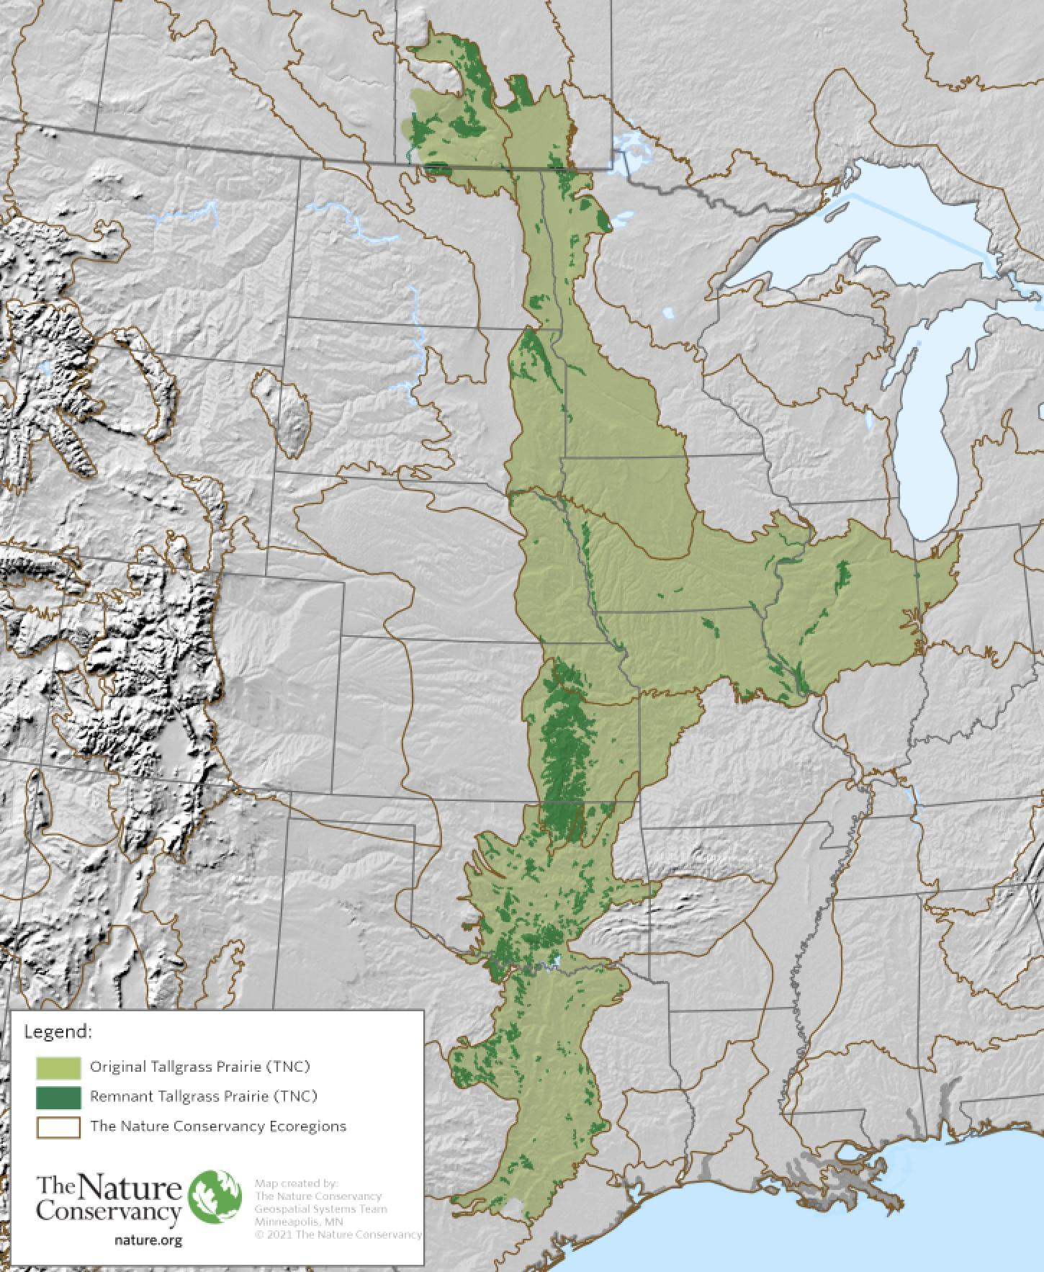
I Notice/I Wonder
Look at the map of the prairies of North America.
What do you notice?
What do you wonder?
Notes:
K20 Center. (2020). I notice, I wonder. Strategies. https://learn.k20center.ou.edu/strategy/180
K20 Center. (2020). Claim, evidence, reasoning (CER). Strategies. https://learn.k20center.ou.edu/strategy/156

Slide 9
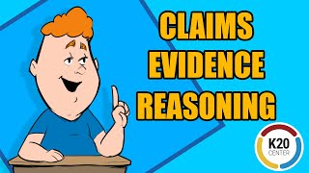
Writing a Claim, Evidence, Reasoning (CER)
Notes:
https://www.youtube.com/watch?v=JGOxVIgmGWE&list=PL-aUhEQeaZXID91azYKwX91vNfNKrANsQ&index=10

Slide 10
Claim, Evidence, Reasoning (CER)
Consider this question: What role does fire play in a prairie ecosystem?

Slide 11
Writing a Claim, Evidence, Reasoning (CER)
Notes:
https://www.youtube.com/watch?v=JGOxVIgmGWE&list=PL-aUhEQeaZXID91azYKwX91vNfNKrANsQ&index=10

Slide 12
Claim, Evidence, Reasoning (CER)
Using the QR code, open the Wakelet and explore the articles and/or videos. 1. Make your claim.
2. Take notes as you explore items in the Wakelet, these will provide you with evidence to support your claim.
Notes:
K20 Center. (2020). Wakelet. Strategies. https://learn.k20center.ou.edu/tech-tool/2180

Slide 13
Card Sort
With a partner, read through each of the cards.
Sort them into one of the two categories:
Goods
Services
Add notes to your handout that will help you on your CER.
Notes:
K20 Center. (2020). Cart sort. Strategies. https://learn.k20center.ou.edu/strategy/147

Slide 14
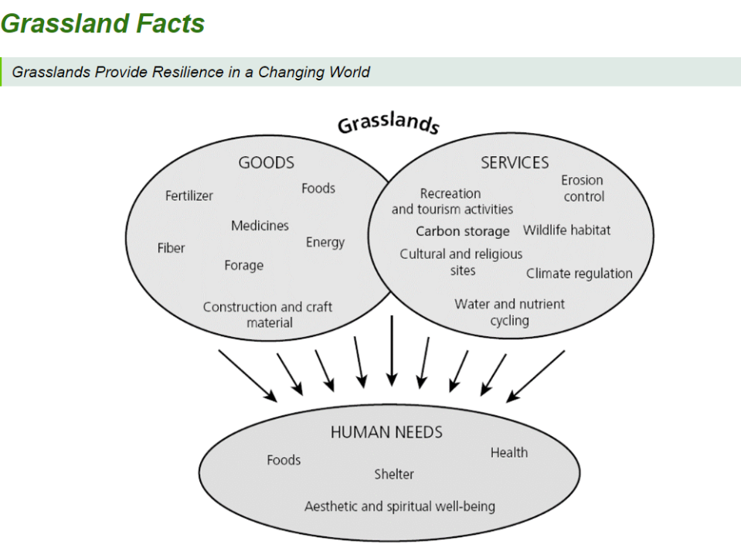
Card Sort

Slide 15
Surprising, Interesting, Troubling
Watch the two videos that tell you something about using fire in a productive way. Here is what you need to think about as you watch them:
What is one fact that was Surprising?
What is one fact that was Interesting?
What is one fact that was Troubling?
Notes:
K20 Center. (2021). S-I-T (Surprising, Interesting, Troubling). Strategies. https://learn.k20center.ou.edu/strategy/926

Slide 16
Andrew Warrior
Notes:
https://www.youtube.com/watch?v=MK0me10ZXfU

Slide 17
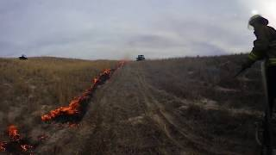
Controlled Burn
Notes:
https://www.youtube.com/watch?v=WZxus9tiC2g

Slide 18
Surprising, Interesting, Troubling
On your sticky notes:
What’s one thing/fact that was Surprising
What’s one thing that was Interesting?
What’s the one thing that was Troubling?

Slide 19
Claim, Evidence, Reasoning (CER)
Review your notes from the lesson.
Consider the essential question: What role does fire play in a prairie ecosystem?
Review your original claim and revise as needed.
Organize your evidence into complete sentences to support your claim.
Provide reasoning that explains why your evidence supports your claim.

Slide 20
Claim, Evidence, Reasoning (CER)
In your final CER, be sure to use the following terms:
Prairie/Grassland
Prescribed Fire
Controlled Fire
Wildfire
Resiliency
Succession

Slide 21
Claim, Evidence, Reasoning (CER)
Review your notes from the lesson.
Consider the essential question: What role does fire play in a prairie ecosystem?
Review your original claim and revise as needed.
Organize your evidence into complete sentences to support your claim.
Provide reasoning that explains why your evidence supports your claim.
Prairie/Grassland
Prescribed Fire
Controlled Fire
Invasive Species
Wildfire
Resiliency
Succession

