Slide 1


Take a few minutes to look at the next four (4) slides.
Stop when you get to slide 6 and complete the activity.

Slide 2
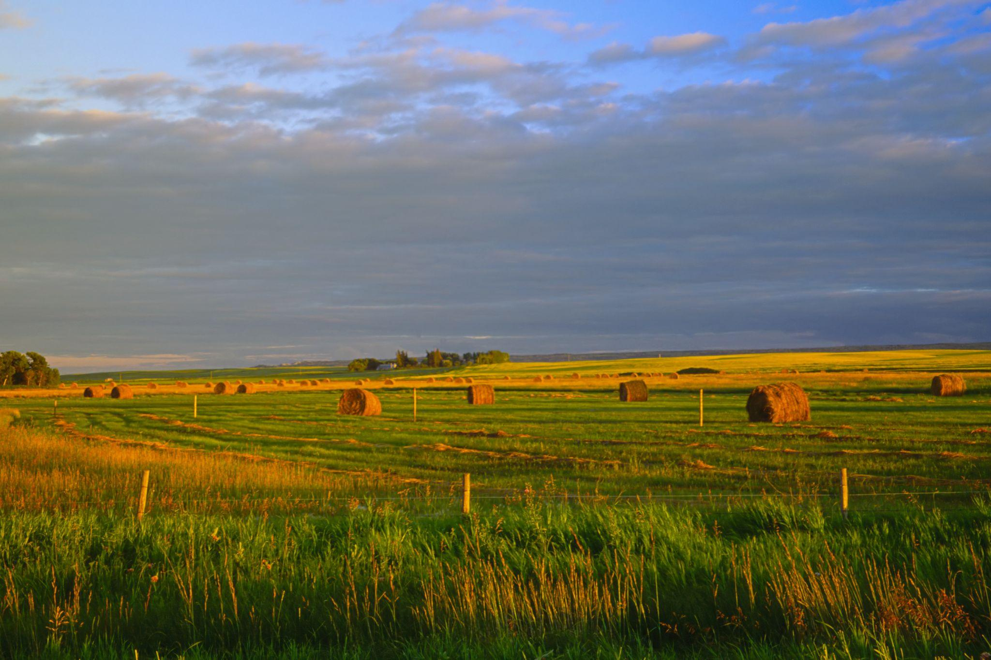
Notes:
https://commons.wikimedia.org/wiki/File:Harvest_time_on_the_prairies_manitoba_%286797008930%29.jpg

Slide 3
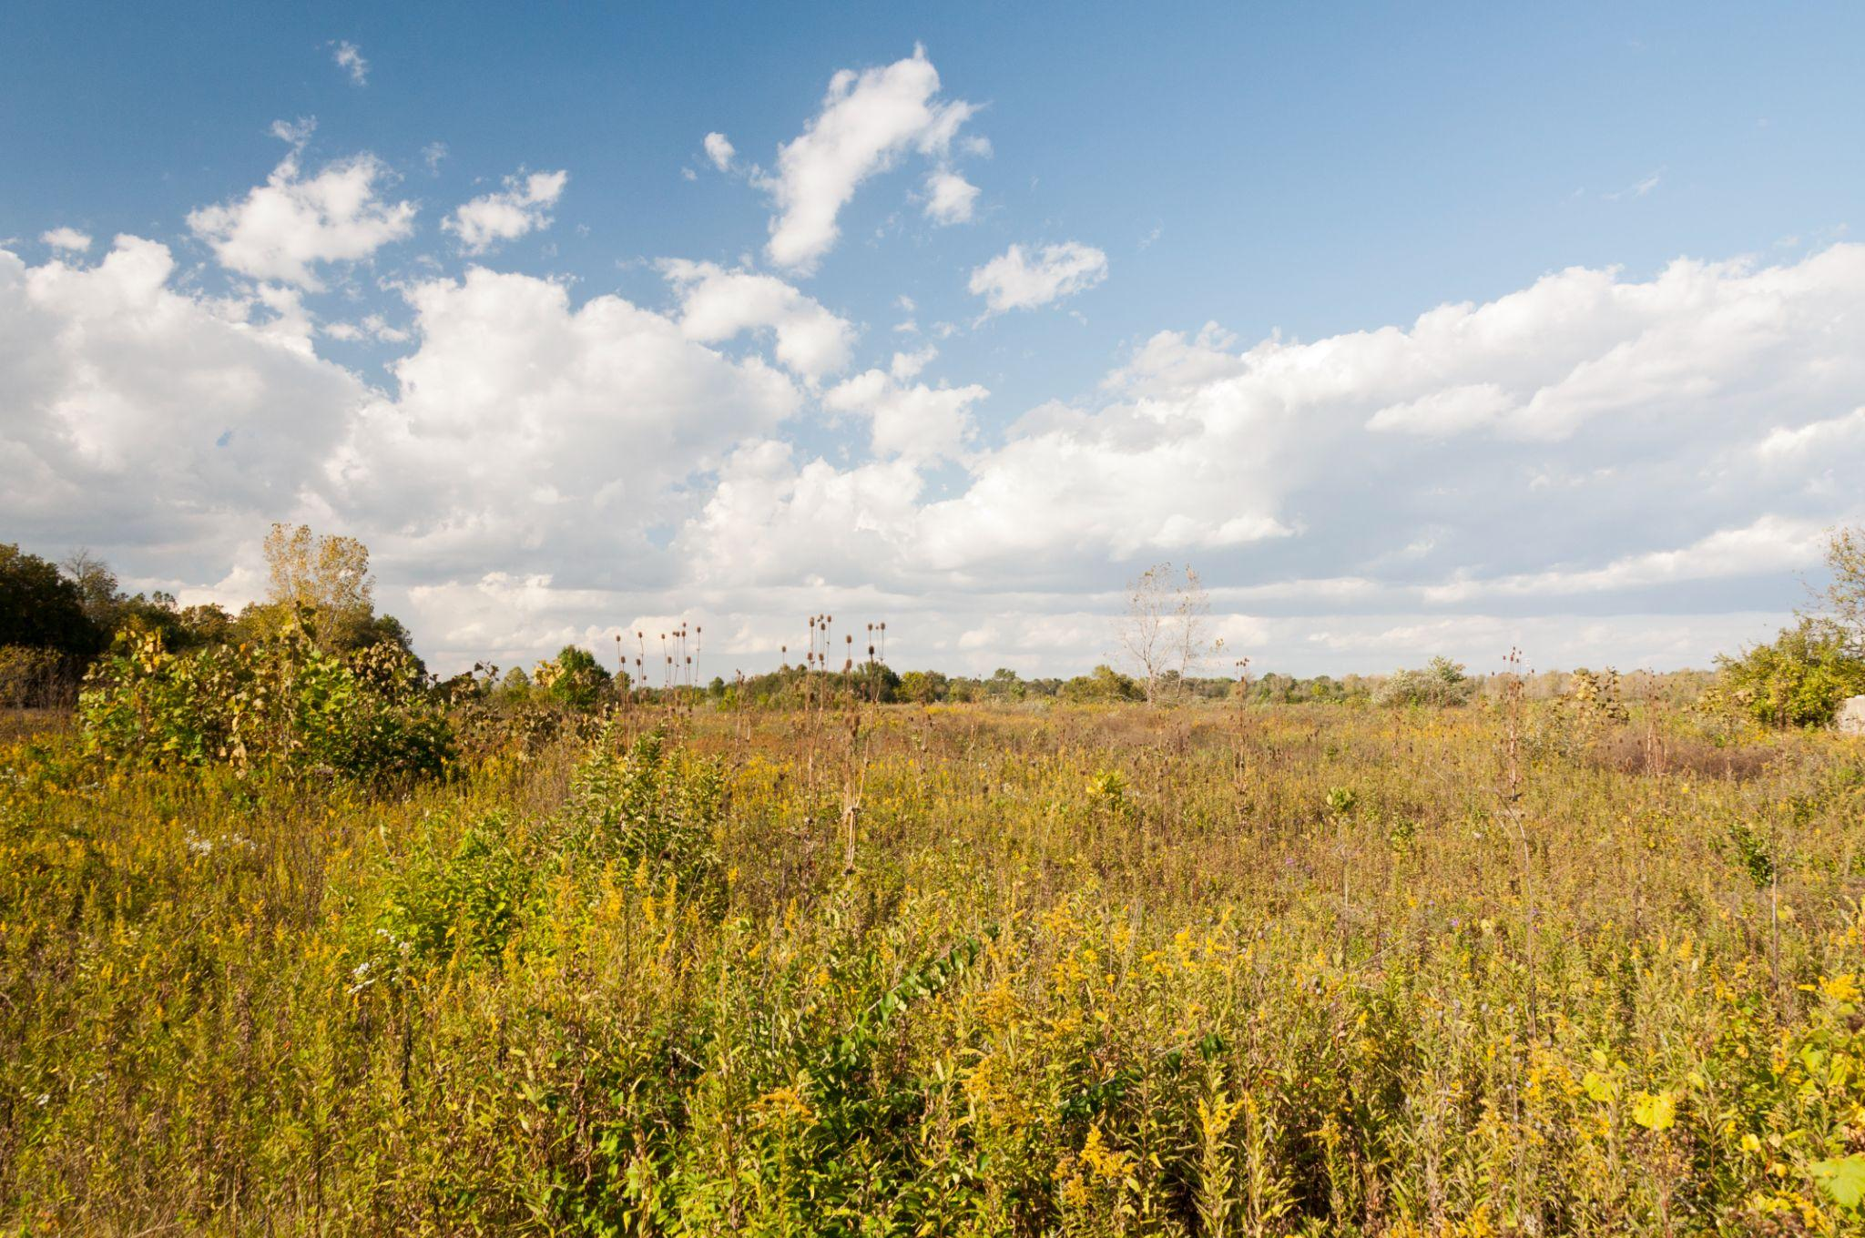
Notes:
https://commons.wikimedia.org/wiki/File:Three_Creeks_-_Prairie_in_Ohio_1.jpg

Slide 4
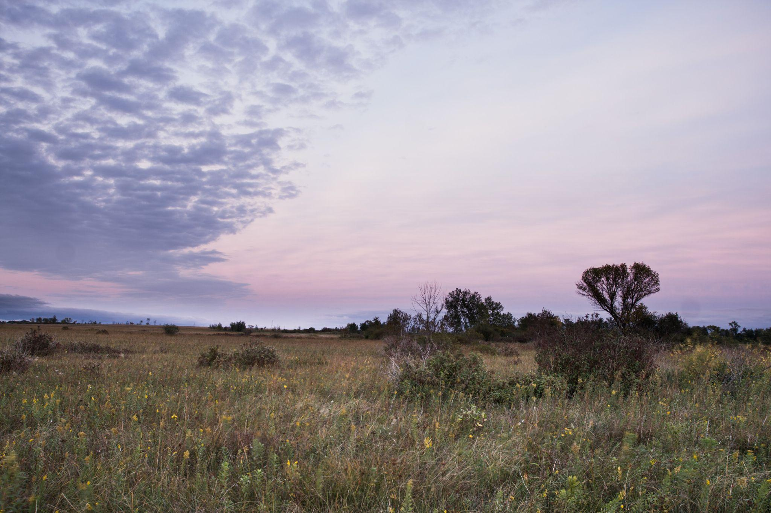
Notes:
https://commons.wikimedia.org/wiki/File:Dusk_on_the_Prairie_%2813182374354%29.jpg

Slide 5
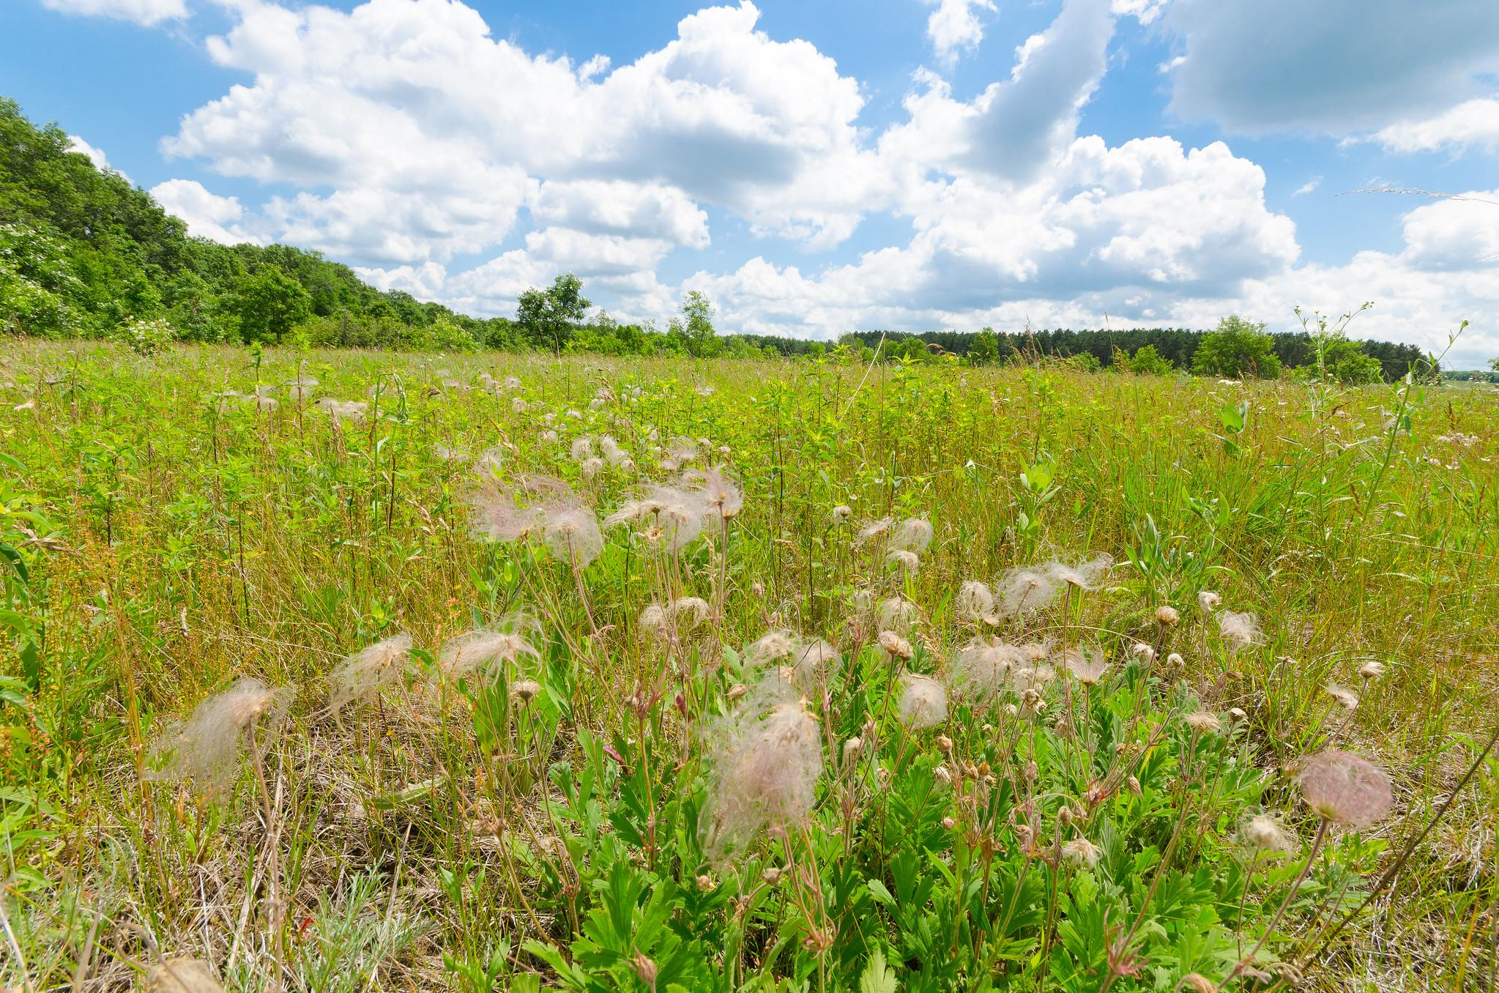
Notes:
https://www.flickr.com/photos/wackybadger/19383364773

Slide 6
On one sticky note, type three (3) adjectives that come to mind after looking at the first four (4) photos.

Slide 7
Take a few minutes to look at the next four (4) slides.
Stop when you get to slide 12 and complete the activity.

Slide 8
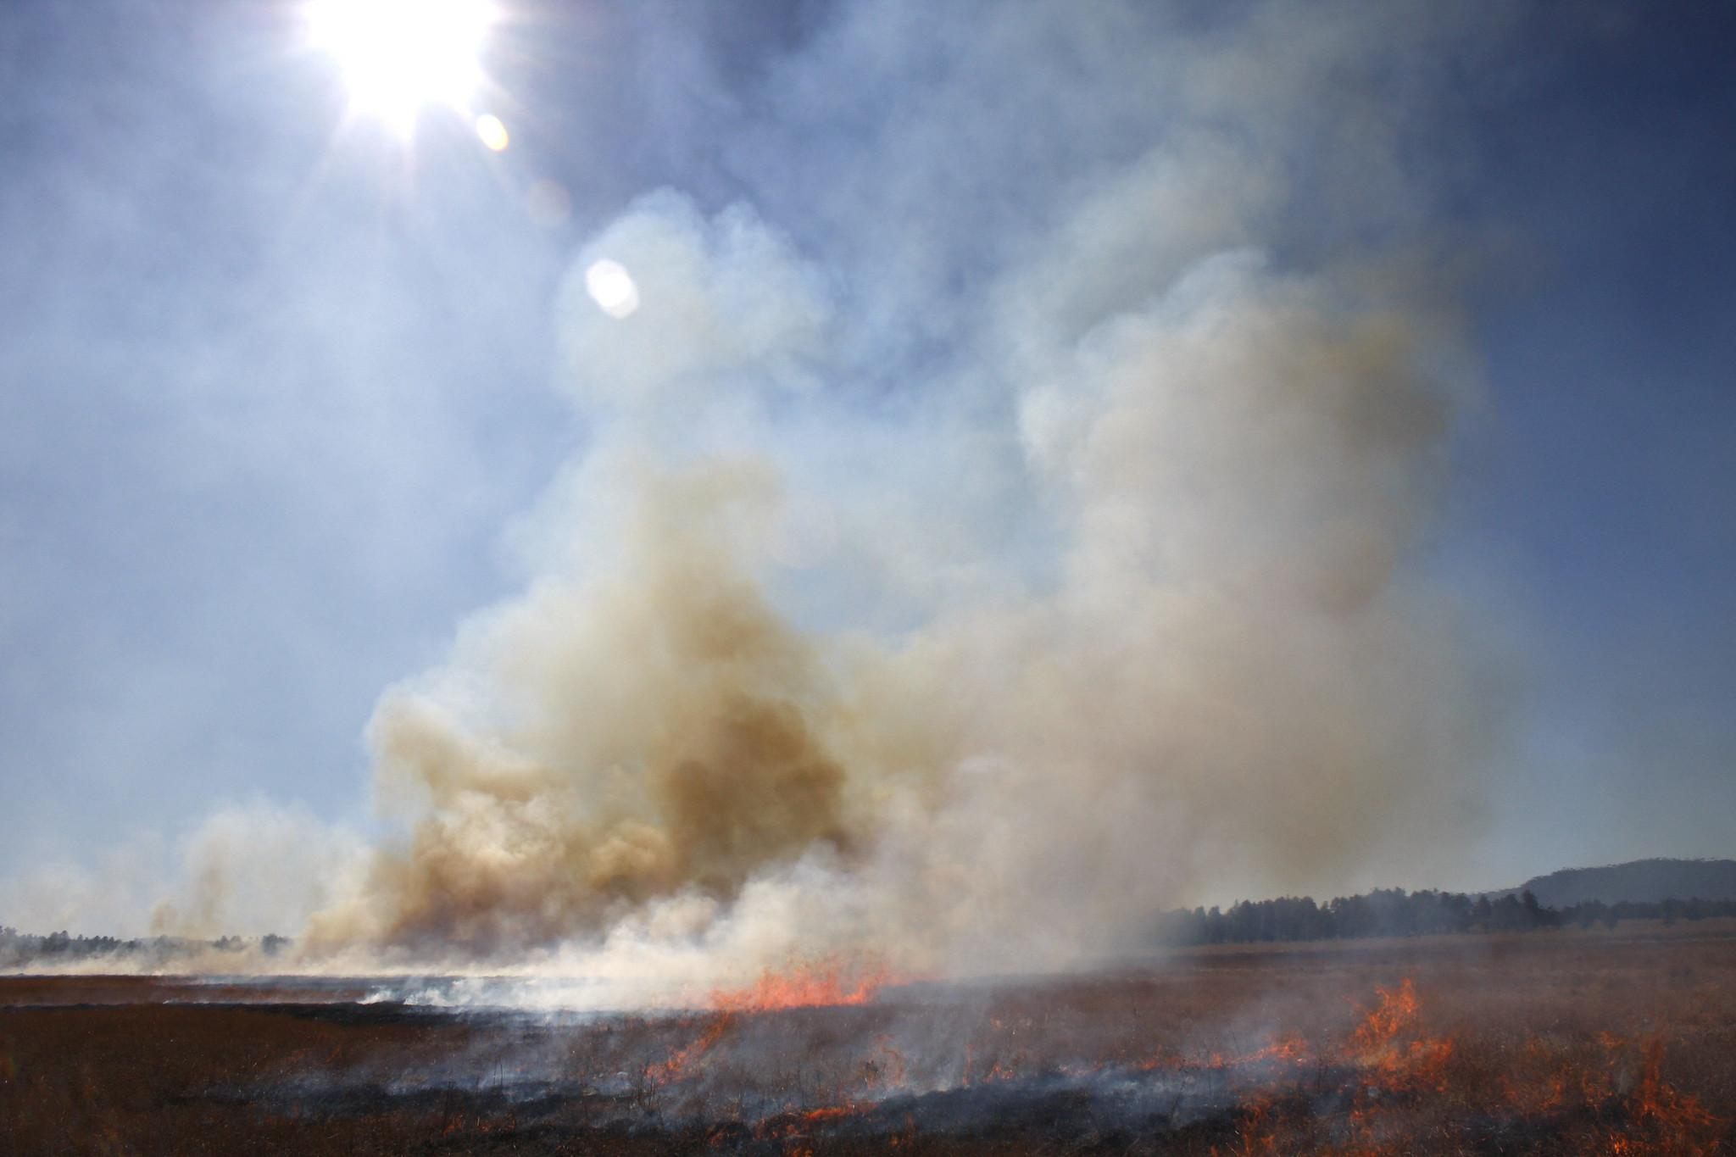
Notes:
https://www.flickr.com/photos/coconinonationalforest/3909876871/in/photostream/

Slide 9
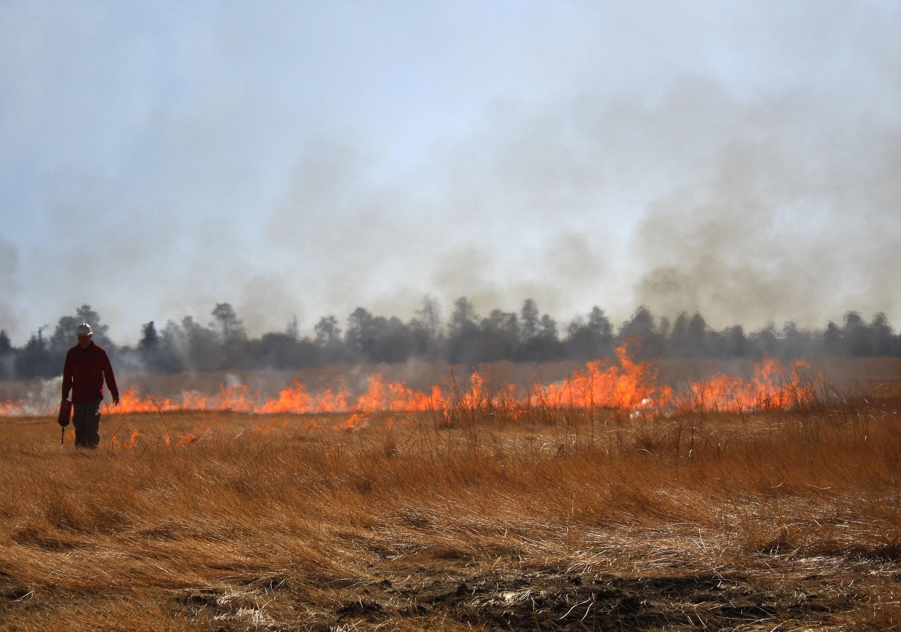
Notes:
https://www.flickr.com/photos/coconinonationalforest/3910664436/in/photostream/

Slide 10
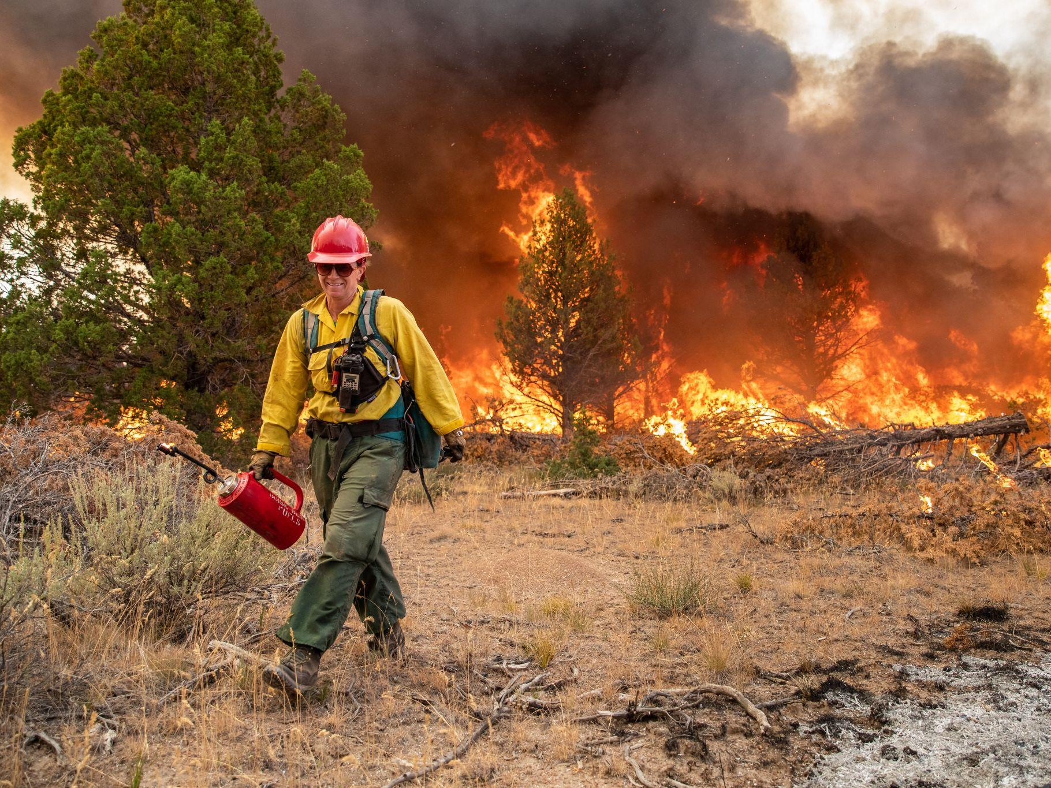
Notes:
https://www.rawpixel.com/image/4036995/photo-image-woods-smoke-person

Slide 11
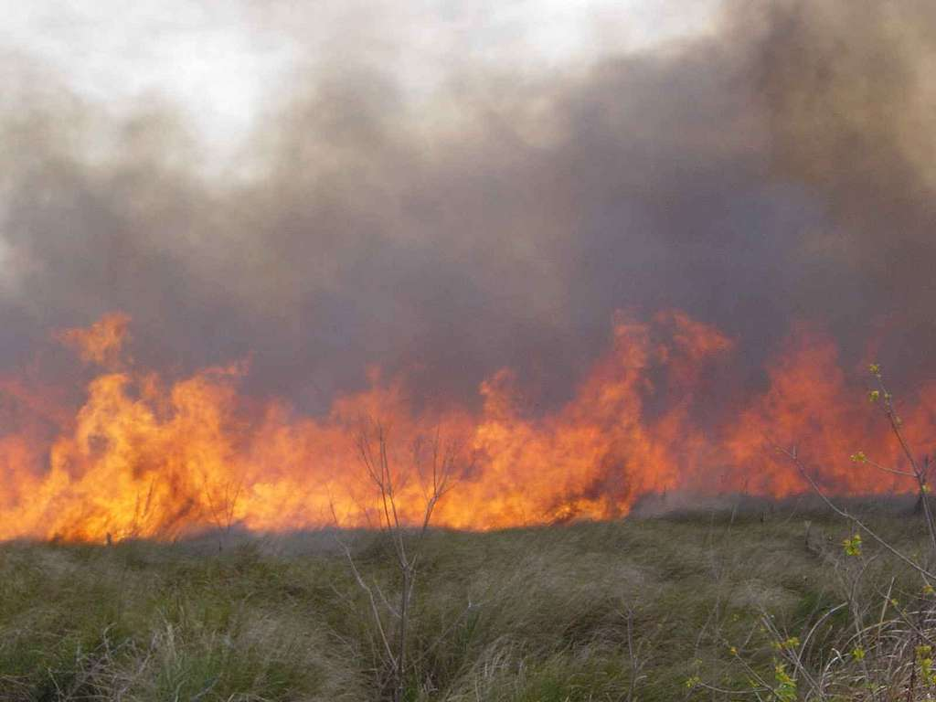
Notes:
https://picryl.com/media/a-cypress-prairie-burns-during-a-early-spring-prescribed-fire-3cfb9d

Slide 12
On one sticky note, type three (3) adjectives that come to mind after looking at the first four (4) photos.

