Slide 2
Elevating Angles, Part 2
Inverse Trigonometry: ADA Accessibility

Slide 3
Essential Question
How is trigonometry used to find the measures of unknown angles?

Slide 4
Lesson Objective
Apply inverse trigonometry functions to find unknown angle measures of right triangles.

Slide 5
ADA Accessibility
The Americans With Disabilities Act (ADA) is a civil rights law that prohibits unjust treatment against individuals with disabilities.
The U.S. Department of Education is a federal agency that promotes student achievement and educational excellence and is tasked with ensuring that students have equal access to education.

Slide 6
ADA Accessibility
What types of considerations must be made to ensure education is available for everyone?

Slide 7

Civil Engineers Consider Accessibility
Accommodations and Civil Engineering
Notes:
K20 Center. (May 2023). K20 ICAP - Accommodations and Civil Engineering. YouTube. https://youtu.be/DD4nSV5eQ00

Slide 8

What Are the Angles of Elevation?
Read the Accessibility Standards handout and determine the angle of elevation for each given diagram.
  Be sure to show your work.
Notes:
U.S. Department of Transportation. (2004). Manual on Uniform Traffic Control Devices handicapped accessible sign [Image]. Wikimedia Commons. https://commons.wikimedia.org/wiki/File:Handicapped_Accessible_sign.svg

Slide 9
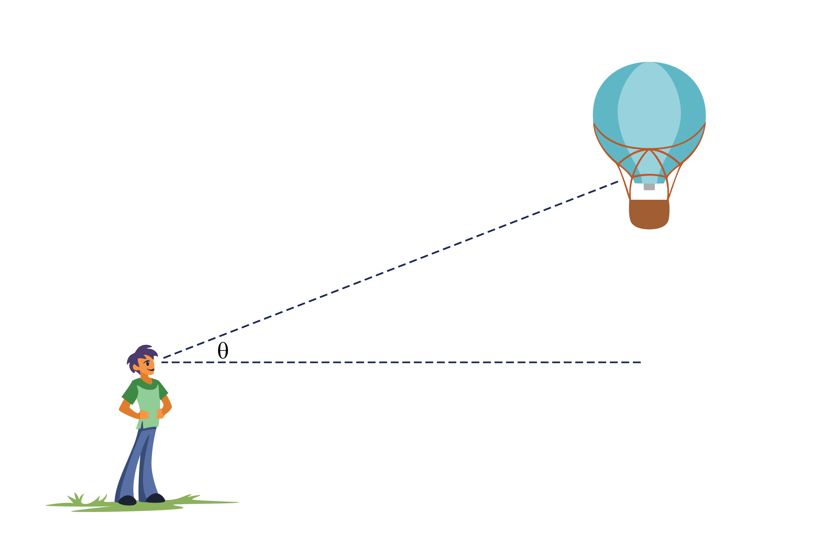
Angle of Elevation
(Angle of Incline)
Line of Sight
Angle of Elevation
Horizontal Line

Slide 10
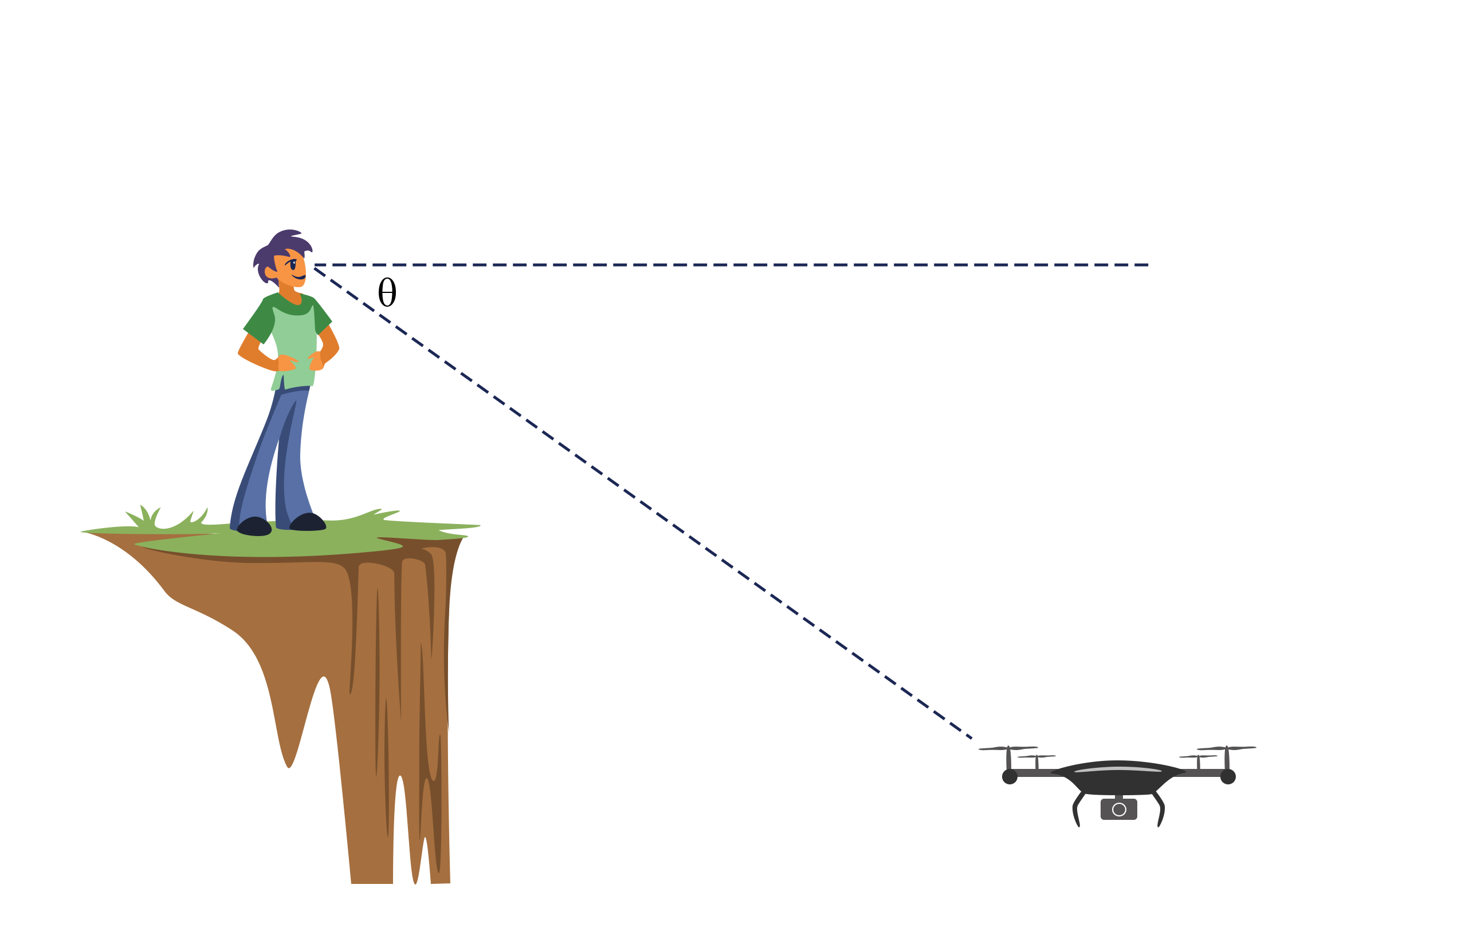
Angle of Depression (Angle of Decline)
Horizontal Line
Angle of Depression
Line of Sight

Slide 11


Angle of Elevation and Depression Are Congruent
θ
Angle of Depression
Line of Sight
θ
Angle of Elevation

Slide 12
Do Our Ramps Meet ADA Standards?
Find two wheelchair ramps on campus to measure.
Did the angle of each ramp meet the ADA’s minimum requirements of accessibility?
  Why or why not? Justify your answer.

Slide 13
Comparing Ramps
Find another pair who measured the same ramp and compare your work.
  Check one another’s algebraic work for accuracy.
  Discuss any differences you may have and collectively come to an understanding.
  You will submit your agreed-upon work in the Compliance Report.

Slide 14
Compliance Report: Sketch
Label your sketch using academic vocabulary and values.
Which angle in your sketch is the angle of elevation?
  Based on what you could measure, would labeling the angle of depression be more appropriate?
In relation to your angle, did you measure the adjacent side, the opposite side, and/or the hypotenuse?
Be sure to include units for your measurements.
  Did you use centimeters, inches, feet, etc.?

Slide 15
Compliance Report (Sample Response)
Ramp Location: North Entrance
Angle of Inclination: 6.766°
angle of elevation
opposite
28 in.
θ
236 in.
adjacent
This ramp does meet ADA regulations because it has limited space and has an angle of incline less than 7.125°.

Slide 16
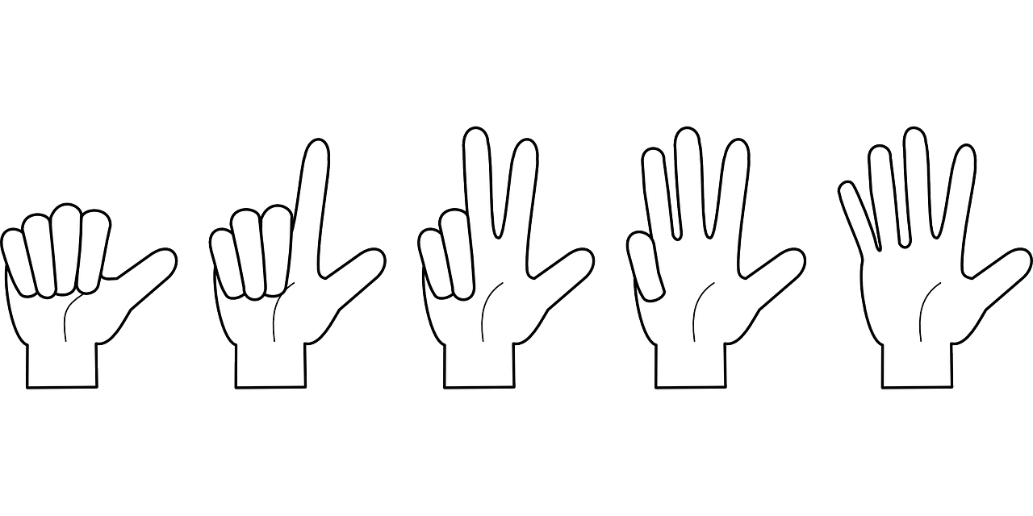
Fist to Five
Who is interested in becoming a civil engineer?
No, thank you
I do not think so
Maybe
Sounds kind of interesting
Definitely
Notes:
K20 Center. (n.d.). Fist to Five. Strategies. https://learn.k20center.ou.edu/strategy/68

