Slide 1
Brushstrokes
Communication/Using Descriptive Language

Slide 2
Essential Questions
How do people communicate with one another?
How does the type of communication we engage in affect our message?
What sensory details and descriptions are present in our world?

Slide 3
Quick Write
How do you communicate with others?
Take out a sheet of paper and list the ways that you regularly communicate with others.
Share your answers with an Elbow Partner.
Share your answers with the class.
Hold on to your paper for a later activity.

Slide 4
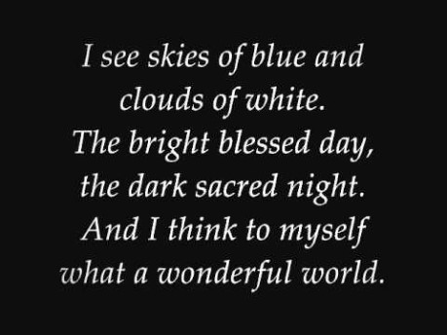
“What a Wonderful World”
Listen to the song and follow along with the lyrics, focusing on the music and the words.
Notes:
Source: Piquant. (2010, November 25). Louis Armstrong - What a wonderful world (lyrics) [Video]. YouTube. https://www.youtube.com/watch?v=A3yCcXgbKrE

Slide 5
Relax > Listen > Paint > Create
As the song repeats, paint as you listen. We will listen to the song several times, so relax, listen, paint, and create.
Express yourself in whatever way the lyrics and music inspire you. Consider your mood, your thoughts, and your reaction to the lyrics and music.
Use a variety of colors and styles of painting.

Slide 6

Gallery Walk: Descriptive Words
On the paper next to your classmate’s painting, write one or two words that you think best describe it.
Remember:
Be careful with wet paint!!
Some descriptors, like “blue” or “green,” are not as helpful as others, like “lovely” or “cheerful” or “bold.”

Slide 7
Return > Read > Revise
Return to your seat and read the descriptive words on your page.
Add at least three words that your peers didn’t “get” from your artwork.
Strike out any words that you feel don’t describe your artwork.
You will be using these words to write an original poem, so make sure you have a strong list of descriptive words.

Slide 8

Our Best Words…
Choose your top three descriptive words to add to the class list.
Looking at the class list:
  Which words could we might replace with stronger, more descriptive words? Which words might we strike out so that we have a class list of excellent descriptive words?

Slide 9
Our Best Words…
Notes:
This slide is blank, so your students will have a place to write.

Slide 10
Quick Write: Revisited
How do you communicate with others?
Take out your quick write sheet.
Reflect on the activity that we just completed.
Think of ways we communicate nonverbally and add them to your list. Consider the importance of written words and pictures.

Slide 11

Think-Pair-Share
How do you communicate with others?
Think about this question on your own.
Pair up with a partner and discuss your individual responses. Then, work together to create a shared response.
Share out with the class.

Slide 12

CUS and Discuss
Analyze the lyrics to “What a Wonderful World.”
  Circle sensory details.
  Underline figurative language and label the type of figurative language in the left margin.
  Star descriptive words.
Discuss with your partner how the writers used these details to enhance the communication style of the song lyrics.

Slide 13

Bring Your Painting to Life With Words
Create an original poem using your own word list and the class word list.
Incorporate figurative language, sensory details, and descriptive words about your painting.
Follow a similar structure to the song and include:
  5 stanzas
  4 lines per stanza (except stanza 5, which is 2 lines)
  (Optional) A similar rhyme scheme (aabc, aabc, aabb, aabc, ab)
Focus on your own creativity!

Slide 14
Excellent Word Choice
Figurative Language | Includes simile, metaphor, personification, onomatopoeia, oxymoron, hyperbole, litotes, and idiom
Sensory Details | Include words related to the five senses (taste, smell, sight, sound, and touch)
Descriptive Words | Words that help you visualize, describe, define, or explain clearly

Slide 15

Tweet Up
Address the essential questions using 140 characters or less. (Spaces and punctuation count as characters.)
Include a hashtag that sums up the main idea or key point from what you have learned.

Slide 16
Essential Questions
How do people communicate with one another?
How does the type of communication we engage in affect our message?
What sensory details and descriptions are present in our world?

