Slide 2
Brushstrokes
Communication: Using Descriptive Language

Slide 3
Essential Questions
How do people communicate with one another?
How does the type of communication we engage in affect our message?
What sensory details and descriptions are present in our world?

Slide 4
Lesson Objectives
Create a visual art piece that conveys the effect of song lyrics.
Understand how to create your own poem that achieves a specific purpose.

Slide 5

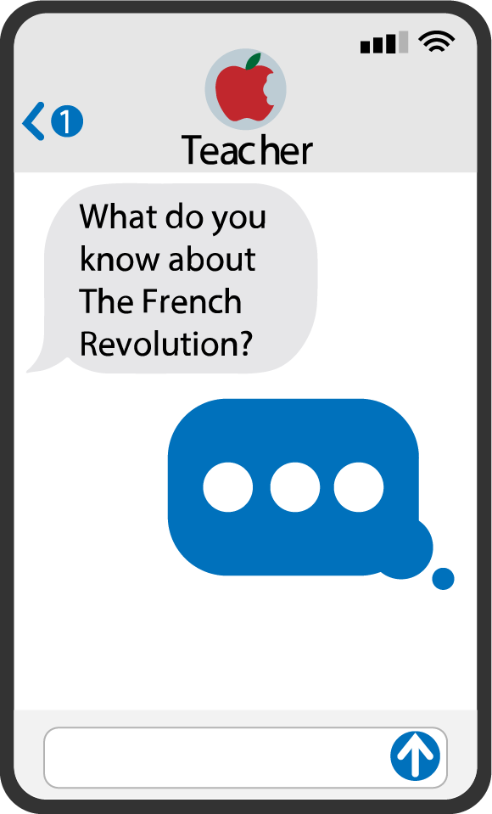
Quick Write
How do you communicate with others?
Take out a sheet of paper and list the ways that you regularly communicate with others.
Share your answers with an Elbow Partner.
Share your answers with the class.
Hold on to your paper for a later activity.
Notes:
K20 Center. (2021, September 21). K20 Center 5-minute timer. [Video]. YouTube. https://youtu.be/EVS_yYQoLJg?feature=shared
K20 Center. (n.d.). Quick write. Strategies. https://learn.k20center.ou.edu/strategy/1127

Slide 6
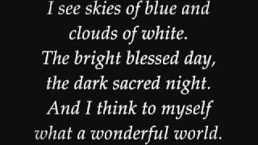
What a Wonderful World
Listen to the song and follow along with the lyrics.
Focus on the music and the words.
Notes:
Piquant. (2010, November 25). Louis Armstrong - What a wonderful world. (Lyrics) [Video]. YouTube. https://www.youtube.com/watch?v=A3yCcXgbKrE

Slide 7
Read → Listen → Paint → Create
As the song repeats, paint as you listen. Listen to the song several times. Relax, listen, paint, and create.
Express yourself in whatever way the lyrics and music inspire you. Consider your mood, your thoughts, and your reaction to the lyrics and music.
Use a variety of colors and styles of painting.

Slide 8

Gallery Walk—Descriptive Words
On the paper next to your classmate’s painting, write one or two words that you think best describe it.
Remember:
Be careful with wet paint!!
Some descriptors like blue or green are not as helpful as others like lovely or cheerful or bold.
Notes:
K20 Center. (n.d.). Gallery walk / carousel. Strategies. https://learn.k20center.ou.edu/strategy/118

Slide 9
Return → Read → Revise
Return to your seat and read the descriptive words on your page.
Add at least three words that your peers didn’t “get” from your artwork.
Strike out any words that you feel don’t describe your artwork.
You will be using these words to write an original poem. Make sure you have a strong list of descriptive words.

Slide 10

Strike Out!
Choose your top three descriptive words to add to the class list.
Looking at the class list:
  Which words could we replace with stronger, more descriptive words?
  Which words could we strike out so that we have a class list of excellent descriptive words?
Notes:
K20 Center. (n.d.). Strike out. Strategies. https://learn.k20center.ou.edu/strategy/136

Slide 11
Our Best Words…
Notes:
This slide is blank, so your students will have a place to write.

Slide 12
Quick Write—Revisited
How do you communicate with others?
Take out your Quick Write sheet.
Reflect on the activity that we just completed.
Think of ways we communicate nonverbally and add them to your list. Consider the importance of written words and pictures.

Slide 13

Think-Pair-Share
How do you communicate with others?
Think about this question on your own.
Pair up with a partner and discuss your individual responses. Then, work together to create a shared response.
Share out with the class.
Notes:
K20 Center. (n.d.). Think-pair-share. Strategies. https://learn.k20center.ou.edu/strategy/139

Slide 14

CUS and Discuss
Analyze the lyrics to What a Wonderful World.
  Circle sensory details.
  Underline figurative language and label the type of figurative language in the left margin.
  Star descriptive words.
Discuss with your partner how the writers used these details to enhance the communication style of the song lyrics.
Notes:
K20 Center. (n.d.). CUS and discuss. Strategies. https://learn.k20center.ou.edu/strategy/162

Slide 15

Bring Your Painting to Life with Words
Create an original poem using your own word list and the class word list.
Incorporate figurative language, sensory details, and descriptive words about your painting.
Follow a similar structure to the song and include:
  5 stanzas;
  4 lines per stanza (except stanza 5, which has 2 lines);
  (Optional) A similar rhyme scheme (AABC/AABC/AABC/AABB/AABC/AB).
Focus on your own creativity!

Slide 16
Excellent Word Choice
Figurative Language | Includes simile, metaphor, personification, onomatopoeia, oxymoron, hyperbole, litotes, and idiom
Sensory Details | Includes words related to the five senses (taste, smell, sight, sound, and touch)
Descriptive Words | Words that help you visualize, describe, define, or explain clearly

Slide 17

Tweet Up
Address the essential questions using 140 characters or less. (Spaces and punctuation count as characters.)
Include a hashtag that sums up the main idea or key point from what you have learned.
Notes:
K20 Center. (n.d.). Tweet up. Strategies. https://learn.k20center.ou.edu/strategy/130

Slide 18
Essential Questions
How do people communicate with one another?
How does the type of communication we engage in affect our message?
What sensory details and descriptions are present in our world?

