Slide 2
Native Symbols in the Modern World
Exploring symbolism in Native American culture

Slide 3
Essential Question
How is symbolism used in Native American culture?

Slide 4
Lesson Objectives
Analyze the significance of symbolism within Native American culture and their regalia.
Research a Native American author and their tribe.
Compare and contrast Native American symbolism in the written word vs. visual arts.

Slide 5

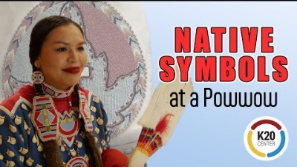
Bell Ringer
              As we watch the video, create a list of symbols and regalia associated with each tribe.
https://youtu.be/dWXf2uswcNY
Notes:
K20 Center. (n.d.). Bell ringers and exit tickets. Strategies. https://learn.k20center.ou.edu/strategy/125
K20 Center. (2023, July 11). Native Symbols at a Powwow. [Video]. YouTube. https://www.youtube.com/watch?v=dWXf2uswcNY

Slide 6


Why-Lighting Poetry
              Navigate to: http://k20.ou.edu/p
              Read the poem and highlight the symbolism present.
              Explain why you highlighted that word or phrase.
              Guiding questions to consider:
Why did you highlight this word or phrase?
How is this an example of symbolism?
What is this a symbol of?
What clarifying questions do you have?
Notes:
K20 Center. (n.d.). Why-lighting. Strategies. Retrieved from https://learn.k20center.ou.edu/strategy/128
YouTube. (2021, September 21). K20 Center 10 minute timer. YouTube. https://www.youtube.com/watch?v=9gy-1Z2Sa-c

Slide 7

Symbolism: Poem vs Video
What were some symbols that stood out in your poems?
Did any of the symbols in your poem connect to the tribal regalia in the video?
Does anyone think the author of the poem may be affiliated with one of the tribes in the video? Why or why not?
What similarities and differences did you find regarding the symbolism in both the poem and the video?

Slide 8

Author Research
Navigate to: http://k20.ou.edu/p
Find information about your author and their tribe and place it in the first and second columns of your handout.
Answer the questions on the Author Research graphic organizer.
Notes:
K20 Center. (n.d.). Wakelet. Tech tools. https://learn.k20center.ou.edu/tech-tool/2180
YouTube. (2021, September 21). K20 Center 10 minute timer. YouTube. https://www.youtube.com/watch?v=9gy-1Z2Sa-c

Slide 9
Why-Lighting Poetry
              Reread your poem and highlight any additional symbolism present in a new color.
              Explain why you highlighted any new words or phrases. Guiding questions to consider:
Why did you highlight this word or phrase?
How is this an example of symbolism?
What is this a symbol of?
What clarifying questions do you have?
Notes:
K20 Center. (n.d.). Why-lighting. Strategies. Retrieved from https://learn.k20center.ou.edu/strategy/128

Slide 10

One-Pager
Select one or two symbols from the poem.
  Sketch each symbol on the page.
  Create a word cloud around each symbol explaining the meaning.
Select two quotes from the poem.
Create a symbolic border (words, symbols, or phrases).
Write a paragraph about the author and tribe.
Add color to your One-pager.
Notes:
K20 Center. (n.d.). One-Pager. Strategies. Retrieved from https://learn.k20center.ou.edu/strategy/72

Slide 11
What did you create?
Share the following from your one-pager with your group:
The symbols from your poem.
The tribe your author is from and the significance of that symbol.
The meaning of your creative border.
Notes:
K20 Center. (n.d.). One-Pager. Strategies. Retrieved from https://learn.k20center.ou.edu/strategy/72

Slide 12
Essential Question
How is symbolism used in Native American culture?

Slide 13
Lesson Objectives
Analyze the significance of symbolism within Native American culture and their regalia.
Research a Native American author and their tribe.
Compare and contrast Native American symbolism in the written word vs. visual arts.

Slide 14

It’s OPTIC-AL
Navigate to: http://k20.ou.edu/p
Using the graphic organizer answer the following questions about each Native American art piece.
O- List observations.
P- List the visual parts you notice.
T- How does the title of the art relate to the art as a whole?
I- How are the parts interrelational? (work together)
C- Conclusion: What is the importance or message of the art?
Notes:
K20 Center. (n.d.). It’s OPTIC-AL. Strategies. Retrieved from https://learn.k20center.ou.edu/strategy/99

Slide 15
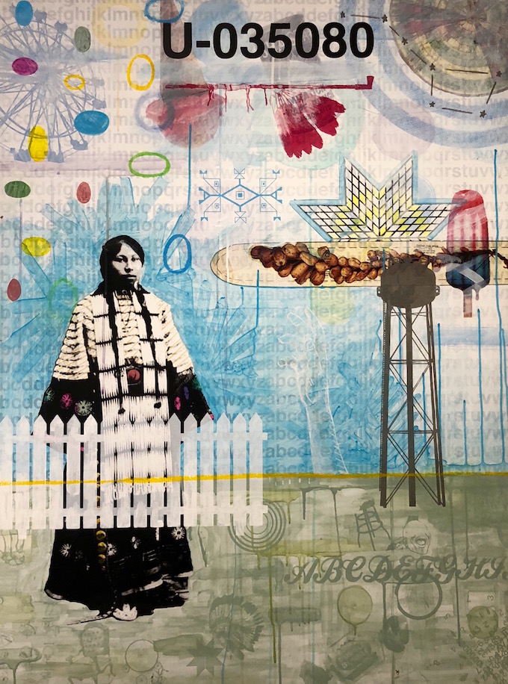
Historical Document by Michael Two Bulls
Inspired by his aunts and uncles, Michael Two Bulls began drawing at a young age. He attended the Institute of American Indian Arts in Santa Fe, New Mexico. His art focuses on identity, history and place. He tries to depict the experiences of his ancestors and the realities he saw growing up.
Tribe: Oglala Lakota
Medium: Multi-media
Notes:
https://artbreakout.com/sociallypolitically-conscious-art/bronxartspace-presents-humble-featuring-artworks-from-15-native-american-contemporary-artists-through-october-13/

Slide 16
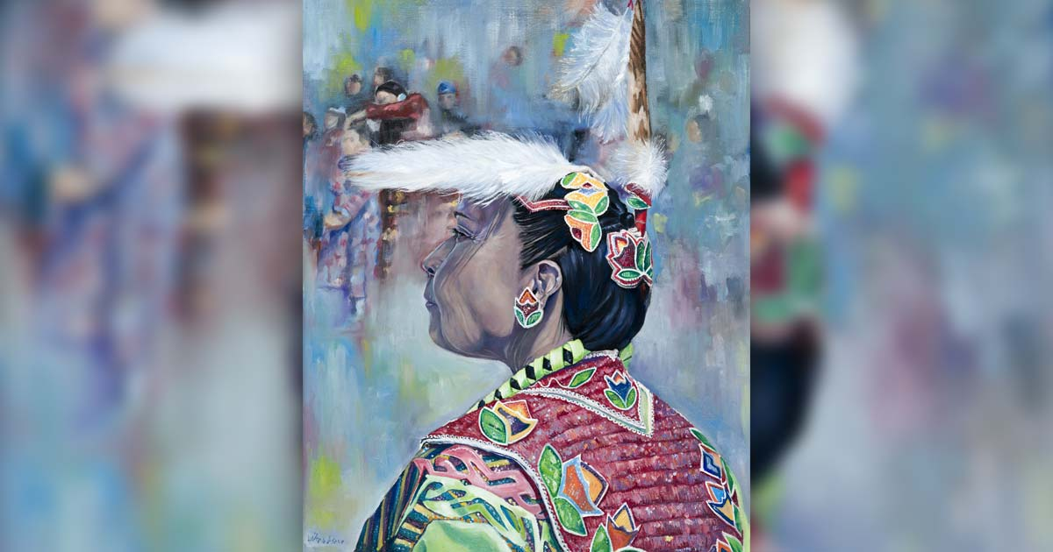
Aunt Becky by Le’Ana Asher
Le’Ana Asher grew up in Michigan. She was drawn to painting and drawing at a young age. Asher attended Eastern Michigan University, earning degrees in painting and drawing. Her art comes from the traditions and culture she experienced as a child, woman, and Native American.
Tribe: Keweenaw Bay Anishinaabe/Ojibwe Indian Community
Medium: Painting and Drawing
Notes:
https://westmichiganwoman.com/cityscene/2819-exploring-contemporary-native-american-art
https://leanaasher.com/about/?v=32aec8db952d

Slide 17
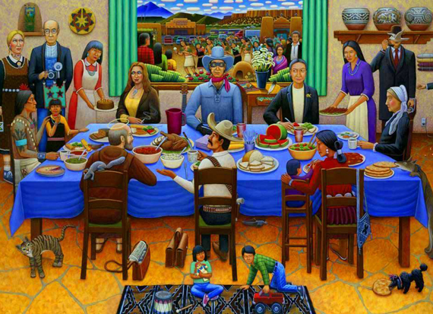
Pueblo Feast Day 2005 by David Bradley
David Bradley attended the Institute for American Indian Art in Sante Fe. His art covers a large range of topics, including historical and political. He is the recipient of many awards and fellowships. Bradley has played an important role in Native American art and Native American rights.
Tribe:Chippewa
Medium: painting and sculpture
Notes:
https://www.davisart.com/blogs/schoolarts-room/david-bradley-and-celebration-of-pueblo/
https://blueraingallery.com/artists/david-bradley

Slide 18
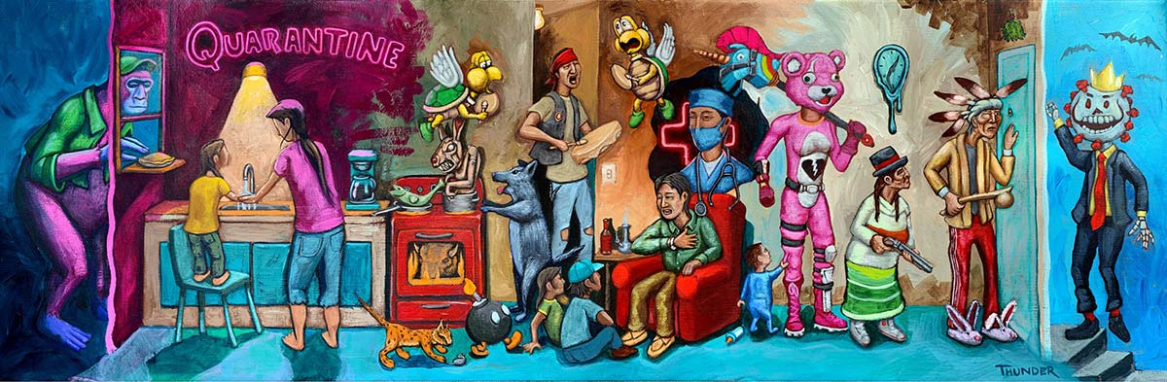
Quarantining at Gramma’s House by Jonathan Thunder
Jonathan Thunder studied Visual Effects and Motion Graphics at the Art Institute International, as well as attending the Institute of American Indian Arts. His art addresses personal experience and social commentary. Thunder has won several awards for his short films.
Tribe: Red Lake Band of Ojibwe
Medium: paintings, animation, film making, 3D projection mapping
Notes:
https://westmichiganwoman.com/cityscene/2819-exploring-contemporary-native-american-art
https://birchbarknativearts.com/jonathan-thunder
https://www.jonthunder.com/about

Slide 19

CER: Poem vs Art
On your paper from the video, write two to three paragraphs comparing and contrasting symbolism in your poem and the art piece you choose.
Notes:
K20 Center. (n.d.). Claim, evidence, reasoning (CER). Strategies. Retrieved from https://learn.k20center.ou.edu/strategy/d9908066f654727934df7bf4f506fc09

Slide 20
CER: Poem vs Art
Claim: The symbolism in [Insert Author’s Name and Name of Poem] and [Artist Name and Title of Art Piece] (is similar or differs) because _____.
Evidence: For example, [insert Author’s Name] uses…
Reasoning
Evidence
Reasoning
Reasoning

