Slide 2
Clear and Present Danger
Gitlow v. New York

Slide 3
Essential Question
How does Gitlow v. New York demonstrate how the First Amendment protects people’s right to free speech?

Slide 4
Lesson Objectives
Evaluate the limitations on the First Amendment and freedom of speech.

Slide 5
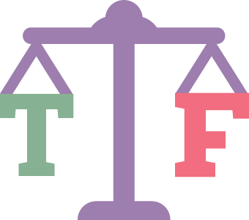
True or False?
Read each statement carefully.
Decide whether the statement is true or false.
If you believe the statement is true, sit on the floor.
If you believe the statement is false, stand up.

Slide 6
True or False?
Freedom of speech is limited.
Notes:
True

Slide 7
True or False?
Threatening a person with violence is protected by freedom of speech.
Notes:
False

Slide 8
True or False?
Everyone has the right to freedom of expression.
Notes:
True

Slide 9
True or False?
Freedom of speech doesn’t cover social media.
Notes:
False

Slide 10
True or False?
Freedom of speech includes art, music, written expression, and other mediums.
Notes:
True

Slide 11
U.S. Constitution - Amendment I
“Congress shall make no law respecting an establishment of religion, or prohibiting the free exercise thereof; or abridging the freedom of speech, or of the press; or the right of the people peaceably to assemble, and to petition the Government for a redress of grievances.”
Notes:
https://www.archives.gov/founding-docs/bill-of-rights-transcript#toc-amendment-i

Slide 12
Claim Cards
Cut the claim cards apart.
Instruct the groups to read over each case.
Ask:
“Is the action of the defendant(s) protected by the First Amendment and freedom of speech?”
Sort the claim cards into “Protected” and “Not Protected” piles.
Notes:
K20 Center. (n.d.).Claim Cards. Strategy. https://learn.k20center.ou.edu/strategy/160

Slide 13
Claim Cards
Is the action of the defendant(s) protected by the First Amendment and freedom of speech?
U.S. Constitution - Amendment I
“Congress shall make no law respecting an establishment of religion, or prohibiting the free exercise thereof; or abridging the freedom of speech, or of the press; or the right of the people peaceably to assemble, and to petition the Government for a redress of grievances.”
Notes:
K20 Center. (n.d.).Claim Cards. Strategy. https://learn.k20center.ou.edu/strategy/160

Slide 14
Claim Cards
Is the action of the defendant(s) protected by the First Amendment and freedom of speech?
U.S. Constitution - Amendment I
“Congress shall make no law respecting an establishment of religion, or prohibiting the free exercise thereof; or abridging the freedom of speech, or of the press; or the right of the people peaceably to assemble, and to petition the Government for a redress of grievances.”
Notes:
K20 Center 5 minute timer. YouTube. (2021, September 21). https://youtu.be/EVS_yYQoLJg

Slide 15
Video: Gitlow v. New York
Notes:
K20 Center. (n.d.). Gitlow v. New York. Video. https://www.youtube.com/watch?v=eSIACD4skAQ

Slide 16
I Notice, I Wonder
Think about the video we just watched.
What is one thing you noticed about freedom of speech?
What is one thing you wonder about the freedom of speech?
Notes:
K20 Center. (n.d.).I Notice, I Wonder. Strategy. https://learn.k20center.ou.edu/strategy/180

Slide 17
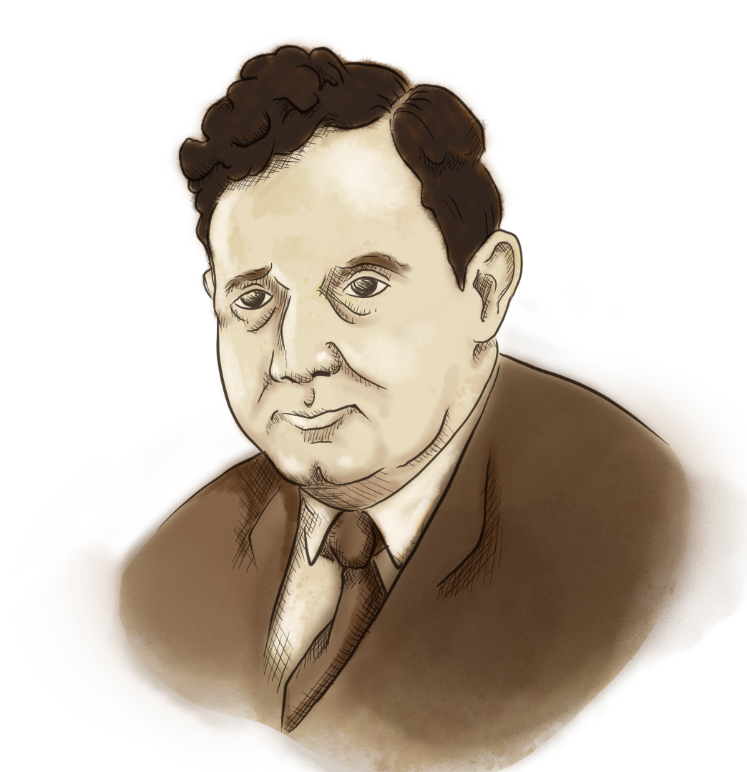
Gitlow v. New York
Read the Gitlow v. New York Brief and answer the
following in the graphic organizer:
Defendant
Plaintiff
Question of the court
Ruling
Rationale

Slide 18
Essential Question
How does Gitlow v. New York demonstrate how the First Amendment protects people’s right to free speech?

Slide 19
Lesson Objectives
Evaluate the limitations on the First Amendment and freedom of speech.

Slide 20
U.S. Constitution - Amendment I
“Congress shall make no law respecting an establishment of religion, or prohibiting the free exercise thereof; or abridging the freedom of speech, or of the press; or the right of the people peaceably to assemble, and to petition the Government for a redress of grievances.”
Notes:
https://www.archives.gov/founding-docs/bill-of-rights-transcript#toc-amendment-i

Slide 21
Claim Cards
Cut the new set of claim cards apart.
Instruct the groups to read over each case.
Considering the First Amendment and the Gitlow v. New York case, ask:
“Is the action of the defendant(s) protected by the First Amendment and freedom of speech?”
Resort the claim cards into “Protected” and “Unprotected” piles.
Notes:
K20 Center. (n.d.). Claim Cards. Strategy. https://learn.k20center.ou.edu/strategy/160

Slide 22
Claim Cards
Considering the First Amendment and the Gitlow ruling, is the action of the defendant(s) within their Constitutional right of freedom of speech?
U.S. Constitution - Amendment I
“Congress shall make no law respecting an establishment of religion, or prohibiting the free exercise thereof; or abridging the freedom of speech, or of the press; or the right of the people peaceably to assemble, and to petition the Government for a redress of grievances.”
Notes:
K20 Center. (n.d.).Claim Cards. Strategy. https://learn.k20center.ou.edu/strategy/160

Slide 23
Claim Cards
Considering the First Amendment and the Gitlow ruling, is the action of the defendant(s) within their Constitutional right of freedom of speech?
U.S. Constitution - Amendment I
“Congress shall make no law respecting an establishment of religion, or prohibiting the free exercise thereof; or abridging the freedom of speech, or of the press; or the right of the people peaceably to assemble, and to petition the Government for a redress of grievances.”
Notes:
K20 Center 5 minute timer. YouTube. (2021, September 21). https://youtu.be/EVS_yYQoLJg

Slide 24
Claim Cards
For each case, hold up the card that shows how your group ruled - “Protected” or “Not Protected.”
Notes:
K20 Center. (n.d.).Claim Cards. Strategy. https://learn.k20center.ou.edu/strategy/160

Slide 25
Case #1: Schenck v. United States
Issue:
Considering the political climate, were the actions of the defendant protected under the First Amendment of the United States Constitution?
Conclusion:
Justice Holmes ruled that under normal circumstances, the leaflet would have been constitutionally protected, but the writing depends upon the circumstances under which it is written. Therefore, the words did create clear and present danger as men might decide not to serve.

Slide 26
Case #2: Bond v. Floyd
Issue:
Are legislators’ rights to freedom of speech in violation of the legislatures’ oath to support the Constitution?
Conclusion:
The Supreme Court ruled in favor of Bond. The Court ruled that a legislator’s oath does not limit their ability to discuss political views or the freedom to express their views over those issues.

Slide 27
Case #3: Shaffer v. United States
Issue:
Were the books mailed a “non mailable” matter under the Espionage Act?
Was there enough evidence to show that the plaintiff committed the act willfully and intentionally?
Conclusion:
Shaffer was convicted of violating the 1917 Espionage Act by committing treasonable and disloyal acts. The writing, publishing, and distribution of the book may have led to the obstruction of recruitment by attacking the just causes for the war.

Slide 28
Case #4: Yates v. United States
Issue:
Does the Smith Act violate the First Amendment?
Conclusion:
The Court ruled in favor of Yates. The Smith Act covered organizing a “new” group and the fact that the Communist Party had been organized three years prior excused it from the application of the act.

Slide 29
Case #5: Brandenburg v. Ohio
Issue:
Was Brandenburg’s right to free speech violated by Ohio’s criminal syndicalism law?
Conclusion:
The Court ruled that the Ohio law did violate Brandenburg’s right to free speech. As his speech was not directly inciting lawless actions. This also created the Brandenburg test to evaluate speeches. Does the speech directly incite lawless action or is it likely to incite lawless action?

Slide 30
Essential Question
“How does Gitlow v. New York show how the First Amendment protects people’s right to free speech?”

