Slide 2
Trig Identities, Part 1
Reciprocal, Quotient, and Pythagorean Identities

Slide 3
Essential Question
How do we use trigonometric identities?

Slide 4
Lesson Objectives
Use reciprocal, quotient, and/or Pythagorean identities to simplify expressions.
Verify trigonometric identities.

Slide 5
Gathering Intel
As a covert operative assigned to a case involving compromised identities, your task is to gather relevant intel.
Write your assigned angle measure at the top of your handout to begin your investigation.
Work with a partner and see what patterns you notice.
Notes:
K20 Center. (n.d.). I notice, I wonder. strategies. Retrieved from https://learn.k20center.ou.edu/strategy/180

Slide 6
Gathering Intel: Sine & Cosecant
Sine and Cosecant seem to be conspiring, what’s their relationship?

Slide 7
Gathering Intel: Sine & Cosecant

Slide 8
Gathering Intel: Cosine & Secant
Cosine and Secant are plotting together, what’s their connection?

Slide 9
Gathering Intel: Cosine & Secant

Slide 10
Gathering Intel: Tangent & Cotangent
Tangent and Cotangent seem to be scheming, what’s their alliance?

Slide 11
Gathering Intel: Cosine & Secant

Slide 12
Gathering Intel: Other Relationships
Sine and Cosine seem to be in cahoots to Tangent and Cotangent but how?

Slide 13
Gathering Intel: Sine, Cosine & Tangent

Slide 14
Gathering Intel: Sine, Cosine & Cotangent

Slide 15
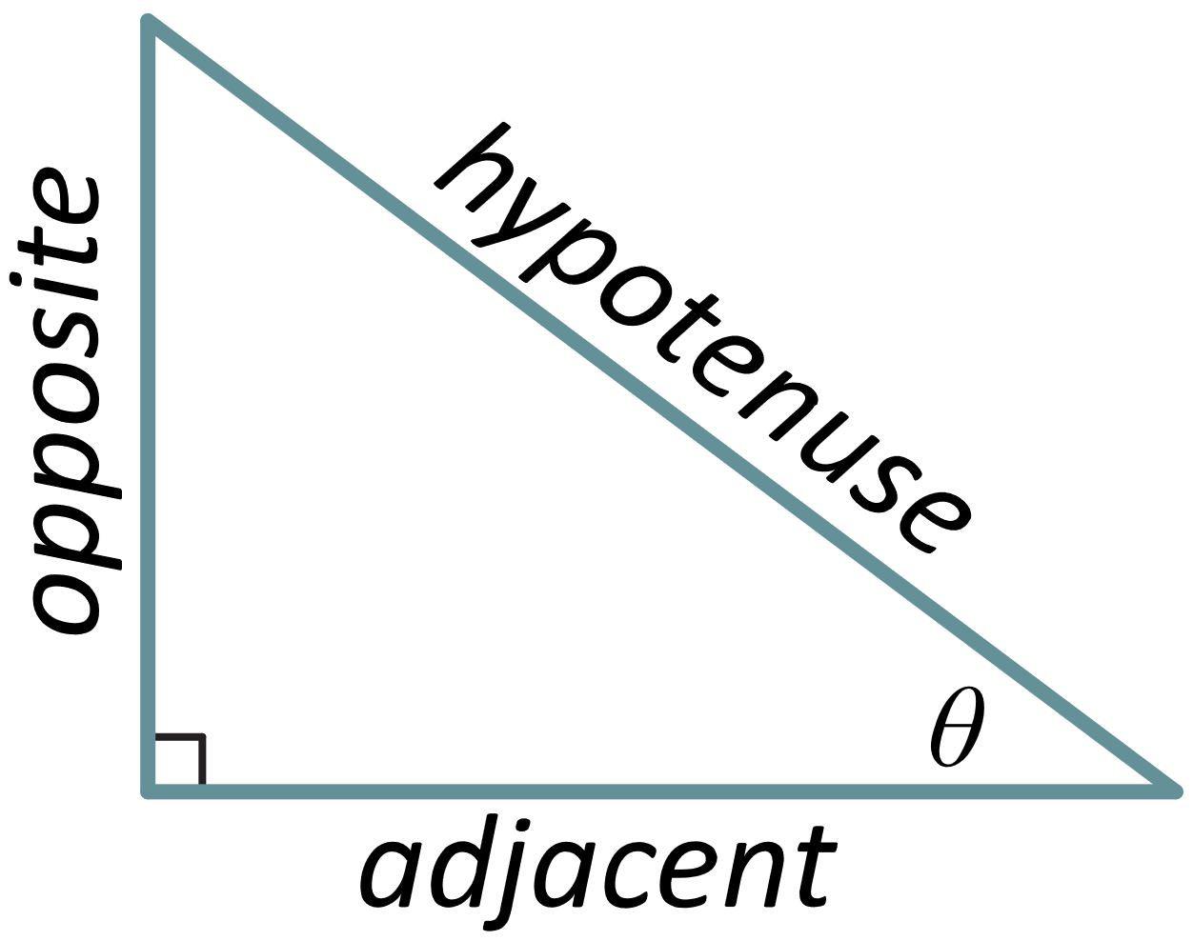
Secret Agent Pythagoras
As an intelligence analyst, your job is to obtain crucial insights and find patterns.
See what information you can gather from Secret Agent Pythagoras without being noticed.
Notes:
K20 Center. (n.d.). Try It, Talk It, Color It, Check It. strategies. Retrieved from https://learn.k20center.ou.edu/strategy/2329

Slide 16
Secret Agent Pythagoras
Try It: Try the problem on your own.
Talk It: Discuss your work with your partner.
Color It: How confident are you in your answer?
Green: We got this and could teach it to others!
Yellow: We are a bit uncertain.
Red: We need help. We might be wrong.
Check It: Compare your results with the class.
Notes:
K20 Center. (n.d.). Try It, Talk It, Color It, Check It. strategies. Retrieved from https://learn.k20center.ou.edu/strategy/2329

Slide 17
Secret Agent Pythagoras
Independently complete Step 1 of your handout.
Then compare your work with your partner.
Notes:
K20 Center. (n.d.). Try It, Talk It, Color It, Check It. strategies. Retrieved from https://learn.k20center.ou.edu/strategy/2329

Slide 18
Check It: Step 1
Notes:
K20 Center. (n.d.). Try It, Talk It, Color It, Check It. strategies. Retrieved from https://learn.k20center.ou.edu/strategy/2329

Slide 19
Secret Agent Pythagoras
Independently complete Step 2 of your handout.
Then compare your work with your partner.
Notes:
K20 Center. (n.d.). Try It, Talk It, Color It, Check It. strategies. Retrieved from https://learn.k20center.ou.edu/strategy/2329

Slide 20
Check It: Step 2
Notes:
K20 Center. (n.d.). Try It, Talk It, Color It, Check It. strategies. Retrieved from https://learn.k20center.ou.edu/strategy/2329

Slide 21
Secret Agent Pythagoras
Independently complete Step 3 of your handout.
Then compare your work with your partner.
Notes:
K20 Center. (n.d.). Try It, Talk It, Color It, Check It. strategies. Retrieved from https://learn.k20center.ou.edu/strategy/2329

Slide 22
Check It: Step 3
Notes:
K20 Center. (n.d.). Try It, Talk It, Color It, Check It. strategies. Retrieved from https://learn.k20center.ou.edu/strategy/2329

Slide 23
Secret Agent Pythagoras
Independently complete Step 4 of your handout.
Then compare your work with your partner.
Notes:
K20 Center. (n.d.). Try It, Talk It, Color It, Check It. strategies. Retrieved from https://learn.k20center.ou.edu/strategy/2329

Slide 24
Check It: Step 4
Notes:
K20 Center. (n.d.). Try It, Talk It, Color It, Check It. strategies. Retrieved from https://learn.k20center.ou.edu/strategy/2329

Slide 25
Secrets Revealed
Now you know the truth; there are three trigonometric equations that are derived from the Pythagorean Theorem.

Slide 26
Trigonometric Identities: Intel Notes
The equations you have seen during this lesson are known as trigonometric identities.
In math, identities are equations where the left side of the equation equals the right side of the equation for any value of the x (or any variable).

Slide 27
Trigonometric Identities: Intel Notes
Pick any value for θ. Which of the following is an example of an identity?

Slide 28
Trigonometric Identities: Intel Notes
Let’s complete the Intel Notes together.
Notice the shorthand notation for exponents and trigonometric functions.

Slide 29
Mission: Trig Spies
As the spymaster, you are responsible for making important decisions and selecting your undercover agents and deep cover agents.
You will need to use your knowledge of simplifying and verifying trigonometric identities for this mission.

Slide 30
Mission Prep
Materials:
2 Stacks of Cards (2 stacks per team)
Undercover Agents Cards
Deep Cover Agents Cards
Scratch Paper (1 per person)
Writing Utensil (1 per person)
Trig Spies Record Sheet (1 per team)

Slide 31
Mission: Trig Spies
Pick a stack, flip over the top card, and each spymaster uses scratch paper to complete the task on the card.
Then compare your work with your teammate(s).
If you agree, write the identity you used on the Trig Spies Record Sheet for which card and record your points.
Card | Identity | Points
A | [Write the identity you used.] | 4

Slide 32
Mission: Trig Spies
The Undercover Agents cards are worth 3-4 points, while the Deep Cover Agents cards are worth 5-6 points and are more challenging.
Good luck! We’re counting on you.
Undercover Agents
Deep Cover Agents

Slide 33
Trig Spies: Timer
15 Minute Timer

Slide 34
Mission Debrief
Your expertise is needed on a new mission, even though this one is not completely resolved. You need to share what you have learned to help prepare others.
Write 2-3 pieces of advice for the new spymaster.
What strategies did you find effective?
How did you decide how to start a problem?
What would you not recommend?

