Slide 2
Trig Identities, Part 2
Reciprocal, Quotient, and Pythagorean Identities

Slide 3
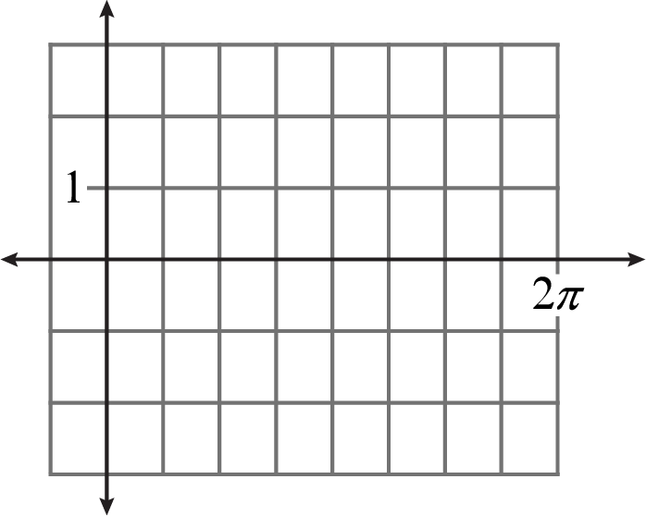
Bell Ringer
Graphically represent sin(θ) = cos(θ).
Explain the meaning of the solution.
Notes:
K20 Center. (n.d.). Bell Ringers and Exit Tickets. Strategies. https://learn.k20center.ou.edu/strategy/125

Slide 4
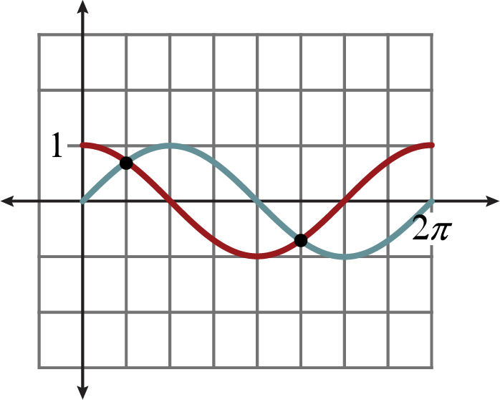
Bell Ringer
The solutions are
The sine function has the same output as the cosine function for those input values.
Notes:
K20 Center. (n.d.). Bell Ringers and Exit Tickets. Strategies. https://learn.k20center.ou.edu/strategy/125

Slide 5
Essential Question
How do we use trigonometric identities?

Slide 6
Lesson Objectives
Use reciprocal, quotient, and/or Pythagorean identities to solve equations.
Use trigonometric identities to solve real-world problems.

Slide 7
Appointment Clocks
You will work with 4 different partners to complete this activity.
For each appointment, you will find a partner and write each other’s name in the corresponding space on your handout.
You will work together to answer the questions on your handout for that appointment.
Repeat these steps for each appointment.

Slide 8
Appointment Clocks – 3:00
Find a partner.
Write your name on your partner’s handout for the 3:00 appointment.
Solve problems 1-2.
Give a thumbs-up when you are done.
3-Minute Timer
Notes:
K20 Center. (2021, September 21). K20 Center 3 minute timer. [Video]. YouTube. https://youtu.be/iISP02KPau0

Slide 9
Appointment Clocks – 3:00

Slide 10
Appointment Clocks – 6:00
Find your next partner.
Write your name on your partner’s handout for the 6:00 appointment.
Solve problems 3-4.
Give a thumbs-up when you are done.
5-Minute Timer
Notes:
K20 Center. (2021, September 21). K20 Center 5 minute timer. [Video]. YouTube. https://youtu.be/EVS_yYQoLJg

Slide 11
Appointment Clocks – 6:00

Slide 12
Appointment Clocks – 9:00
Find your next partner.
Write your name on your partner’s handout for the 9:00 appointment.
Solve problems 5-6.
Give a thumbs-up when you are done.
5-Minute Timer
Notes:
K20 Center. (2021, September 21). K20 Center 5 minute timer. [Video]. YouTube. https://youtu.be/EVS_yYQoLJg

Slide 13
Appointment Clocks – 9:00

Slide 14
Appointment Clocks – 12:00
Find your next partner.
Write your name on your partner’s handout for the 12:00 appointment.

Slide 15
Appointment Clocks – 12:00
Discuss what was similar and what was different about the problems you solved.
How was question 1 like question 2?
How does question 3 compare to question 4?
How was question 5 the same yet different than question 6?
3-Minute Timer
Notes:
K20 Center. (2021, September 21). K20 Center 3 minute timer. [Video]. YouTube. https://youtu.be/iISP02KPau0

Slide 16
Guided Notes
Let’s complete the Guided Notes together.

Slide 17
Drilling for Filling
Petroleum engineers are professionals who specialize in the extraction of oil and gas from the Earth's crust. They use advanced drilling techniques to access underground reservoirs and retrieve these valuable resources. By analyzing geological data and employing innovative technology, petroleum engineers play a crucial role in locating and drilling wells to extract oil, ensuring a steady supply of energy for various industries and daily life.

Slide 18
Drilling for Filling: Hypothesis
Which method of drilling do you think will be more effective: vertical or horizontal? Why?
Vertical | Horizontal

Slide 19
Drilling for Filling: Materials
Let’s test your hypothesis and see if we can determine which method is more effective.
Gather your group’s materials. These are to be shared with your partner.

Slide 20
Drilling for Filling: Overview
You will each drill twice (once vertically, once horizontally) into your own Twinkie and collect filling.
You will each record your results on the shared handout; one row per person.
Use 2 different colors to represent your data.
Each person will record their results in a different color on the table.

Slide 21
Drilling for Filling: Let’s Begin
Unwrap your Twinkie and place it on the plate with the bottom facing up. You should see 3 holes, where the filling was injected.
Using the non-bendy end of your straw, drill a vertical hole in the Twinkie.
As you are drilling, slowly rotate the straw and apply slight pressure.
Drill until the straw hits the plate.

Slide 22
Drilling for Filling: Extraction
While still turning, slowly pull the straw straight out of the Twinkie.
DO NOT put your finger over the straw opening; leave it open.
Lay the straw down on the Drilling Records table. Color the number of squares that represent how much filling you extracted.
Remember, there is 1 row for each person.

Slide 23
Drilling for Filling: Another Approach
Using the bendy end of a new straw, start drilling straight down; then use the bend in the straw to make the end of the straw horizontal.
DO NOT spin the straw as you drill.
Slowly, remove the straw.
DO NOT put your finger over the straw opening; leave it open.

Slide 24
Drilling for Filling: Extraction
Lay the straw down on the Drilling Records table. Color the number of squares that represent how much filling you extracted.
Remember, there is 1 row for each person.
Compare your results.
What conclusion(s) can be drawn?
Did this support your original hypothesis?
Clean up your workspace.

Slide 25
Oil Drilling: Petroleum Engineer
Petroleum Engineering and Trigonometry

Slide 26
Oil Drilling
What is an advantage of horizontal drilling?

Slide 27
Oil Drilling
A well planner is working with a petroleum engineer to design a well. There will be three sections of drilling: the vertical portion, the curved portion, and the horizontal portion. The point where the drilling transitions from the vertical to curved portion is known as the kickoff point.

Slide 28
Oil Drilling
The drilling will need to transition from the vertical portion to the curved portion to bypass a salt dome section. Salt domes cause expensive challenges when drilling, so it is best if they are avoided.

Slide 29
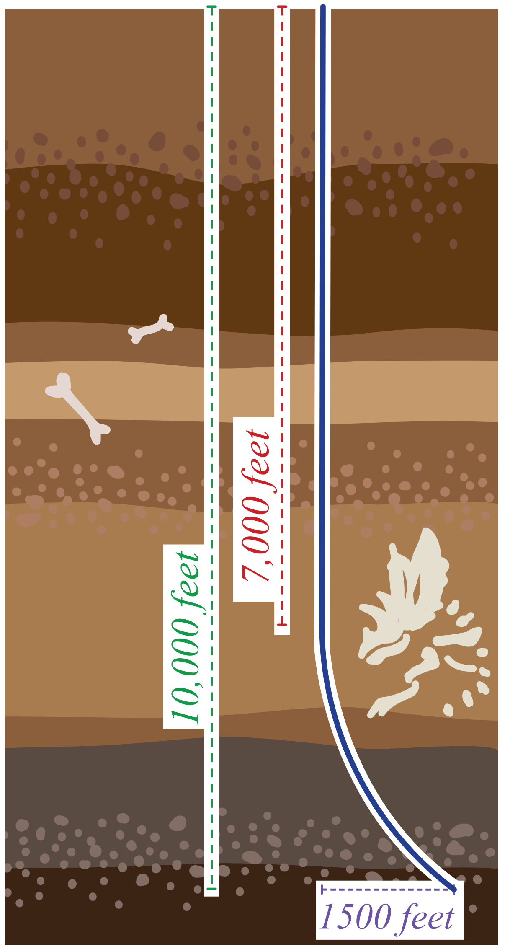
Oil Drilling
The desired horizontal width, x, for the curved portion is 1,500 feet. The true vertical depth includes the vertical height of the curved portion, y, and vertical length of the vertical portion; this total needs to be 10,000 feet.

Slide 30
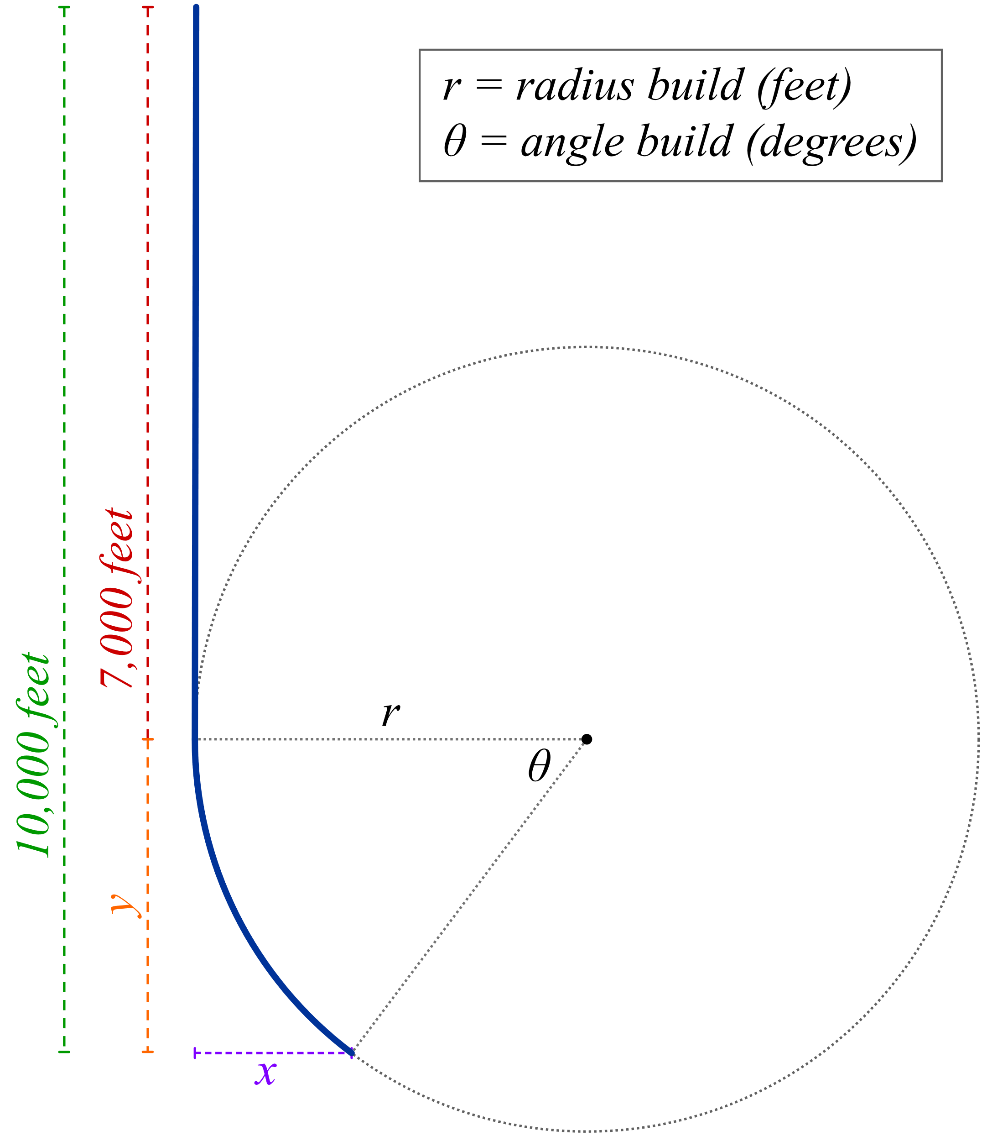
Oil Drilling: Part A

Slide 31
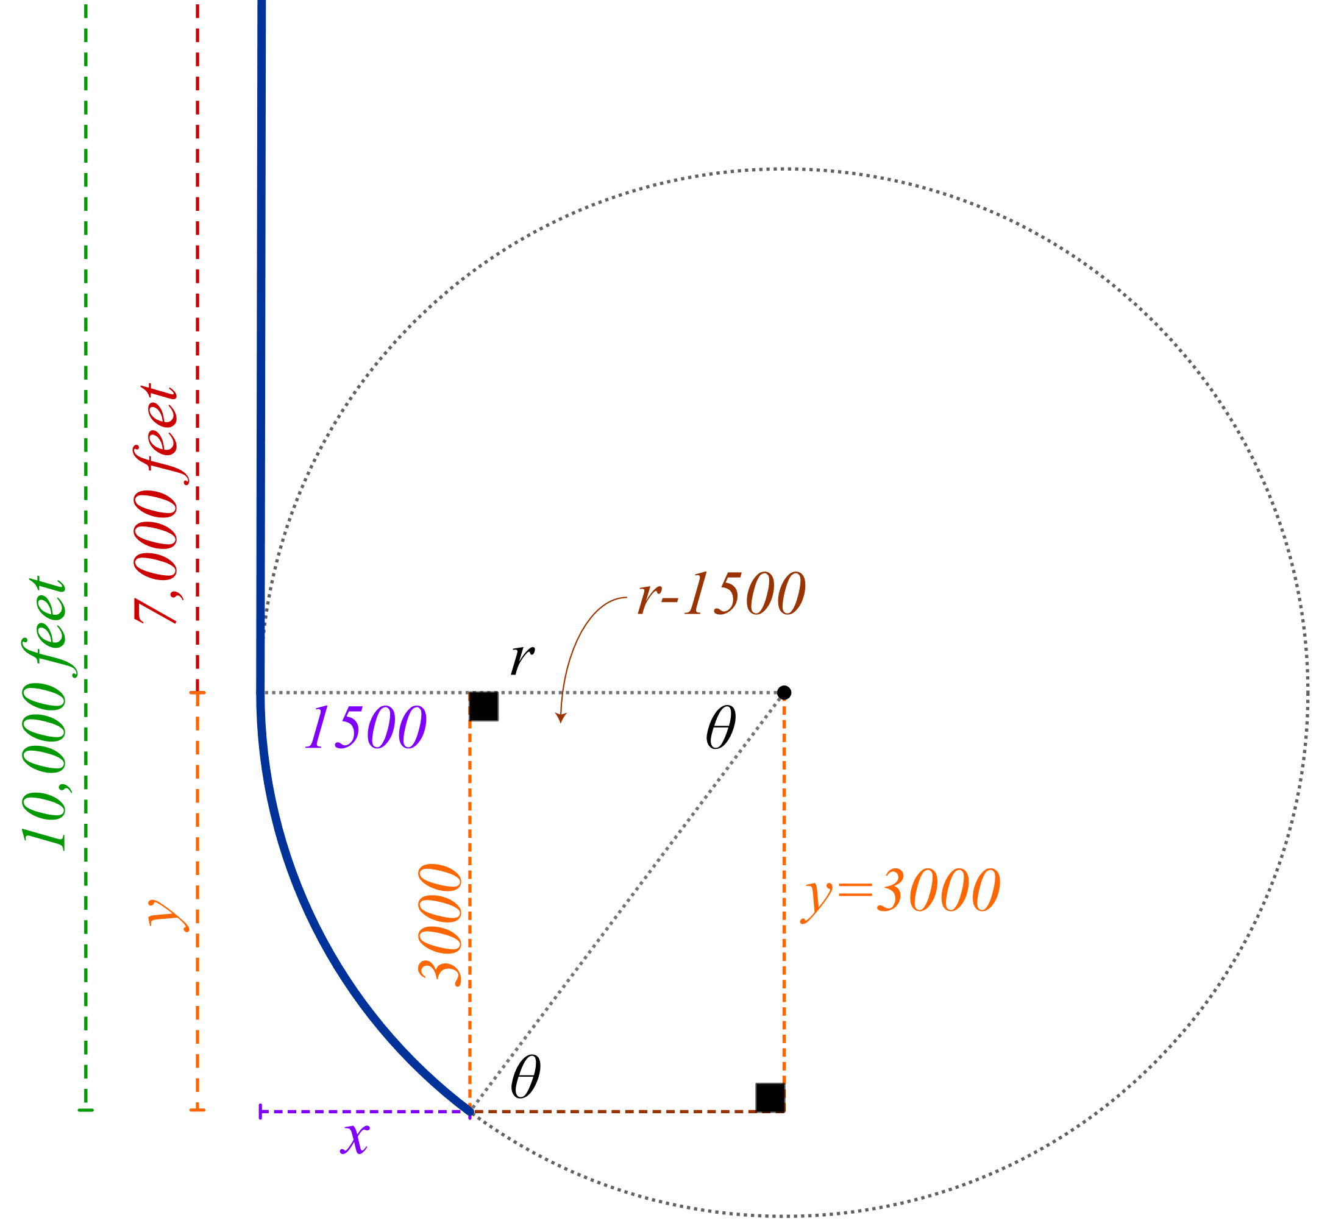
Oil Drilling: Part A (Solution)

Slide 32
Oil Drilling: Part A (Solution)

Slide 33
Oil Drilling: Part B
Use your results to find θ. Round to the nearest degree.

Slide 34
Oil Drilling: Part B (Solution)

Slide 35
Oil Drilling: Part B (Solution…continued)

Slide 36
Oil Drilling: Part C
Determine the value of r.

Slide 37
Oil Drilling: Part C (Solution)

Slide 38
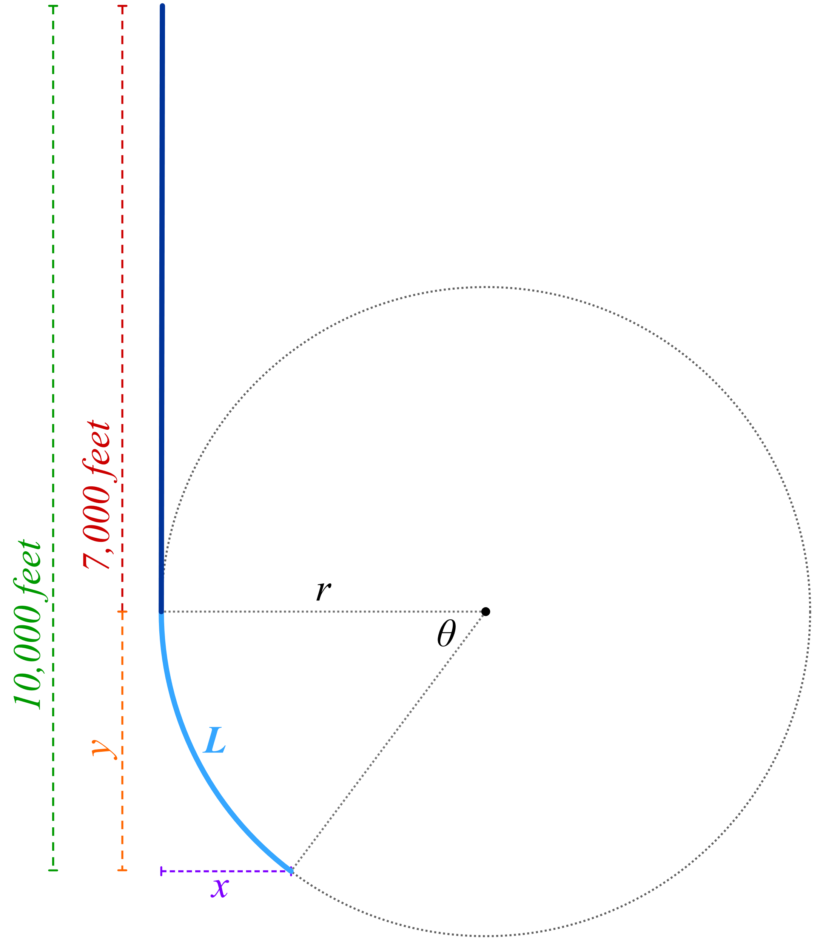
Oil Drilling: Part D
Calculate the total length of the vertical and curved portions. This total length is known as the measured depth, m, and is measured in feet. Round to the nearest foot.

Slide 39
Oil Drilling: Part D (Solution)

Slide 40
Oil Drilling: Part E

Slide 41
Oil Drilling: Part E (Solution)

Slide 42
Exit Ticket
Notes:
K20 Center. (n.d.). Bell Ringers and Exit Tickets. Strategies. https://learn.k20center.ou.edu/strategy/125

Slide 43
Exit Ticket (Solution)
Notes:
K20 Center. (n.d.). Bell Ringers and Exit Tickets. Strategies. https://learn.k20center.ou.edu/strategy/125

