Slide 2
Trig Identities, Part 3
Sum, Difference, and Double-Angle Identities

Slide 3
Essential Question
How do we use trigonometric identities?

Slide 4
Lesson Objectives
Use sum, difference, and/or double-angle identities to simplify expressions.
Verify trigonometric identities.

Slide 5
Setting the Scene
Wake up! The taxi to take you to the airport is on its way.
Pack your bag and put on your archeologist’s hat.
The meter is running!
Your ticket says you are going to Rhodes, Greece.
You have it on good authority that some ancient trigonometry artifacts have been found there.
You have 19 hours and 42 minutes before arriving. It’s time to catch up on some basics.

Slide 6
Hipparchus, The Founder of Trigonometry
But first some history:
Hipparchus (huh·paar·kuhs), a Greek astronomer, was fascinated with both astronomy and mathematics. He is thought to have written many works using trigonometry and is known as the Founder of Trigonometry.
He recorded observations during the second century BCE and was exceptionally precise. One of his accomplishments was estimating the length of a year within seven minutes of accuracy.

Slide 7
Even, Odd, or Neither?
Before you arrive on site, you want to brush up on some basics:
The symmetry of a graph can help us decide if we should check whether a function is even, odd, or neither.
Even functions are symmetric about the y-axis.
Odd functions are symmetric about the origin.

Slide 8
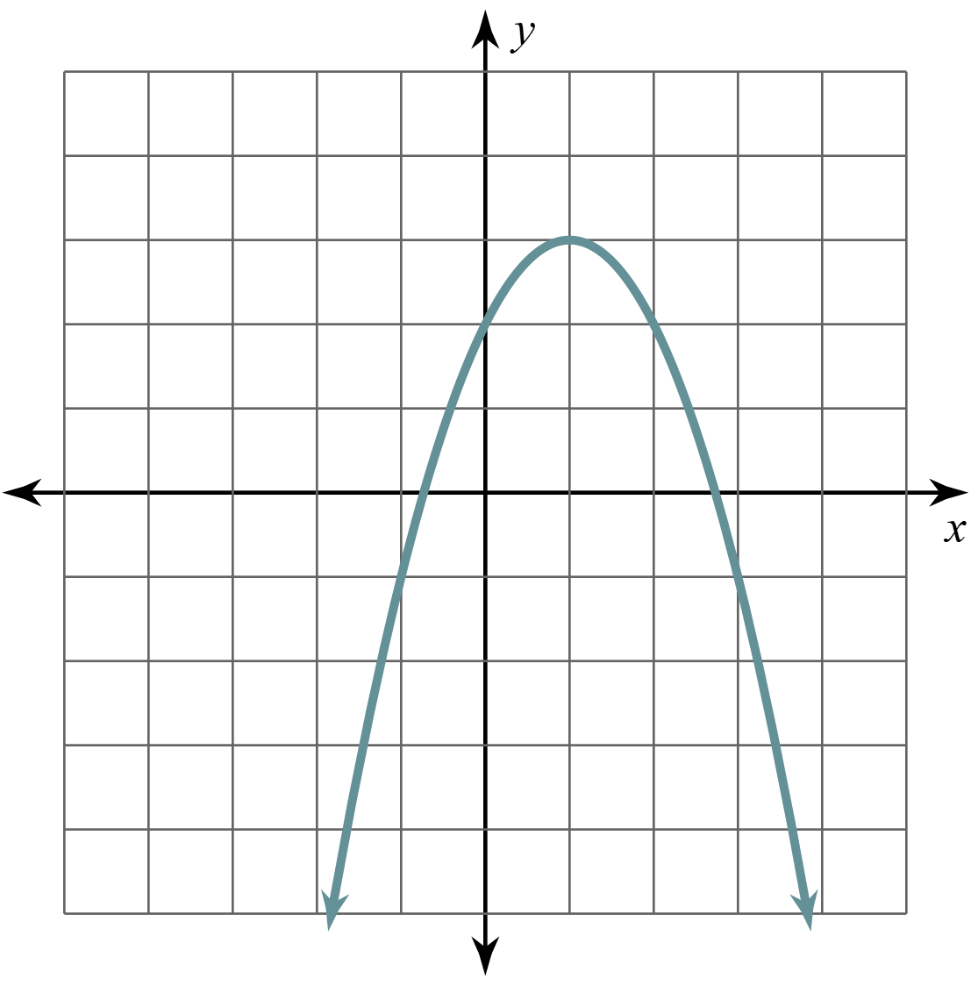
Even, Odd, or Neither? (Solution)
Graph | Symmetry | Even, Odd, Neither
 | This graph has line symmetry. It is symmetric with respect to the line x = 1.

Slide 9
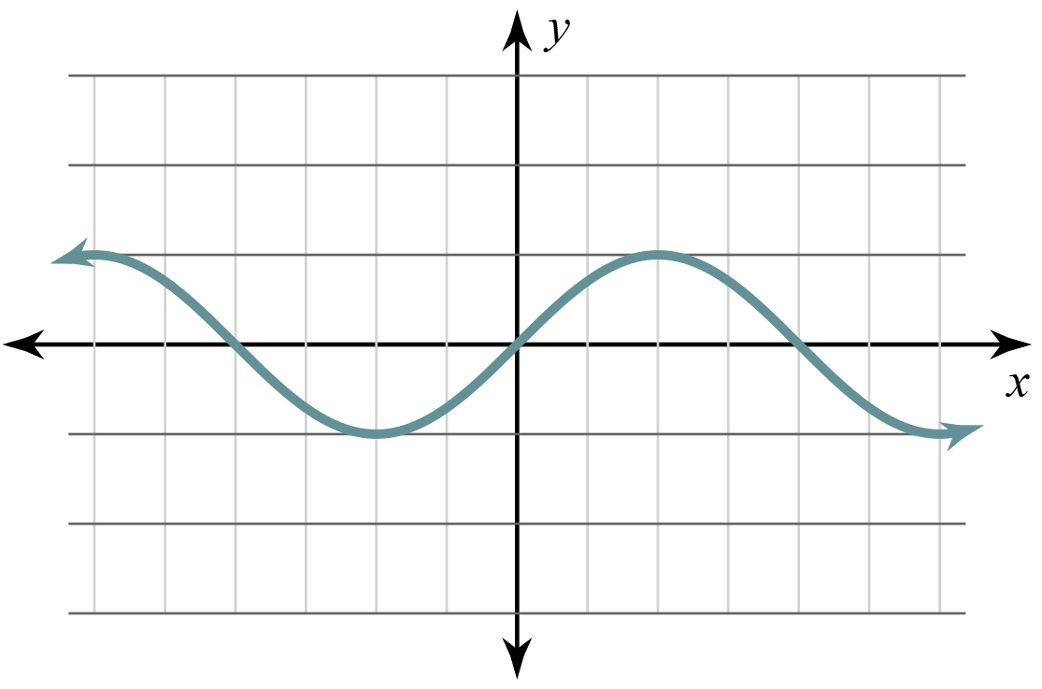
Even, Odd, or Neither? (Solution)
Graph | Symmetry | Even, Odd, Neither
 | This graph has point symmetry. It is symmetric with respect to the origin.

Slide 10
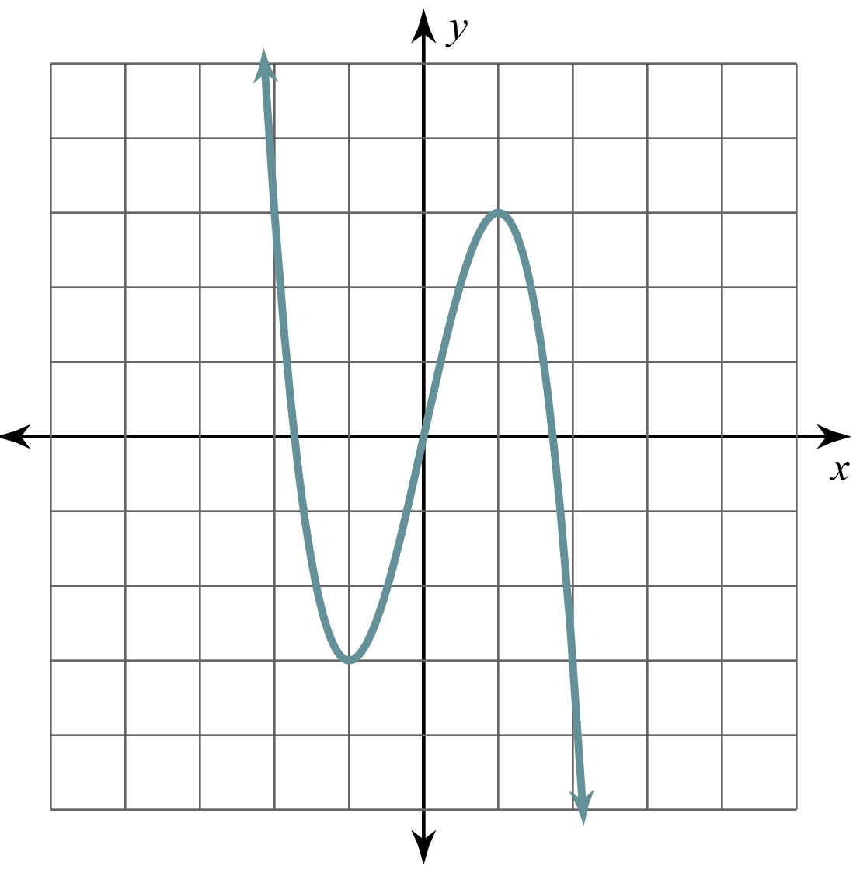
Even, Odd, or Neither? (Solution)
Graph | Symmetry | Even, Odd, Neither
 | This graph has point symmetry. It is symmetric with respect to the origin.

Slide 11
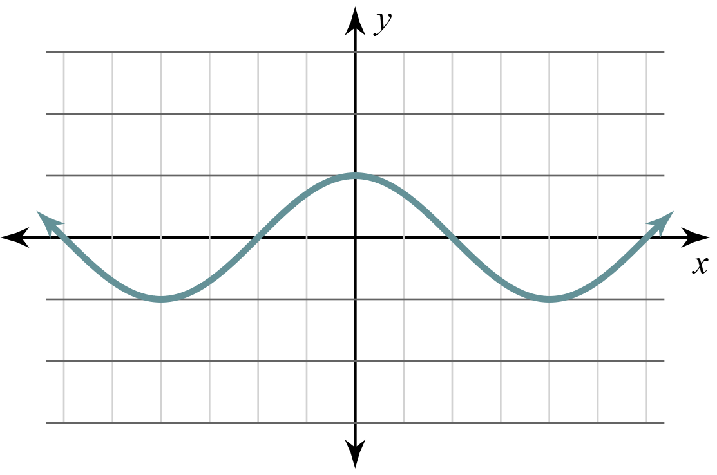
Even, Odd, or Neither? (Solution)
Graph | Symmetry | Even, Odd, Neither
 | This graph has line symmetry. It is symmetric with respect to the line x = 0.

Slide 12
Ancient Greece
Through your research, you have learned that, unfortunately, all but one of Hipparchus’ works have been lost, and very little is known of his life.
When you get to the dig site, you are momentarily dazzled by the beauty of the island.
But the team has unearthed a scroll that needs your attention.

Slide 13
Ancient Greece
Being buried in rubble for centuries has taken its toll.
So, you unroll the scroll very carefully, inch by inch. Could this be one of his lost writings?
We are not sure how long this scroll is going to hold up in the wind from the Aegean Sea.

Slide 14
The Scrolls: Steps 1-2
Oh no! It has been torn into two pieces!
Grab a partner and examine your artifact.
Each pair needs 2 copies of The Scroll handout. One for Student A and one for Student B.
Work quickly to get through Steps 1-2 on your handout.

Slide 15
Into the Unknown: Step 3
Now it’s time to figure out the problem together.
Use the information you just gathered to find the sum identity for sine.

Slide 16
Into the Unknown: Step 3
What did your team discover?

Slide 17
Into the Unknown: Cosine – Step 4
Try to find the sum identity for cosine.
Notes:
K20 Center. (n.d.). Inverted Pyramid. Strategies. https://learn.k20center.ou.edu/strategy/173

Slide 18
Into the Unknown: Cosine – Small Groups
Find another pair and compare your proofs.
Did you get the same result?
Were your steps the same or different?
Notes:
K20 Center. (n.d.). Inverted Pyramid. Strategies. https://learn.k20center.ou.edu/strategy/173

Slide 19
Into the Unknown: Cosine – Whole Class
Did we all get the same result?
Notes:
K20 Center. (n.d.). Inverted Pyramid. Strategies. https://learn.k20center.ou.edu/strategy/173

Slide 20
Artifacts
The scroll has started to crumble.
Luckily, you have collected the information you need.
There are some additional artifacts that have been brought to your attention. What else can we prove?
Use the sum identities for sine and cosine to find new identities.

Slide 21
Artifacts
Work with a partner on this epic quest to inspect each artifact carefully.
After checking your work for Artifact 1, collect Artifact 2 and begin inspecting. Repeat for Artifact 3.
Record all of your work (which will become your research papers) on a piece of notebook paper.

Slide 22
It Belongs in a Museum
Notes:
K20 Center. (n.d.). Bell Ringers and Exit Tickets. Strategies. https://learn.k20center.ou.edu/strategy/125

Slide 23
It Belongs in a Museum (Solution)
Notes:
K20 Center. (n.d.). Bell Ringers and Exit Tickets. Strategies. https://learn.k20center.ou.edu/strategy/125

Slide 24
It Belongs in a Museum (Solution)
Notes:
K20 Center. (n.d.). Bell Ringers and Exit Tickets. Strategies. https://learn.k20center.ou.edu/strategy/125

