Slide 1
When Should the Courts Act?
A US Government Lesson

Slide 2
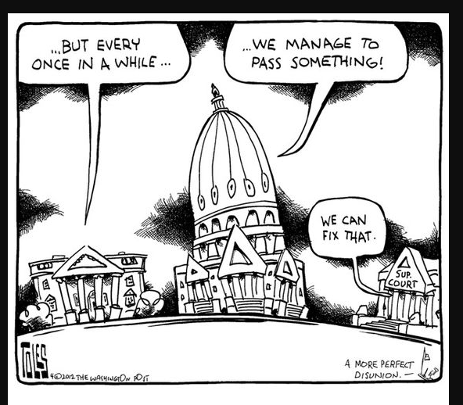
What does this cartoon mean?
1.Who or what do each of the buildings in the cartoon represent?
2. How do these groups interact with each other?
3. What does it mean when the third building says, “We can fix that!” What is their role?

Slide 3
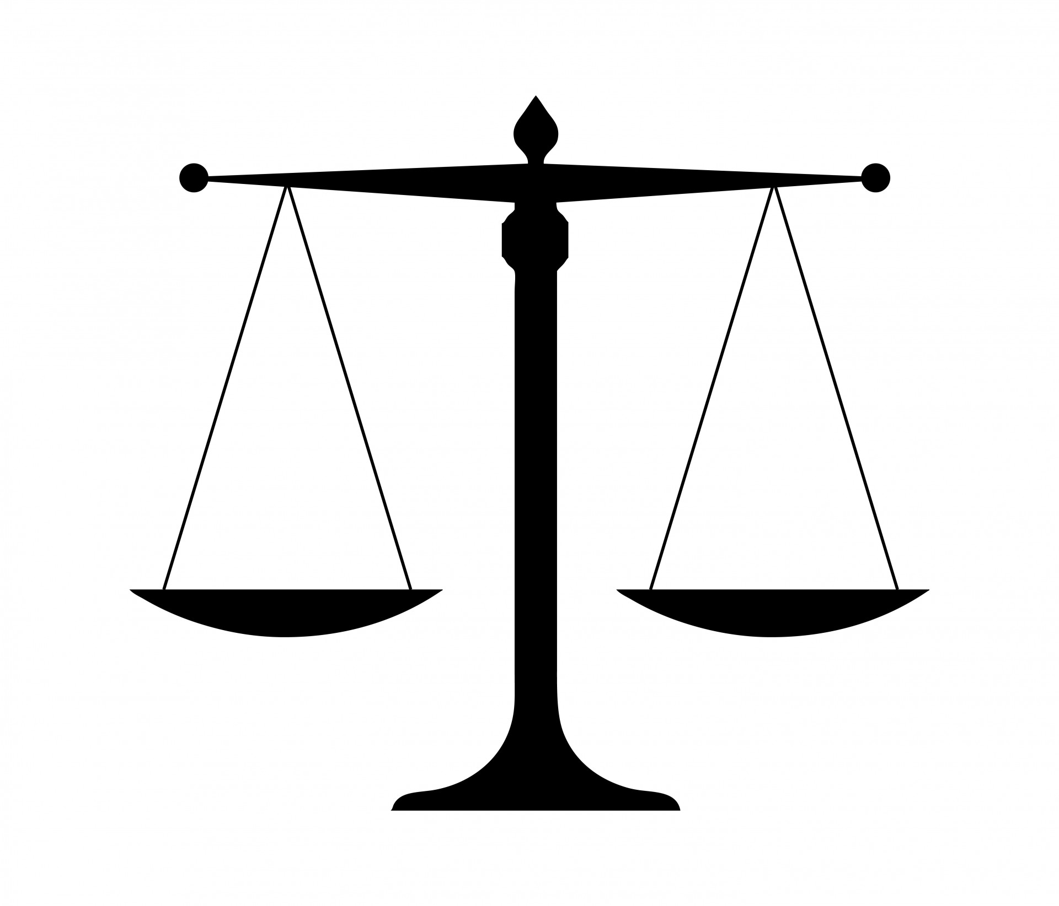
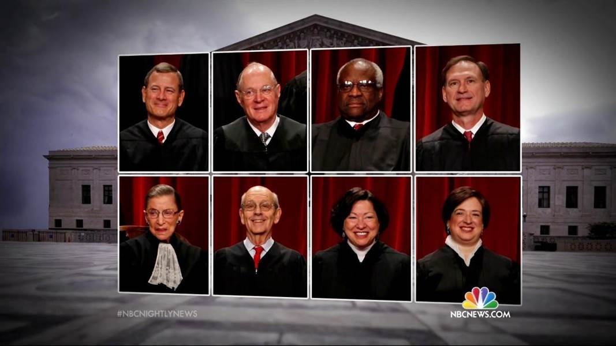
What is the difference between judicial activism or judicial restraint?
Activism?? Restraint??

Slide 4
Judicial Activism or Judicial Restraint?

Slide 5
Frayer Model Activity
Definition | Supreme Court case examples 1. 2. 3.
Pros | Cons
Judicial Activism or Judicial Restraint

Slide 6
3-2-1 Activity on Notebook paper:
You may need to refer back to your Frayer Model to help compose your answers.
3 reasons or circumstances for the courts to practice Judicial Activism.
2 circumstances or reasons for the courts to practice Judicial Restraint.
1 court case in which you agree with the decision of the Supreme Court.

Slide 7
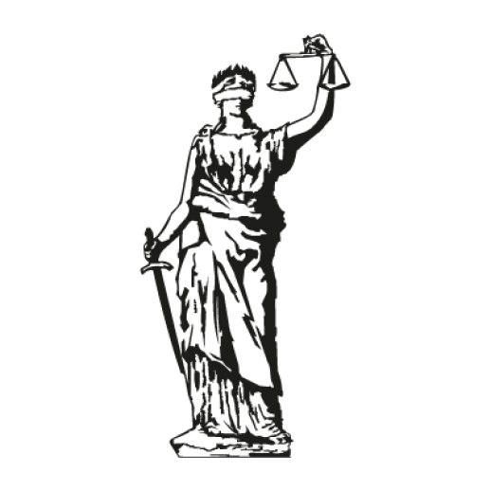
A Symbol of the Law:
Justice is blind to bias or special interest
The scales are balanced for fairness
The sword represents truth

