Slide 2
Soccer & Statistics
ICAP: Math

Slide 3
Essential Questions
What are measures of central tendency? How are they used by sports organization professionals?

Slide 4
Lesson Objectives:
By the end of this lesson, we will be able to:
calculate measures of central tendency (mean, median, and mode) for a set of data.
create an argument based on measure of central tendency calculations.
describe how math is used in the work of sports professionals.

Slide 5

Cognitive Comics
In the “Before” column, draw a picture that illustrates a member of a soccer organization.

Slide 6
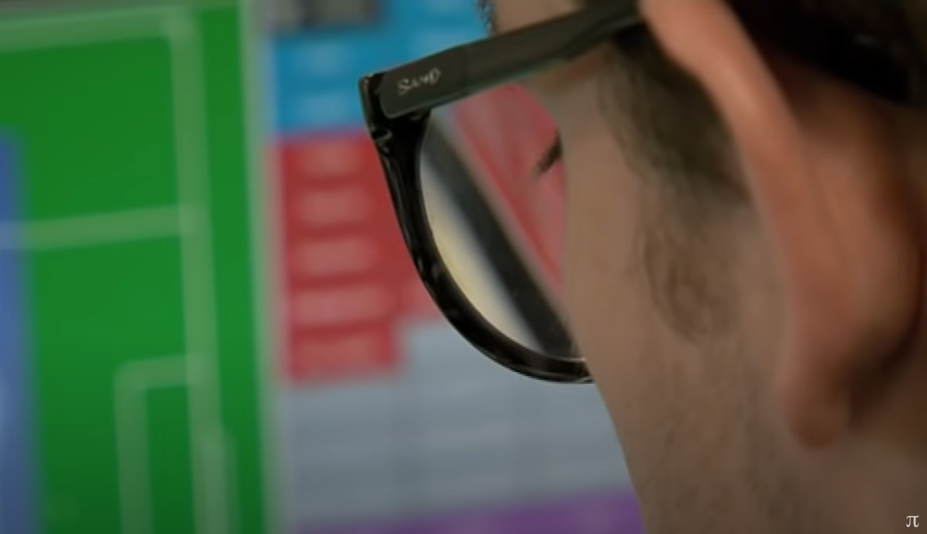
Soccer Statisticians
Numberphile. (2013, March 31). Statistics on Match Day - Numberphile. YouTube. https://youtu.be/GyN-qpVfOWA
Notes:
Numberphile. (2013, March 31). Statistics on Match Day - Numberphile. YouTube. https://youtu.be/GyN-qpVfOWA

Slide 7
Cognitive Comics
In the “After” column, draw a picture that illustrates the job description of one of the statisticians in the video.

Slide 8
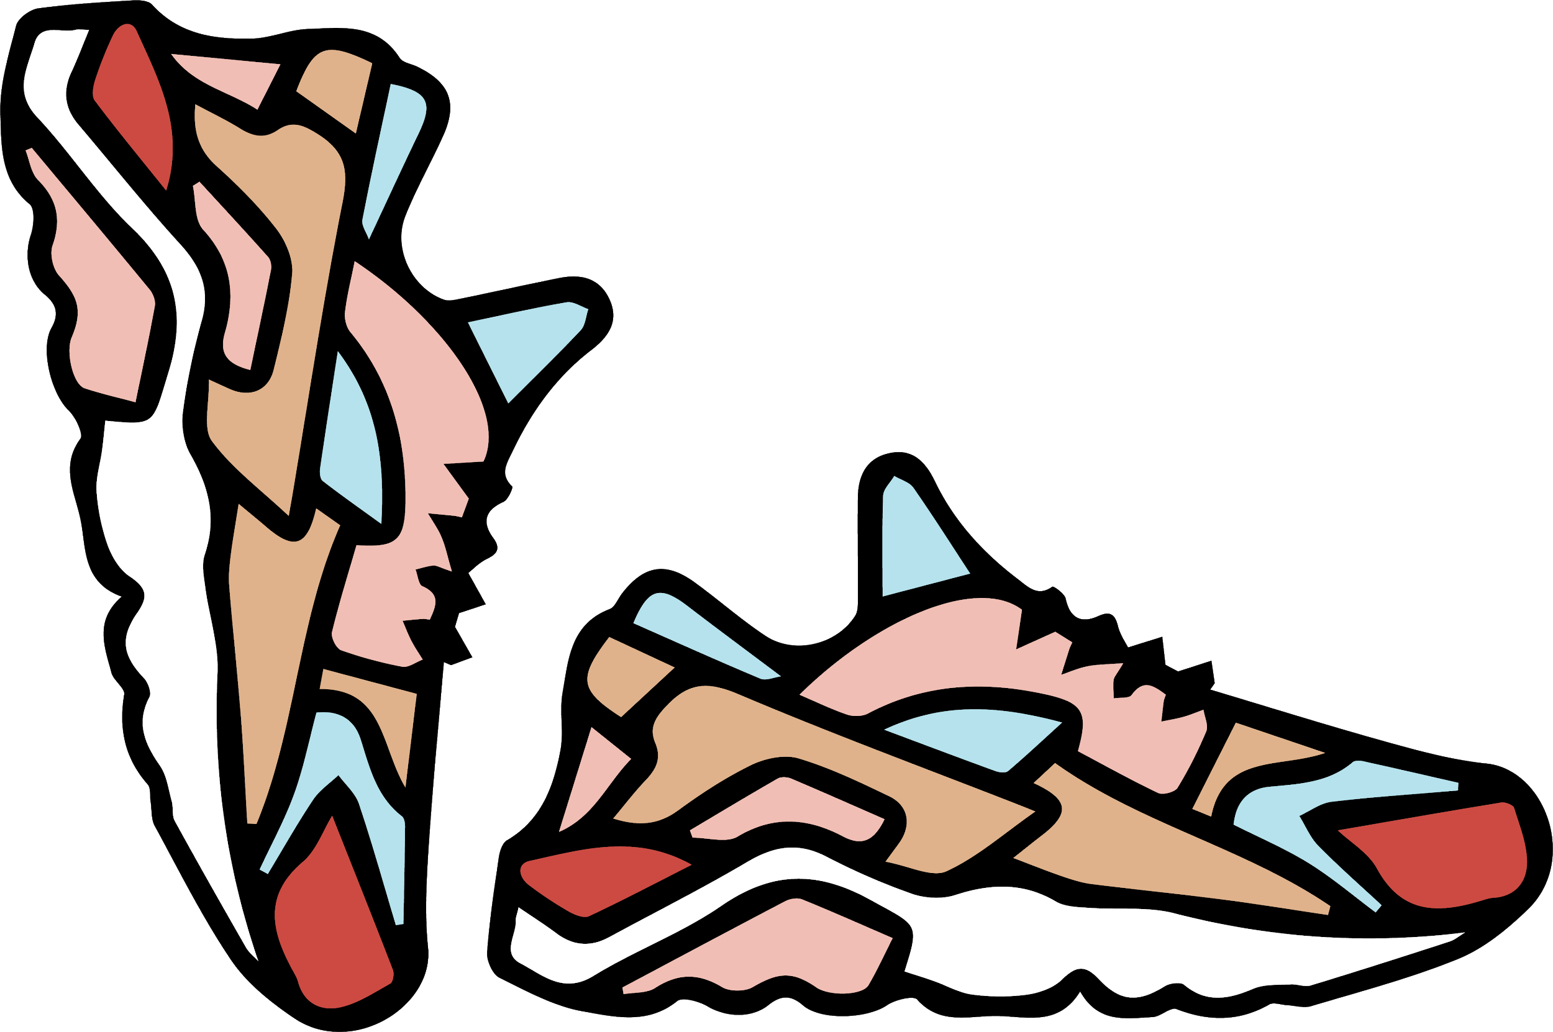
What Is Your Cleat Size?
Equipment is a major part of any game, particularly soccer. Cleats must fit correctly for players to perform at their best
It is your job as the equipment manager of a fantasy team to order a new player’s shoes. The new player is not responding to your e-mails, text messages, or phone calls, so you must order his cleats without knowing his shoe size.

Slide 9
What Is Your Cleat Size?
With your Elbow Partner, use the handout and its questions to analyze the cleat size dataset of your team.

Slide 10
What Is Your Cleat Size?
Talk to your new Elbow Partner about the answers you came up with in your analysis of the cleat size data.

Slide 11
Mean
Is there something else we can do (besides looking at the most common number and the middle number) to find a shoe size that would represent all the numbers?
Definition/Process | What is the mean shoe size?
Sum of the numbers divided by the number of numbers. Add up all of the numbers in the data set. Divide the sum by the number of terms that are in the data set.

Slide 12
Median
What shoe size do you think is right in the middle of the biggest and smallest?
Definition/Process | What is the median shoe size?

Slide 13
Mode
What do you think is the most common shoe size of the fantasy players?
Definition | What is the mode shoe size?

Slide 14
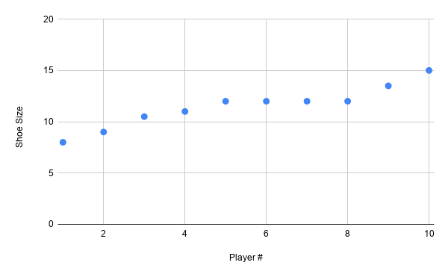
Line of Best Fit
What is an outlier?
Where would you draw a line of best fit on this scatter plot? Why?
*When you’re creating your line of best fit, try to have the same number of points above and below the line.

Slide 15
Line of Best Fit Equation
Based on the line you drew, pick two points to create an equation for your line.
What is your equation?

Slide 16
Inserting and Deleting Points
What happens if you delete the outlier? How does that affect the data?
What happens if you insert two more points that are near the rest? How does that affect the data?

Slide 17

OKC Energy Player Statistics
Use the Player Statistics handout to answer the questions. Then, for the last activity, Tweet Up a statistic you explored using fewer than 140 characters. Use a hashtag that identifies the main point of today’s lesson.

Slide 18
Draft Your Team & Develop Your Pitch
Your options for creating your fantasy team of players:
Option 1. Select 11 players from the team’s roster of 22 that you think would make the best starting lineup based on player statistics.
Option 2. Formulate an argument for a player trade with another team based on player statistics.
Now, develop a pitch to present your argument to OKC Energy’s general. The pitch should include:
your 11-player lineup chosen (for option 1), or your recommended player trade (for option 2);
the data you used to make these choices;
and your rationale behind these choices.

