Slide 2
Stats on the Sideline
ICAP: Math

Slide 3
Essential Questions
What are measures of central tendency?
How are they used by sports reporters?

Slide 4
Lesson Objectives
Calculate measures of central tendency for a set of data.
Support a statement based on measure of central tendency calculations.
Describe how math is used in the work of sports professionals.

Slide 5
Card Sort
With your group, decide how you think the cards should be sorted.

Slide 6
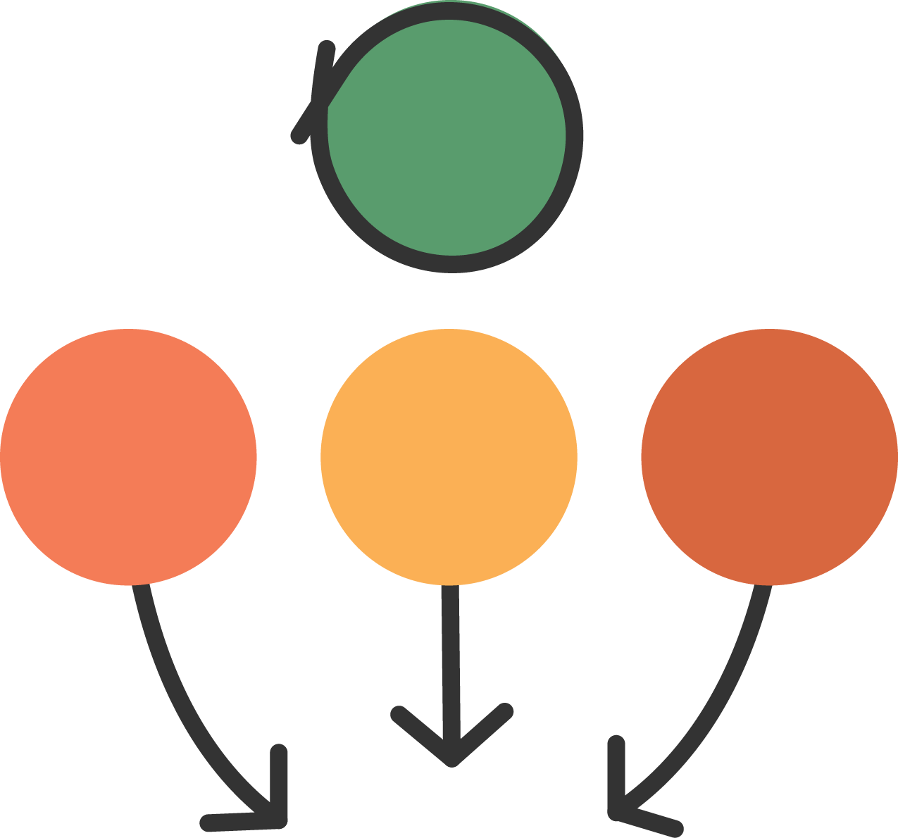
Three Stray, One Stay
Select one person to stay with your cards.
Stay: One person will stay to answer questions while the rest of the group circulates to other Card Sorts.
Stray: The rest of the group will circulate to other Card Sorts, ask questions, and bring information back to share with their original group.

Slide 7
Sports Statisticians
K20 ICAP - Stats on the Sideline (Middle School)
Notes:
K20 Center. (2023, April 12). K20 ICAP - Stats on the Sideline (Middle School). YouTube. https://youtu.be/rGI8PX4UbNI

Slide 8
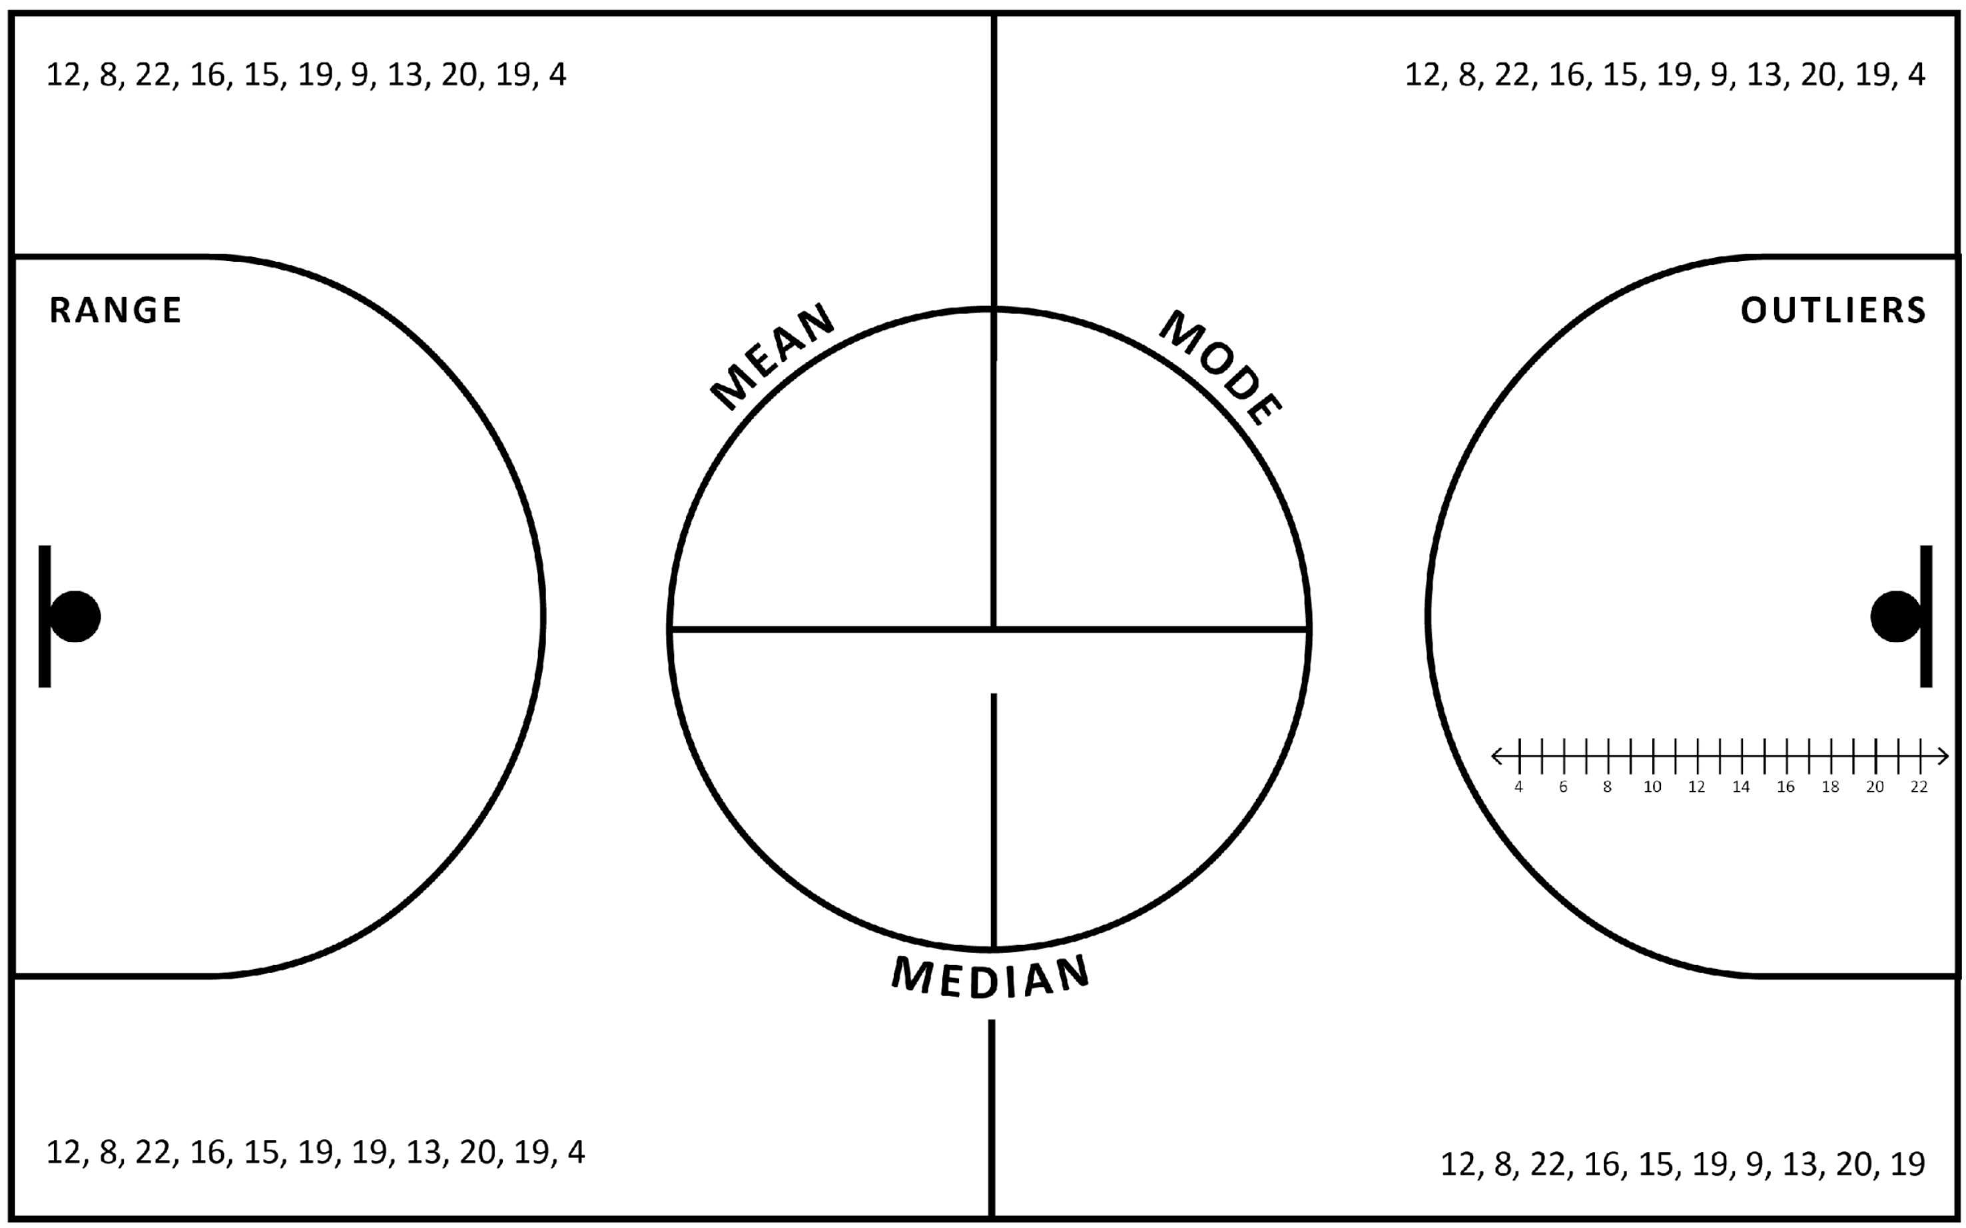
Guided Notes

Slide 9
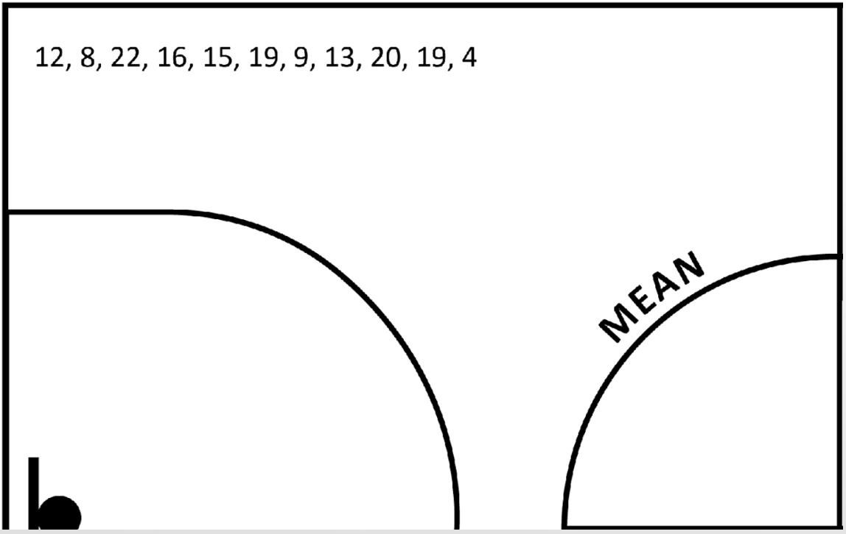
Guided Notes: Mean

Slide 10
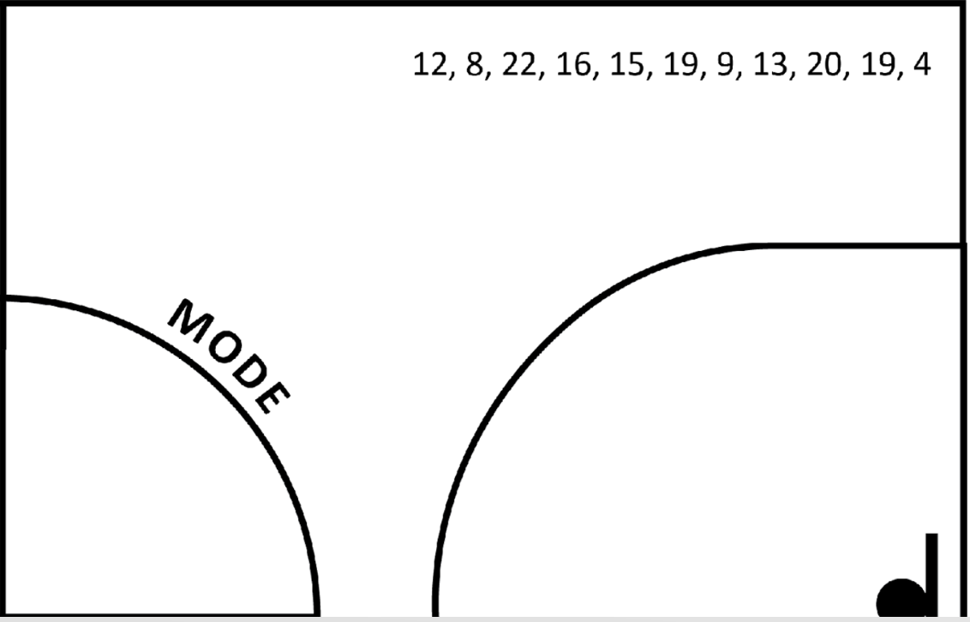
Guided Notes: Mode

Slide 11
Guided Notes: Median

Slide 12
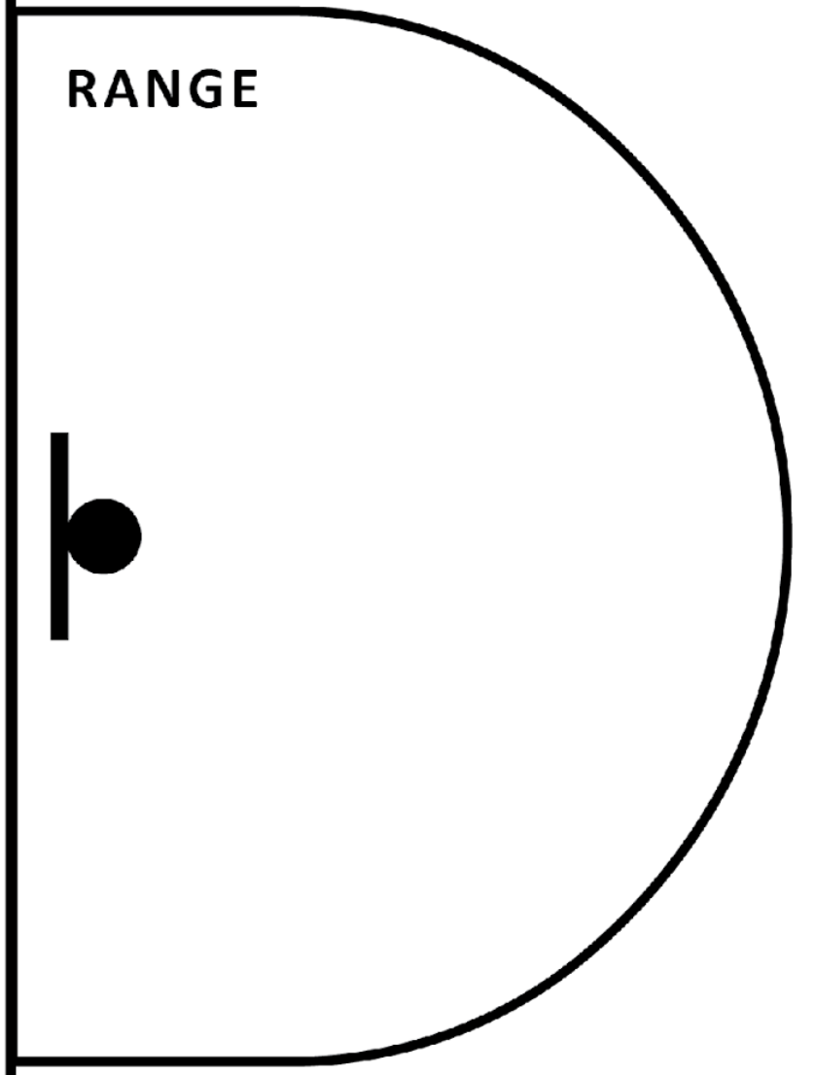
Guided Notes: Range

Slide 13
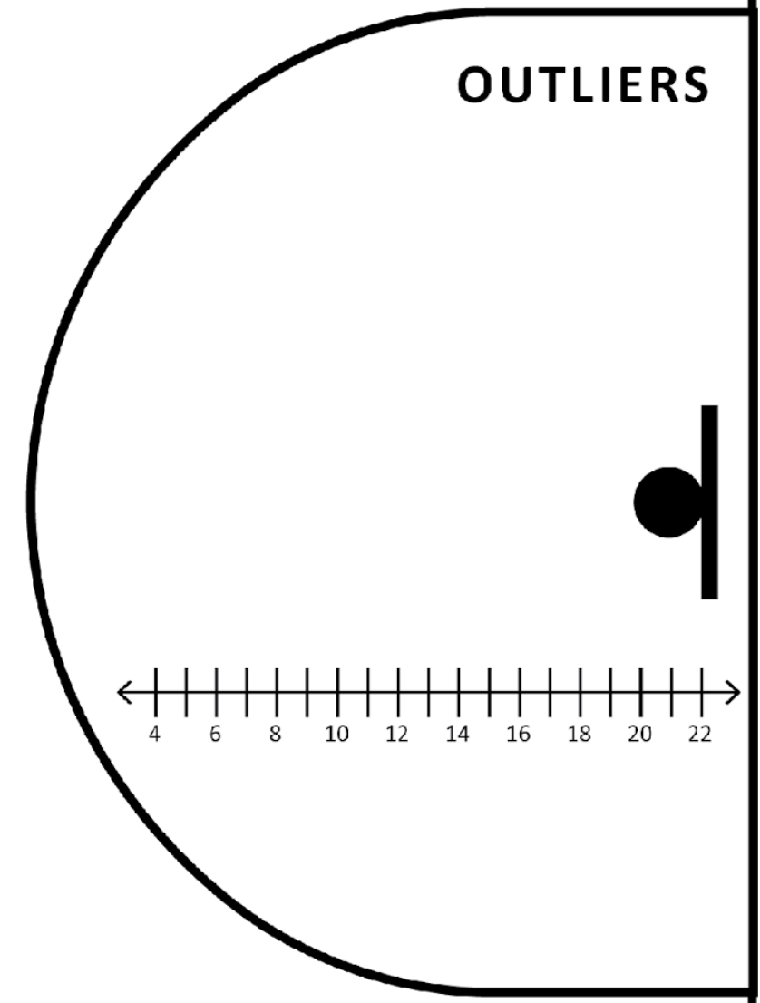
Guided Notes: Outlier

Slide 14
Guided Notes: Quartiles
Q1
Q2
Q3
IQR
4, 8, 9, 12, 13, 15, 16, 19, 19, 20, 22

Slide 15
Stats on the Sideline
You have just been handed OKC Thunder players’ average points per game from the 2021-22 regular season.
You will need to analyze the data to determine each of the measures of central tendency and spread.

Slide 16
Tweet Up
Take a look at your analyzed data to determine your “MVP,” or Most Valuable Point of Data.
Create a headline to represent that measure of center.

