Slide 2
Math in Motion
Visual Approach to Quadratics

Slide 3
Essential Question
What do real life events look like when graphed?

Slide 4
Lesson Objectives
Predict the actions of a real-life scenario and create a graph to represent the scenario.
Discover the physical appearance of a parabola and learn terminology associated with the graph.

Slide 5
Bouncing a ball
In teams, complete the following tests on the handout.
  Dribble the ball in place.
  Dribble the ball while walking.
  Bounce the ball between the pair
  Bounce the ball down the hallway.
Pair 1 completes each test while Pair 2 sketches on the handout.
Switch roles, and Pair 2 completes the tests while Pair 1 sketches.

Slide 6
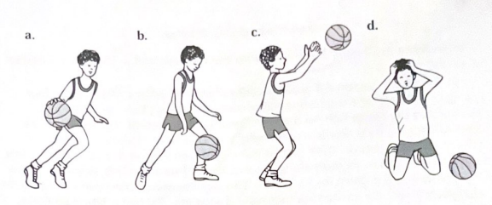
Interpreting
On your paper, write a few sentences describing what is happening in the sequence of pictures.
Notes:
Dyke, F. V. (1998). A visual approach to algebra. Dale Seymour Publications.

Slide 7
Graphing
With the story in mind, graph the distance of the ball from the ground as a function of time.
Distance
Time

Slide 8

Think-Pair-Share
Turn to the person next to you and share your sequence of events, graphing with each other.
  What is similar?
  What is different?
  Does the description match the graph?
Notes:
K20 Center. (n.d.). Think-Pair-Share. Strategies. https://learn.k20center.ou.edu/strategy/139

Slide 9
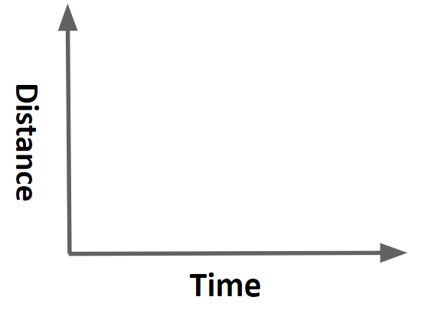
Student work

Slide 10
Student work

Slide 11
Student work

Slide 12
Student work

Slide 13
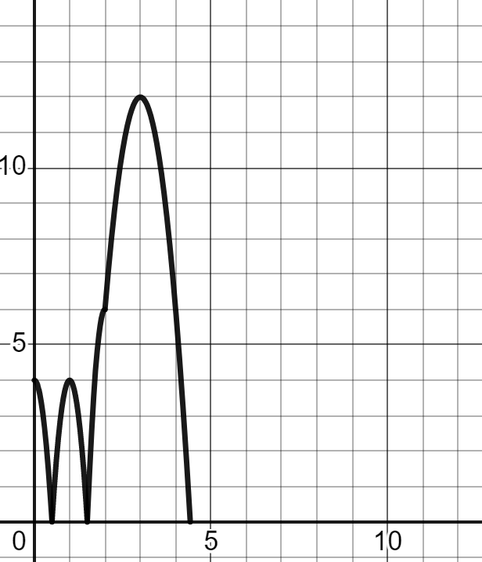
One interpretation of the graph
Distance (sec)
Time (sec)
Notes:
Graphing calculator. Desmos. (n.d.). https://www.desmos.com/calculator/dh8vh06ljx

Slide 14
Let’s isolate one part of the graph to investigate.
Distance (sec)
Time (sec)
Notes:
Graphing calculator. Desmos. (n.d.). https://www.desmos.com/calculator/dh8vh06ljx

Slide 15
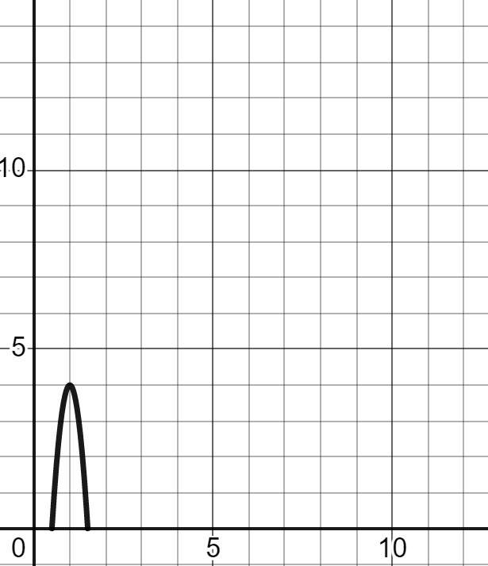
Given the information, answer the prompts on your handout.
Distance (sec)
Time (sec)
Notes:
Graphing calculator. Desmos. (n.d.). https://www.desmos.com/calculator/dh8vh06ljx

Slide 16
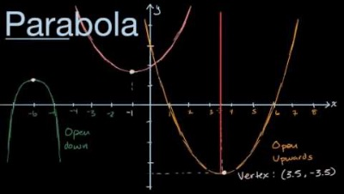
Whole Class discussion
This graph is called a parabola.
Is it linear?
Since it is U-shaped, we classify this graph as quadratic.
Notes:
Khan Academy. (2017, April 3). Visual introduction to parabolas [Video]. YouTube. https://www.youtube.com/watch?v=BGz3pkoGPag

Slide 17


Math in Motion
With your elbow partner, use the graph at the top of your handout to fill in the table below.
Notes:
K20 Center. (n.d.). Elbow Partners. Strategies. https://learn.k20center.ou.edu/strategy/116
K20 Center. (2021, September 21). K20 Center 10 minute timer [Video]. YouTube. https://www.youtube.com/watch?v=9gy-1Z2Sa-c&list=PL-aUhEQeaZXLMF3fItNDxiuSkEr0pq0c2&index=12

Slide 18
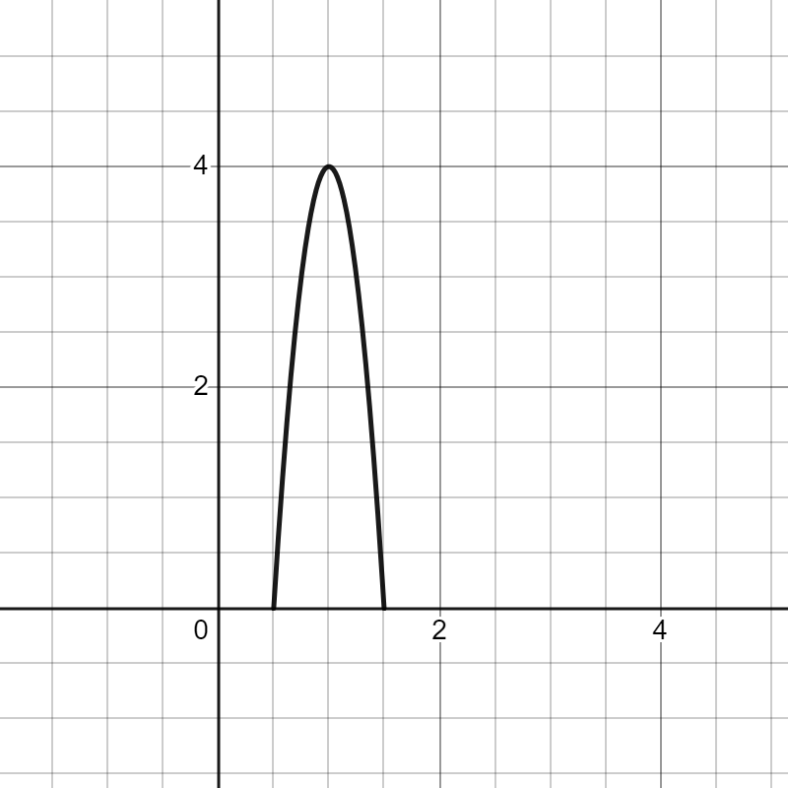
Whole class discussion
Question | Answer | Vocabulary word
Which way is the u-shape opening? (up or down)
Where is the highest part of the shape? Mark this on the graph with a point.
What are the x-intercepts of the shape?
Notes:
Graphing calculator. Desmos. (n.d.). https://www.desmos.com/calculator/dh8vh06ljx

Slide 19
Whole class discussion
Question | Answer | Vocabulary word
Which way is the u-shape opening? (up or down) | Down | Direction
Where is the highest part of the shape? Mark this on the graph with a point. | (1,4) | Minimum or Maximum (The point on the graph is the vertex)
What are the x-intercepts of the shape? | (0.5, 0) (1.5, 0) | Intercepting points
Notes:
Graphing calculator. Desmos. (n.d.). https://www.desmos.com/calculator/dh8vh06ljx

Slide 20
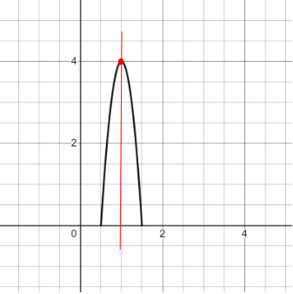
Whole Class discussion
Question | Answer | Vocabulary word
Where is the line of symmetry on the shape? | Draw the line of symmetry directly on the graph
Does this graph show a linear function?
Notes:
Graphing calculator. Desmos. (n.d.). https://www.desmos.com/calculator/dh8vh06ljx

Slide 21

Whole Class discussion
Question | Answer | Vocabulary word
Where is the line of symmetry on the shape? | Draw the line of symmetry directly on the graph | Axis of Symmetry
Does this graph show a linear function? | No | Quadratic function
Notes:
Graphing calculator. Desmos. (n.d.). https://www.desmos.com/calculator/dh8vh06ljx

Slide 22
Extend
First, in a group brainstorm a scenario that involves a parabola.
Second, choose one of the following ways to display your scenario.
Then, graph the action on a piece of graph paper. Be sure to include units on your graph.
Digitally Record | Illustrate | Write a narrative

Slide 23
Evaluate
Pair up with another group.
Share your scenario, and graph with the other group.
Then using the other group’s graph, identify the following terms:
  Does the graph match the description?
  Minimum/Maximum
  Which way is it opening?
  Vertex
  Axis of symmetry (write an equation to represent the line)
  X-intercept or Y-intercept
Notes:
K20 Center. (n.d.). Exit Ticket. Strategies. https://learn.k20center.ou.edu/strategy/125

