Slide 2
Bent Out Of Shape Solar System
Newton’s Law of Gravitation

Slide 3
Essential Questions
Why do objects attract each other?
What holds solar systems together?
How does spacetime explain how gravity acts at a distance?

Slide 4
Lesson Objectives
Apply Newton’s Law of Gravitation to qualitatively explain the motion of orbiting objects in the solar system.
Incorporate spacetime into explanations of orbiting objects that include the connection that spacetime is warped by the mass in it.
Use Newton’s Law of Gravitation to relate to circular orbits to calculate the period, velocity, and centripetal force for a two-object system.

Slide 5
The Sound of a Gravitational Wave
Create a table with two columns labeled “I Notice” and “I Wonder.”
As the video is viewed, write observations in the I Notice column and questions in the I Wonder column.
I Notice | I Wonder

Slide 6
The Sound of a Gravitational Wave
In 1915, Einstein proposed the idea that waves of gravity were traveling throughout the universe that would compress and stretch the world around us as they traveled.
In 2015, scientists were able to make the first recording of a gravitational wave.
The video we are about to watch is the wave pattern that was recorded, and the clip has been altered so that the wave pattern is in our audible range so that we can hear the sound of the pattern.

Slide 7
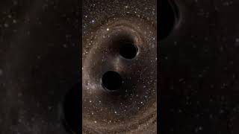
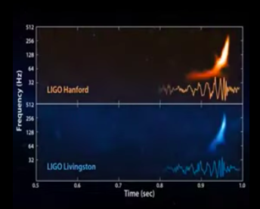
Sound of First Recorded Gravitational Wave in 2015
https://www.youtube.com/watch?v=Nvl89a46Ogw
Notes:
YouTube. (2020, November 3rd). Sound of the first detected gravitational wave!! https://youtu.be/Nvl89a46Ogw

Slide 8
The Sound of a Gravitational Wave
Record your observations in your table.

Slide 9
The Sound of a Gravitational Wave
Discuss your observations and questions with your group and record the highlights on the butcher paper that will be hung around the classroom.
At the end of the unit, you will have the opportunity to see which questions you can now answer.

Slide 10
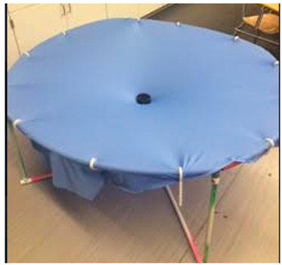
Fabric of Spacetime
Follow the instructions on the Fabric of Spacetime handout.
Repeat the experiments multiple times.

Slide 11
Einstein’s Spacetime Reading
Read Einstein’s Spacetime handout.
As you read
Circle new words you are not familiar with
Underline details that support the main ideas
Star the main ideas
With a partner, revisit your notes on the Fabric of Spacetime handout and explain question 2 again using the idea that mass bends spacetime.

Slide 12
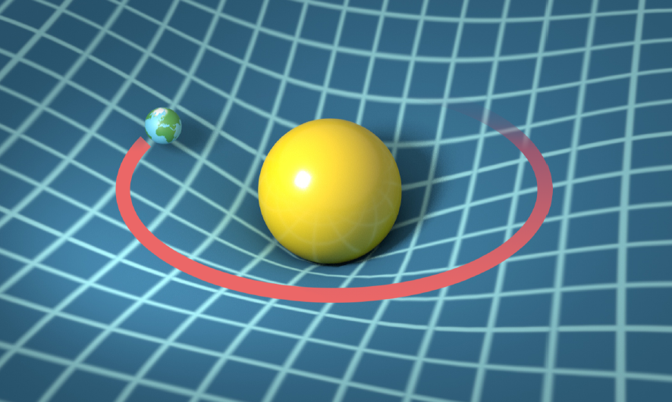
Gravity Holds Solar System Together
Use the Gravity Holds Solar System Together handout to derive and apply equations for how the solar system works.

Slide 13
Gravity Holds Solar System Together
Work with an elbow partner to answer question 8.

Slide 14
Gravity Holds Solar System Together
Respond to question 9 by writing a claim, evidence, and reasoning response.
Claim - answer the question in one sentence.
Evidence - provide at least one piece of information that supports your claim.
Reasoning - explain how the evidence supports your claim.

Slide 15
Gravitational Waves
On the Gravitational Waves handout, fill in the I Notice/I Wonder table as you watch two videos.
Answer the questions on the handout after the videos.

Slide 16
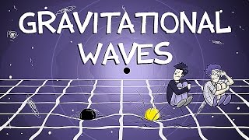
Gravitational Waves
https://www.youtube.com/watch?v=4GbWfNHtHRg
Notes:
YouTube. (1 February 2016). Gravitational Waves Explained. https://www.youtube.com/watch?v=4GbWfNHtHRg

Slide 17
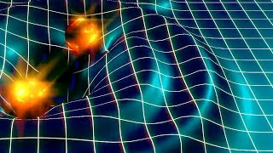
Gravitational Waves
https://www.youtube.com/watch?v=s06_jRK939I
Notes:
YouTube. (2016, February 11th). Brian Greene Explains the Discovery of Gravitational Waves. https://www.youtube.com/watch?v=s06_jRK939I

Slide 18
What have we learned?
In your group, look at the butcher paper around the room.
In your groups, answer 3 of the questions and write down one question you still do not know the answer to.
Record and turn in your answers on a sheet of notebook paper.

Slide 19
Exit Ticket
Using the idea that the world around us is made of spacetime, explain why light traveling even at 3 x 108m/s cannot escape a black hole.
Show the work for the derivation again and calculate the following:
Gravitational force of the sun on Jupiter;
The average speed of Jupiter in the orbit around the sun;
The time in seconds that it takes for Jupiter to orbit the sun.
Answers will vary from reality since the true orbit is not a perfect circle. M_{S} is the mass of the sun; M_{J} is the mass of Jupiter; and r is the distance from the center of mass of the sun to the center of mass of Jupiter.

