Slide 2
“It’s All Greek to Me!”
Greek and Latin Roots
7th or 8th Grade
English Language Arts

Slide 3
Learning Objectives
By the end of this lesson you will be able to...
Identify Greek and Latin root words in a reading.
Write a paragraph using Greek and Latin root words appropriately.
Recognize how knowing the roots of words can improve your reading skills.

Slide 4
Essential Questions
How can identifying and knowing word roots support your reading skills?
How can knowing word roots help you in your spelling and writing?

Slide 5

Where do English words come from?

Slide 6

“Give me a word … any word!”
Source: rulfoq. (2008, December 30). My Big fat greek wedding - Give me any word, and I show you how the root is greek... [Video file]. YouTube. https://www.youtube.com/watch?v=VL9whwwTK6I

Slide 7
How many of these common Greek roots do you know?

Slide 8
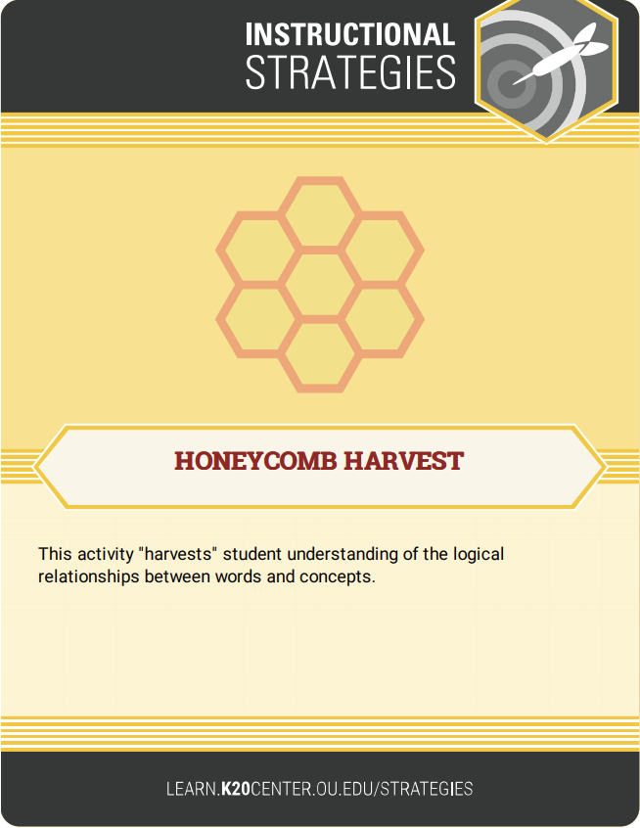
Honeycomb Harvest
With your group, read the words, definitions, and examples on all the cards.
Organize and arrange the hexagons so that the sides of related roots, their definitions, and English examples are touching to create a honeycomb effect.
Be prepared to justify and explain your decisions.
Notes:
K20 Center. (n.d.). Honeycomb harvest. Strategies. https://learn.k20center.ou.edu/strategy/61

Slide 9

Honeycomb Harvest Example
Capture
English word
Cap
Root
Captive
English word
Take, Hold
Meaning

Slide 10

Honeycomb Harvest - Activity Timer
Notes:
K20 Center. (2021, September 21). K20 Center 15 minute timer. [Video]. YouTube. https://youtu.be/m3zT2IxZQaw?si=Ql4_cZBMxEIH4brM

Slide 11

“What-Lighting”
While reading the text, identify the words that have Greek and Latin roots and highlight those words.
In the margin, write the meaning of each word that you highlighted.
Notes:
K20 Center. (n.d.). Why-lighting. Strategies. https://learn.k20center.ou.edu/strategy/128

Slide 12

“What-Lighting” – Activity Timer
Notes:
K20 Center. (2021, September 21). K20 Center 20 minute timer. [Video]. YouTube. https://youtu.be/bjcwzinQlEE?si=mm7jZaf1Clefb_Ko

Slide 13
Creative Writing Paragraph
Write a paragraph using 10 (or more) English words with Latin or Greek roots.
Use one or more of the following as your topic/theme:
A Greek god
A mythological creature
Ancient Greece

Slide 14
Don’t Forget!
A paragraph has 7–9 sentences and:
Focuses on one topic.
Includes a beginning, middle, and end.
Uses correct spelling, punctuation, and grammar from start to finish.
Uses language skills correctly and appropriately.
  Include 10 or more Greek and Latin root words.
  Highlight each one.

