Slide 2
Missing Colors
Light Absorption

Slide 3
Essential Questions
How is light absorbed by substances?
How are absorption spectra used to identify stars and the elements that make them up?

Slide 4
Lesson Objectives
Explain the relationship between the color of a substance and the light it absorbs.
Explain the relationship between light absorption and the Bohr atom model.
Explain how absorbance spectra are used to identify celestial bodies and their elemental compositions.

Slide 5
Gummed Up Photons
You will shine red, green and white lights through red, green and white gummy bears and see if light is absorbed and which color(s) of light are absorbed.

Slide 6
Make a Prediction
Discuss the following question and answer it on your handout for each gummy bear and light source combination.
Do you think the light will be absorbed by the gummy bear?

Slide 7
I Notice, I Wonder
During your investigation, record the following:
What do you notice about the gummy bears and the lights?
What questions do you have about the gummy bears and the light?
Notes:
K20 Center. (n.d.). I notice, I wonder. strategies. Retrieved from https://learn.k20center.ou.edu/strategy/180

Slide 8
Safety for “Gummed Up Photons”
Point the lasers/LED lights at the notecard behind the gummy bears.
Do not shine the lasers/LED lights anywhere but at the notecard.
Do not shine lasers/LED lights in directly in your eyes or in others’ eyes.

Slide 9
Materials for “Gummed Up Photons”
Collect the following materials for your group:
Three Gummy Bears (red, green, and white)
Three Light Sources (red, green, and white)
One Notecard
Ruler

Slide 10
Procedure for “Gummed Up Photons”
Line up the gummy bears on a table.
Place the note card behind the gummy bears, on its edge, against a wall or object.
Shine the red light through each gummy bear one at a time and record your observations and question in your Science notebook.
Shine the green light through each gummy bear one at a time and record your observations and questions.
Shine the white light through each gummy bear one at a time and record your observations and questions.

Slide 11
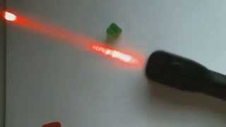
Gummy Bear Video
Notes:
YouTube. (2015, September 20). Homeschool science experiment: Properties of light, Gummy Bears, biggest misconceptions kids have. YouTube. https://www.youtube.com/watch?v=lSRaJTzY0go

Slide 12
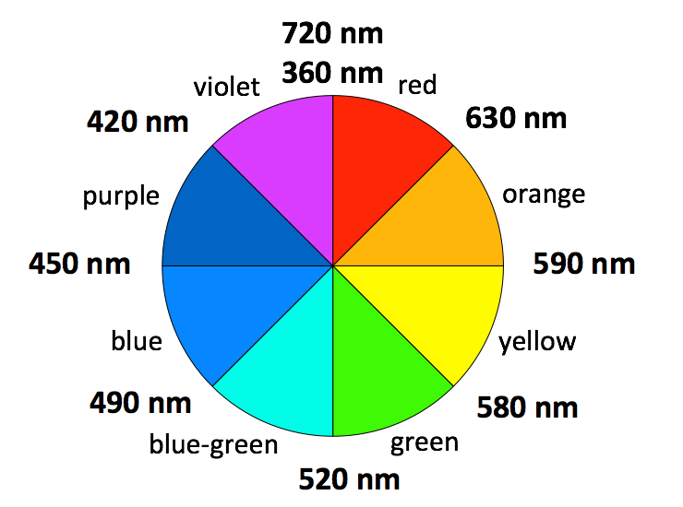
Complimentary Colors
Each color of light has a complimentary color. The color wheel places complimentary colors on opposite sides of the wheel. For example, the complimentary color of red is blue-green.
Notes:
File:color circle (RGB).SVG. Wikimedia Commons. (n.d.). https://commons.wikimedia.org/wiki/File:Color_circle_(RGB).svg

Slide 13
Make a Prediction
You are going to pass white light through water and red, blue, green and yellow solutions.
Based on your observations during the first activity, write down a prediction of what colors will be absorbed by each solution.
Use the color wheel to help make your predictions.
Notes:
File:color circle (RGB).SVG. Wikimedia Commons. (n.d.). https://commons.wikimedia.org/wiki/File:Color_circle_(RGB).svg

Slide 14
Materials for “What is Missing?”
Collect the following materials for your group:
Five test tubes in rack
Water
10 ml Graduated cylinder
Set of food dye
Light source (cell phone)
C-Spectra® plastic slide
Ruler

Slide 15
Procedure for “What is Missing?”
Prop the light source on its side against the wall or another kind of support.
Hold your C-spectra slide about 30 cm in front of the light source. Adjust the position of the slide until you can see a continuous spectrum.
Have you partner hold the clear test tube in front of the light. In your notebook record the effect on the spectrum. Are any colors missing?
Repeat with the other four test tubes.

Slide 16
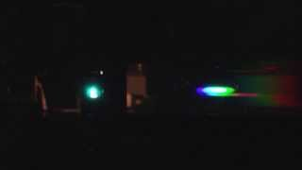
Aqueous Ions Absorbing Light
Notes:
Absorption spectra with light source of selected metal ions. YouTube. (2013, December 10). https://youtu.be/Jhb_RSiWnhk

Slide 17
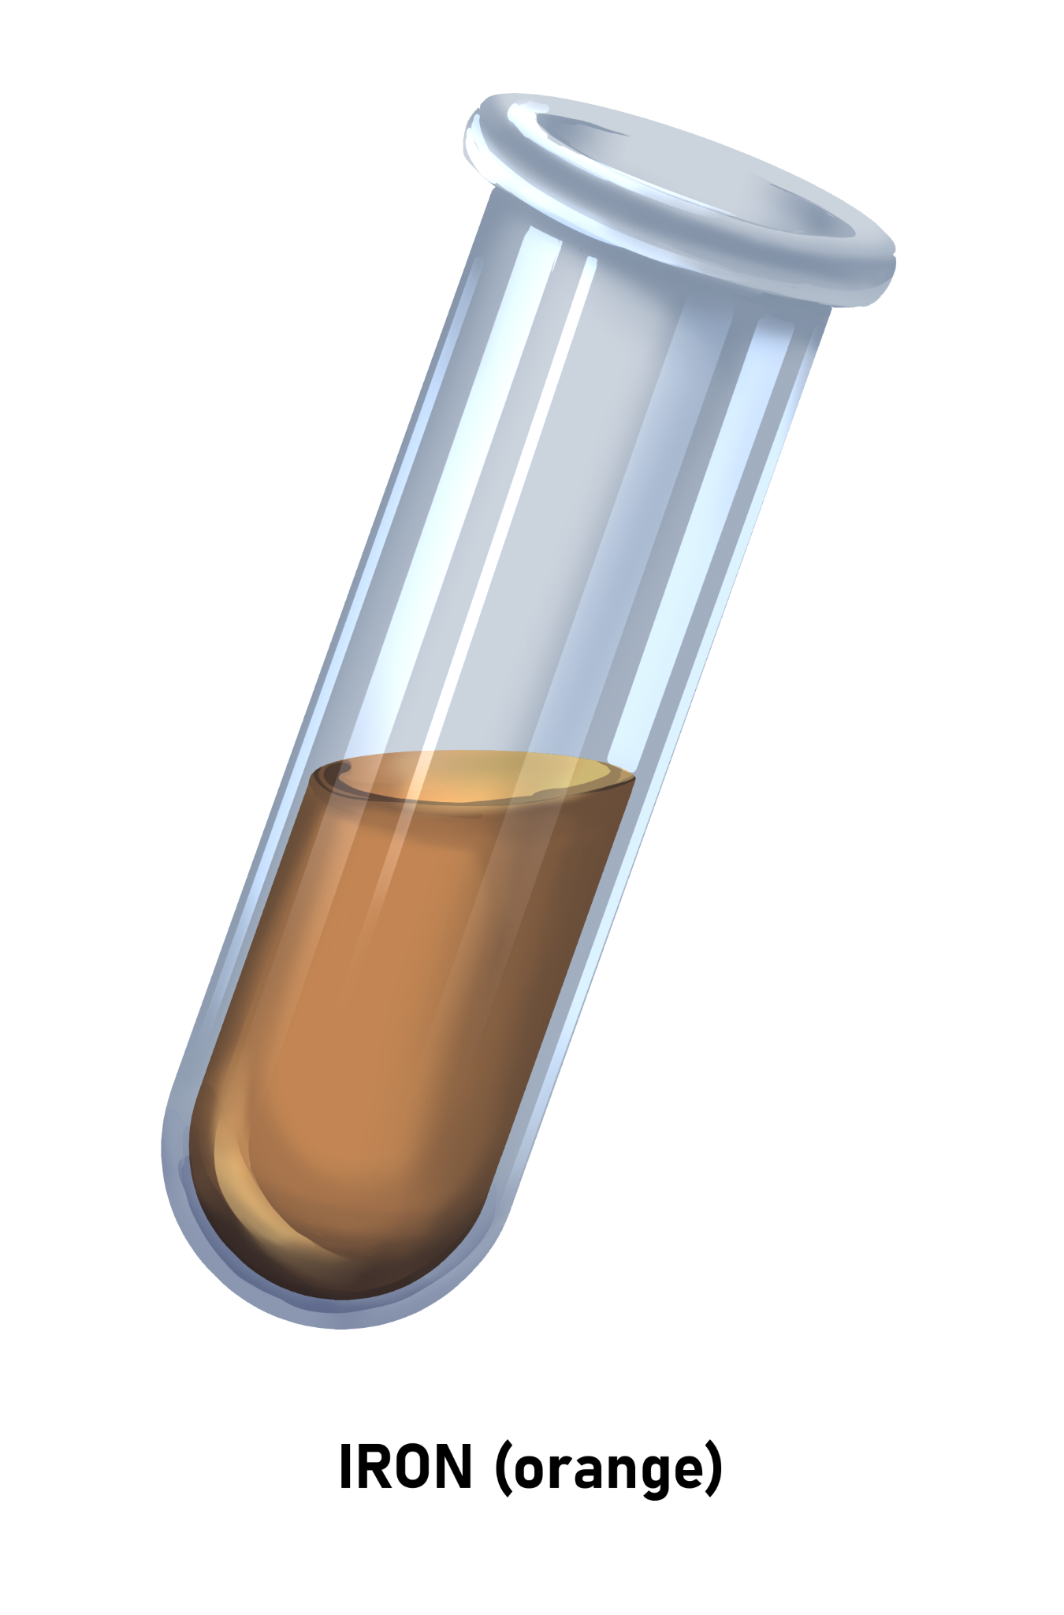
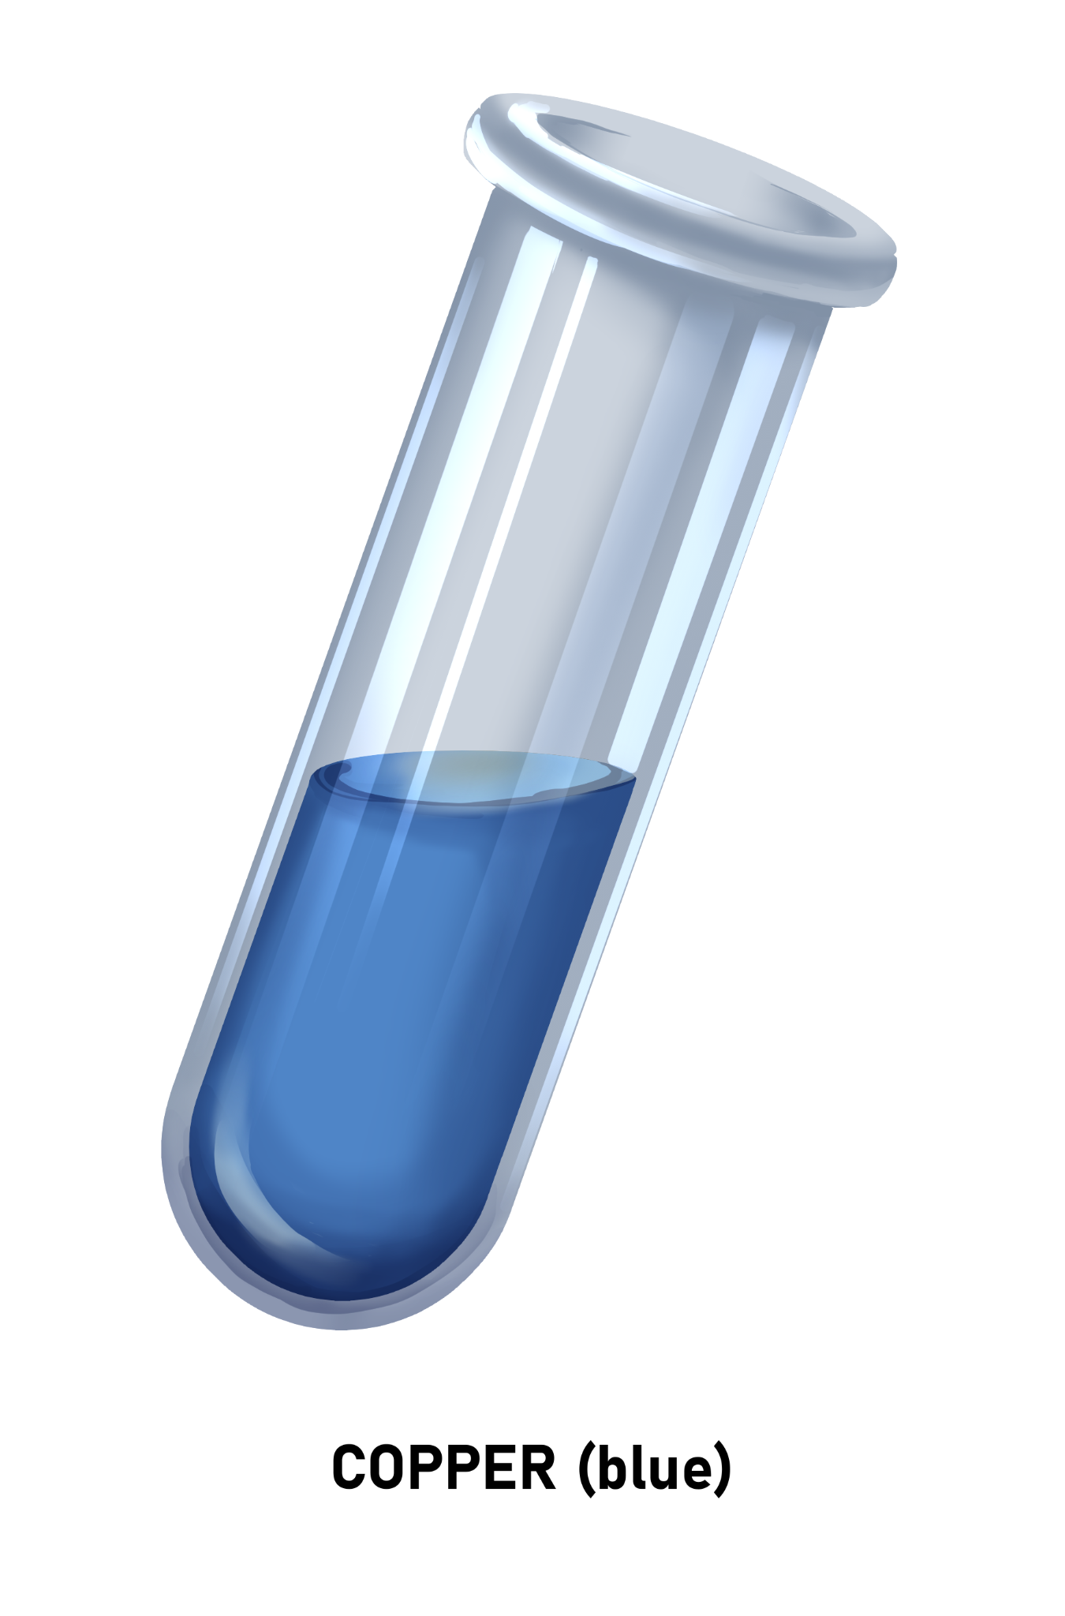
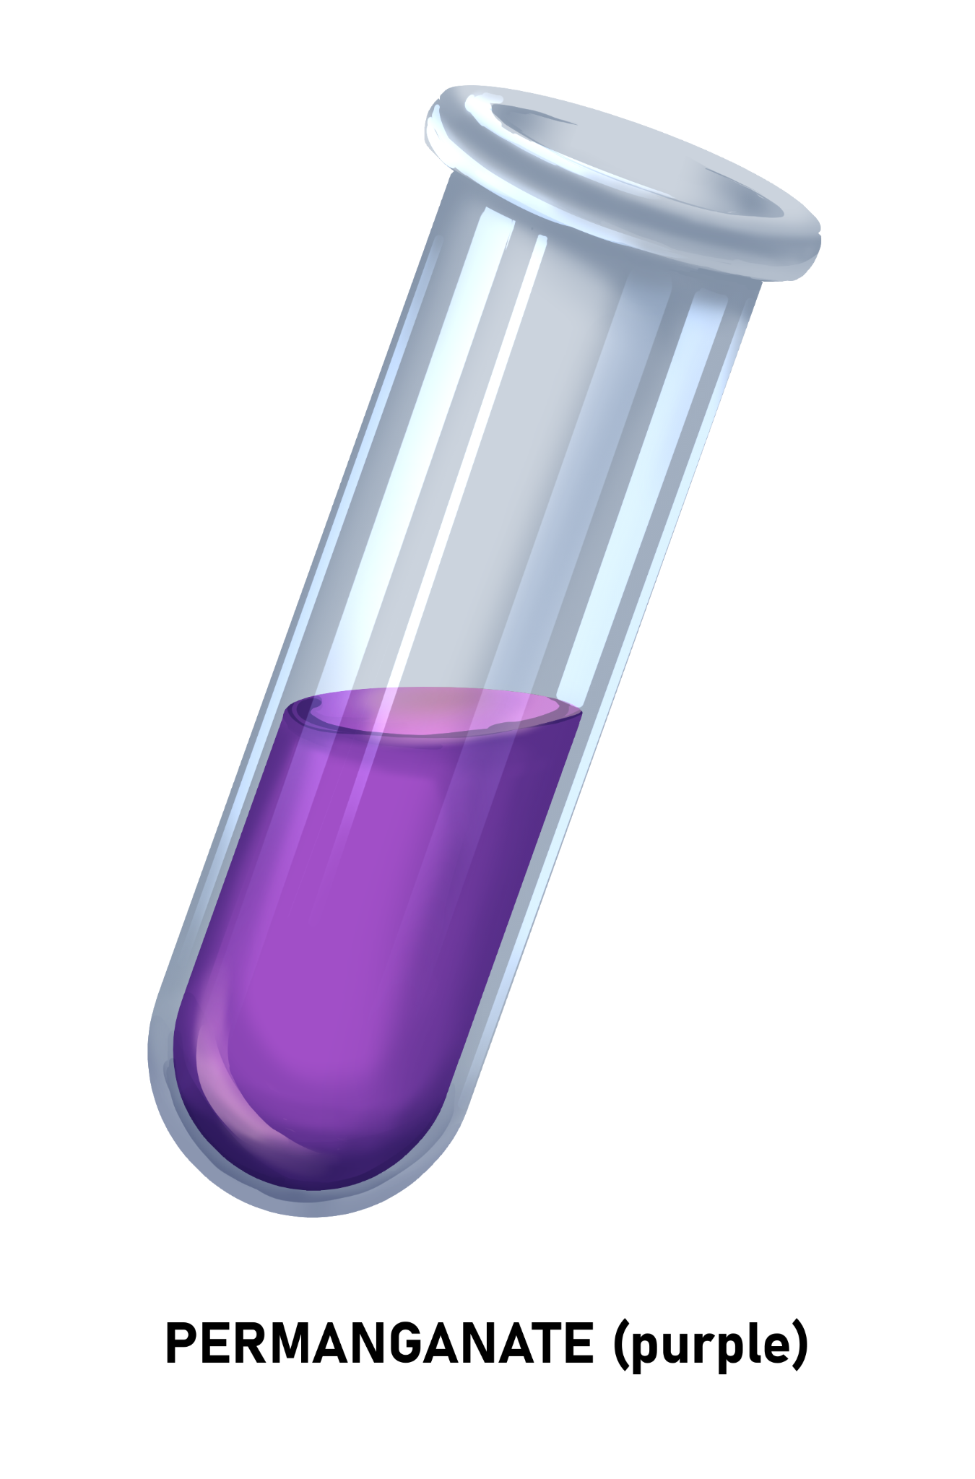
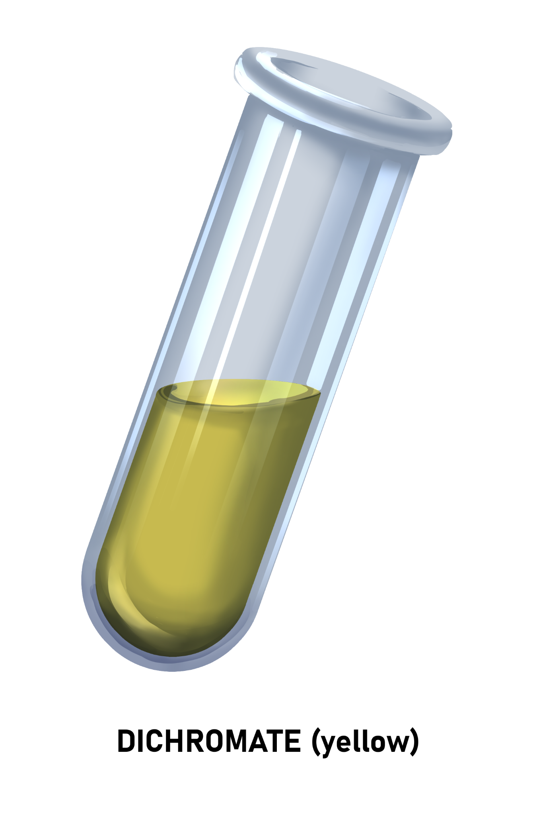
Aqueous Ions Absorbing Light
Solutions of iron, copper, permanganate and dichromate ions are shown below.
Notes:
File:color circle (RGB).SVG. Wikimedia Commons. (n.d.). https://commons.wikimedia.org/wiki/File:Color_circle_(RGB).svg

Slide 18
How is light absorbed by substances?
Get in groups of 3.
In your group assign each person one of the following roles:
Reader: Will read text from the handout.
Recorder: Record answers to questions.
Reporter: Share answers with other groups.
Complete the Elevated Electrons handout.

Slide 19
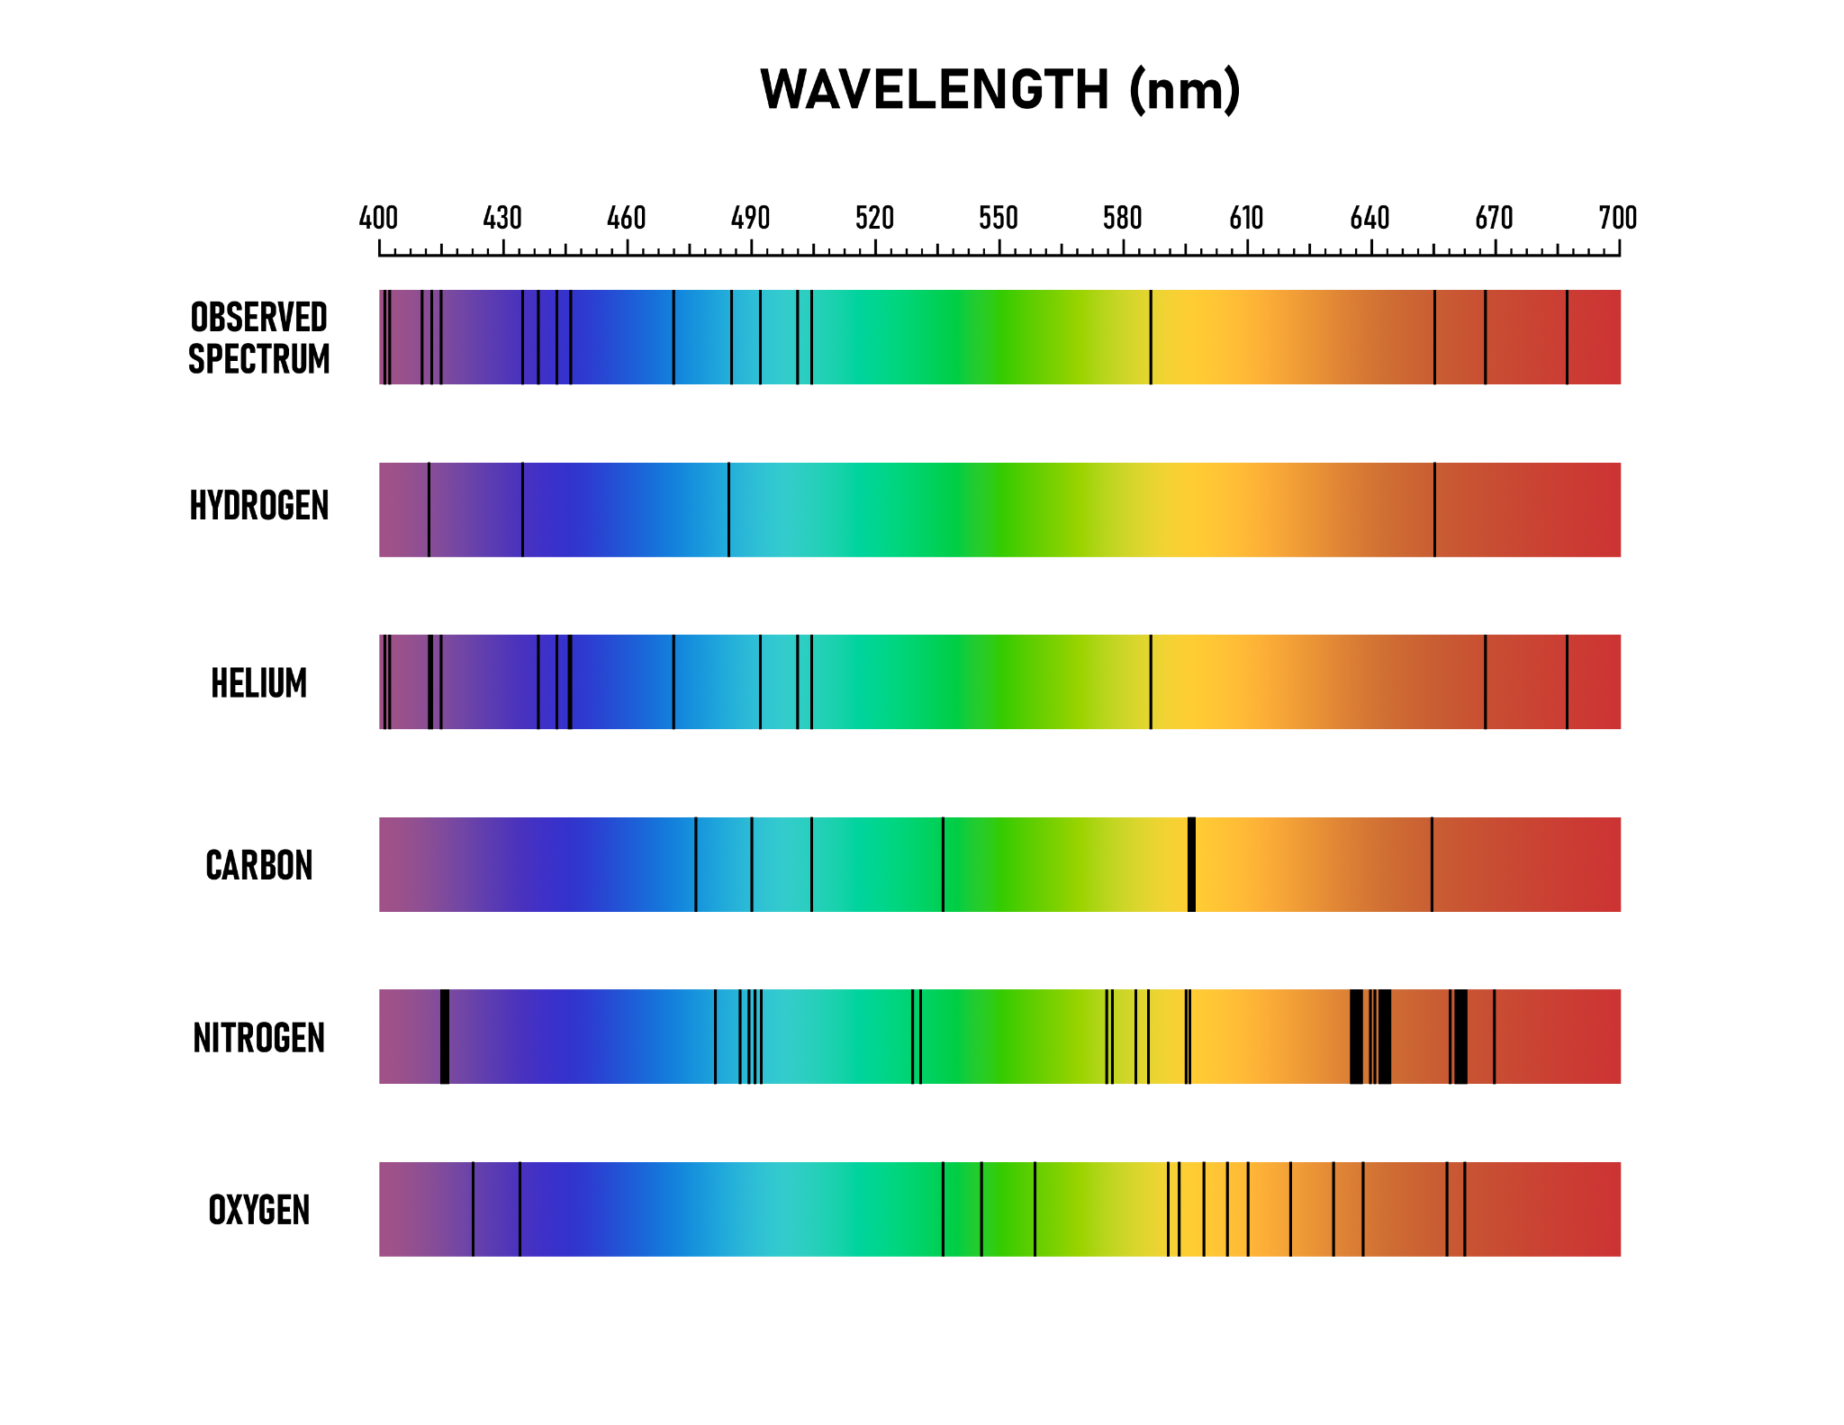
Absorption Spectra
This model shows the spectra produced when white light passes through gases of hydrogen, helium, carbon, nitrogen and oxygen. Is each spectrum unique to each element?

Slide 20
Star Codes
Get in groups of 3.
In your group assign each person one of the following roles:
Reader: Will read text from the handout.
Recorder: Record answers to questions.
Reporter: Share answers with other groups.
Complete Star Codes handout.

Slide 21
Star Codes
Just as different elements produce unique absorption spectra, different celestial objects produce different spectra. These spectra can be used to identify the object.

Slide 22
Solar Spectra
When light/photons are emitted by hot objects and that light then passes through a gaseous atmosphere, some of the photons will be absorbed by the atoms making up the atmosphere. When this light is diffracted into a spectrum, the photons that were absorbed will appear as dark lines or absence of light.

Slide 23
Simplified spectrum of the Sun
The spectrum of the Sun shows the absorption of all of the elements in the Sun’s atmosphere combined. Most of the Sun’s atmosphere is composed of hydrogen and helium. Can you see evidence of these elements in the spectrum?

Slide 24
Spectroscopy of the stars
Notes:
YouTube. (2011, March 11). Spectroscopy of stars - wonders of the universe: Stardust - BBC Two. YouTube. https://www.youtube.com/watch?v=n_KyYFYNvpI

Slide 25
What Did I Learned Today?
On your paper write down what you learned over the past few investigations and answer the following two questions.
How is light absorbed by substances?
How are absorption spectra used to identify stars and the elements that make them up?
Notes:
K20 Center. (n.d.). What Did I Learn Today?. strategies. Retrieved from https://learn.k20center.ou.edu/strategy/169

