Slide 2
Diffraction Lesson 5
The Red Universe

Slide 3
Essential Question
What evidence do we have that objects in the universe are moving away from us?

Slide 4
Lesson Objective
Explain redshift and what is tells us about the movement of celestial objects in the Universe.

Slide 5
Agree or Disagree
Sound waves shorten as a sound source moves toward you and lengthen as a source moves away from you.

Slide 7
Radar Gun
Examine the image on the Radar Video Questions handout and think about what you know about doppler effect.
Answer questions 1-6 based on prior knowledge.
If you are unsure of an answer, try to find the answer in the video.
Notes:
YouTube. (2021, September 21). K20 Center 10 minute timer. YouTube. https://www.youtube.com/watch?v=9gy-1Z2Sa-c

Slide 8
Applying the Doppler Effect in Radar Guns.
https://www.youtube.com/watch?v=DAwW7_nYG0c
Notes:
YouTube. (2016, January 7). How police radar guns work. YouTube. https://www.youtube.com/watch?v=DAwW7_nYG0c

Slide 9
GUS Method
As you work with your group to answer the questions on your Shifting Colors handout, label each question to reflect the following:
G - we guessed
U - we are unsure if our answer is correct
S - we are sure of our answer and can explain our choice
Notes:
K20 Center. (n.d.). GUS Method. Strategies. Retrieved from https://learn.k20center.ou.edu/strategy/76

Slide 10
Shifting Colors Handout
In your group assign each person one of the following roles:
Reader: Will read text from the model sheet.
Recorder: Records answers and labels the questions.
Reporter: Share answers with the class.
Don’t forget to label each questions with one of the following:
G - Guessed
U - Unsure
S - Sure

Slide 11
Redshift of Distant Galaxies
https://www.youtube.com/watch?v=RO4i_g6gSMU
Notes:
YouTube. (2017, August 2). Redshift of distant galaxies. YouTube. https://www.youtube.com/watch?v=RO4i_g6gSMU

Slide 12
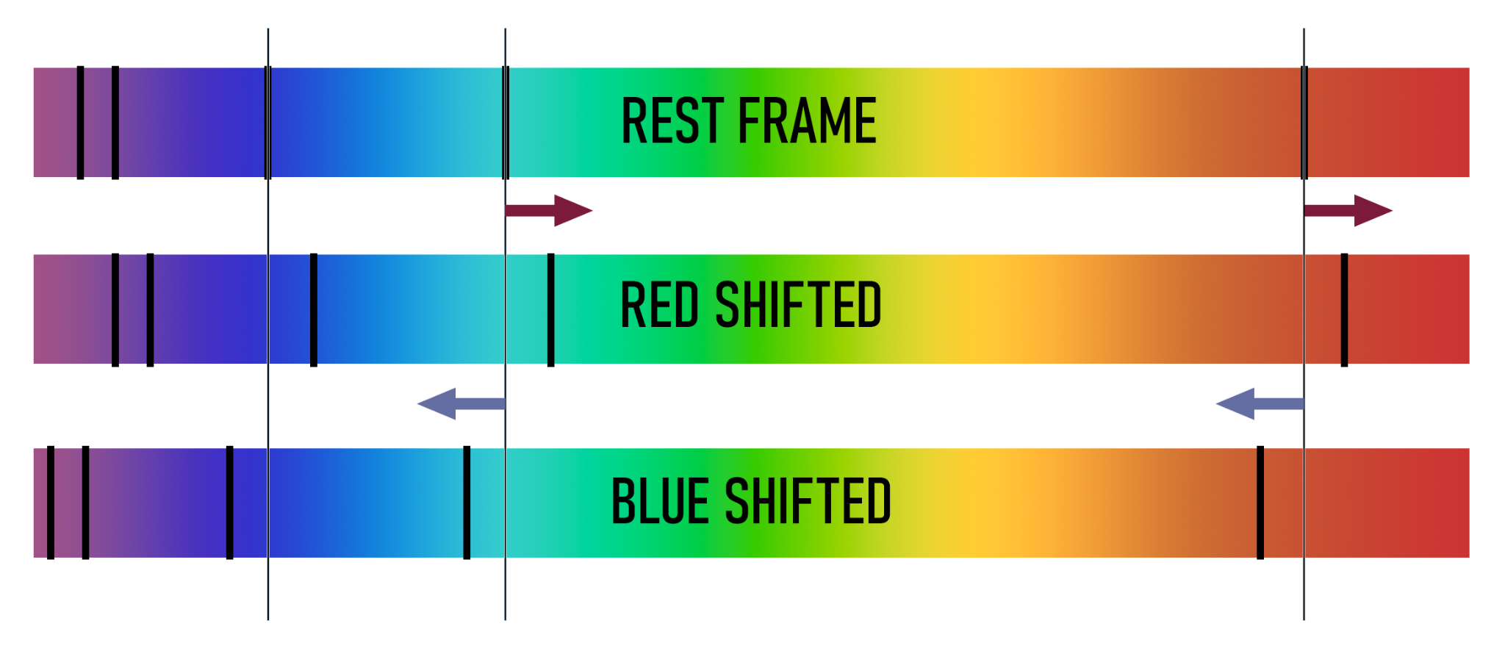
Caption This
With your partner examine the image below.
Discuss a 1-3 sentence caption that best represents this image and what you learned.
Be prepared to share your caption with the class.
Notes:
K20 Center. (n.d.). Caption this. Strategies. https://learn.k20center.ou.edu/strategy/82

Slide 13
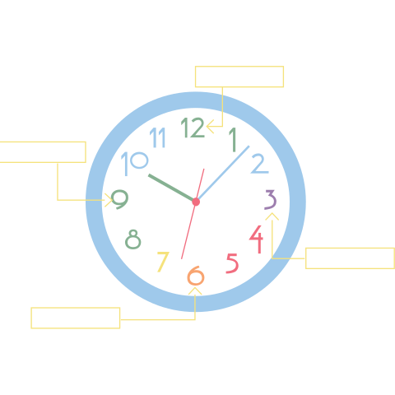
Appointment Clocks
Look at the top of page two on your handout, take two minutes and walk around the room finding a partner for each appointment.
For each partner fill in their name on the corresponding time.
You will need a different partner for each time.
Once you have completed your appointment clock, find your 12 o’clock partner and wait for
instructions.
Notes:
K20 Center. (n.d.). Appointment clocks. Strategies. https://learn.k20center.ou.edu/strategy/124

Slide 14
Redshift in Absorbance Spectra -
Appointment Clocks
You will answer all questions in your science notebook.
Your teacher will instruct you when to rotate.
With your 12 o’clock partner, answer questions 1 and 2.
With your 3 o’clock partner, answer questions 3 and 4.
With your 6 o’clock partner, answer question 5-7.
With your 9 o’clock partner, answer questions 8-10.
Notes:
K20 Center. (n.d.). Appointment clocks. Strategies. https://learn.k20center.ou.edu/strategy/124

Slide 15
Beyond Red
Read the first four questions on your Beyond Red handout.
In the margin write whether you agree or disagree with each statement.
Notes:
K20 Center. (n.d.). Anticipation Guide. Strategies. https://learn.k20center.ou.edu/strategy/2364

Slide 16
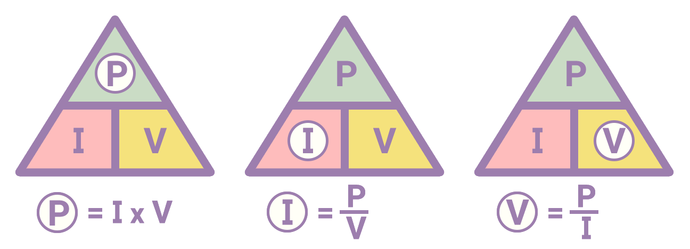
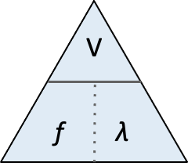
What is the Triangle of Power?
•To solve for one of the variables, cover that letter. The remaining line separation and variables will help write the equation:
what you covered = remaining variables with the operator; a division symbol for a solid line and a multiplication symbol for a dotted line
Notes:
K20 Center. (n.d.b.). Triangle of power. Strategies. Retrieved from https://learn.k20center.ou.edu/strategy/1663

Slide 17
Beyond Red
In your group work to solve the equations in questions 5 -12 using the Triangle of Power strategy.

Slide 18
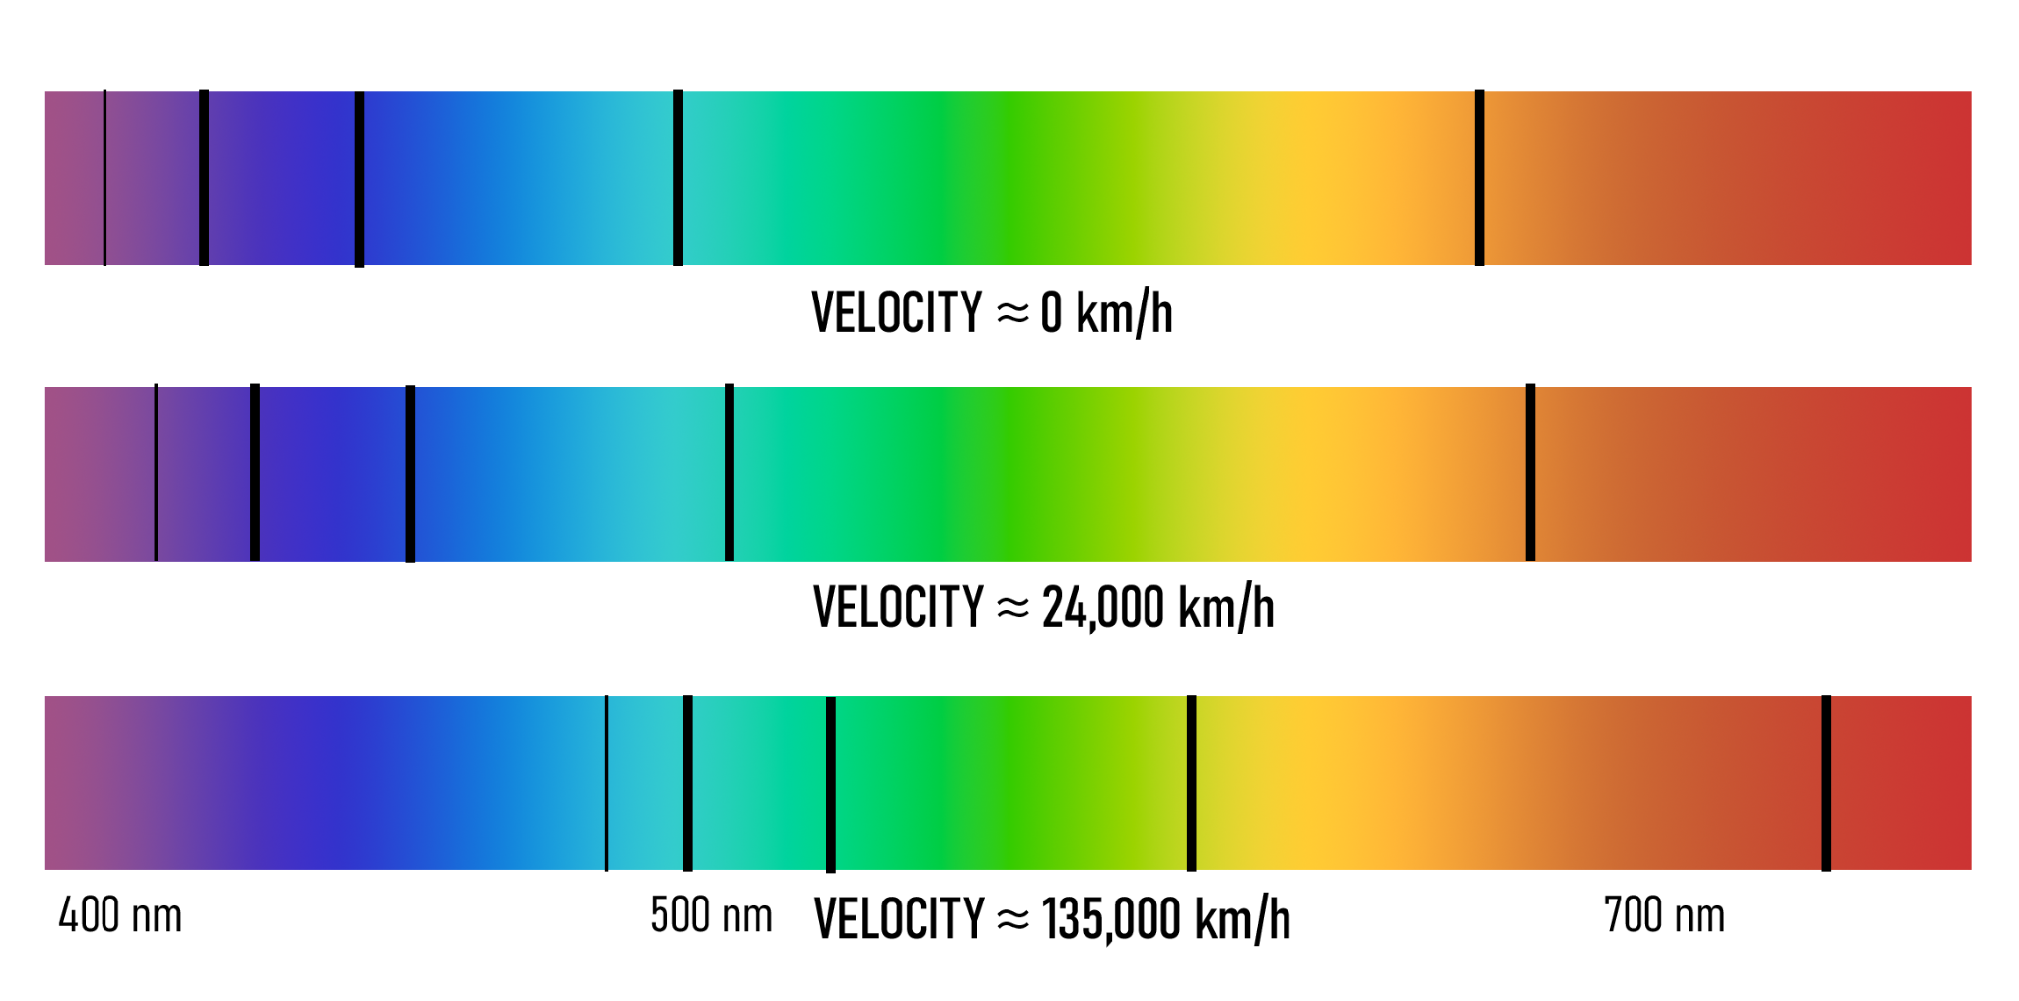
Caption This
With your group examine the image on the slide.
Discuss a 1-3 sentence caption that best represents this image and what you learned.
Be prepared to share your caption with the class.
Notes:
K20 Center. (n.d.). Caption this. Strategies. https://learn.k20center.ou.edu/strategy/82

Slide 19
Model the expanding Universe
With your partner, complete the following steps:
Draw objects, stars, or galaxies all over the deflated balloon.
Discuss how close the objects you drew are in relation to each other.
Blow up the balloon and tie it closed.
Observe how the objects you drew moved in
relation to each other.

Slide 20
Question
How does your balloon model the expansion of the Universe?

Slide 21
The Power of the James Webb Telescope
https://www.youtube.com/watch?v=U4BCk8OdHSA
Notes:
YouTube. (2019, December 9). The power of the James Webb Telescope. YouTube. https://www.youtube.com/watch?v=U4BCk8OdHSA

Slide 22
Webb vs Hubble Comparison Video
https://www.youtube.com/watch?v=97E4kcbNV8g
Notes:
YouTube. (2022, June 29). James Webb Telescope vs Hubble telescope images comparison. YouTube. https://www.youtube.com/watch?v=97E4kcbNV8g

Slide 23
Two-Minute Paper
Think about what you have learned about objects in the Universe and how they move away from each other.
You will have 2 minutes to write a paper that support the following statement:
Objects in the Universe are moving
away from each other.
Notes:
K20 Center. (n.d.). Two-minute paper. Strategies. Retrieved from https://learn.k20center.ou.edu/strategy/d9908066f654727934df7bf4f506cf73
YouTube. (2021a, September 21). K20 Center 2 minute timer. YouTube. https://www.youtube.com/watch?v=HcEEAnwOt2c

