Slide 2
Composite Figures in Architecture
Perimeter and Area of Composite Figures

Slide 3
Essential Questions
How can you use formulas to find the perimeter and area of object with an unusual shape?
How do the dimensions of a figure affect the perimeter and area?

Slide 4
Lesson Objective
Find the perimeter and area of composite figures using both pattern blocks and architecture designs.

Slide 5
KWL Chart: Perimeter and Area
What I Know | What I Want to Know | What I Learned
Notes:
K20 Center. (n.d.). KWHL graphic organizer. Strategies. https://learn.k20center.ou.edu/strategy/127

Slide 6
Explore with Shapes
Perimeter
The distance around the shape found by adding all the sides.
Area Formulas
Triangle: ½ bh Square: s² Rectangle: lw Circle: πr²
Use pattern blocks, rulers, and area formulas to find the perimeter and area of each unique shape.

Slide 7
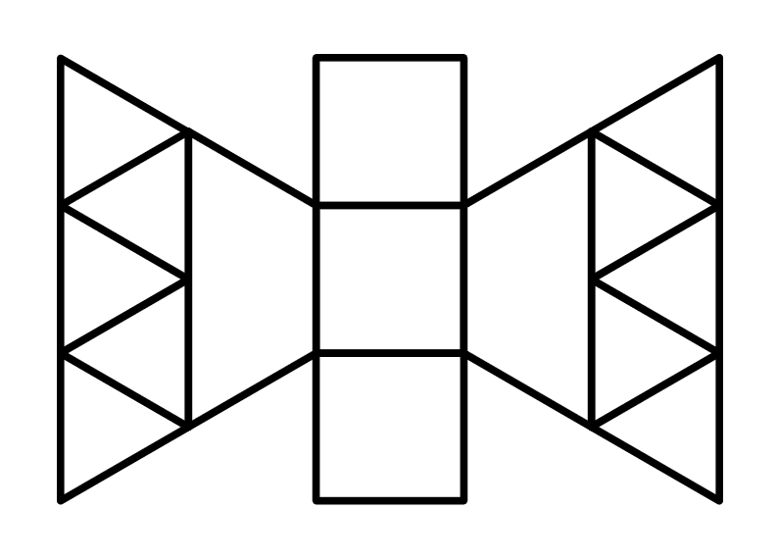
How did you calculate the perimeter and area?

Slide 8
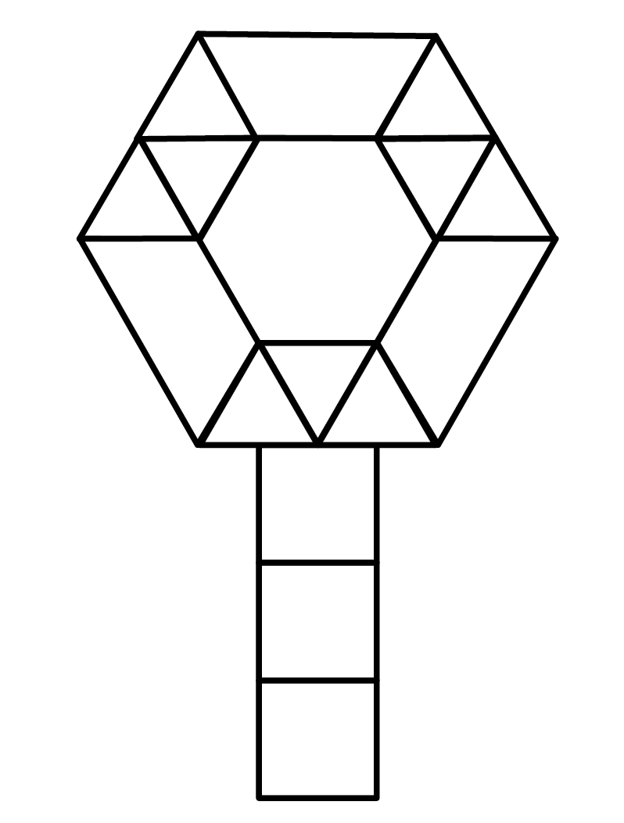
How did you calculate the perimeter and area?

Slide 9
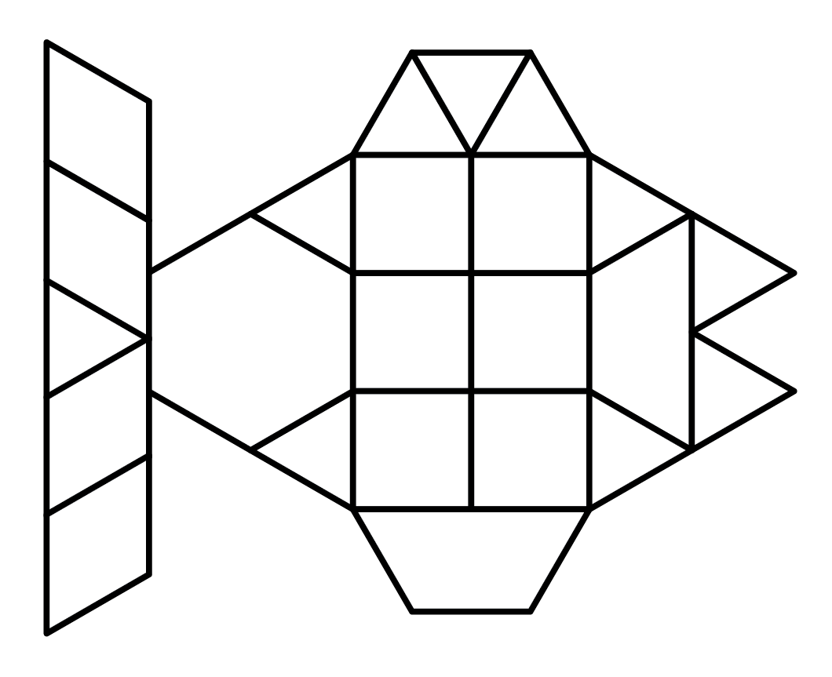
How did you calculate the perimeter and area?

Slide 10
Area of a Trapezoid
a
h
b

Slide 11
KWL Chart: Perimeter and Area
What I Know | What I Want to Know | What I Learned
Notes:
K20 Center. (n.d.). KWHL graphic organizer. Strategies. https://learn.k20center.ou.edu/strategy/127

Slide 12
A Day in the Life of an Architect
Notes:
Student Edge. (2014, May 13). I wanna be an architect - A day in the life of an architect [Video]. YouTube. https://youtu.be/asdgRAjGK-M

Slide 13
Architecture
Design the floor plan of your dream house using rectangles, squares, triangles, trapezoids, and circles. (See the example on the left.)
Find the perimeter and area of your entire floor plan. Record the perimeter and area on a sticky note.
Notes:
Floor plan of first floor home [Photograph]. (1873). Library of Congress. https://www.loc.gov/item/2006682529/

Slide 14
Pass the Problem
Pass your floor plan design to another person in your group.
First round: Find the perimeter of the design.
Second round: Find the area of the design.
Final round: Check your answers with the architect who created the design.
Notes:
K20 Center. (n.d.). Pass the problem. Strategies. https://learn.k20center.ou.edu/strategy/151

